Slide 1
Delivering the New Virtual Workspace for Education
Unified Virtual Desktop, Voice, and Video
Notes:
1
Define VXI here

Slide 2
Agenda
Trends and Challenges in Education
Education Use Cases
Cisco’s Virtualization Vision
Cisco VXI Portfolio
Services Support and Validated Designs
Case Studies
Summary

Slide 3

Explosion of Mobile Devices
Education Becomes Social
“Sales of smartphones and tablets are now greater than all PCs, including notebooks.”
“Android is the #1 OS for mobile platforms with more than 350,000 new activations per day.”
Video Becomes Pervasive
“65% of companies are deploying at least one enterprise social software tool.”
The Rise of Cloud Computing
“People spend more time on Facebook than any other website.”
“One third of corporations say they are using video at least once per week.”
“By 2013, over 90% of network data traffic will be video.”
“20% of professional PCs will be managed under a hosted virtual desktop model by 2013.”
“60% of server workloads will be virtualized by 2013.”

Slide 4
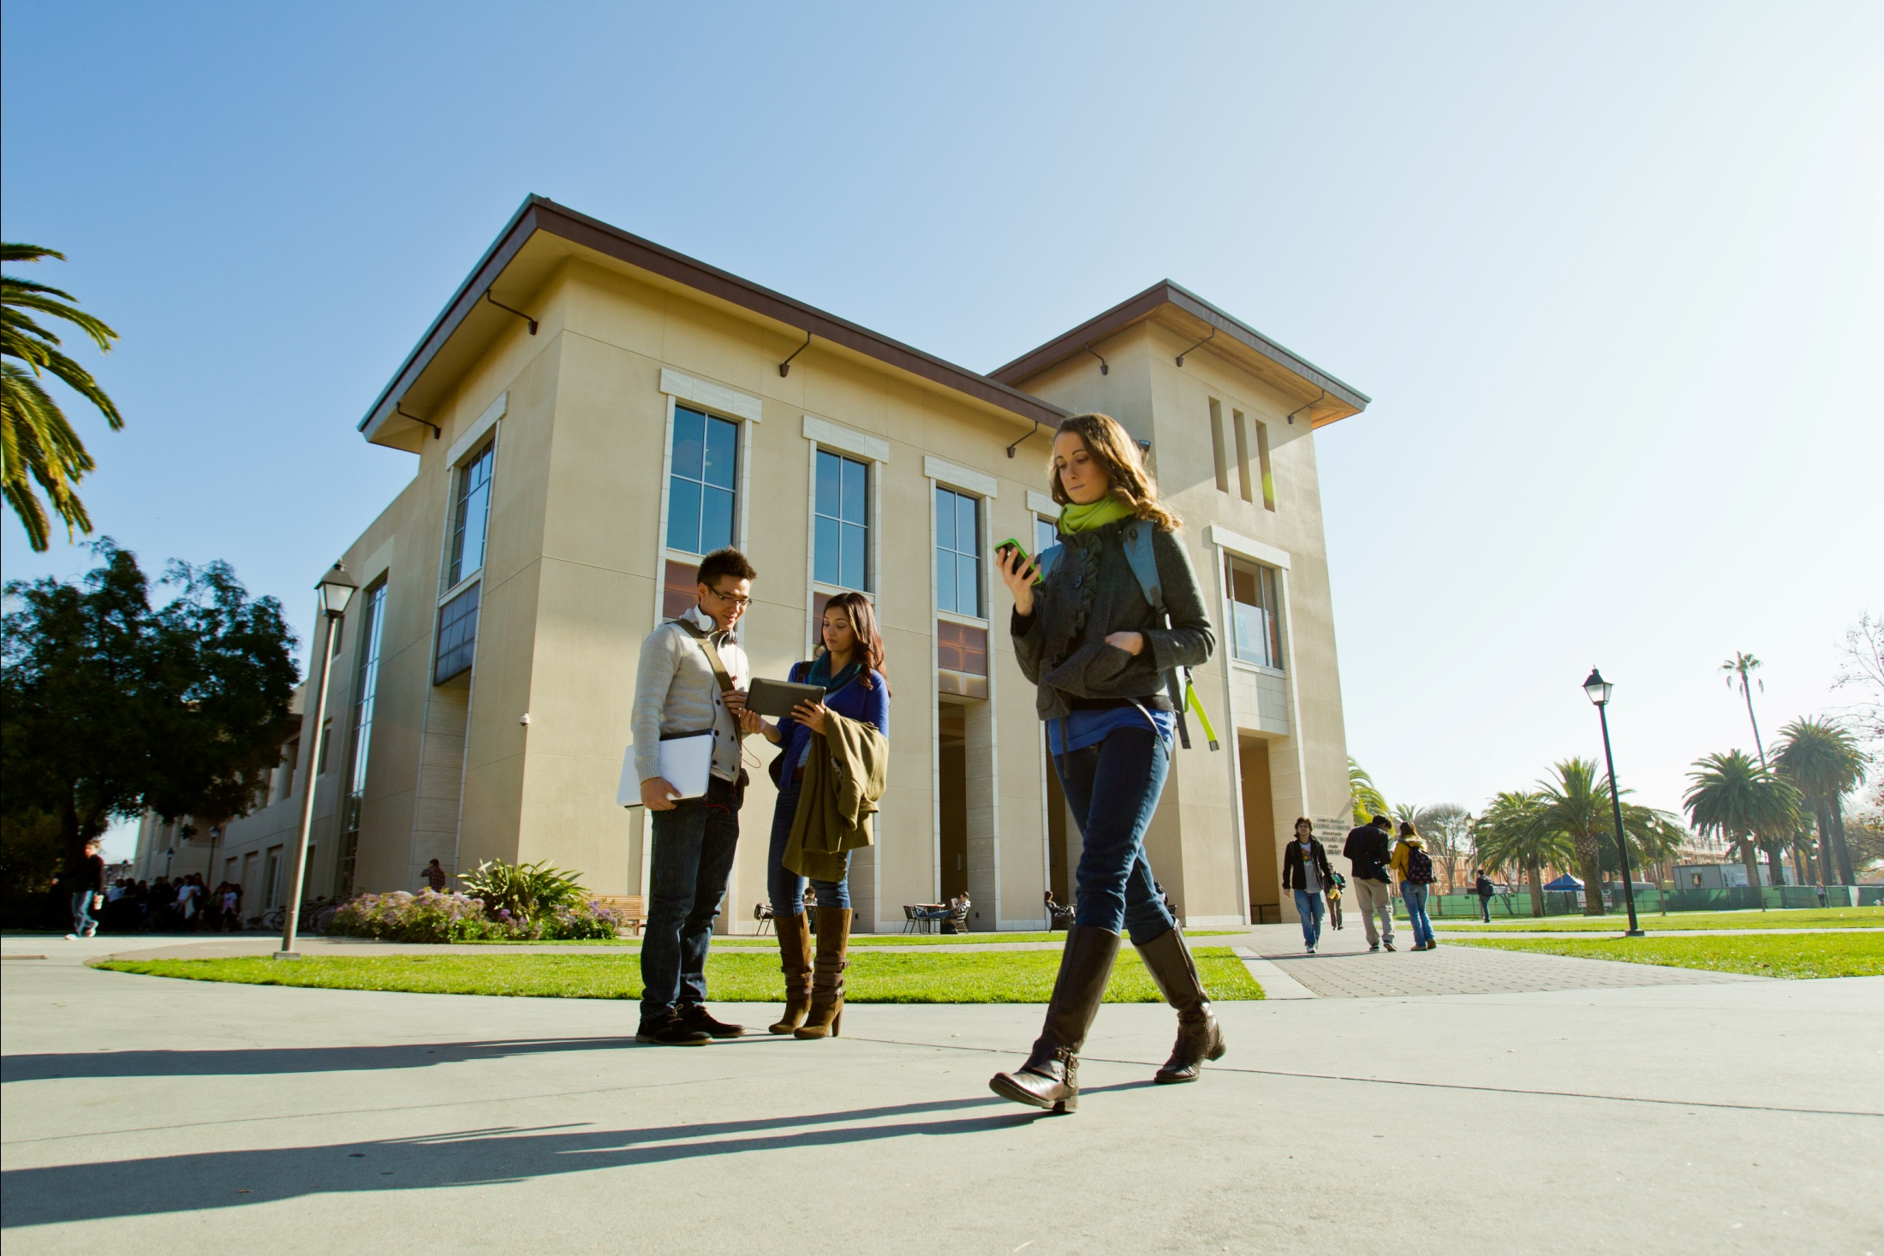
Education Work Styles Are Evolving
New Solutions Are Needed to Support Growing Trends
MOBILE
Rich secure collaboration
from any device, any location
SOCIAL
Learning networks to locate, connect and engage
VISUAL
High quality video available everywhere; real-time & offline
VIRTUAL
Hosted applications, voice & video
Interaction with VDI economics
Notes:
The meaning of “going to school” is changing.
While school is more important than ever, the idea of the classroom is changing.
These changes are largely being driven by important technology trends:
Mobility is a given for the current generation of students. However, this extends far beyond basic connectivity. Learning itself is becoming mobile.
Today’s students have grown up with social networking tools and expect the same degree of interactions on campus and in their classes.
Video is creating new opportunities to expand access to education while maintaining the person-to-person interactivity and an high quality asynchronous education.
Technology is broadening the opportunity for learning, making every personally owned computer, smartphone, and tablet a potential academic resource.

Slide 5
And…The Virtualization Market Is Growing
In Millions
78%
91%
138%
Graphic adaptation created by Cisco based on Gartner data. Source: Gartner, Inc., Forecast: Hosted Virtual Desktops, Worldwide, 2010-2014 (2010 Update), 2010 – 2014 (2010 Update), Ranjit Atwal, December 1, 2010.
Notes:
According to Gartner, desktop virtualization is on the rise in the enterprise. The worldwide hosted virtual desktop (HVD) market is expected to reach 70 million units, or 15 percent of enterprise desktops and laptops by 2014.* But, quality should not be compromised. To further accelerate this rapid market growth, customers need to ensure users receive a rich high-definition experience for voice and video, and an integrated systems approach that reduces the costs and complexity of deployment.

Slide 6
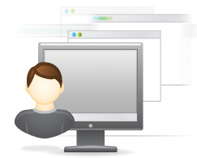


Desktop Virtualization in a Nutshell
Desktop virtualization delivers virtual desktops to users on any device. The user's virtual desktop environment is dynamically assembled and delivered using the network.
Different types of users across campus need different types of desktops. Some require simplicity and standardization, while others require high performance and personalization.
Access from anywhere
Dynamic desktop assembly
Deliver rich media

Slide 7

Desktop Virtualization and Education
Pressures and Challenges in Education
Rising costs (PC refresh, energy, and support)
Rising expectations from students, faculty, and staff
Mobility and BYOD
Limitations of computer lab delivery model
Data center and network bottlenecks
Security and compliance
New business models
“How do we do more with less? Well, that’s where virtual desktops come in. We see cost savings. We see the number of help-desk tickets go down. You see the number of miles that your technicians have to drive to fix these problems go down. Anytime you can centrally manage a particular application, it makes your job a whole lot easier.”
Brooks Moore
Manager of Technology Services
Aledo Independent School District
Notes:
Education leaders are confronted with significant pressures and challenges.
Pressures to control if not scale back the cost of IT services.
At the same time, demands from students, faculty and staff for robust IT services are increasing.
The list of supported devices and applications is growing driven by end-user choice.
Maintaining network security, data privacy and compliance is extremely challenging in this environment.
Students and faculty are increasingly dissatisfied with traditional computer labs. They want to be able to access the applications they need for courses any time from any device.
Delivering all of the above places increased demands on networks and data centers. Networks need to be more intelligent and data centers automated at the same time that they must be more reliable, faster and scalable.
Increasingly, Education leaders are looking for new models to respond to these pressures and challenges. They are searching for models that are sustainable and meet the changing needs of today’s education institutions.

Slide 8
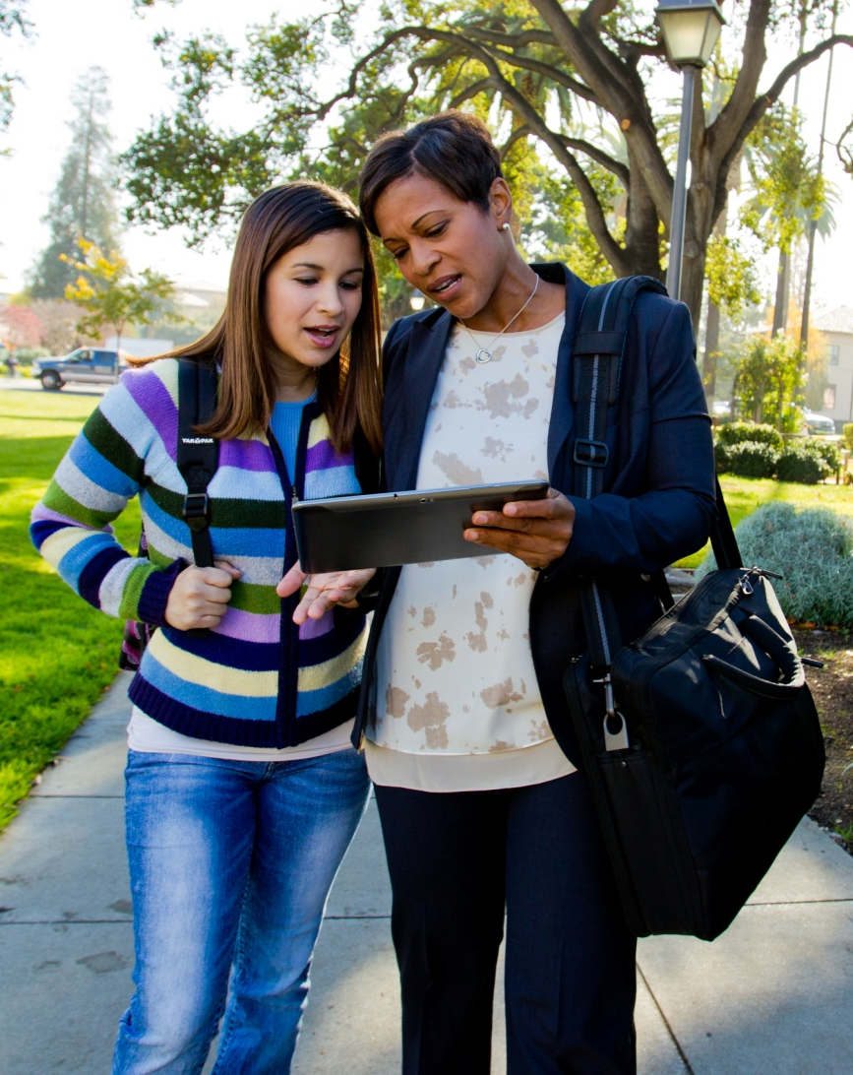
VXI Benefits for Education
Administrators
  Virtual workspace solution for immersive student-teacher interactions and accelerated learning
  Enhanced compliance and risk mitigation
  Lower costs and improved ROI
  Students and Educators
  Uncompromised experience, anywhere on any device
  Choice and flexibility, aligning with different learning and teaching styles
  IT Leaders
Rapidly address changing application demands
Optimized business agility
Heightened security against unauthorized applications or malware
Faster deployment with validated designs
Notes:
Cisco VXI delivers virtual workspaces that go beyond traditional classroom desktops to unify virtual desktops, voice, and video.
Administrators
Delivers a virtual workspace solution that unifies virtual desktop, voice, video and collaboration for immersive student-teacher interactions and accelerated learning
Enhances compliance and risk mitigation by securely centralizing data and applications
Improves ROI through optimized infrastructure, simplified operations, extended PC refresh cycles and lower energy costs
Students and Educators
Delivers uncompromised experience with access to all applications and collaboration services, anywhere on any device
Offers choice, freedom, and flexibility, aligning with different learning and teaching styles
IT Leaders
Rapidly address changing application demands, while ensuring standardized operating images
Optimizes business agility by facilitating secure provisioning of more end users
Provides heightened security against unauthorized applications or malware
Enables faster, simpler deployment of workspace solutions with validated designs, system roadmaps, streamlined operational model, as well as end-to-end support and service

Slide 9
Agenda
Trends and Challenges in Education
Education Use Cases
Cisco’s Virtualization Vision
Cisco VXI Portfolio
Services Support and Validated Designs
Case Studies
Summary

Slide 10
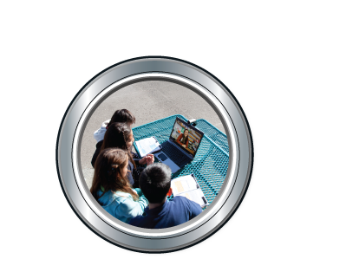

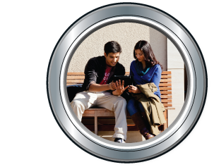
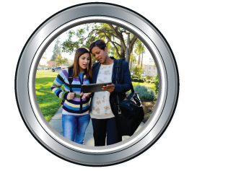
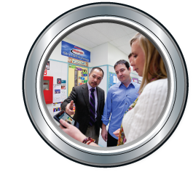


VXI Use Cases in Education
Provide consistent experience on and off campus
Secure access and data compliance
Unified video, voice, and collaboration
Access on any device (BYOD)
Efficient, scalable IT support
Flexible, multipurpose computer labs
Notes:
Cisco VXI empowers Education and IT leaders to provide flexible, secure workspace services with uncompromised user experiences for students, teachers, and administrators.
Cisco VXI helps to address important use cases in education:
Providing personal virtual workspaces for remote learning environments instead of fixed computer labs.
Provision a virtual workspace for every student, teacher, and staff member, which provides a consistent experience on or off campus
Offering nonpersistent or “clean” desktops free of viruses, malware, or unauthorized applications which increases security and data compliance
Allowing students to access their personal workspace from personal devices such as tablets or smartphones
Creates opportunity to scale existing IT resources:
Optimizing adds, moves, and changes for large desktop populations, while consuming minimal IT resources and time
Simplifying migration to newer operating systems
Reducing support and help-desk calls
More sustainable IT model by extending the time between required desktop hardware refreshes and lower energy costs
In the next few slides, we’ll explore a few of these opportunities in greater detail.

Slide 11
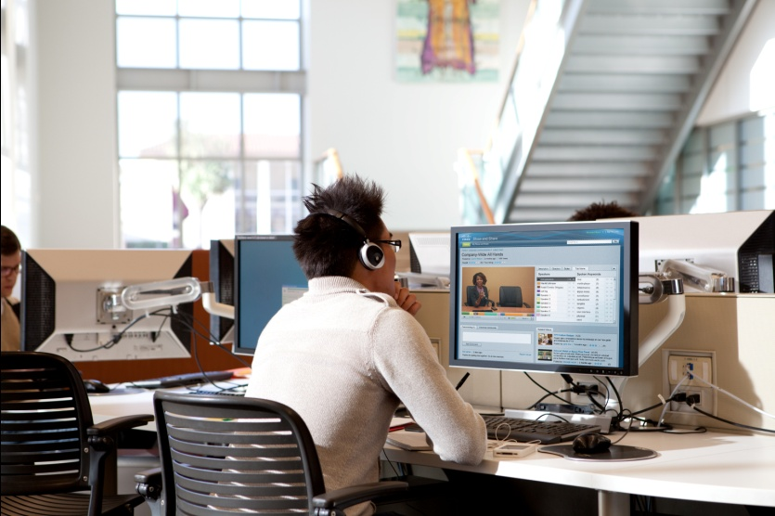
Use Case: Computer Labs
Old Workflow
  Dedicated workstations and applications in physical computer labs
  Fixed environment, configured for specific course of study
  Access only during scheduled hours
  New Workflow
  Flexible, multipurpose labs
  Rapid reconfiguration of labs based on changing needs
  Results
  Increased flexibility resulting in expanded access to education and computing resources
  Consistent experience for off-campus students
  IT support time and cost savings
  Potential reduction in software licensing and hardware costs
Notes:
Old Workflow
Traditional computer labs are fixed environments, in which the operating system and applications are tied to a specific workstation .
The configuration of labs is often determined by course requirements for specific applications. As a result, they must be reconfigured as courses change.
Access to labs is limited to “hours of operation” .
New Workflow
VXI enables classrooms and computing labs to be transformed from fixed environments, to learning spaces that are instantly customizable and tailored to meet the needs of each faculty member or class.
Since VXI separates the operating system and applications from the client device, students and faculty are able to login to a virtual workspace that is configured for their unique requirements. As a result, existing computer labs can be repurposed as multi-purpose resources that serve a far greater number of end users.
As student or faculty requirements change, these virtual workspaces can be rapidly reconfigured simply by loading a different virtual desktop. This allows existing IT staff to support a greater number of end user workspaces.
In addition, end users do not need to be physically present in a specific lab to access their workspace. This has particular benefits for off-campus or remote students participating on online courses who now have access to the same computing resources and applications as on-campus students.

Slide 12
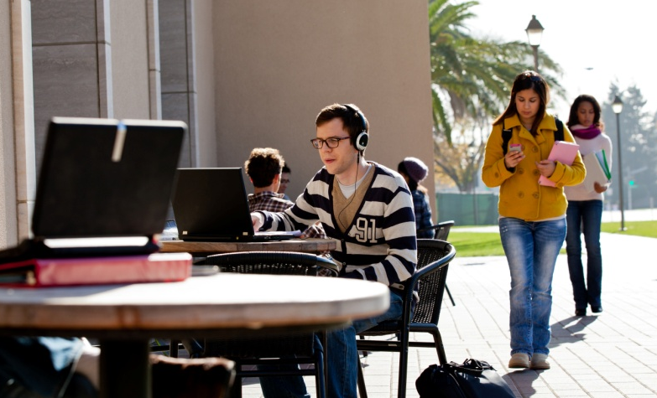
Use Case: Mobility and BYOD
Old Workflow
  Prescribed list of supported devices
  Single laptop per end user
  Tethered to defined computing locations
  New Workflow
  Anytime access to virtual workspace
  Multiple devices per end user
  Any device access via laptops, tablets,
  or smartphones
  Results
  Consistent and uncompromised experience across devices
  Consistent experience for off-campus students
  IT support time and cost savings
Notes:
Old Workflow
Not too long ago, schools, colleges and universities were able to “recommend” or determine which devices students, faculty and staff used to connect to the network.
End users typically had a single device, usually a laptop.
New Workflow
Times have changed!
Today’s generation of students expect to be able to connect from anywhere on the device of their choice.
In addition, each end-user is likely to have multiple devices (laptop, table and/or a smart phone).
Results
VXI allows students, faculty and staff to login into their virtual workspace and access the resources and applications they need for work and complete course assignments.
This experience is consistent across devices.

Slide 13
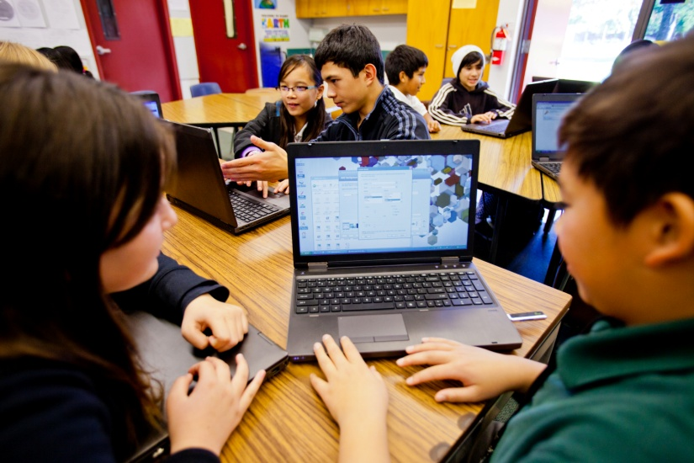
Use Case: Simplified IT
Old Workflow
  High cost supporting institution’s workstations
  Maintenance requires travel to each individual classroom, lab, or office
  IT support staff cannot scale to accommodate
  new users or devices
  Security and data exposure
  High energy costs
  New Workflow
  Virtual workspaces centrally built, deployed, patched, and managed
  Existing staff can support larger population of virtual workspaces users
  Central security patches and data protection
  Energy efficient
  Results
  Sustainable IT cost structure
  Improved security
Notes:
Old Workflow
High cost maintaining institution’s workstations with current software and security patches
Configuration requires travel to each individual classroom, lab, or office
IT support staff cannot scale to accommodate new users or devices
High energy costs

Slide 14
Agenda
Trends and Challenges in Education
Education Use Cases
Cisco’s Virtualization Vision
Cisco VXI Portfolio
Services Support and Validated Designs
Case Studies
Summary

Slide 15


VXI Is More than Desktop Virtualization
Cisco VXI
VXI provides the platform for desktop virtualization ▼
While offering the solution
▼ for virtual workspaces
Virtual Desktops
Virtual Workspaces
Terminal Services
App Virtualization
Virtual Desktop Infrastructure (VDI)
Desktop Streaming
Built on the industry’s fastest-growing data center virtualization platform
Virtual Desktops + …
Rich Media
Unified Communications
Network-Optimized Performance
End-to-End Security
Built with the industry’s leading collaboration, networking, and security architectures
Notes:
VXI is more than Desktop Vitrualization
Cisco VXI is more than “VDI” ; it combines the commonly understood desktop virtualization features with:
end to end system
rich media support
enhanced security
application migration and acceleration support
POE/Energy Wise
Only Cisco is positioned to offer this comprehensive solution

Slide 16
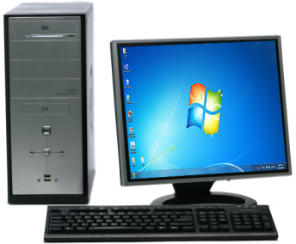
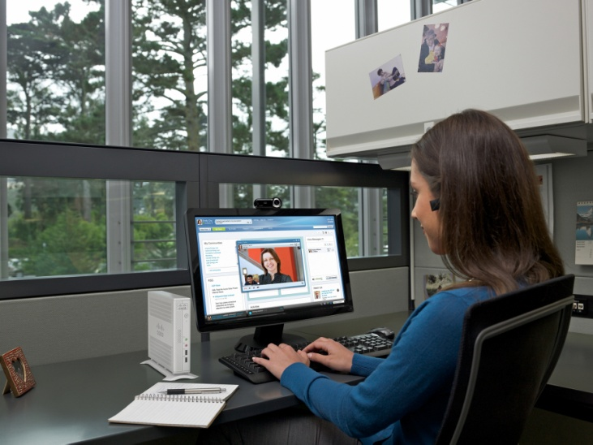

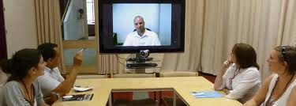
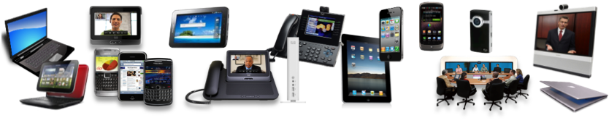
Uncompromised Experience
Any app, any data, any device, any media…Anywhere!
Virtual Desktop
New Virtual Workspace
Voice
Video

Slide 17

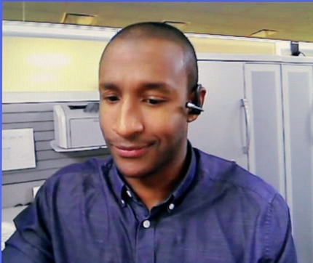
Cisco VXI Powers the New Virtual Workspace
Before
After
Provides uncompromised user experience
Notes:
Before:
Unusable experience
Hairpin effect
Increased cost and resource utilization
Bandwidth explosion
Heavy virtual machine processing in data center
After:
Uncompromised user experience
Routes voice and video point-to-point
Optimized resources
Bandwidth reduction from megabytes to kilobytes
Reduced processing in data center
Enterprise-grade voice and video

Slide 18



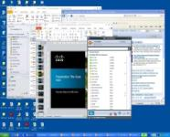



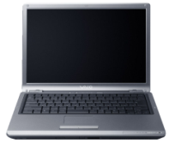


Voice, Video, and Virtual Desktop
Uncompromised user experience
  Routes voice and video point-to-point
Optimized resources
  Bandwidth reduction from megabytes to kilobytes
  Reduced processing in data center
Enterprise-grade voice and video based on
Cisco Unified Communications
Data Center
Desktop
Virtualization Protocol
VM-User 1
Media Flow
VXC 6215
Signalling
(SIP)
Signalling
(SIP)
Virtualization-Aware
Borderless Network
CUCM
Media Flow
Signalling
(SIP)
Signalling
(SIP)
Media Flow
VXC 4000
Desktop
Virtualization Protocol
VM-User 2

Slide 19



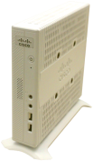

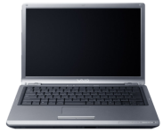



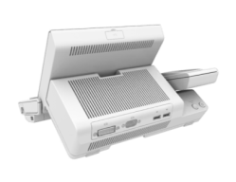











Cisco VXI
Virtualized, End-to-End Solution
= Cisco Products
Virtualized Data Center
Virtualization-Aware
Borderless Network
Virtualized
Collaborative Workspace
Applications/Desktop OS
Cisco Collaboration
Applications
MS Office
Cisco Virtualization Experience Clients
Cisco®
Identity
Services
Engine
Desktop Virtualization Software
AnyConnect
Cisco VXC 6215 Thin Client
Hypervisor
CDN
Cisco VXC 4000 PC Client
WAAS
Quad
AnyConnect
UCS
ASA
WAAS
Cisco VXC 22xx & 21xx Zero Client
Nexus 1000v
Hypervisor
ACE
Virtual Security Gateway
Unified
CM
PoE
Switching
Routing
Compute
Cius Business Tablet
Storage
End-to-End Management and Optimization

Slide 20
Agenda
Trends and Challenges in Education
Education Use Cases
Cisco’s Virtualization Vision
Cisco VXI Portfolio
Services Support and Validated Designs
Case Studies
Summary

Slide 21


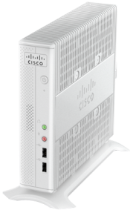
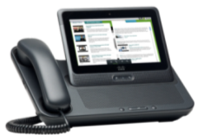
Virtualization Experience Client (VXC) Portfolio
Powering the User Experience
Zero Clients | Zero Clients | Software Appliance | Thin Client | Enterprise Tablet
VXC 2100 Series | VXC 2200 Series | VXC 4000 | VXC 6215 | Cisco Cius
Notes:
We are shipping VXC 2100, 2200 and Cius. And in Q4 of 2011, we will be adding to the VXC portfolio with the new VXC 6215 thin client and the VXC 4000 software appliance.

Slide 22

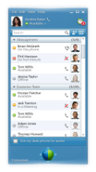
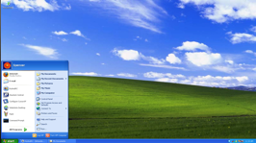
Cisco VXC 4000
Rich media collaboration from a virtualized Windows XP and Windows 7 PC
Great user experience with real-time voice from a virtual desktop
Leverage existing PCs and extend refresh
Supports Citrix XenDesktop and VMware View
Video-supported version in CY12
Notes:
Cisco Virtualization Experience Client 2110: “integrated” as part of the 9900 and 8900 IP phones with integrated video. We take the existing footstand, remove it and attach the backpack. You can connect from accessory port, POE…elegant way to deploy. Contains both phone and zero client.
Supports Citrix XenDesktop and VMware View
Supports Power over Ethernet (POE)
Uses single Ethernet port for phone and thin client
VMware View

Slide 23
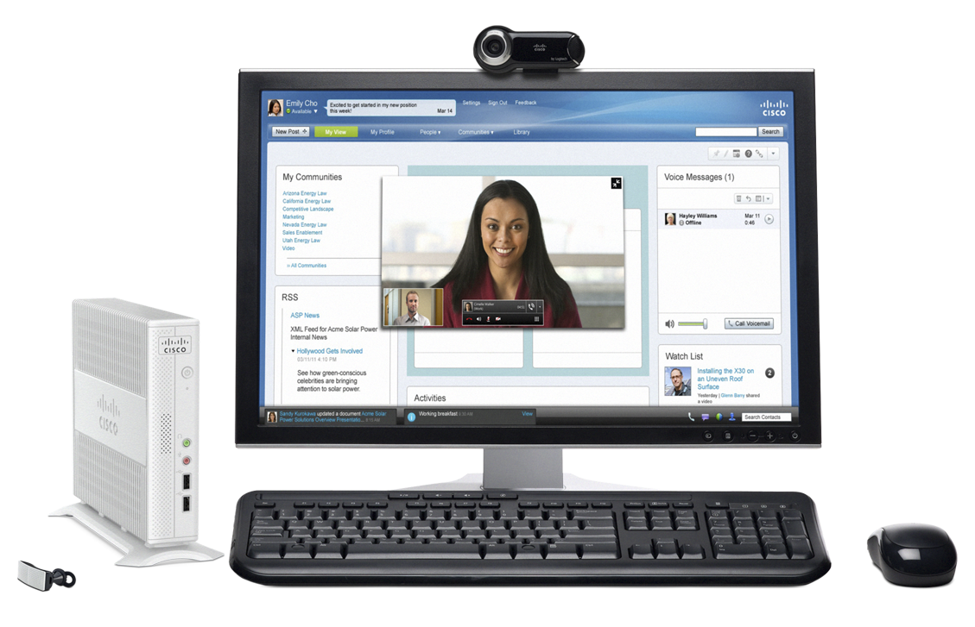
Cisco VXC 6215
Enterprise-ready voice, video, virtual desktop solution
New virtual workspace experience
Future-proofed design that grows with the business
Linux-based platform supports Citrix XenDesktop and VMware View; RDP for VDI only
New
Notes:
Cisco Virtualization Experience Client 2110: “integrated” as part of the 9900 and 8900 IP phones with integrated video. We take the existing footstand, remove it and attach the backpack. You can connect from accessory port, POE…elegant way to deploy. Contains both phone and zero client.
Supports Citrix XenDesktop and VMware View
Supports Power over Ethernet (POE)
Uses single Ethernet port for phone and thin client

Slide 24



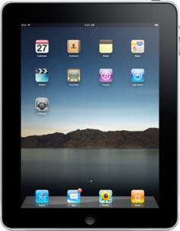



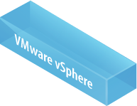
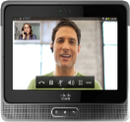
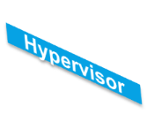

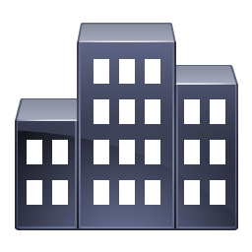
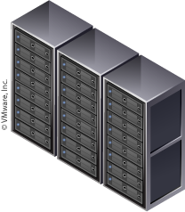
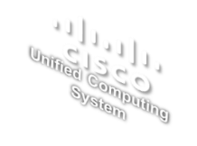



Cisco VXI: Borderless Network
Workspace-optimized network, security, and mobility architecture
Hosted Virtual
Desktops
Service Provider
Campus
WAN
Workspace-optimized LAN/WAN
Data Center
FCOE
Branch
ACCESS
END-TO-END SECURITY
OPTIMIZED WAN
INFRASTRUCTURE
Endpoints delivering rich-media experience, UPOE, Plug and Play Auto Smartports
Single Point Policy, Mobile endpoints, Consistent physical and virtual security
WAAS-based Optimization, Flexible Netflow and QoS, High availability
Scalable virtual Compute
Scalable, simple networking
Cloud-ready Virtual Switches
Uncompromised User Experience Enabled by the Virtualization-Aware Borderless Network

Slide 25
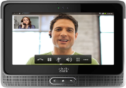
Cisco VXI: Borderless Network
Cisco Identity Service Engine (ISE) for VXI
Consistent Security Policy Enforcement Networkwide
  Physical desktops, virtual desktops, BYOD
Supports Data Security, Access Control, and Compliance
  Protects intellectual property
  Ensures right level of access for device type
Context-Aware Identity and Authentication Services
WHO
WHAT
WHERE
WHEN
HOW
Notes:
25
Policy based Access for VXI with Cisco Identity Services Engine (ISE)
Cisco Identity Services Engine (ISE) – designed to deliver policy-based services that easily scale across multiple applications and network services – has been validated for the Cisco Virtualization Experience Infrastructure (VXI) to provide secure role-based and device-based access to corporate data via virtual desktops. By combining network and VDI capabilities, businesses now have the flexibility to allow users to bring personal devices onto the corporate network without compromising data integrity. .
Scales to Meet Organizational Need: Allows IT to efficiently and easily extend support from physical desktops to virtual desktop environments with multiple devices per user. ISE centralizes all policy creation, and seamlessly propagates the information to all Cisco switches, wireless controllers, and network access devices (NAD).
Data Security and Compliance for Bring Your Own Desktop (BYOD) and Mobile Tablets - ISE helps IT simplify how to manage the bring-your-own-device (BYOD) phenomena, where users expect to access their virtual desktops through multiple devices. Cisco ISE centralized policy platform enables coordinated policy creation and consistent policy enforcement across the entire corporate infrastructure, with any user, using any device from anywhere -- both virtual and non-virtual sessions.
ISE provides device profiling and associates different policies for corporate vs. non-corporate devices or on a per device basis. It recognizes tablets such as iPad and Cius and other non-corporate devices and mandates that the user in corporate network on personal device or tablets accesses any and every corporate data through virtual desktop alone. The corporate device will have better flexibility of accessing data directly on the desktop or through a VDI session. This model of flexibility and control allows the IT admin to be assured of data containment in virtual desktops or corporate devices and minimizes the threat of leaking data via employee’s personal desktop after employee leaves the company.

Slide 26
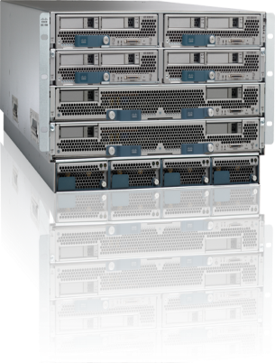

Leading the Industry in Virtual Desktop Performance and Scale
Optimized Platform for Desktop Virtualization
Cisco UCS
Lower cost for compute + network infrastructure
Greater virtual desktop density without
performance impact
Simple operation—start in minutes, scale in seconds
Massive scalability—scales easily to 1000s of desktops per UCS system
Expansive memory footprint and I/O to avoid desktop virtualization bottlenecks
Memory
CPU
I/O
Unified Fabric (FCoE)
Notes:
Using the Cisco Unified Computing System as the basis for your virtual desktop infrastructure unites computing, networking, virtualization, and storage access using technology innovation to bring ideal platform for desktop virtualization
Specifically, the Cisco UCS costs at least 20% less than competitors due to its radically simplified architecture requiring fewer components .
Supports 60% more virtual desktops without impacting user performance
Is easy to deploy and scale
Massive Scalability – Full system scales to 320 servers x 120 virtual desktops/server = up to 38,400 desktops
Largest and most cost-effective memory footprint for a 2-socket server combined with screaming fast, secured I/O avoiding bottlenecks

Slide 27

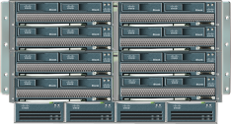
Cisco VXI Data Center
Scaling + Simplifying Virtual Desktops = Lower Operating Costs
Management
Domain
500% increase
= 30K+ virtual desktops
Server VDI
Density
45% increase
= up to 160 virtual desktops
Chassis
Unified Fabric
4 x capacity
4 x lower latency
Enhanced Data Center Features—Part of VXI Validated Design
Notes:
Management domain scalability
Previously supported 12 chassis per Fabric Interconnect with B250 M2 = 110 virtual desktops per blade:
= 4*110 per chassis * 12 = 5280 per management domain
QA confirmed that 20 chassis is supported with Capitola. One thing we can talk about is in the old architecture it was B250M2 on 20 chassis = 160x4 = 640 desktops/chassis -> 640x20 = 12800 desktops/UCS management domain
With B230M1 we will get the same per server density as B250M2, so that means 2x more VMs on the UCS Management domain (B230 is half width compared to b250 is fullwidth)
Adding 20% more density with B230M2. That is roughly 192 VM/blade.
Net increased management domain scalability with B230M2 and 20 chassis per domain from 5280 virtual desktops per FI management in old architecture per domain to 192*8 blades*20 chassis = 30,720 virtual desktops with Capitola architecture.
Moving from 110 Windows 7 Virtual Desktops per B250 M2 server to 160 Virtual Desktops per B250 server.

Slide 28
Agenda
Trends and Challenges in Education
Education Use Cases
Cisco’s Virtualization Vision
Cisco VXI Portfolio
Services Support and Validated Designs
Case Studies
Summary

Slide 29


Transforming Today’s Campus:
Cisco Services for VXI
Accelerate Business Value
Ensure optimal user experience
Minimize risk and accelerate time to value
Security, orchestration, and automation integrated in design
Service management blueprint to realign current IT operating models
Roadmap to rationalize use cases and target applications best suited for the new landscape
Run
Optimization
Allied Services for VXI
Build
Pre-Production Pilot
Planning and Design
Implementation and Migration
Plan
Strategy
Assessment
Discover
Discovery Workshop
Desktop Virtualization Journey
Available from Certified Partners or Cisco Direct
www.cisco.com/go/services/edu
Notes:
Campuses have been built the same way for 50 years – with each building system having its own network. Networks for data, voice, video, clocks & bells, energy management, building controls and overhead paging, etc.
Cisco Connected Learning solutions takes these multiple networks and converges them into one environment that connects learning, building, service and data systems that enhance global collaboration and research, improve information security, enhance student services, enable real-time communications and collaboration, improve energy use and create a smart, “green” campuses.
These advanced solutions can transform your campus into a connected learning environment, but in order for them to provide that value, they must be deployed quickly, efficiently, and with minimal disruption – to maximize a return on your investments and scale your campus services for the future.
Cisco Services and our partners are the experts in these advanced solutions and the support services you need to maintain them.
Working with higher education organizations to streamline processes, contain costs, and enable real-time communications and interaction, Cisco Services and our partners can help plan and create true 21st century connected learning experiences. By helping to optimize existing resources, and seamlessly and rapidly integrate new technologies, we ensure secure, reliable access to data and resources for administrators, researchers, staff, faculty members, and students alike.
www.cisco.com/go/educationservices

Slide 30
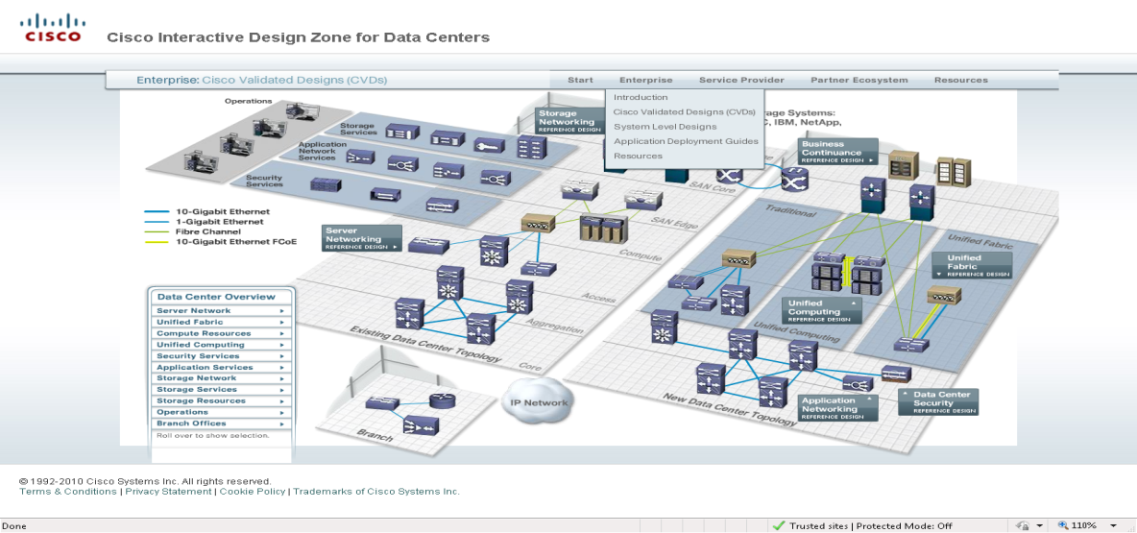
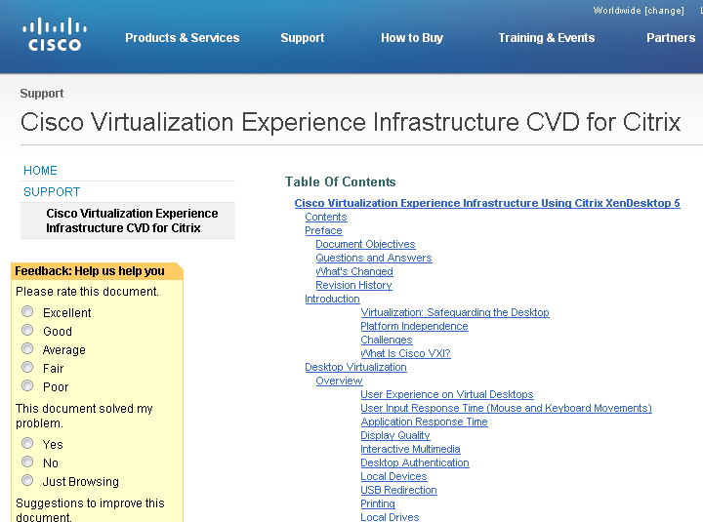
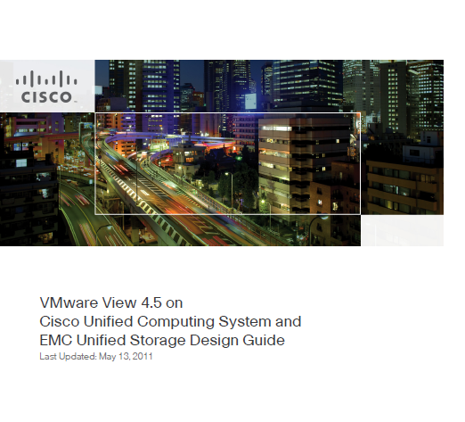
Cisco Validated Designs
VXI Cisco Validated Designs:
  Citrix XenDesktop
  VMware View
Growing partner ecosystem including:
  NetApp, EMC, Intel, Wyse
  Samsung, AppSense, Microsoft, McAfee
  LiquidwareLabs, Trend Micro, Atlantis, Unidesk
Increasing number of channel partners:
  Partners transforming from traditional desktop to virtual workspace practice

Slide 31
Agenda
Trends and Challenges in Education
Education Use Cases
Cisco’s Virtualization Vision
Cisco VXI Portfolio
Services Support and Validated Designs
Case Studies
Summary

Slide 32


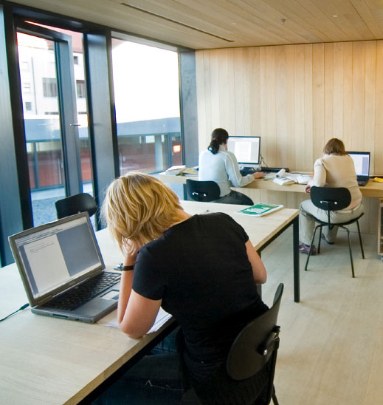

Seattle University:
Supporting Effective Research Initiatives
Situation
Short desktop computer lifecycles, difficult management of desktop application environment, and high operating expenses
Inability to meet specific, real-time software application requests from users
Disconnect between desktops, applications, and data within data center
Solution
Implement Cisco Unified Computing System (UCS) optimized for VMware and Virtual Desktop
Cisco Services utilized for planning, design, and implementation phases
Results
Ability to deploy software applications and business requirements on demand
Faster response times to users to help meet educational and administrative needs
Conversion to virtual desktops, decrease in operating expenses, and prolonged desktop lifecycle
Notes:
Situation
Short desktop computer lifecycles, difficult management of the desktop application environment, and high operating expenses
Inability to meet specific, real-time software application requests from professors, students, and college deans
Disconnect between desktops, applications, and data within the data center
Solution
Implement state-of-the-art Cisco Unified Computing System technology optimized for VMware and Virtual Desktop
Enable server management from single screen using unified computing system
Results
Ability to deploy specific software applications and business requirements for any educational or administrative department on demand
Faster response times to students, teachers, and faculty to help meet educational and administrative needs
Conversion of lab machines to virtual desktops, decrease in operating expenses, and prolonged desktop lifecycle

Slide 33
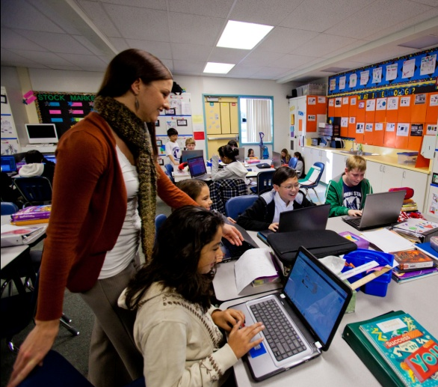

Park Hills School District:
Providing Next-Generation Learning to Students
Situation
Cost-effectively upgrade and update 4500 computers across 15 schools
Reduce downtime associated with maintenance, repairs, and upgrades
Implement flexible solution that can scale to meet future capacity and technology demands
Solution
Cisco desktop virtualization solution with Citrix XenDesktop, using Unified Computing System platform
Results
Substantial time and cost savings achieved during maintenance and technology refresh cycles
Improved technology for students, with flexibility to easily add functionality and capacity as needed
Green benefits from reduced power consumption
Notes:
Situation
Short desktop computer lifecycles, difficult management of the desktop application environment, and high operating expenses
Inability to meet specific, real-time software application requests from professors, students, and college deans
Disconnect between desktops, applications, and data within the data center
Solution
Implement state-of-the-art Cisco Unified Computing System technology optimized for VMware and Virtual Desktop
Enable server management from single screen using unified computing system
Results
Ability to deploy specific software applications and business requirements for any educational or administrative department on demand
Faster response times to students, teachers, and faculty to help meet educational and administrative needs
Conversion of lab machines to virtual desktops, decrease in operating expenses, and prolonged desktop lifecycle

Slide 34
Agenda
Trends and Challenges in Education
Education Use Cases
Cisco’s Virtualization Vision
Cisco VXI Portfolio
Services Support and Validated Designs
Case Studies
Summary

Slide 35
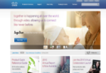
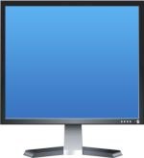


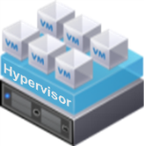
Summary: Virtualization in Education
Desktop Virtualization in Education Continues to Gain Momentum
  Broad applicability across education user base
  Simplifying education workflows
  Fast, highly secure access to critical applications
Cisco VXI Offers Validated End-to-End Capability
  Open ecosystem with key technology partners
  New set of desktop virtualization devices
  Improved ROI on desktop virtualization deployment
VXI
Notes:
ROI calculator tool will be available….
Who is this typically sold to? There are different buying centers, people that worry about voice/UC, and people that worry about network, then people that focus on DC, people that are focused on desktops….
Each customer is starting to wake up….most are moving this way….about 25% of customers will move 25-50% of their desktops in this direction! All orgs are restructuring their companies to deal with this new VXI approach….mandated by CIO to change….taking a look at technology, about the process and about the people.
80%+ of our customers….are looking at virtualization in this environment. Some key triggers:
Windows 7 migration.
Out-tasked workers (call centers)
Greenfield opportunity for a server
Where in DC upgrade cycle, partner with your DC colleagues
VMworld---analyst take away was how surprised he was, how many customers were trying to bring UC and DV together. It goes together, the partnership with UC and DV and upgrade cycles. Cisco is perfectly positioned to do that.
Screenpop to a desktop, technically not hugely different. Virtual machine in DC running as your PC. Same connections as the normal way. User sees on their monitor…ability to have UC applications virtualized in DC, but locally it works via CPI controlling that phone
Microsoft---relationship---what does this mean for Cisco. (at the virtualization level) Setting aside the licensing…..partner, in UC, banging heads OCS….overlap in competing some spaces, and partner in others…what we are doing in the DC, is different from what we are doing at the end points….partnering and competing.
Citrix and Vmware----are the big players in the hypervisor space.
Pricing---will be competitive. Price the value in the “solution”. Range is $300-400/unit
Bring your own…..workers bringing their own laptops. Don’t care what device, as long as you buy licensing, it will work. Wide variety, device agnostic, best in class. User to pick it, not thrust a endpoint on the user.
Much of this came from Sales org, from the GET team…tremendous interest from customers….lots of credit is due to sales team for demanding this from CDO.
Demos will be available in EBCs and portable kits….couple of VDs, Quad, etc…one uses Quad to call the other with CUPC…demos are key part of sales enablement.
Customer stories will be KEY!
Customer story: ING, huge $14M deal…in DC.

Slide 36




Resources
For more info about
  The Virtualized Workspace
  VXI
Please visit:
  http://www.cisco.com/go/vxi

Slide 37
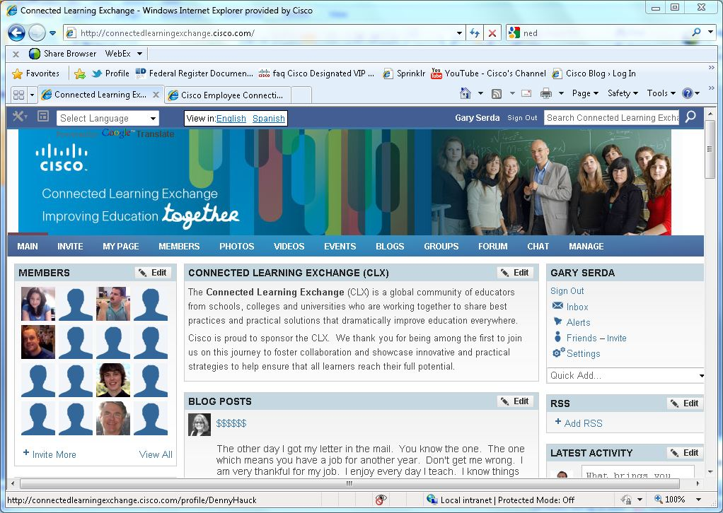
Connected Learning Exchange (CLX)
The CLX is a global community of educators who share best practices and practical solutions that dramatically improve education everywhere.
Join the CLX to:
Connect with educators from around the world
Participate in Affinity Groups
Access free online professional development
Be recognized by Cisco and the Community via the CLX Leader Recognition Program
http://clx.cisco.com
Notes:
The CLX is a global community of educators from schools, colleges and universities who are working together to share best practices and practical solutions that dramatically improve education everywhere.
Cisco is proud to sponsor the CLX. We thank you for being among the first to join us on this journey to foster collaboration and showcase innovative and practical strategies to help ensure that all learners reach their full potential.
As an educator interested in online learning, we encourage you to join the CLX to connect with like minded colleagues from around the world.
The Special Interest Groups can be a valuable professional development resource that will allow you to exchange best practices and share resources with other members of the community.

Slide 38




Let’s Stay Connected
Post a comment or photo
http://www.facebook.com/#!/CiscoEducation
Follow us
http://twitter.com/#!/CiscoEDU
Check out the Cisco Education Blog
http://blogs.cisco.com/category/education/
Subscribe to watch Cisco education videos
http://www.youtubecisco.com/education

