Slide 1
Delivering the New Virtual Workspace for Government
Unified Virtual Desktop, Voice, and Video
Notes:
I like this graphic

Slide 2
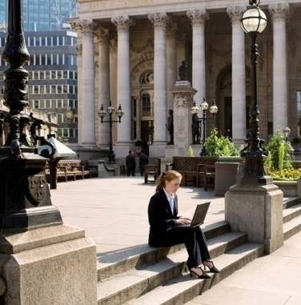
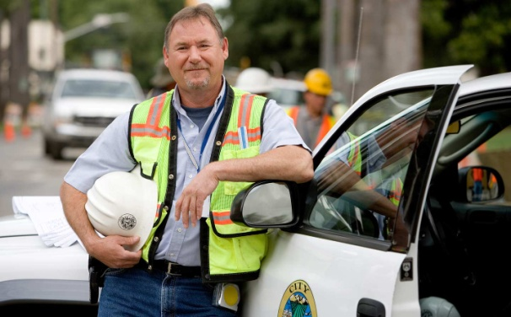

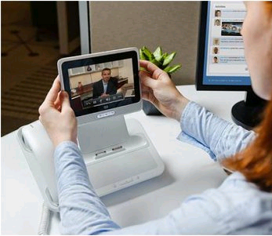
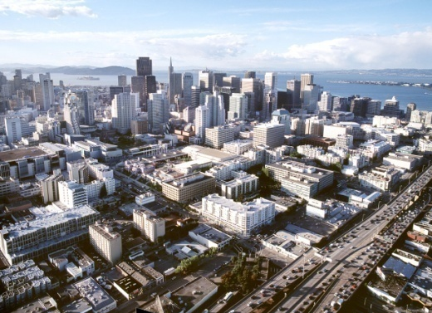
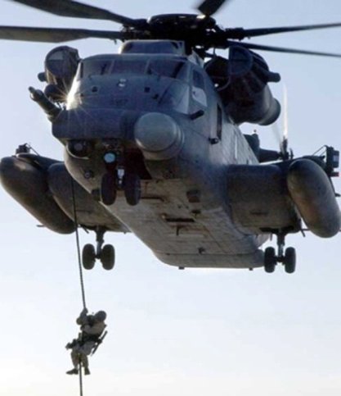
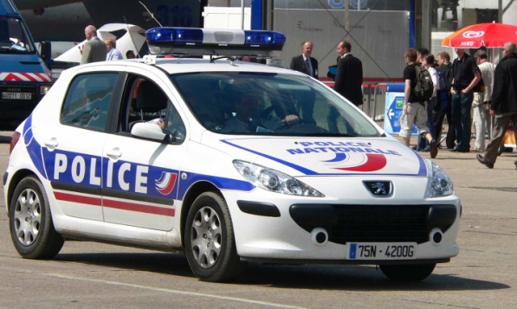
Cisco Desktop Virtualization for Government
Journey to Virtualization Experience Infrastructure (VXI)
Trends and Challenges
Use Case Scenarios
Architecture: Journey to Virtualization Experience Infrastructure (VXI)
Case Studies and Best Practices
Additional Resources and Next Steps
Notes:
New pic

Slide 3
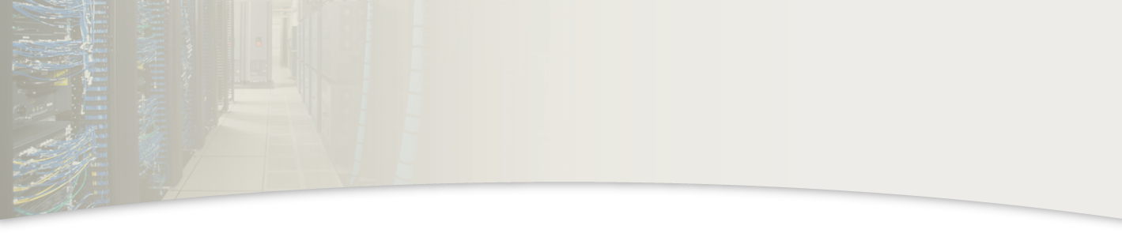


Trends and Challenges for Government

Slide 4
Challenges for National Government
Government organizations under severe pressure to reduce costs
Expected to provide constituents with a variety of services while streamlining processes
Need to provide secure applications, communications and information to geographically dispersed workforce
Need to ensure critical infrastructure projection and continuity of government during planned and unplanned events

Slide 5
Challenges for Regional Government
f
Streamline and cut costs
Improve operational efficiency and government workforce productivity
Stimulate economic development
Enhance services for citizens
Notes:
New pic

Slide 6
Challenges for Public Safety and Defense
Provide force multiplier to support agency missions
Provide real-time services to service personnel as they deploy and deliver mission-critical services
Unify workspace for multiple communications systems
Mobilize responders with situational awareness and interoperable communications capabilities
Notes:
New pic

Slide 7
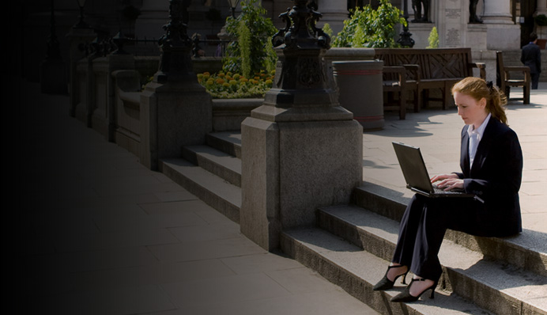
Challenges
Challenging times require government to consider how their communities can prevail over current obstacles and pave the way for future prosperity
Under pressure to:
  Stimulate economic development
  Streamline to cut costs and improve operational efficiency
  Enhance services for citizens

Slide 8

Network Platform
Use the network platform as the unifying force to:
  Equip citizens, businesses, and government employees with 24/7 access to information
  Encourage collaboration among agencies and departments
  Empower all constituents to participate in the community

Slide 9
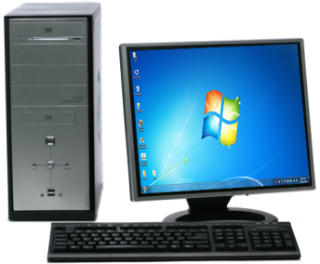
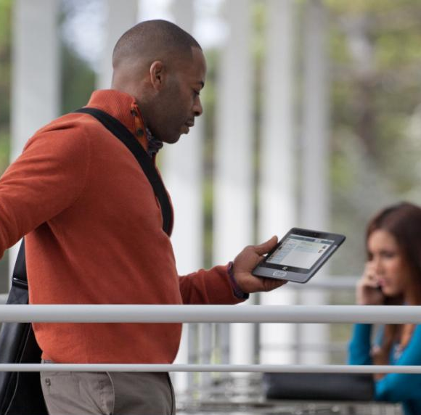

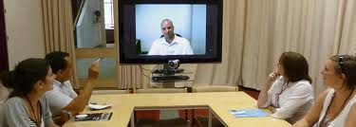
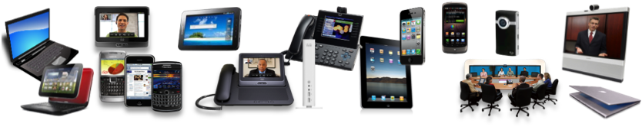
Convergence of Workspace Modalities
Any App, Any Data, Any Device, Any Media - Anywhere
PC Centric
The New Virtual Workspace
Phone Centric
Video Centric

Slide 10

Government Use Cases

Slide 11



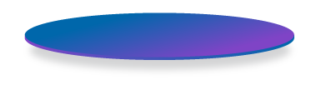
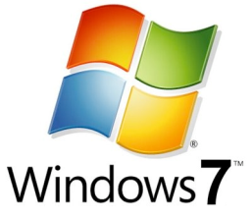

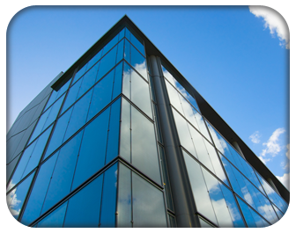
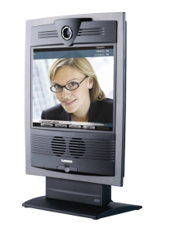
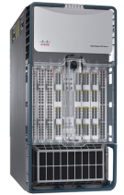

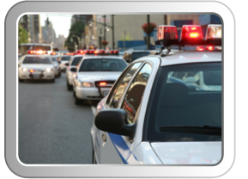

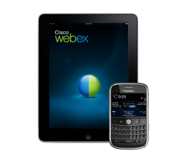
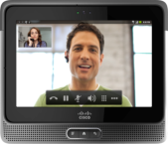

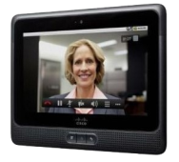
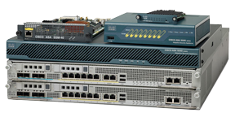
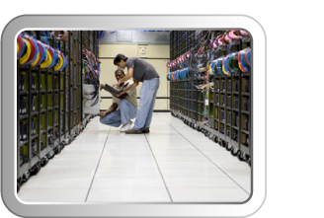
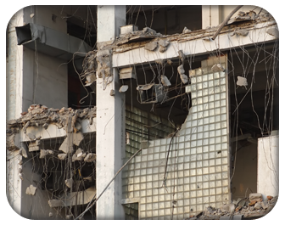

Teleworkers
Mobile Tablets (Cius)
Windows 7 Migration
Remote Government Offices
Data Center / Virtualization
VXI
Virtual Workspace
Borderless Networks
Collaboration
Mobile Public Safety
Mobile Apps (BYO)
Data Center Operational Efficiency
Continuity of Government
Disaster Recovery
Mobile Public Works

Slide 12
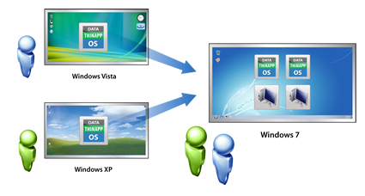
Use Case: Windows 7 Migration
Challenges
Scenario
Reduce migration costs
Minimize application incompatibility
Extend life of existing
desktop software
Upgrading 100s to 1000s of desktop devices is costly and time consuming
Benefits
Minimize costly application porting and reduce regression testing
Reduce conflicts and support calls
Enhance image and application management
Extend the life of your application and hardware to protect your investment

Slide 13


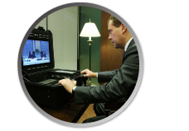
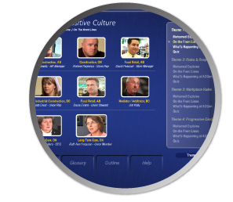
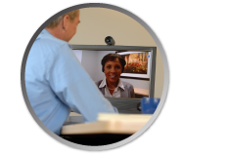
Use Case: Shared Inter-Agency Services
Challenges
Scenario
Need to foster collaboration with other government agencies and departments
Reduce operational and capital costs
Fragmented technology silos need to be shared cost effectively
Benefits
End-to-end security, authentication
Rich-media handled as easily as voice
Compatible with existing infrastructure
Compliance with many government mandates and certification standards
Notes:
13
13
train crthouse employees
Train convicts
Live or on demand learning to various locations

Slide 14

Use Case: Mobile and Teleworkers
Challenges
Scenario
Reduce costs by managing
desktop applications and users centrally
Centrally control sensitive data
Streamline desktop and application deployment
Traffic congestions and commuter delays
Benefits
  Increase workforce productivity
  Retain talent and improve their quality of life
  Provide anytime access to field agents and knowledge workers
  Maintain security and identity management
  Lower facility and operational costs
Notes:
14
14

Slide 15
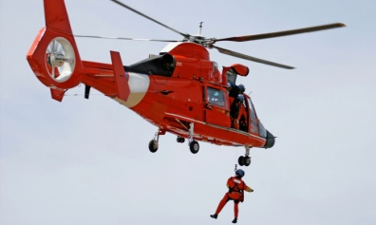
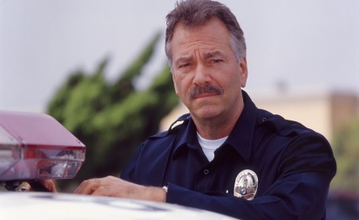
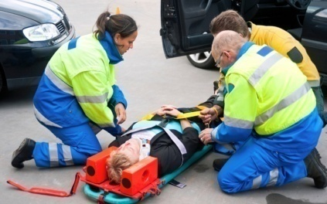
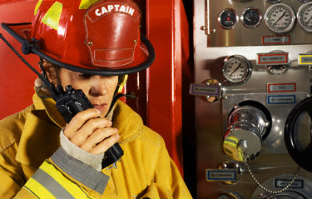
Use Case: Continuity of Government
Challenges
Scenario
Weather, fires, natural disasters, and emergencies disrupt government agencies
Service outages put constituents at risk
Need for flexible, secure communications capabilities during crisis
Benefits
Government teleworkers can communicate from home during crisis (24x7(
Reduces reliance on transportation and during an emergency
Provides path to resumption of normal operations

Slide 16

Use Case: Public Safety and Security
Challenges
Scenario
  Impact of crime and emergencies on community
  Challenges coordinating law enforcement response
  Delays gathering evidence for criminal investigation and prosecution
Benefits
  Increases situational awareness
  Analytics help identify suspicious activity and gather evidence
  Improves community safety

Slide 17

Use Case: Public Works
Challenges
Scenario
Delays in service to public works
Limited access to detailed schematics
Citizens frustrated with delays in service for aging infrastructure
Benefits
Optimize field service through mobile worker access to all case information
Enable desktop access regardless of network connection

Slide 18
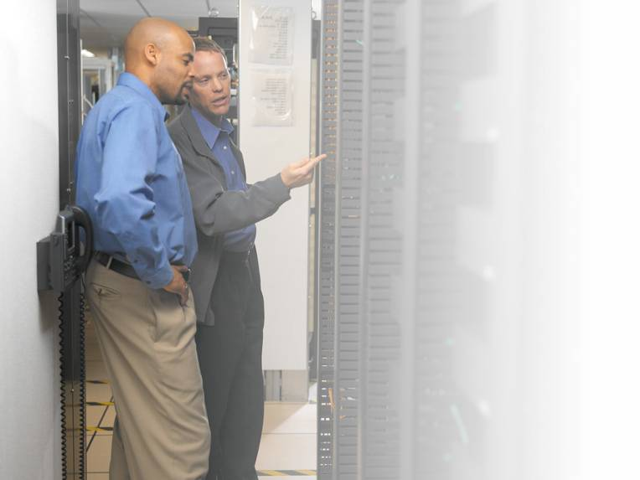

Use Case: Streamline IT Processes and Improve Operational Efficiency
Challenges
Scenario
Reduce costs by managing
desktop applications and users centrally
Centrally control sensitive data
Streamline desktop and application deployment
Benefits
  Flexible secure access
  Availability of
  desktops, applications and data 24/7
  Move locations and devices with a consistent user experience
  Optimized end-user experience

Slide 19

Architectural Foundation
Journey to Virtualization Experience Infrastructure (VXI)

Slide 20










21st Century Government
Relies on the Network
Collaboration
Citizens/Business
Digital Media
Collaboration
Applications
Employees
Servers
Business
Applications
Middleware
Storage
Databases
Data Center

Slide 21




Vision of the
Virtualization Experience Infrastructure
Delivering a Next Generation Virtual Workspace – unifying virtual desktops with voice and video to enable a new way to deliver IT
Secure, Flexible and Uncompromised
Media Rich Experience
Data Center
Virtualization
Any
App
Security
VXI
Any Data
Virtual
Workspace
Virtual
Workspace
Any Media
TCO / ROI
Any Device
Borderless
Networks
Collaboration
System Integration

Slide 22

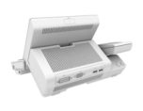

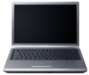




New Architecture for Virtual Workspaces
Virtualized Data Center
Virtualization-Aware
Borderless Network
Virtualized
Collaborative Workspace
Cisco Collaboration
Applications
MS Office
Microsoft OS
Branch
MOBILE CLIENT
Desktop Virtualization Software
Hypervisor
ZERO CLIENT
WAN Opt.
Routing
Virtual
Unified CM
Access Switching w/PoE
Unified Fabric
REPURPOSED RICH CLIENT
WAN Optimization
Hypervisor
Virtual Quad
Compute
UCS
THIN CLIENT
Server Load Balancing
Centralized Security Policy Management

Slide 23
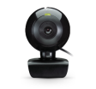

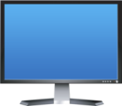
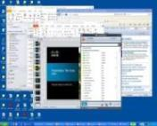






Voice, Video, Virtual Desktop Challenge
Display Protocol
Monolithic data flows
  Voice/Video embedded in the display protocol
  Media flow goes all the way back to data center and back
  Heavy processing on virtual desktop in data center
  Bandwidth explosion
  Latency and jitter
  Display protocol and possible endpoint become unstable
Data Center
Media Flow (desktop/webcam/audio)
Virtual Desktop
xx Mbps
Thin Client
Signalling
Call
Manager
LAN/WAN
Signalling
xx Mbps
Virtual Desktop
Media Flow
Thin Client
Display Protocol

Slide 24
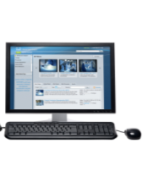



Next Generation Virtual Workspace
Unifying virtual desktop, voice, video
VXI
User interacts with “soft client”
on virtual desktop in data center
Endpoint intelligently routes
local client-to-client streaming
of video / voice
WAN Optimization improves performance
Benefits
Bandwidth reduction
Reduced processing in data center, increase in VM blade density
High quality voice and video
Network handling real-time data
(QOS, CAC)
  Eliminates hairpinning of media through data center
Data Center
Virtual Desktop
Display Protocol
(WAN Optimized)
yy kbps
Thin Client
Signalling
Call
Manager
Media Flow
(webcam/audio)
Signalling
yy kbps
Display Protocol
(WAN Optimized)
Virtual Desktop
Thin Client

Slide 25
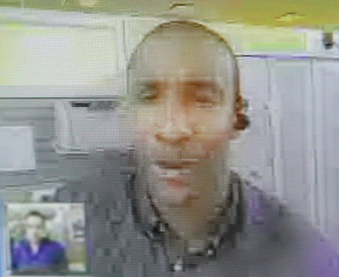
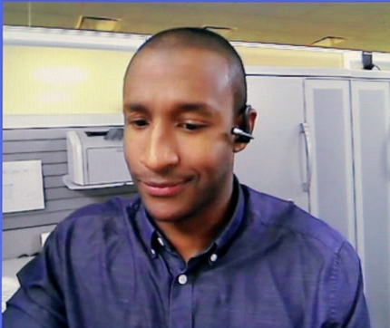
New Virtual Workspace Experience
Before
After
Unusable experience
  Hairpin effect
Increased cost and resource utilization
  Bandwidth explosion
  Heavy virtual machine processing in data center
Uncompromised user experience
  Routes voice and video point-to-point
Optimized resources
  Bandwidth reduction from megabytes to kilobytes
  Reduced processing in data center
Enterprise-grade voice and video

Slide 26
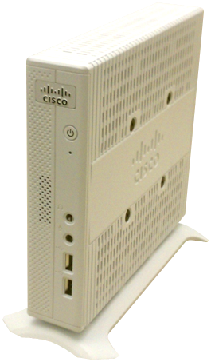
Virtualization Experience Client
An evolved thin client that unifies voice, video and virtual desktop in one device
Support high quality, scalable voice and video, delivering optimal user experience
Introduces unique voice, video processing capabilities that efficiently use network and data center CPU resources, eliminating the hairpin effect
Linux based platform supports major display protocols
Notes:
Cisco Virtualization Experience Client 2110: “integrated” as part of the 9900 and 8900 IP phones with integrated video. We take the existing footstand, remove it and attach the backpack. You can connect from accessory port, POE…elegant way to deploy. Contains both phone and zero client.
Supports Citrix XenDesktop and VMware View
Supports Power over Ethernet (POE)
Uses single Ethernet port for phone and thin client

Slide 27
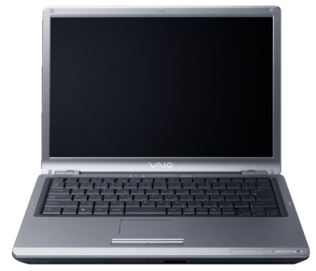
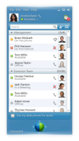
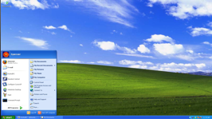
Enabling Virtual Workspaces on Rich-Clients
Turn a Windows PC (‘thick/rich-client’) into Rich Media capable Virtual Desktop Client
Introduce unique voice and video processing capabilities that efficiently use network and data center CPU resources, eliminating the hairpin effect
Endpoint support: WinXP, Win7
Notes:
Cisco Virtualization Experience Client 2110: “integrated” as part of the 9900 and 8900 IP phones with integrated video. We take the existing footstand, remove it and attach the backpack. You can connect from accessory port, POE…elegant way to deploy. Contains both phone and zero client.
Supports Citrix XenDesktop and VMware View
Supports Power over Ethernet (POE)
Uses single Ethernet port for phone and thin client

Slide 28
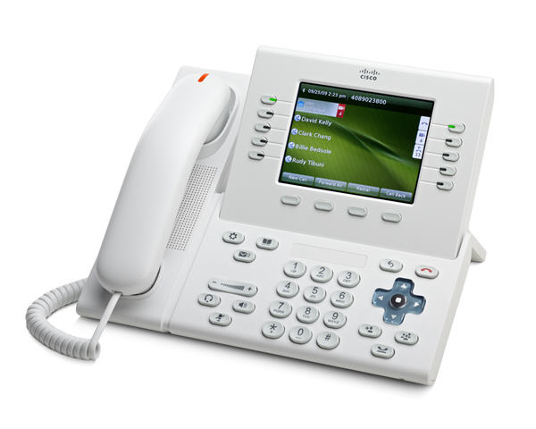
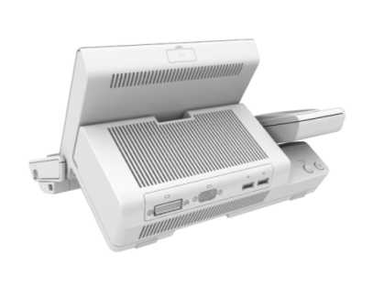
Virtual Workspace / Hardphone Integration
Integrates with existing user’s deskphone
Power via Phone – Leverages existing Power over Ethernet (PoE)
Supports 2 monitors, USB keyboard & mouse, 4 USB ports, Audio Mic in / Speaker out
Display up to 1920 x 1200 x 32 at 60 Hz in single- and dual- display modes

Slide 29
Network Optimization of Display Traffic
Before WAN Opt.
After
WAN Opt.
Response Time
Bandwidth Consumption
Video Quality
HD Quality
Seconds (s)
70%
faster
Kbps
Frame per second
Pixelated
Choppy
Out of Sync
LAN
80ms T1 WAN
80ms T1 WAN + WAAS
Virtual Workspace
Virtual Workspace
Up to 70%
Up to 3X
HD Quality
Faster
More Users
User Experience
Notes:
Early customer results show significant benefits for WAAS with Citrix Desktop Virtualization
70% faster response time
2-3X time more users support
HD Quality user experience comparable to a LAN-like experience
Customer interest has been excellent. Many see WAAS enabling them to speed up their deployments and meet their own goals for DC centralization and Desktop Virtualization

Slide 30
Data Center Optimizations for Virtual Workspaces
Desktop Density and Scalability
Great virtual desktop density with linear performance scalability
Rapid Provisioning of Desktops
Service profile templates for rapid provisioning of desktop pools
Networking Visibility and Security to Virtual Desktops
Prioritization of Desktop Pools
QoS and bandwidth controls deliver prioritization to desktop pools
Flexibility and Bandwidth for Converged Multiple Networks
Unified ports and 80G burst b/w allow for convergence with performance
Validated Designs and Reference Architectures
End-to-end reference architectures reduce risk for optimized stack

Slide 31
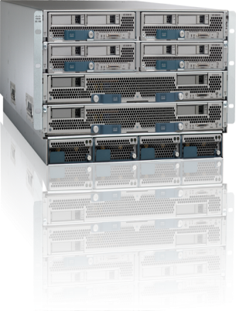

Optimized Infrastructure for
Next-Generation Workspaces
Ideal Architecture for Desktop Virtualization
Lower cost for compute + network infrastructure
Greater virtual desktop density w/o
performance impact
Simple Operation—start in minutes, scale
in seconds
Massive Scalability—scales easily to 1000’s of
desktops per UCS system
Extended memory and I/O to avoid desktop
virtualization bottlenecks
Memory
CPU
I/O
Unified Fabric (FCoE)
Notes:
Our VXI system is anchored on the Unified Computing System
UCS has been in the market now for just over 2 years, and in that short time, has created a huge disruption to the status quo of virtualized blade computing. With over 7400 customers and counting, and vaulting to the #3 position in blade server technology, IT organizations everywhere are resonating with it
Why?
When you think about deploying virtual desktops on any infrastructure, there are 3 key dimensions that dictate whether our compute platform is up to the task
These are:
1.) leveraging the latest generation of Intel Xeon processors, utilizing the most advanced computing footprint available, ensuring great desktop performance
2.) having a hugely scalable, but cost-effective memory footprint that enables greater densities of hosted desktops per server blade, without sacrificing application responsiveness
3. Leveraging a consolidated networking infrastructure for both storage access and LAN, using 10GbE lossless Ethernet to drive higher I/O throughput with lower latency.

Slide 32
Case Studies and Best Practices

Slide 33



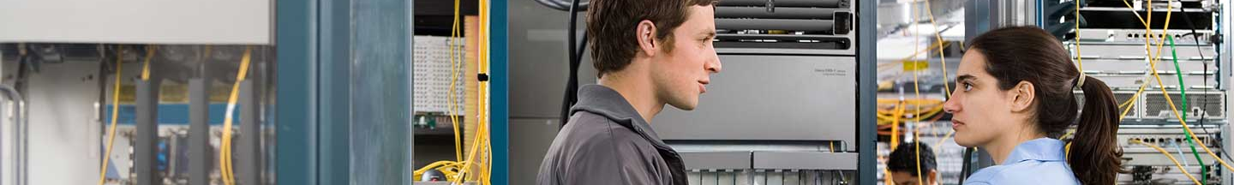
Bourget Airport Municipal Community
Challenge
Le Bourget Airport Municipal
Reduce cost of service delivery
Consolidate onto virtual platforms
Go from “customers standing in line” to online
“We were looking for a way to consolidate onto virtual platforms and the UCS environment was ideal for that. It has all the servers. It has an extensive amount of memory. It gives us all the network capability. At the same time saving space, energy, and giving us a platform that was the leading edge.”
David Larose, IT infrastructure, Communauté de Communes de l’aéroport du
Bourget
Solution
Cisco® Unified Computing System
Benefit
Saves space
Saves energy
Rolls out new services (less than 1 day)
Reduces cost and IT burden
Notes:
http://www.cisco.com/en/US/solutions/collateral/ns340/ns517/ns224/Bourget_UK.pdf
Communauté de Communes de l’aéroport du Bourget
Bourget Airport Municipal Community
(Le Bourget, Drancy, and Duny)
Le Bourget
France
Cities: 3
Population: 82243 inhabitants
Project Manager:
David Larose
Servers:
9 blade servers
1 DMZ
16 VDI virtualized servers
Nexus 1000V and 7000
VSphere 4.0
Virtualization level: 99%
Result:
70 virtual servers
virtualized network edge
virtual mode VoIP
Big savings and better control of
the virtual infrastructure
With vSphere virtualization from VMware and the Cisco Nexus® 1000V virtual switch, Le
Bourget Communauté has virtualized their servers and desktops. Voice over IP (VoIP)
virtualization, an impossible task prior to the arrival of the of the Cisco® Nexus 1000v
virtual switch, is the next step.
David Larose heads the IT infrastructure team for the Communauté de Communes de l’aéroport du
Bourget, a group of three municipal authorities (Le Bourget, Drancy, and Duny) in the northeastern
suburbs of Paris. One thousand desktop PCs support the efforts of 2500 employees, delivering a
vast range of services to the public. User needs are challenging in their diversity : from the welcome
desk to the back office, running software ranging from standard office automation applications to
specialized tools for planning and operations, with PCs located in town halls, schools, libraries, and
multiple other facilities, including self-service kiosks for the public. The CIO of Le Bourget
Communauté, however, has everything under control.
The project began in 2008 with the launch of an ambitious plan to virtualize the infrastructure, with
the objective of saving space. Additional benefits included having servers dedicated to specific
functions, difficult with the previous infrastructure, and easy cloning of servers for test purposes.
Twenty-seven physical servers, supporting various applications with multiple data storage models,
were virtualized. “We virtualized everything, including the DMZ and the Exchange 2007 server,
despite Microsoft telling us it wouldn’t work,” says Larose. “We’re now running 70 virtual servers.”
Satisfied with the results, the organization made the decision to extend the program, virtualizing the
1000 desktop PCs over the network.
The virtual desktop deployment is based on 16 blade servers hosted in the Drancy data center.
Focusing on machines running less demanding office automation applications reduces the CPU
load. Applications are virtualized using VMware ThinApp, reducing the number of templates needed,
with just one Windows XP master. Storage requirements are kept under control by using a linked
clone deployment, such that only the differences between the virtual desktop and the template need
to be saved to disk. “Our 6TB SAN is easily big enough for our needs,” says Larose. “A year ago,
before the linked clone technology was available, I would have needed much more.”
HQ: Le Bourget
France
Cities: 3
Population: 82243 inhabitants
Project Manager:
David Larose
Servers:
9 blade servers
1 DMZ
16 VDI virtualized servers
Nexus 1000V and 7000
VSphere 4.0
Virtualization level: 99%
Result:
70 virtual servers
virtualized network edge
virtual mode VoIP
Big savings and better control of
the virtual infrastructure
Communauté de
Communes de l’Aéroport
du Bourget
©2010 Cisco | VMware. All rights reserved.
Page 2
With a total cost of about €400,000, Larose calculates that he has saved roughly 20 percent
compared with the cost of desktop hardware renewal, and virtualization has revitalized certain
outdated PCs. Further savings are expected, in particular lower electricity bills, with savings of about
2.2 GW over the next three years.
Improved efficiency and reliability
Le Bourget Communauté has not finished virtualizing yet, though. The CIO has now decided to
virtualize the VoIP system on IPv6, simultaneously improving the security of the network edge and
optimizing overall management of the network of virtual machines. The trigger for this new phase
was the installation of the Nexus 1000V switch. “Without this switch it would have been impossible to
think about virtualizing the VoIP infrastructure,” says Larose. “It means I can deliver guaranteed QoS
levels for my end users.” Configuration tasks can be carried out three times faster on the Nexus
1000V. “We’re spending one-third of the time we used to, and our VDI deployment is more reliable,”
says Larose. “In fact, with the Nexus 1000V, we no longer have to think about virtualization. We just
virtualize, with no limits on what we want to do.”
Teams cooperate more effectively
The changes introduced by vSphere and the Nexus 1000V go beyond the technical integration, with
network administrators and system administrators now cooperating more effectively. “The network
team is more comfortable now, because they’re back in control of a network, which was being
©2010 Cisco | VMware. All rights reserved.
managed by engineers from the server team,” says Larose. “The server team was configuring the
vswitches, but that’s not really their job.” The results are measurable; optimization of the network
hardware has resulted in improvements in overall reliability and security.
Training on the new switch was minimal, with the Nexus 1000V based on the same operating system
as the Nexus 7000. Handover from the server team to the network team was facilitated, and the
network team now manages the virtual switches alongside the physical switches.
Larose plans in the future to deploy Dynamic ARP Inspection in order to run a virtual desktop
infrastructure that is as secure as the previous physical approach.
The next major project on the roadmap for Le Bourget Communauté is a disaster recovery plan.
“We’re looking at two options,” says Larose. “Either we build a secondary data center in one of the
two other municipalities or we opt for the vCloud solution, with our backup virtualized and hosted by
a service provider. That would give us real-time replication, like the first option, but at the moment
there aren’t any European vCloud providers.”
For more details, see:
http://www.cisco.com/go/nexus1000v
http://www.cisco.com/go/nexus
http://www.vmware.com/solutions/partners/alliances/cisco.html
Le Bourget Airport Municipal Community
Nearly 100% virtualized! For David Larose, CIO of the Communauté de communes - Le Bourget Airport the sky's the limit when it comes to
virtualizing the IT infrastructure. Servers, storage, desktops, DMZ, VoIP - all are virtualized. How does he do it? With VMware vSphere and the Cisco
Nexus 1000v virtual switch. "Without the Nexus 1000v and vSphere products, we wouldn't have felt so confident about virtualizing our VoIP
deployment. Today we're ready to virtualize everything. There's no limits!" says David Larose.

Slide 34

Pennsylvania Office of Attorney General
Challenge
Pennsylvania AG
Modernize outdated, outmoded data center
Undertake complete overhaul (desktop levels and core infrastructure)
“Systems don’t go down anymore. They don’t crash. I think our end users now have grown to expect that the system isa lways on, always available, and always performing at a high level.”
George White, Chief Information Officer, Pennsylvania Office of Attorney General
Solution
Cisco® Intelligent network platform
NetApp storage solutions and VMWare
Disaster recovery solution
Benefit
Runs applications in highly efficient manner
Reduces calls to help desk by 30%
Cuts energy consumption by 40%
Delivers 70% ROI
Notes:
http://www.cisco.com/web/strategy/docs/gov/paoffice_cs.pdf
Business Challenge
The Pennsylvania Office of Attorney General (OAG) has
a proud history as one of the oldest government
organizations in America. The OAG is an independent
office, serving as the chief law enforcement office in the
Commonwealth. In this capacity, the agency performs a
broad range of functions, including investigating and
prosecuting criminal cases; representing Commonwealth
agencies in civil litigation; providing legal reviews of all
state agency contracts; investigating, mediating, and
prosecuting consumer protection matters; and managing
a host of other public protection actions. With nearly 900
employees based in 22 locations, it is an office that must
stay competitive with some of the largest, most powerful,
and most well-funded law firms in the country.
“We have to compete with suspected criminals and the
firms who represent them,” says George White, chief
information officer for the Pennsylvania Attorney
General’s Office. “Often times, they have access to just
as much funding as the law enforcement agencies that
are going after them.”
When White came into the office in 2005, he found that the OAG’s IT infrastructure was outdated
and outmoded. He discovered that the environment had fallen into disarray, with aging and
disparate technologies suffering with respect to performance,
reliability, and availability.
“It really left our end users in a position where they didn’t have
a great deal of confidence in what their IT systems could do for
them,” White says.
White’s Information Technology Section (ITS) inventoried all of
the agency’s hardware, software, applications, and the
systems they were running at the time as part of an examination of performance and end user
statistics. White concluded that a top-to-bottom data modernization was necessary with the goal of
saving time and money.
Network Solution
Once the challenge of an outdated, inefficient data center was assessed, ITS embarked on an
ambitious plan to completely overhaul its operations. The office began meeting with vendors and
evaluated the technologies that each vendor brought to the table. It decided that a wholesale
replacement of all of the office’s servers, along with replacing all the storage systems and network
components, was necessary. The best course of action, says White, was to virtualize the office’s
data center.
“We selected Cisco for our networking components, we selected NetApp as our storage vendor,
and we selected VMWare for our virtualization,” White says.
One of the glaring deficiencies ITS found in doing its system review was that the agency had
literally no disaster recovery capabilities. There was no mechanism in place to back up critical data
for the various areas of the organization should a catastrophic event occur. Also, there was no plan
to govern the processes and procedures that an office would need to go through for an orderly
recovery. According to White, turning to Cisco helped solve the problem.
“Along with the implementation of the technologies that we put in place and the overhaul of the data
center, we also put in place a parallel system in our State College office, and all of the data that is
critical for use by our agents, our attorneys, our management, and our staff is replicated real-time
up to State College (PA),” White says. “So in the event of a catastrophic event at our core
headquarters in Harrisburg, all of that data would be protected and recoverable in a matter of
minutes.”
White says that Cisco Capital® was involved when the Attorney General’s Office decided to lease
equipment instead of buying it. Leasing over a four-to-five-year period allowed the office to stay
within the initial budget of the agency and to avoid extracting funds from other programs that were
protecting the public.
“The leasing approach was great for us in terms of introducing all these technologies into the
organization, and doing it in a very fiscally sound and proven way,” White says.
Business Results
The OAG has been extremely satisfied with the results from the data center modernization. It now
has a high-performing, modern platform that benefits end users with the capabilities that they need
to run their critical applications.
When assessing return on investment (ROI), the OAG discovered significant savings in several
areas. The office achieved a 30 percent reduction in calls to its help desk because the environment
was much more stable, resulting in savings of time and salary. It also achieved productivity
enhancements with respect to the ability of the staff to manage the environment. Staff members
were not spending as much time on manual activities, because now they were able to automate several redundant tasks that had taken up a large amount of time in the past. Today, the Attorney
General’s Office is able to do single mailbox restores should a problem occur. Finally, server setup
time went from taking a whole day to only five to ten minutes
“The ability to gain some economy with respect to our server utilization and storage utilization, and
doing things in a more efficient manner in that area gained us some considerable savings,” says
White.
Return on investment was also realized in green
savings, according to White. The OAG experienced a 40
percent reduction in energy consumption in the data
center. It was also able to reclaim approximately 33
percent of its data center footprint because of the
physical consolidation that resulted in some space
savings. Overall, the OAG achieved a 70 percent ROI
and a payback in 30 months on an initial investment of
US$1.6 million.
“We’ve had real improvements,” White says. “We have
not only benefited operationally but also financially from
the project…Systems don’t go down anymore. They
don’t crash. I think our end users now have grown to
expect that the system is always on, always available, and always performing at a high level.”

Slide 35
Why Cisco?
Additional Resources and Next Steps

Slide 36





Why Cisco?
Delivering Sustainable Advantage
Architectural
Approach
World Class
Services
Industry-Leading Partnerships
Notes:
36

Slide 37
Cisco Services Planning and Support
Process Led, People Delivered Technology Enabled
Quantified ROI and Project Justification
SLA Driven -Application Centric Architecture
Architecture
People, Process, Technology Transformation Roadmap
Operations
Management
Migration and
Transition
Application Delivery Infrastructure Mapping
Monitoring and SLA Management
Application Virtualization
Organization and Operations Readiness
Infrastructure/Application Migration
Notes:
37
Organizations face many challenges when they choose to virtualization strategy. Our approach is process-led, people-delivered, technology-enabled.
The challenges start at an organization level. Siloed organizations – with separate teams for applications, security, storage, servers, network, and facilities – present a complex environment for end-to-end approaches such as virtualization. Compounding the impact of organizational challenges, many organizations struggle with understanding how virtualization will impact day-to-day operational and IT service management procedures. At an architecture level, many virtualization projects are limited to servers; they haven’t extended it into the network, storage, applications, or SLAs.
Even more significant in today’s uncertain economy, you may not realize all of the ways a virtualization strategy can deliver financial benefits to both people and processes. CxOs are unwilling to invest in organizational, service management, and technology strategies until they are able to quantify the periodic (throughout the project lifecycle) and recurring (post-project ongoing) savings they will achieve from virtualization.
Cisco’s strategy can accelerate the adoption of virtualization. Based on a holistic approach, the Cisco holistic approach extends beyond server virtualization to network, storage, and compute resources tied to an application-centric view of the data center for true organizational transformation.
Architecture value – Cisco Services can help measure, quantify, and report on the impact to CAPEX and OPEX. The impact is measured in terms such as Return on Investment (ROI) and Total Cost of Ownership (TCO), looking at impact throughout the project lifecycle as well as the ongoing operational (run) expenses. This is tied directly to the End-to-end architecture – we can help organizations evolve to an end-to-end architecture that is business-aligned, SLA-driven, and application centric. The end-to-end architecture also helps enterprises drive down energy consumption and costs in the data center by tying the architecture to physical infrastructure requirements such as power and cooling, and benchmarking energy efficiency across infrastructure and facilities systems for increases efficiencies.
Migration and Transition You might have the right architecture and funding case, but implementing a virtualization strategy can be daunting. The second area is migration and transition services to lower the risk and speed the transition to the new architecture. This address questions around what application and infrastructure do I migration, Which servers and software are not being used? Which software products can be consolidated? Which physical servers are candidates for virtualization? What is the impact on business applications of changing infrastructure components
The third area around Virtualization operations management – Critical to a successful migration is a transformational roadmap that addresses people, processes, and technology. Cisco Services helps your team address organizational and operational maturity and readiness. Finally, we bring in the right Operate and Monitoring services to protect the customer’s investment once they migrate. We’ve built new services and expertise to deliver the high quality customer experience you have come to expect.

Slide 38
VDI Services Portfolio
Prepare
Plan
Design
Implement
Operate
Optimize
Strategy
Service
Planning and
Design Service
Implementation
Service
Operation &
Optimization
“How can Virtual desktop fit into my overall DC Strategy? Costs? ROI?
Process Impact?”
“What Architecture Maximizes the end user experience?
“How Do We Realize Our Architecture—
On-Time, Within Budget, and in Our Environment?”
“How Do We Ensure Evolution and Ongoing Cost Reduction?”
Assess Strategy
Customer Workshops
Technology Assessment
  Infrastructure
  Servers/Storage
  Existing desktop service models
  Organizational and operational readiness
Build business case
Design
Develop architecture, tools and interfaces
Develop/update desktop service models
Develop/update security and access models
Plan for technology and operations migration
Implement and Integrate
Validate solution with Proof-of-Concept deploy solution
Integrate solution components with infrastructure
Deploy new desktop service models
Migrate desktops and users
Optimize via…
Review architecture, tools and interfaces
Day-2 support
Problem/Change Mgmt
Arch. Monitoring
Triage support for Cisco & 3rd Party
System Level support
Customer Reporting
Accelerate
Time to Value
World Class Expertise World Class Presence
Proven Delivery Capability
Delivering Unique Cisco Insight
Notes:
38

Slide 39
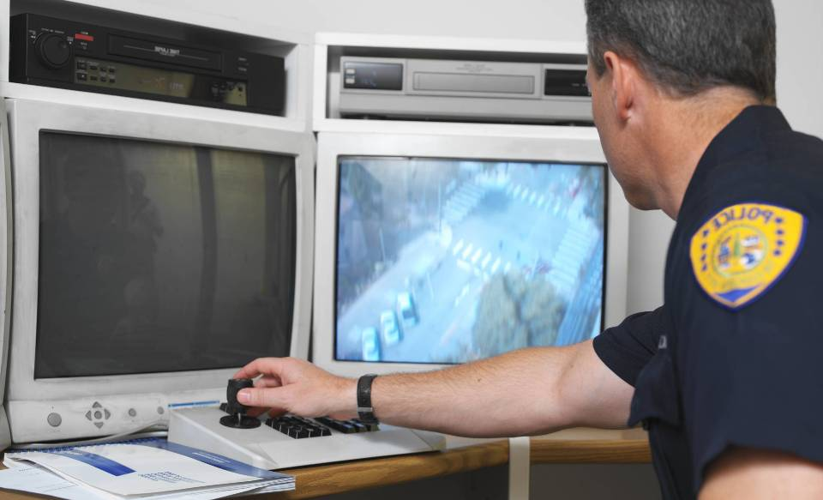

Cisco Capital Exists for Your Success
Public Sector Customers Finance Technology for Three Main Reasons
Maximizing technology within your physical budget today
Relieve budget pressure – Free up cash for other uses
Technology Migration
www.cisco.com/go/ciscocapital
Notes:
39
39

Slide 40
Cisco VXI TCO Customer Examples
5 Year Desktop TCO
Healthcare
3,000 users Windows XP
5 year savings 32%
Total Savings
16%
Power
-73%
University
3,750 users Windows 7
5 year saving 18%
Client H/W
-46%
Desktop Support
– 37%
3,000 users Windows 7
6 year savings 24%
Saves $1,000 per user per year
Financial
Government
1,200 users Windows 7
5 year savings 22%
Notes:
Healthcare: Caritas – Northeast USA
University: Nottingham (UK)
Financial: RBS
Government: City of Colorado Springs

Slide 41





Additional Resources
Blog: blogs.cisco.com/government
Twitter: @CiscoGovt
Public Sector Customer Connection: https://communities.cisco.com/community/usergroups/publicsector
Cisco.com: www.cisco.com/go/government, www.cisco.com/go/vxi and www.cisco.com/go/designzone

