Slide 1
Cisco Virtualization Experience Infrastructure (VXI) Smart Solution for Healthcare
Notes:
1
Define VXI here

Slide 2
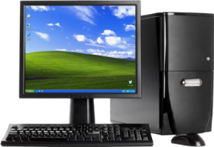
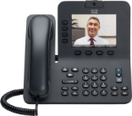
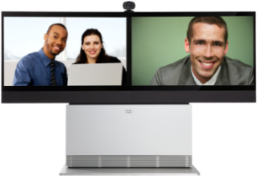
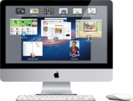
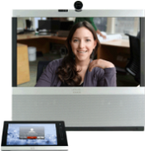
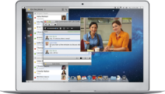
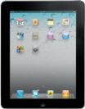





























How You Worked Used to Depend on This…
Now It Depends on This…
Wired
Wireless

Slide 3
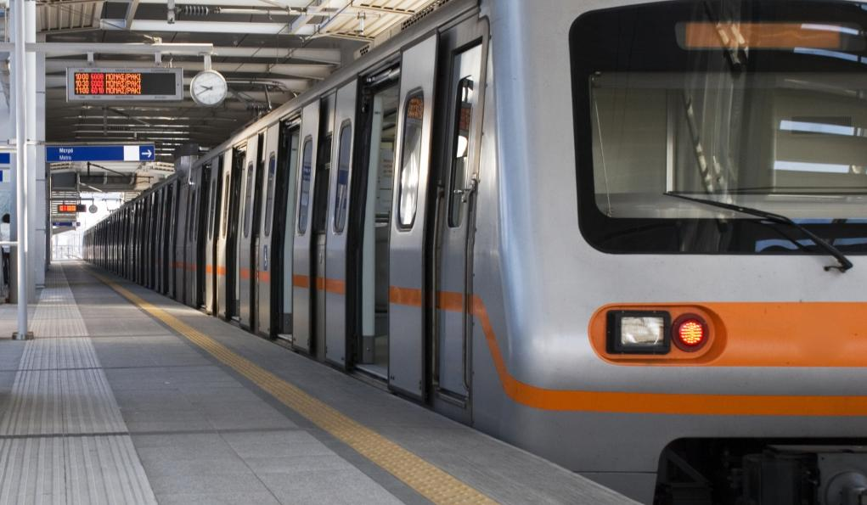

Cisco Vision for Unified Workspace
Delivered by Cisco Smart Solutions
Experience
Mobility
Security
Any Device
Any Expertise
Any Application
Anywhere
Notes:
This is it vision of the Cisco Unified Workspace – to give you access to any information, any application, any expertise from anywhere on any device. But it is also bounded by policy – policy which mitigates risk for the business, based on their risk profile – so that sensitive data is protected, whether that be electronic health records, or sensitive manufacturing processes.
The defining attributes of the Unified Workspace is mobility– your workspace moves with you, and it is secure. And, like Telepresence before it, the experience is the key attribute. Even with the best technology available today, if the user experience is poor, then neither Cisco nor our customers can be successful. Conversely, as we empower our customer to Work, Their Way with greater freedom and flexibility, both Cisco and our customer base benefit.

Slide 4
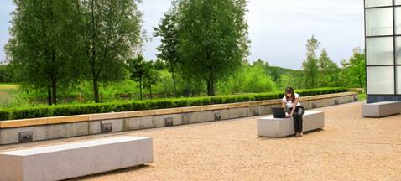

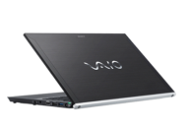
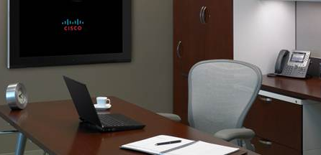
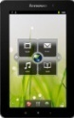
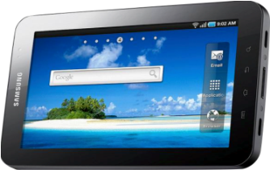
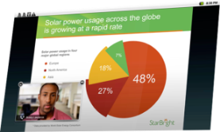




Cisco Smart Solutions
Smart Solution Components
Tested, Validated, Documented Designs
Integrated Cisco + 3rd Party Roadmaps
Solution Lifecycle Management
Work Your Way
Services Practices
Technical Training and Support
Cisco and Partner Enablement:
Demos, ROI Assets, Tools, Financing
Notes:
Cisco Smart Solutions include:
Cisco Validated Design -process and documentation
Integrated Cisco + 3rd Party Roadmaps
Solution Lifecycle Management
Service Practices
Sales and Technical Training and support
Solutions Enablement, Tools, Demos and Financing
Customer Benefits:
Sustainable solution for customers – reduce complexity today, provide continuity and investment protection as solution evolves (roadmap for solution)
Cisco absorbs complexity – Assuming responsibility for complex integration work for our customers, so they don’t have to integrate for themselves
Reducing risk – Customer is assured solution components will work together, can depend on Cisco for Smart Solution support
Internally, Cisco manages Smart Solutions in the following way:
Governed by the Enterprise Business Council
Smart Solutions by definition are cross architectural
Smart Solutions typically driven by third-party component/integration requirements from Cisco ecosystem partners

Slide 5
The Virtualization Market is Growing
Gartner Hosted Virtual Desktop Installed Base Forecast
In Millions
Graphic adaptation created by Cisco based on Gartner data. Source: Gartner, Inc., Forecast: Hosted Virtual Desktops, Worldwide, 2010-2014 (2012 Update)
Notes:
NOTES:
The New Forecast
The Gartner forecast for HVD now extends to 2016. Compared to our previous HVD forecast (in 2010), the total penetration or migration of users from the professional PC installed base is similar but takes place over a longer period. Our expectation is that current deployments, while starting to become more consistent in volume, are still low. In 2011 we saw just under 6 million new users deployed on HVD. To put this figure into perspective, it represents less than 1.6% of the current worldwide total professional PC installed base — and highlights the difference between hype and reality. Our user surveys have all indicated the intention of organizations both large and midsize to adopt HVD. The reality is that in the short-term the prohibitive cost will continue to limit the real appeal of this platform.
QUOTES:
Quotes
Gartner expects that by the end of 2016, 30% of large organizations (more than 1,000 users) will have deployed HVDs to 20% of their users or more.
Gartner expects that HVD capabilities will provide a user experience comparable to that of PCs by 2014.
Gartner believes HVD capex will fall by 10% by 2014.
TCO reductions of up to 13% compared to well-managed desktops are likely to be realized beyond year three of a deployment.
CAGR if Total Installed Base is 33.1% from 2012-2016

Slide 6
Desktop Virtualization Drivers in Healthcare
Other | 9%
Mobile Device Support | 3%
Remote Access | 39%
Information Security | 8%
Desktop Roaming | 14%
Desktop Manageability | 27%
Source: Imprivata Desktop Virtualization Survey 2011

Slide 7

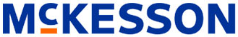





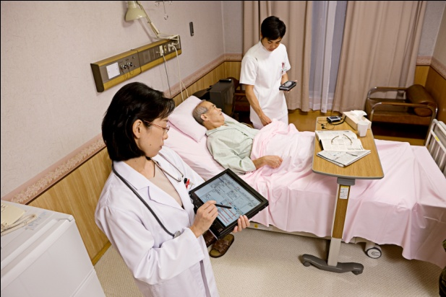
Desktop Virtualization Drivers in Healthcare
Move to Electronic Medical Records (EMR)
Meaningful Use and government stimulus for Healthcare IT
Need to maintain HIPAA compliance
Need to support mobile
medical staff
Need to provide secure access to sensitive patient data

Slide 8
Healthcare Needs for Desktop Virtualization
Providing secure, speedy access to applications and patient data
Ensuring session mobility between inpatient and ambulatory
care delivery locations, onsite/offsite doctors’ offices and administration areas
Changing the data types and the security profile based not only on the user’s role but also location in the health system
Facilitating secure availability of patient data on mobile devices
Managing rising administration costs
Providing access to legacy applications from diverse platforms
Meeting compliance and regulatory requirements

Slide 9
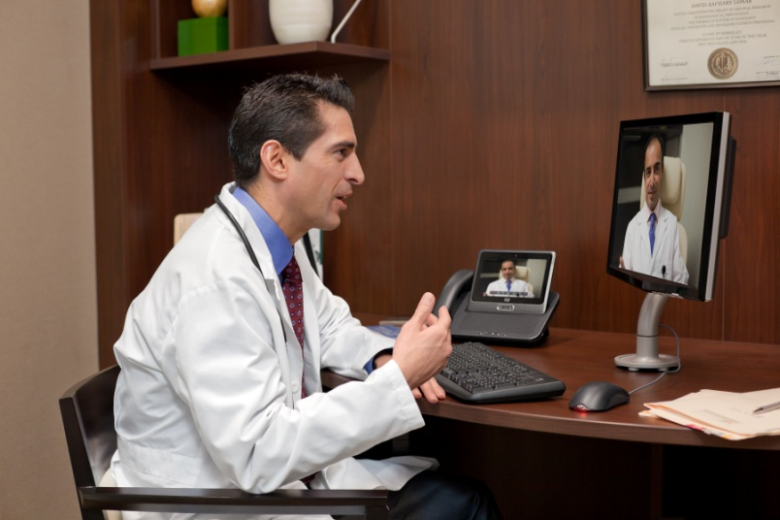
Use Case: Referential Clinical Imaging
Old Workflow
  Dedicated workstations to review and analyze patient images
  Local access only resulting in travel time and delay in getting back to patients
New Workflow
  Clinicians are able to review images on the device of their choosing, at any location (at home, in the office, or at an outpatient clinic)
  Results
  Significant time savings for physicians
  Increased flexibility resulting in quicker turn around and improved patient care
Conservative estimate of 5 minutes (for modeling)

Slide 10

Use Case: “Follow-Me Clinical Desktops”
Old Workflow
  50+ Logins per day
  2+ min to log in, launch app and view patient data
  Time consuming process hampering nurse productivity
New Workflow
  Access virtual desktop from
  any endpoint
  Instantly resumes all apps and data
Results
  Reduced login time
  Improved productivity resulting in better patient care

Slide 11
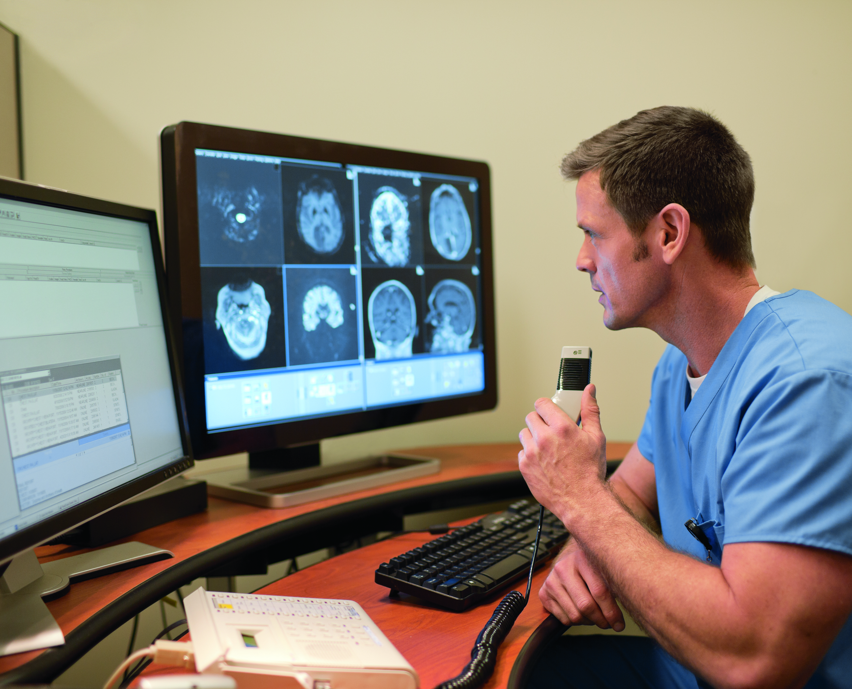
Use Case: “Ubiquitous” Dictation
Old Workflow
  Dedicated workstations with application and
  USB microphone
  Physicians take 5-minute round trip to
  workstation each time
  Remote physicians must be provisioned separately
New Workflow
  Any USB-enabled endpoint that accepts dictation
  No need to provision dedicated hardware
  for remote physicians
Results
  Reduction in “Time-to-reach” workstation
  Potential reduction in software licensing and hardware costs
  Improved Productivity gain
Qualitative benefit

Slide 12

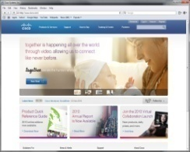
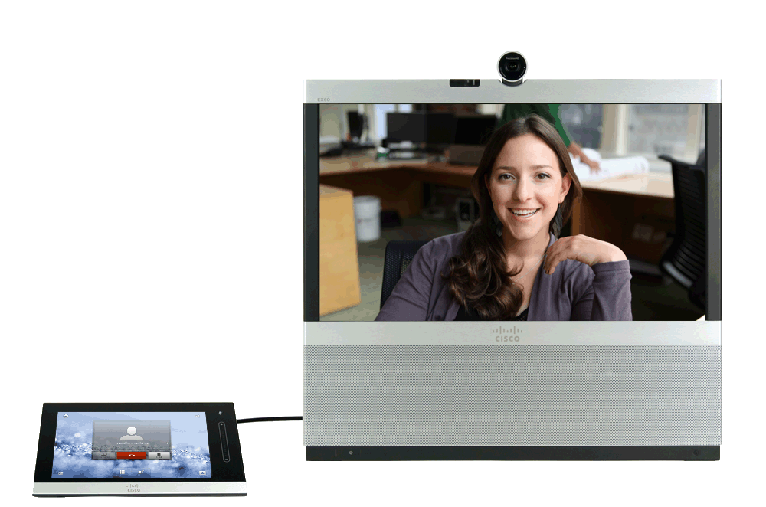
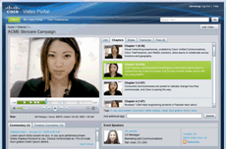
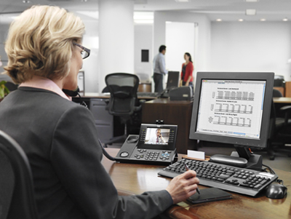
Cisco VXI Smart Solution
Delivering a Unified Workspace Experience
Virtual Desktops & Apps
Secure
Flexible
Data Center
Data
Apps
Virtual
Workspace
Video
Workspace
Device
Media
Voice
Collaboration
Location
Borderless
Networks
Uncompromised

Slide 13
VXI Smart Solution
More than Desktop Virtualization
VXI is the ideal platform for desktop virtualization… ▼
Unified Workspace
Rich Media, Voice, Video
Unified Communications
Network Optimization
End-to-End Security
Fully integrated solution
Virtual Desktops
More scalable
More secure
Higher performance
Simplified deployment
Reduced costs
▲ …and delivers the virtual solution for a Unified Workspace
Notes:
Built on the leading desktop virtualization, data center and storage platforms
Built with the leading collaboration, networking, security technologies

Slide 14
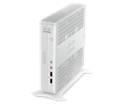

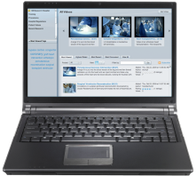





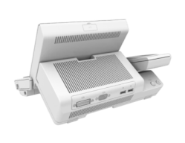

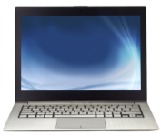



Cisco VXI Smart Solution Architecture
Cisco Products
Virtualized Data Center
Borderless Network
Collaborative Workspace
APPLICATIONS/DESKTOP OS
AnyConnect
Collab
Finesse
CTIOS
MS
Office
VXC 6215 Thin Client
Identity
Services
Engine
DESKTOP VIRTUALIZATION SOFTWARE
HYPERVISOR
VXC 4000 Software Appliance
WAAS
UC Mgr
vWAAS
UCS
WAAS
VXC 22xx & 21xx Zero Clients
ASA
Contact Center
Routing
(ISR)
ACE
Security Gateway
Nexus
1000v
PoE
Smart Cards
Tablets
Smart Phones Laptops
Ultrabooks
DCN
Cloud Compute
STORAGE
Switching
Jabber
End to End Management , Optimization and Services

Slide 15

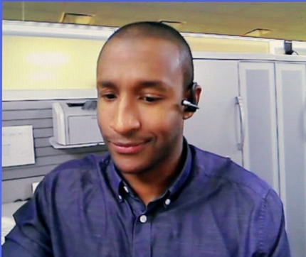
Cisco VXI Smart Solution in Action
Before
After
Delivers uncompromised user experience

Slide 16

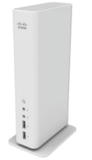
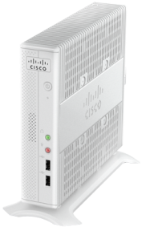
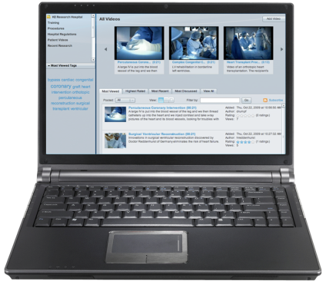
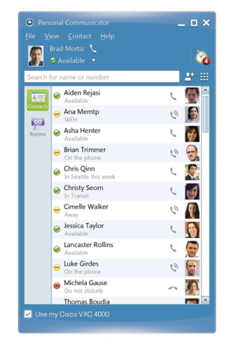
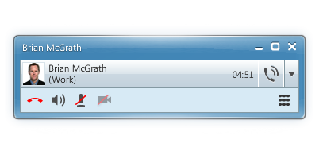
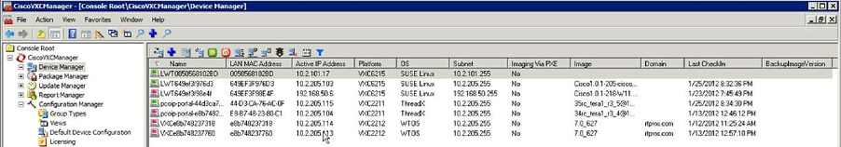
Cisco Virtualization Experience Client (VXC) Portfolio
Zero Clients | Zero Clients | Thin Client | Software Appliance
VXC 2111/2112 | VXC 2211/2212 | VXC 6215 | VXC 4000
Management
VXC Manager

Slide 17
Cisco Identity Service Engine (ISE) for VXI
Consistent Security Policy Enforcement Network-wide
  Physical desktops, virtual desktops, BYOD
Supports Data Security, Access Control, and Compliance
  Protects intellectual property
  Ensures right level of access for device type
Context-aware Identity and Authentication Services
WHO
WHAT
WHERE
WHEN
HOW
Notes:
17
Policy based Access for VXI with Cisco Identity Services Engine (ISE)
Cisco Identity Services Engine (ISE) – designed to deliver policy-based services that easily scale across multiple applications and network services – has been validated for the Cisco Virtualization Experience Infrastructure (VXI) to provide secure role-based and device-based access to corporate data via virtual desktops. By combining network and VDI capabilities, businesses now have the flexibility to allow users to bring personal devices onto the corporate network without compromising data integrity. .
Scales to Meet Organizational Need: Allows IT to efficiently and easily extend support from physical desktops to virtual desktop environments with multiple devices per user. ISE centralizes all policy creation, and seamlessly propagates the information to all Cisco switches, wireless controllers, and network access devices (NAD).
Data Security and Compliance for Bring Your Own Desktop (BYOD) and Mobile Tablets - ISE helps IT simplify how to manage the bring-your-own-device (BYOD) phenomena, where users expect to access their virtual desktops through multiple devices. Cisco ISE centralized policy platform enables coordinated policy creation and consistent policy enforcement across the entire corporate infrastructure, with any user, using any device from anywhere -- both virtual and non-virtual sessions.
ISE provides device profiling and associates different policies for corporate vs. non-corporate devices or on a per device basis. It recognizes tablets such as iPad and Ultrabook and other non-corporate devices and mandates that the user in corporate network on personal device or tablets accesses any and every corporate data through virtual desktop alone. The corporate device will have better flexibility of accessing data directly on the desktop or through a VDI session. This model of flexibility and control allows the IT admin to be assured of data containment in virtual desktops or corporate devices and minimizes the threat of leaking data via employee’s personal desktop after employee leaves the company.

Slide 18
Cisco VXI Data Center
The optimized infrastructure for Desktop Virtualization
Simplified Desktop Deployment
Simplified Management
Integrated, Pre-Validated reducing Risk
Simple
Comprehensive security from client, network and data center
Desktop-aware policies and administration
Security policy access control and segmentation of virtual desktops
Secure
Scalable
Industry leading desktop density
On-demand desktop provisioning
Easily scales to 1000s of virtual desktop per UCS system
Deliver a simple, secure and scalable infrastructure with a compelling ROI in a fully integrated, open and validated desktop virtualization solution

Slide 19
Data Center Optimization
Desktop Density and Scalability
Great virtual desktop density with linear performance scalability
Rapid Provisioning of Desktops
Service profile templates for rapid provisioning of desktop pools
Networking Visibility and Security to Virtual Desktops
Prioritization of Desktop Pools
QoS and bandwidth controls deliver prioritization to desktop pools
Flexibility and Bandwidth for Converged Multiple Networks
Unified ports and 80G burst b/w allow for convergence with performance
Validated Designs and Reference Architectures
End-to-end reference architectures reduce risk for optimized stack

Slide 20
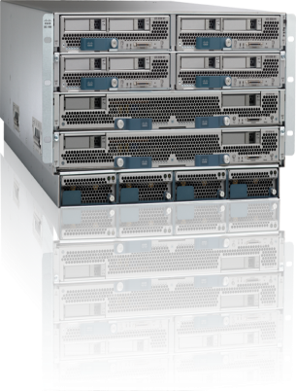

Optimized Infrastructure
Ideal Architecture for Desktop Virtualization
Lower cost for compute + network infrastructure
Greater virtual desktop density w/o
performance impact
Simple Operation—start in minutes, scale
in seconds
Massive Scalability—scales easily to 1000’s of
desktops per UCS system
Extended memory and I/O to avoid desktop
virtualization bottlenecks
Memory
CPU
I/O
Unified Fabric (FCoE)
Notes:
Our VXI system is anchored on the Unified Computing System
UCS has been in the market now for just over 2 years, and in that short time, has created a huge disruption to the status quo of virtualized blade computing. With over 7400 customers and counting, and vaulting to the #3 position in blade server technology, IT organizations everywhere are resonating with it
Why?
When you think about deploying virtual desktops on any infrastructure, there are 3 key dimensions that dictate whether our compute platform is up to the task
These are:
1.) leveraging the latest generation of Intel Xeon processors, utilizing the most advanced computing footprint available, ensuring great desktop performance
2.) having a hugely scalable, but cost-effective memory footprint that enables greater densities of hosted desktops per server blade, without sacrificing application responsiveness
3. Leveraging a consolidated networking infrastructure for both storage access and LAN, using 10GbE lossless Ethernet to drive higher I/O throughput with lower latency.

Slide 21
Benefits of Cisco UCS for Desktop Virtualization
ARCHITECTURE
Simple, resilient architecture for deploying VMware View
SCALABILITY
Linear scalability and performance from 100 to 1000’s of desktops without a change in architecture
BALANCED SYSTEM
Providing the right balance of memory, I/O and CPU is the key to cost-effective scalability
SIMPLICITY
Rapid provisioning with Cisco UCS Manager for ease of scale
VALIDATED DESIGNS
Part of Cisco VXI featuring an end-to-end solution including Security, WAN Optimization and UCS
Notes:
A PVS based design for VMware View essentially needs a fast/low-latency network
Cisco UCS provides not only 10G low-latency cut-through architecture but also provides QOS guarantees
Other server vendors have to have multiple switching points to achieve this level of service
Our unique architecture delivers the best in class Compute/Network and storage for View Deployment
With Provisioning Server deployments the 10G network really shines and with QoS also benefits all storage

Slide 22
Scalability Results
9.16 VMs/core with B250 and 192GB/memory
Linear Scale from 1 to 16 blades and beyond
Desktop Profile
Windows 7, 32bit
1.5GB RAM
1vCPU
Write-back cache 3GB on NFS
# virtual desktops
UCS Blade Profile
B250 M2
192GB Memory
Dual Xeon 5680 CPU
UCS Blades
Note: Results shouldn’t be taken out of context
LoginVSI 2.1
Medium worker workload
Source: http://www.cisco.com/en/US/netsol/ns1099/index.html

Slide 23
Cisco VXI: Data Center Savings and Success
Faster Payback, Ongoing Savings (better ROI, lower TCO)
Highest virtual desktop density per server = fewer servers needed
33% lower network infrastructure costs
Up to 50% less storage needed per desktop
Improved Productivity, Enhanced Business Agility
Faster and simpler deployment reduces implementation times
High performance systems and network provide best user exp.
Quickly react to changing market, competitive, or internal conditions
Investment Protection
Latest technology, b.o.b. partners
Flexibility and choice
Scalable, flexible, secure arch. for DV, VXI, DC apps, cloud, etc.
Notes:
Faster payback and ongoing savings (better ROI and lower TCO)
Industry’s highest virtual desktop density on a single blade server – fewer servers needed to support X virtual desktops
One-third lower network infrastructure costs – fewer cables needed per server with UCS architecture and unified fabric
Reduced storage costs with storage tiering and deduplication, with up to 50 percent less storage space needed per desktop
Improved deployment time and high performance speeds productivity and provides business agility
Faster and simpler deployment reduces implementation times and costs for lost productivity – IT and end-users
High performance systems and network provide best user experience
Quickly react to changing market, competitive, or internal conditions
Investment protection
Latest technology with best of breed partners
Flexibility and choice of form factor, hypervisor, desktop virtualization software, storage
Scalable, flexible, secure architecture for desktop virtualization, VXI, datacenter apps, cloud, etc.

Slide 24

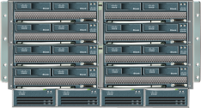
Cisco VXI Data Center
Scaling + Simplifying Virtual Desktops = Lower Operating Costs
500% increase
= 30K+ virtual desktops
Management
Domain
45% increase
= up to 186 virtual desktops*
Server VDI
Density
4 x capacity
4 x lower latency
Chassis
Unified Fabric
Enhanced data center features - part of VXI validated design
186 Desktops on B200 M3*
Notes:
186 Desktops on B200 M3**
Knowledge Worker Profile
384 G memory, Dual Xeon
E5-2690/8-Core CPU
175 Desktops on B230 M2*
Knowledge Worker Profile
384 G memory, Dual
E7-2870/10-Core CPU
Management domain scalability
Previously supported 12 chassis per Fabric Interconnect with B250 M2 = 110 virtual desktops per blade:
= 4*110 per chassis * 12 = 5280 per management domain
QA confirmed that 20 chassis is supported with capitola. One thing we can talk about is in the old architecture it was B250M2 on 20 chassis = 160x4 = 640 desktops/chassis -> 640x20 = 12800 desktops/UCS management domain
With B230M1 we will get the same per server density as B250M2, so that means 2x more VMs on the UCS Management domain (B230 is half width compared to b250 is fullwidth)
Adding 20% more density with B230M2. That is roughly 192 VM/blade.
Net increased management domain scalability with B230M2 and 20 chassis per domain from 5280 virtual desktops per FI management in old architecture per domain to 192*8 blades*20 chassis = 30,720 virtual desktops with Capitola architecture.
Moving from 110 Windows 7 Virtual Desktops per B250 M2 server to 160 Virtual Desktops per B250 server.

Slide 25

Cisco VXI Data Center
30%
Less Cost
90%
Less Time
60%
Less Cost
Deploy 2x
Capacity
No Staff
Increase
30%
Faster
Deployment Times
Infrastructure
Costs
Deployment
Times
Application
Performance
Power
Cooling
IT
Staffing
Tangible Benefits that Impact Desktop Virtualization

Slide 26
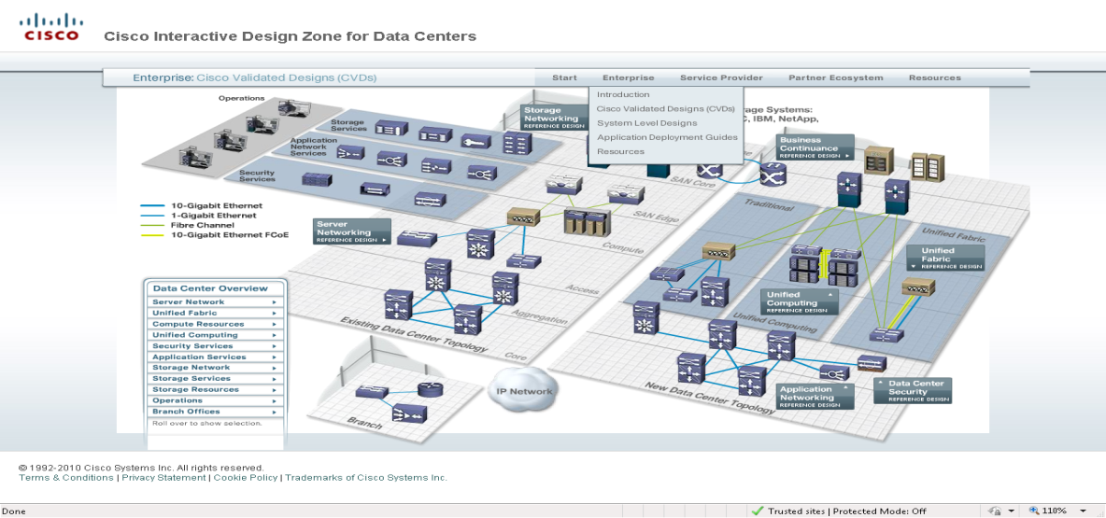
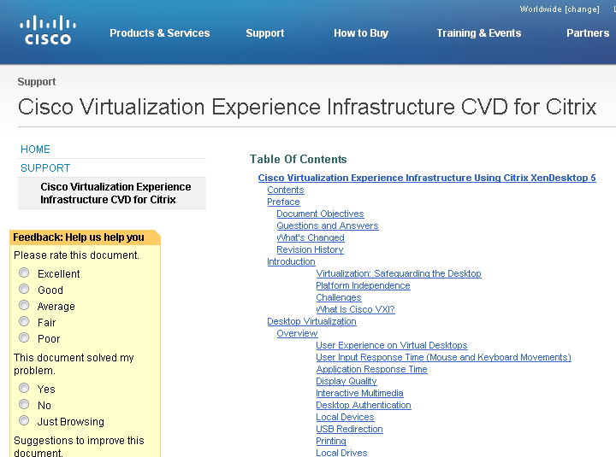
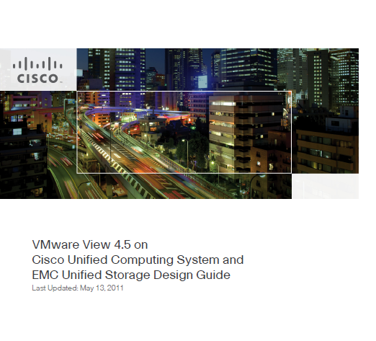
Cisco Validated Design for VXI
Cisco Validated Designs (CVDs):
  Citrix XenDesktop
  Citrix XenApp
  VMware View
Risk reduction in customer deployment
  System integration and validation
  Multiple Hypervisors
  Multiple storage solutions

Slide 27

Benefits
Hardware Independence
  Continue using legacy hardware that would ordinarily have to be replaced
  Provide same clinical user experience on variety of devices
Upgrades and Scalability
  Users access updated applications immediately, filter by User or IP
  Additional capacity easily added at the datacenter level
Increased Availability
  Server, application resources focused in data center
  Less downtime, no waiting for desktop restoral
  Less troubleshooting, faster problem resolution
  Improved continuity of care
Less Maintenance
  50% fewer help desk tickets
Better Compliance
  Roll out changes to security policies everywhere at once—
  comprehensive and traceable
Better Energy Efficiency

Slide 28

Seattle Children’s Hospital
One of the Leading Children’s Hospital in United States
Challenge
  Improve clinician productivity and patient care by enabling fast, easy access to applications and data from any station
  Increase scalability to efficiently deploy up to 3000 virtual desktops without compromising application performance
  Improve service resiliency
  Solution
  Cisco Unified Computing System
  Cisco Nexus 5000 Series Switches
  Impact
  Saved each clinician at least 45 minutes per day
  through single log-on and fast application performance
  Increased scalability up to 120 users per blade
  with no performance degradation
  Eliminated service outages due to incompatible
  network interface cards
Notes:
28

Slide 29

South West Alliance of Rural Health
Leading Health Care Organization in Australia
Challenge
  Deliver IT services to 13 public health agencies
  Support extremely mobile clinician staff
Solution
  Cisco VXI with Cisco VXC,
  UC and UCS
Impact
  Create more efficient and
  collaborative patient care
  environments
  Optimize patient care experience
  Increase staff confidence in
  electronic health records
Notes:
29

Slide 30



Quintiles
Leading Change in the Pharmaceutical Services Industry
Challenge
  Deliver quality centralized IT services
  to branch offices
  Optimize network performance for a seamless virtual desktop experience
  Minimize bandwidth utilization
Solution
  Cisco VXI with Cisco WAAS for HDX
Impact
  Maintain a consistent level of LAN
  like performance
  Reduce infrastructure requirements at the branch office
  Avoid costly bandwidth upgrades
Notes:
Head quartered in Research Triangle Park, NC, Quintiles is the only fully integrated bio and pharmaceutical services provider offering clinical, commercial, consulting and capital solutions. More than 22,000 Quintiles employees in 60 countries helped develop or commercialize all of 2010’s top 50 best-selling products or compounds.
Quintiles was named Top 10 IT Innovators for Information Week 500 – Sept 2011
http://www.informationweek.com/news/galleries/global-cio/interviews/231601038?pgno=5
•Challenge - With more dependency being placed on the WAN for delivering centralized applications via Citrix, we needed to ensure optimal network performance by accelerating traffic and reducing bandwidth demands to allow a seamless VDI experience.
•Solution - WAAS allows us to optimize our traditional file/print traffic, as well as reducing the bandwidth required for ICA ensuring consistent performance for all users.
•Impact - We’ve leveraged WAAS optimization to allow us to centralize users file and print requirements to the datacenter and maintain a consistent level of LAN like performance. This has reduced our infrastructure requirements at the branch office, and enabled us to avoid costly bandwidth upgrades.

Slide 31
Summary
Desktop Virtualization in Healthcare Continues to Gain Momentum
  Broad applicability across healthcare user base
  Simplifying clinician workflows
  Fast and highly secure access to critical applications
Cisco VXI Offers Validated End-to-End Capability
  Open ecosystem with key technology partners
  New set of desktop virtualization devices
  Improved ROI on desktop virtualization deployment
Notes:
ROI calculator tool will be available….
Who is this typically sold to? There are different buying centers, people that worry about voice/UC, and people that worry about network, then people that focus on DC, people that are focused on desktops….
Each customer is starting to wake up….most are moving this way….about 25% of customers will move 25-50% of their desktops in this direction! All orgs are restructuring their companies to deal with this new VXI approach….mandated by CIO to change….taking a look at technology, about the process and about the people.
80%+ of our customers….are looking at virtualization in this environment. Some key triggers:
Windows 7 migration.
Out-tasked workers (call centers)
Greenfield opportunity for a server
Where in DC upgrade cycle, partner with your DC colleagues
VMworld---analyst take away was how surprised he was, how many customers were trying to bring UC and DV together. It goes together, the partnership with UC and DV and upgrade cycles. Cisco is perfectly positioned to do that.
Screenpop to a desktop, technically not hugely different. Virtual machine in DC running as your PC. Same connections as the normal way. User sees on their monitor…ability to have UC applications virtualized in DC, but locally it works via CPI controlling that phone
Microsoft---relationship---what does this mean for Cisco. (at the virtualization level) Setting aside the licensing…..partner, in UC, banging heads OCS….overlap in competing some spaces, and partner in others…what we are doing in the DC, is different from what we are doing at the end points….partnering and competing.
Citrix and Vmware----are the big players in the hypervisor space.
Pricing---will be competitive. Price the value in the “solution”. Range is $300-400/unit
Bring your own…..workers bringing their own laptops. Don’t care what device, as long as you buy licensing, it will work. Wide variety, device agnostic, best in class. User to pick it, not thrust a endpoint on the user.
Much of this came from Sales org, from the GET team…tremendous interest from customers….lots of credit is due to sales team for demanding this from CDO.
Demos will be available in EBCs and portable kits….couple of VDs, Quad, etc…one uses Quad to call the other with CUPC…demos are key part of sales enablement.
Customer stories will be KEY!
Customer story: ING, huge $14M deal…in DC.

Slide 32
Cisco VXI Smart Solution
  Talk to your Cisco Account Team and set up a time to see VXI in Action!
  For more information, go to:
http://www.cisco.com/go/vxi
VXI Design Zone
http://www.cisco.com/en/US/solutions/ns340/ns414/ns742/ns1100/landing_vxi.html

