Slide 1
Cisco VXI with Citrix XenDesktop:
The Next Generation Virtual Workspace

Slide 2



Today’s Demanding Business Environment
Rising Expectations
Velocity and Volatility
Growth
  Freedom to chose devices, work locations, and collaboration
  from anywhere
  Speed of change with new markets, competitors
  and services
Margin
Financial Pressures
Innovation Everywhere
  Controlling CapEx and managing a more predictable spend; new profit centers (cloud), etc.
Risk
  Devices, work styles, processes, applications, services, the cloud
Notes:
We see a number of trends. At first glance, these trends might not seem like anything new. What's different is that technology is now available that lets organizations deal with these trends in a new way.
Organizations still face the same pressures to innovate, to respond to changing demands, and to meet expectations. But technology is now at a point where it can help organizations face these many challenges in a new way.
Consumers, employees, and partners have come to expect the same kinds of deep, intimate, and on-demand relationships that they experience every day in their personal lives. Technology is making it possible to deliver those kinds of relationships on a very broad basis.
At the same time, we're seeing that innovation is coming from a wider variety of places. New devices are being introduced rapidly, and IT teams have to be prepared. Organizations are looking for new platforms that support these devices -- the next iPad, the latest smartphone -- so they can keep up with market velocity and manage market volatility.
And, of course, everyone is being tasked to do more with less. In the public and private sectors alike, organizations are looking to technology to enhance services while working with consistent or smaller budgets.
Ultimately, the business has increased pressures around Growth Margin and Risk, which IT needs to be able to support and address.
(SALES TEAMS – Use these slides to generate discussions on what the customer wants to focus on)
------------------------------------------------------------------------------------------------------------------------------------------------------------------------------------------------------------------------
Data Sources:
Rising Expectations (HBR, 9/3/10 "IT in the Age of the Empowered Employee" http://blogs.hbr.org/cs/2010/09/it_in_the_age_of_empowered_employees.html?cm_sp=blog_flyout-_-cs-_-it_in_the_age_of_empowered_employees)
Market Velocity (Deloitte, - BUILDING SUPPLY CHAIN EXCELLENCE IN EMERGING ECONOMIES (http://www.deloitte.com/assets/Dcom-UnitedStates/Local%20Assets/Documents/us_mfg_chapter2_globalization_engelkoudalopt_optimized.pdf)
Innovation Everywhere (Harvard Business Review http://hbswk.hbs.edu/archive/5258.html)
Financial Pressures (AT Kearney (Global Champions 2009) http://www.atkearney.com/images/global/pdf/Global_Champions_2009.pdf) “In fact, of the 2500 companies analyzed, only 42 large and internationally operating companies have managed to show any positive value growth over the 5-year period”
2

Slide 3
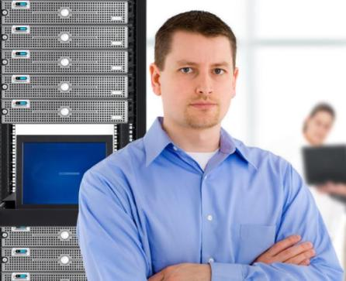
Business Priorities Driving the Need for a New Workspace
Rising Expectations
Market Velocity and Volatility
BYOD
Workspace mobility
Executive mobility
Deploy new workspaces faster
On-board new project teams, partners, and consultants
Protect data (DR) and data usage
Innovation Everywhere
Financial Pressures
Devices (tablets, ultra books, smartphones, etc.)
Apps from a storefront (SaaS, etc.)
Video and collaboration
Workshifting
Reduce cost of migrating to Windows 7
Ensure flexibility without compromising security
Regulation compliance
Notes:
The demanding business environment we discussed on the previous slide is driving the need for a new workspace. To support rising expectations, the new workspace needs to support new styles of working, bring your device, the ability to access the workspace from any type of device, and executive mobility. It needs to allow users to leverage innovation to access their workspace from any device at any location, including applications, content (data), desktops, and collaboration (voice and video) tools. It also needs to support workshifting. It needs to enable the company to deploy new workspaces faster to on-board new project teams, partners, and consultants as quickly as possible, so they can become productive from day one. Finally, any solution should help to reduce the cost and management burden of migrating to Windows 7, and simplify the ongoing and onerous tasks of securing access and data, and ensuring compliance with corporate and governmental regulations.
(SALES TEAMS – Use these slides to generate discussions on what the customer wants to focus on)
------------------------------------------------------------------------------------------------------------------------------------------------------------------------------------------------------------------------
Data Sources:
Rising Expectations (HBR, 9/3/10 "IT in the Age of the Empowered Employee" http://blogs.hbr.org/cs/2010/09/it_in_the_age_of_empowered_employees.html?cm_sp=blog_flyout-_-cs-_-it_in_the_age_of_empowered_employees)
Market Velocity (Deloitte, - BUILDING SUPPLY CHAIN EXCELLENCE IN EMERGING ECONOMIES (http://www.deloitte.com/assets/Dcom-UnitedStates/Local%20Assets/Documents/us_mfg_chapter2_globalization_engelkoudalopt_optimized.pdf)
Innovation Everywhere (Harvard Business Review http://hbswk.hbs.edu/archive/5258.html)
Financial Pressures (AT Kearney (Global Champions 2009) http://www.atkearney.com/images/global/pdf/Global_Champions_2009.pdf) “In fact, of the 2500 companies analyzed, only 42 large and internationally operating companies have managed to show any positive value growth over the 5-year period”
3

Slide 4
The Workspace Market Transition Is Accelerating
The worldwide hosted virtual desktop (HVD) market will accelerate through 2016 to reach
70 million units; 30% of large organizations will deploy HVDs to 20% of their users or more*
In 2011 47% of Enterprises have initiated Desktop Virtualization projects—but only
3% desktop penetration*
7 Billion new wireless devices by 2015
Gartner Hosted Virtual Desktop Installed Base Forecast
Which are important IT initiatives for your organization for the next 12–24 months?
In Millions
23%
Automating IT—Server Virtualization
Private Cloud
24%
Data Center Migration
25%
31%
Data Center Consolidation
Desktop Virtualization
36%
Graphic adaptation created by Cisco based on Gartner data. Source: Gartner, Inc., Forecast: Hosted Virtual Desktops, Worldwide, 2010-2014 (2012 Update)
Source: Enterprise Strategy Group, Dec., 2010
* Gartner Group
Notes:
Point out that analysts and industry specialist agree that the transition of the workspace is accelerating. It’s a very important topic for many organizations.

Slide 5
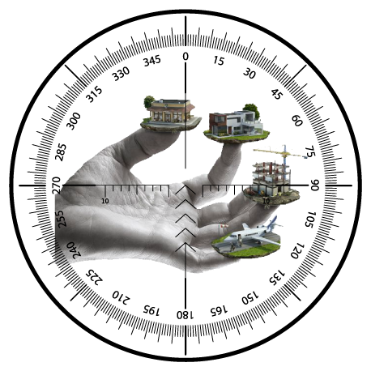

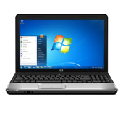



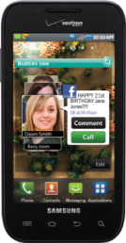
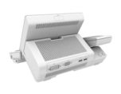






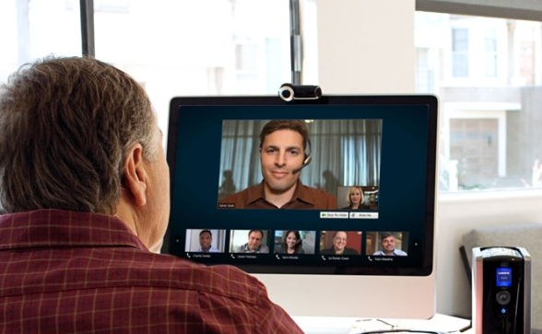
What Is the Vision for the New Virtual Workspace?
Worker
Mobility
Complete
Support for
Any Device
Workspace
Secure Access
to Apps and
Content
Integral Voice
and Video
Notes:
The Cisco and Citrix vision for the new virtual workspace is one that delivers a complete workspace, comprising enterprise, desktop, and web/SaaS applications, as well as content/data, voice, and video collaboration. It should give works mobility with the same experience, regardless of their device or location. It should support any device, whether corporate or bring your own, virtual or native, wired or wireless, and tablet or smartphone. Voice and video should be integrated into the workspace. And finally, it should provide secure access to all of a user’s enterprise applications and content, where stored on premise or in the cloud.

Slide 6

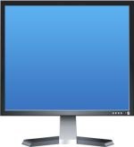

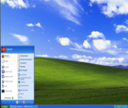
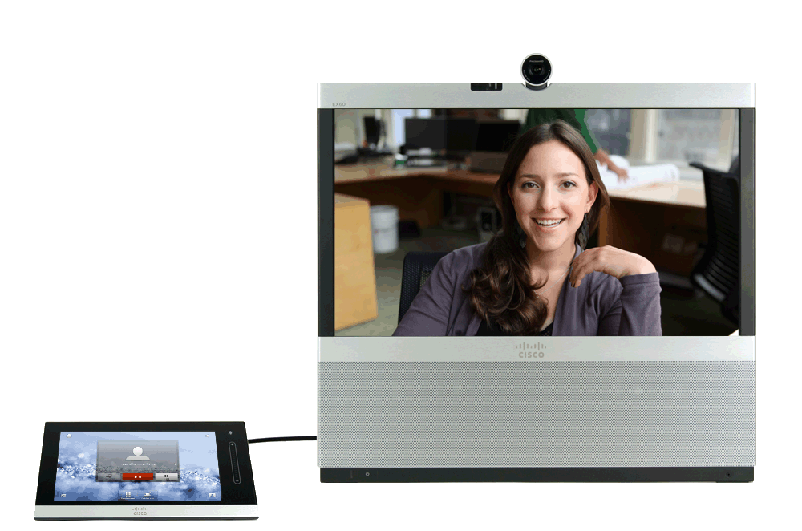
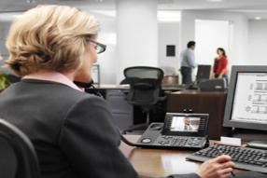
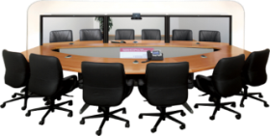
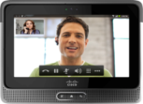
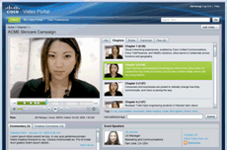
Next Generation Virtual Workspace
Virtual Desktop/Apps
Cisco VXI
Video
Data Center
Virtualization
Voice
Data
App
Virtual
Workspace
Collaboration
Device
Media
Borderless
Networks
Location
Citrix XenDesktop
Notes:
Cisco VXI encompasses the three critical architectures (datacenter, collaboration, & borderless networks) needed to deliver the next-generation workspace, and Citrix XenDesktop runs across these three architectures, making the joint solution an ideal platform for deploying the vision for a next-generation virtual workspace.
Building on an existing partnership, the companies continue to collaborate on development an/or design validation and optimization with Cisco UCS and XenDesktop and Citrix XenServer to further enable the virtual workspace. For example, the companies have already collaborated to optimize Citrix HDX traffic over Cisco WAAS resulting in:
Better end-user experience for real-time multimedia streaming applications
Better IT management, control, and security over the traffic running over the enterprise network
Enable enterprises to run hybrid environments where users can be local or remote, without sacrificing a degradation of service

Slide 7

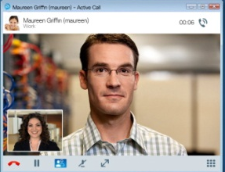
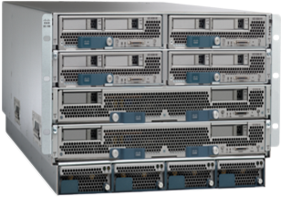





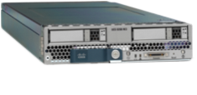

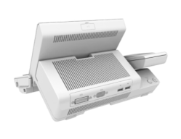

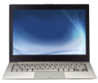




End-to-End Workspace Virtualization Solution
Cisco VXI with Citrix XenDesktop
Cisco Unified Data Center
Cisco Borderless Network
Cisco Collaborative Workspace
Compute-UCS
Campus/Branch
Cisco Jabber
UCS B200 M3
Any device, virtual desktop end-points, UC accessories
Hypervisor
Desktop
Virtualization
Software
Microsoft OS
Citrix
XenServer
Citrix
Receiver
Collaboration
Tools
Citrix XenDesktop Complete End-to-end
Notes:
With Cisco VXI and Citrix XenDesktop, you can build an end-to-end workspace virtualization solution. This slides shows how Cisco VXI provides a unified data center, networks that are borderless, and a collaborative workspace. Citrix XendDesktop spans across the three pillars of the Citrix VXI solution to provide a complete end-to-end solution.
UC Accessories include: Logitech UC Keyboard K725-C with Logitech Mouse M525-C, Logitech Webcam C920-C, Jabra Handset 450 for Cisco, and Jabra Speak 450 for Cisco.

Slide 8













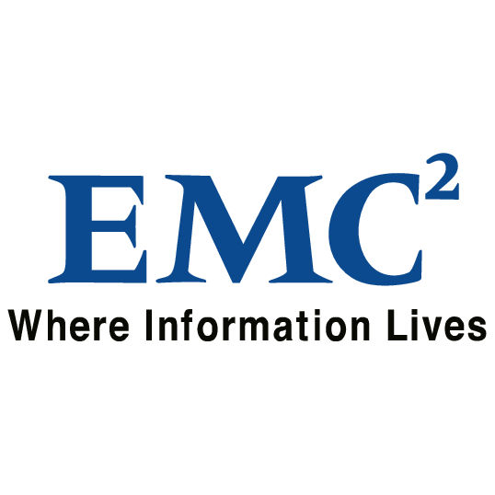
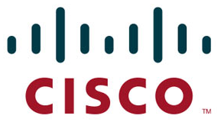
Scalable, Simplified, Secure Data Center
Integrated solution with Cisco Unified
Data Center and Citrix XenDesktop
Simplicity in deployment and expansion
with preconfigured starter kits and
expansion packs
Validated interoperability
Coordinated support
Proven—100+ joint customers with
10s of 1000s of virtual desktops
Cross-industry adoption—healthcare,
financial services, government,
education, etc.
UCS—12000+ customers
Partner Solution Elements
App
App
Data
Desktop O/S
Desktop Virtualization S/W
Citrix XenDesktop
Hypervisor
XenServer / VMware / Hyper-V
Storage
Virtualization
Cisco UCS
Platform
Unified Management
Unified Fabric
Unified
Computing
Cisco Unified Data Center
Virtualized Data Center
Notes:
The Citrix VXI Unified Data Center provides a scalable, simplified, secure data center for the next generation virtual workspace. The integrated solution provides simplicity in deployment and expansion with preconfigured starter kits and expansion packs. Management and deployment are simplified with a single, integrated desktop virtualization and rich media solution that spans from the datacenter, to networking, to the end device, anywhere.
Optimizations and integrations are fully validated and tested by both companies, reducing the integration burden and speeding deployments.
Cisco acts as a first point of contact for technical support across the entire VXI solution set, including Cisco and 3rd-party partner products. Customers can call either Citrix or Cisco and the companies will work to address interoperability issues.
The solution is proven with over 1– joint customers with tens of thousands of virtual desktops that are already running Citrix UCS and Citrix XenDesktop. It’s been adopted across all major industries. And Finally, UCS has over 10,000 customers so the underlying data center is already proven and well accepted in IT departments.
Remove the UCS existing box and replace it with UCS chassis
8

Slide 9
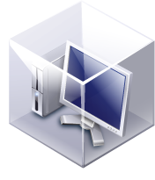
Leading the Industry in Virtual Desktop
Performance and Scale
The Optimized Platform for
Desktop Virtualization
Lower cost for compute + network infrastructure
and tier-0 storage on server
Greater virtual desktop density without performance impact
Simple Operation—start in minutes,
scale in seconds
Massive Scalability—scales easily to
1000’s of desktops per UCS system
Extended memory and I/O to avoid desktop
virtualization bottlenecks
Greater networking visibility and policy-based management for virtual desktops and
application virtualization
Cisco UCS
Memory
I/O
CPU
Unified Fabric (FCoE)
Notes:
Using the Cisco Unified Computing System as the basis for your virtual desktop infrastructure unites computing, networking, virtualization, and storage access using technology innovation to bring ideal platform for desktop virtualization
Specifically, the Cisco UCS costs at least 20% less than competitors due to its radically simplified architecture requiring fewer components .
Supports 60% more virtual desktops without impacting user performance
Is easy to deploy and scale
Massive Scalability – Full system scales to 320 servers x 120 virtual desktops/server = up to 38,400 desktops
Largest and most cost-effective memory footprint for a 2-socket server combined with screaming fast, secured I/O avoiding bottlenecks

Slide 10
Citrix XenDesktop
“Ten Minutes to Xen”
Any device, anywhere with Receiver
HDX™ user experience
Beyond VDI with FlexCast
Citrix
XenDesktop
Access Windows, web, or SaaS apps
Open, scalable, proven
Notes:
Citrix XenDesktop is a desktop virtualization solution that transforms Windows desktops and apps into an on-demand service available to any user, any device, anywhere. XenDesktop quickly and securely delivers any type of virtual desktops, Windows, web, and SaaS applications to PCs, Macs, tablets, smartphones, laptops, and thin clients — all with a high-definition user experience. Citrix FlexCast delivery technology enables IT to go beyond VDI and deliver virtual desktops to any type of user, including task workers, mobile workers, power users, and contractors. XenDesktop also helps IT rapidly adapt to business initiatives, such as offshoring, M&A, and branch expansion by simplifying desktop delivery and enabling user self-service. The open, scalable and proven architecture dramatically simplifies virtual desktop management, support and systems integration, optimizes performance, improves security, and lowers costs. In addition, XenDesktop is now expanded to included support for Cisco Unified Communications / Jabber deployment.

Slide 11
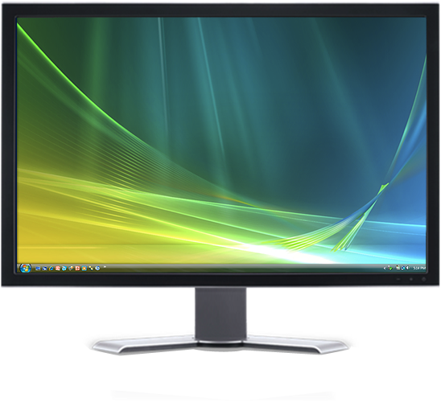


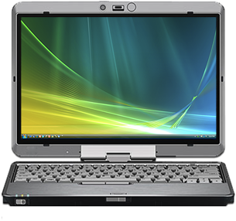
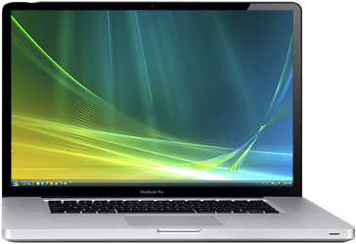
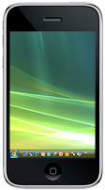
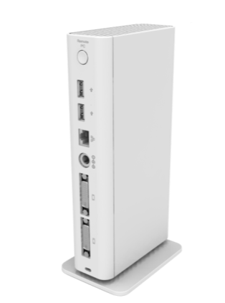


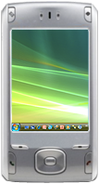

Holistic Desktop Virtualization Solution
App
App
Data
High-Definition
Delivery
Any Device
Optimized Infrastructure
Local Virtual
Machine
Flexibility and
Mobility
Streamed
VHD
High
Performance
Desktop Delivery
Models
Hosted Virtual
Desktop (VDI)
Cost-Effective
Flexibility
Hosted
Shared
Focused
Simplicity
  On-Demand Applications
Notes:
Just as desktop virtualization can provide specific benefits for different industries, HOW you deploy desktop virtualization can maximize your benefits.
When deploying desktop virtualization, it is important to recognize that different users have different desktop needs. For example, highly mobile users, who spend a lot of time out of the office and, possibly off the network, require access to their desktop and applications even when offline. At the same time, you wouldn’t think of giving a call center employee a graphics workstation. It is essential that your desktop virtualization solution has the flexibility to match deployment with user and business needs.
The Cisco Desktop Virtualization solution with Citrix XenDesktop has this flexibility. The solution provides a rock solid infrastructure genetically designed to optimize virtual environments layered with high-definition delivery of desktops and applications to any device, including Cisco UC accessories (Logitech UC Keyboard K725-C with Logitech Mouse M525-C, Logitech Webcam C920-C, Jabra Handset 450 for Cisco, and Jabra Speak 450 for Cisco).
This enables the delivery of desktops, from the central management hub, directly to a mobile user’s desktop, enabling the user mobility while maintaining centralized control, distribution, and management providing increased efficiency and lower costs.
For users who need local computing power for high performance graphics or modelling, streaming the entire desktop environment, operating system, applications, and user settings down to the local workstation provides the high performance the user needs balanced with desktop management simplicity and control.
For users with moderate performance requirements who spend most of their working time online, the desktop can be streamed into a hosted virtual machine, enabling consistent deployment of all desktops and applications across the business.
And for users who have focused application use, such as call centers or nursing stations, you can gain the greatest ROI by deploying hosted shared desktops where the user interface information is sent across the network, simplifying both management and deployment. You may already be familiar with this architecture through previous versions of Citrix Presentation Manager or Citrix XenApp.
Separating out the applications from the desktops then enables centralized management of the applications and enables on-demand access to those applications across the enterprise, regardless of the device.

Slide 12
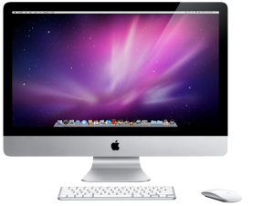
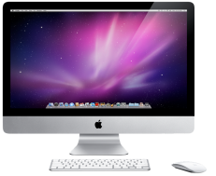
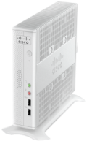
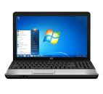



Citrix XenDesktop: Delivery for Every Work Style
Deliver every type of virtual desktop – each specifically tailored to meet the performance, security, and flexibility requirements of any user, enabling work your way
Offline access
to desktops
LAN-based access
to desktops
Online access to desktops from anywhere
Access to
apps from
anywhere
Local device
Office device
Execs, engineers, researchers
Any device
Factory workers, retail clerks, bank tellers, nurses’ stations
Any device, online or offline
Personalized
Basic
Mobile workers w/offline needs
Road warriors
Knowledge workers
Contractors
Shared workstations
Labs, conference, training, classrooms, task workers
On-demand apps
Knowledge workers
Contractors
Knowledge
workers
Task workers,
call centers
Notes:
Types of Access
Offline access to desktops: (Local VM) Local VM desktops extend the benefits of centralized, single-instance management to mobile workers that
need to use their laptops offline. When they are able to connect to a suitable network, changes to the OS, apps and user data are automatically
synchronized with the datacenter. This gives people such as road warriors (sales reps, traveling execs, etc.), knowledge workers, and external contractors
access to their personalized corporate desktops via their high-performance devices when they are not connected to the network.
How it works: A virtual machine is installed to the user’s device for use with or without a network connection. All changes are synchronized when the
user connects back to the network.
Requirements: Capable processing power on user’s device and occasional network connectivity.
LAN-based access to desktops: (Streamed VHD) Streamed VHDs leverage the local processing power of rich clients, while providing centralized single-image management of the desktop.
This approach offers an easy, low-cost way for customers to get started with desktop virtualization by leveraging existing PC resources and keeping datacenter
overhead to a minimum. It can also be ideal for government and university labs that use diskless PCs for maximum data security.
Online access to desktops from anywhere: (Hosted VDI and Shared VDI) Hosted VDI desktops offer a personalized Windows® desktop experience, typically needed by office workers, which can be securely delivered over any network to any device. This option combines the benefits of central management with full user personalization, and can generally support up to 150 desktops per server. Hosted Shared desktops provide a locked down, streamlined and standardized environment with a core set of applications, ideally suited for task workers where personalization is not needed — or allowed. Supporting up to 500 users on a single server, this model offers a significant cost savings
over any other virtual desktop technology.
On-demand apps: Allows any Windows application to be centralized and managed in the datacenter, hosted either on multi-user terminal servers or virtual machines,
and instantly delivered as a service to physical and virtual desktops. Optimized for each user device, network, and location, applications are delivered via a high-speed
protocol for use while connected or streamed via Citrix application virtualization or Microsoft App-V directly to the endpoint for use when offline.
Types of Workers
Road warriors: Road Warriors need access to their virtual desktop from everywhere, regardless of their ability to connect to a network. In addition, these workers expect the ability to personalize their PCs, by installing their own applications and storing their own data, such as photos and music, on these devices. Road warriors are best supported with local VM and on-demand apps.
Knowledge workers: Today's knowledge workers don't just work in their offices all day - they attend meetings, visit branch offices, work from home, and even coffee shops. These anywhere workers expect access to all of their same applications and data wherever they are. Knowledge workers are best supported with Local VM, Hosted VDI, and/or on-demand apps
Task workers: Task Workers perform a set of well-defined tasks. These workers access a small set of applications and have limited requirements from their PCs. However, since these workers are interacting with your customers, partners, and employees, they have access to your most critical data. Task workers can be supported using LAN-based access (streamed), online access (hosted shared), and/or on-demand apps.
Contractors: External contractors are increasingly part of your everyday business. They need access to all of your applications and data, yet you have little control over the devices they use and the locations they work from. Consequently, IT is stuck making trade offs on the cost of providing these workers a device vs. the security risk of allowing them access from their own devices. These workers are best supported by Local VM, Hosted VDI, and/or on-demand apps.
Shared workstations: Maintaining even the most state of the art university and business computer labs, conference rooms or training centers has its challenges. Specifically, the constant requirement to re-provision desktops with the latest operating systems and applications as the needs of the organization change, tops the list. These workers are best supported by streamed, Hosted VDI, and/or on-demand apps.

Slide 13

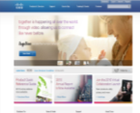
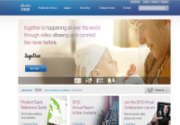





Optimized, Secure, Efficient Network
Optimize network to ease and accelerate enterprise-wide adoption of desktop virtualization
End to end security and policy based
on identity and location
Deliver exceptional performance,
reliability and security
Deliver Rich End-user Virtual Experiences
Hypervisor
Notes:
A major focus for VXI is the user experience. VXI delivers a superior, rich media user experience to a variety of end points.
The ROI advantage is about what happens in the data center and the UCS platform. It’s about how many users to put on a blade. The VXI solution allows customers to get much more density on those blades. From an ROI perspective, that’s a huge plus.
VXI provides a fully integrated solution in that it goes across the data center, the network, the virtualized end points and includes third-party technology. It’s all tested in RTP, generating a set of thoroughly tested and validated CVDs.

Slide 14
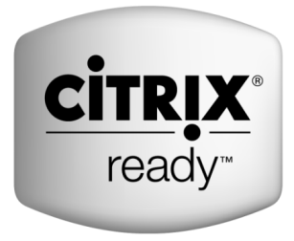
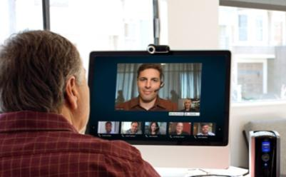
Cisco WAAS Optimized for XenDesktop
High Quality
User Experience
Jointly Supported
High performance
over Cisco networks
  First third-party networking vendor to optimize HDX traffic
  Fully supported by Citrix
  Easy automated deployment
  Transparent interoperability
  LAN-like experience
  Improved application performance
  HD-quality video
  Faster print jobs
  Single solution for virtual
  and physical desktops
Cisco WAAS Now Optimized for Citrix XenDesktop
Notes:
The first product from the collaboration is the next version of Cisco Wide Area Application Services (WAAS) with the goal of improving application performance running on a virtual desktop over the WAN. Cisco WAAS 4.5.1 is verified Citrix Ready and fully supported. Citrix HDX traffic is optimized on Cisco WAAS, whether voice and video, and/or data and applications. You can apply Quality of Service (QoS) to the HDX traffic, resulting in:
Better end-user experience for real-time multimedia streaming applications
Better IT management, control, and security over the traffic running over the enterprise network
Enable enterprises to run hybrid environments where users can be local or remote, without sacrificing a degradation of service

Slide 15
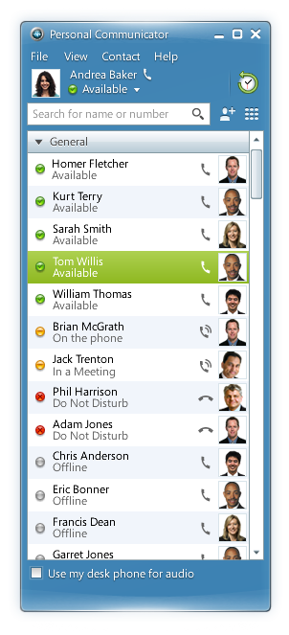
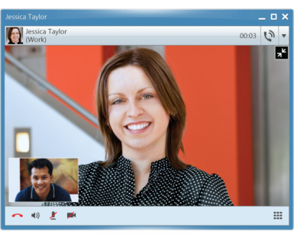
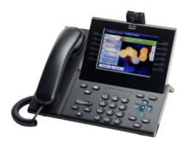
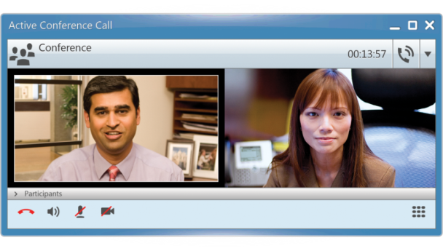
Business Quality Collaborative Workspace
Citrix Receiver
Leverage the latest devices with
a universal client
Enable end-user flexibility, choice
and productivity
Cisco Unified Communications
Simple, intuitive, integrated user experience
Voice soft phone or desk phone control
Video- and audio-rich experience—secure high definition
Interoperate with Cisco TelePresence, IP Video Phones, 3rd-party video solutions
Cisco Jabber—messaging, sharing, conferencing
Notes:
Citrix Receiver is a universal client technology that enables IT to deliver virtual desktops, Windows, web and SaaS applications and content as an on-demand service to any user or device. With Citrix Receiver IT has complete control over security, performance, and user experience, with no need to own or manage the physical device or its location. With Citrix Receiver, end users can quickly and easily get access to Enterprise applications and data to remain productive while enjoying the flexibility in choosing their device and where and when to work.
The Cisco UC Application solution provides anywhere access to business-class IP telephony and video using simple, intuitive, integrated UC accessories to provide an exceptional user experience. (Logitech UC Keyboard K725-C with Logitech Mouse M525-C, Logitech Webcam C920-C, Jabra Handset 450 for Cisco, and Jabra Speak 450 for Cisco.)
The solution is deployed with the market-leading Cisco Unified Communications Manager call control solution and the integrated softphone includes wide-band and high-fidelity audio so you get clear, reliable and high quality communications. The soft phone is integrated with your contact list you can simply click on a contact name or from an IM to launch a call. You receive pop-up notifications of incoming calls so you can see who is calling and choose to accept the call or divert it to voicemail with a simple mouse click. You can also access “phone-like” features, such as transfer, hold, mute and conference and move calls to your mobile device. Contact cards provide additional contact information and multiple options for initiating communications.
The client includes a standards-based high-definition video (720p) client, and desk phone control features. These features mean that high-quality and high-availability audio and video telephony are available at all locations and to users' desk phones, soft clients, and mobile devices. Cisco Unified Personal Communicator makes audio and video communications a simple click away. Because the solution uses industry standards you can connect directly (no expensive gateway required) to industry standards audio and video endpoints, including Cisco TelePresence and solutions from third-parties. Interactive face-to-face communications enhances productivity and the quality of communications, streamlines business decision making, and improves teamwork. By reducing the need for in-person meetings, videoconferencing also enables companies to save money on travel expenses and time associated with traveling to meetings.
Cisco Unified Personal Communicator is integrated with Cisco conferencing solutions, such as Cisco WebEx and Cisco Unified MeetingPlace solutions, so you can instantly share documents and expand chats and conversations to multiparty audio, web, and video conferences
Visual voicemail lets you view and listen to voice messages quickly and easily.
With Cisco Unified Personal Communicator, your communication and collaboration tools are always available from anywhere you work, enabling smarter, more-effective communications.
In addition, Cisco Virtualization Experience Media Engine (VXME) enables Jabber to run in virtualized environments. It provides secure high definition audio and video via local media processing as well as quality of services (QoS) for voice/video media. It is also MediaNet compatible. It is integrated with Unified Communications accessories and is supported with Citrix XenDesktop and Citrix XenApp for Published Desktops.

Slide 16


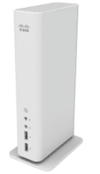
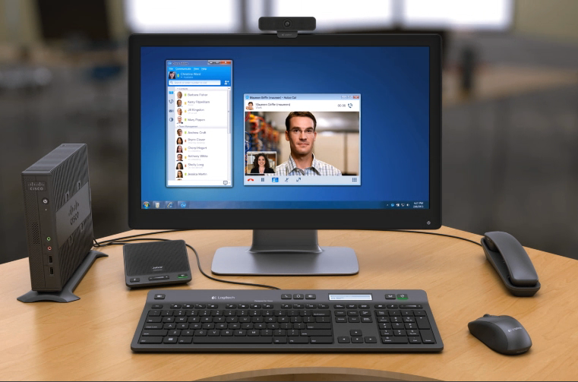
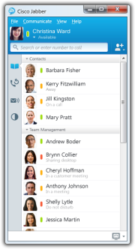
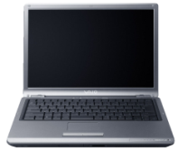
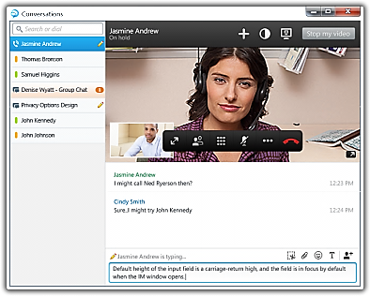


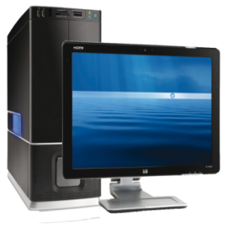
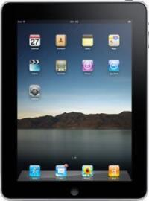
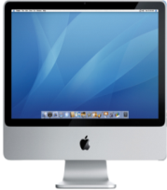
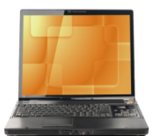




Any Device, Anywhere, Fixed and Mobile
Corporate Owned
Citrix
Receiver
Leverage the latest devices with a universal client
Enable end-user flexibility, choice and productivity
    Simple, fast, self-service installation and auto-updates
    Support for 1B+ mobile devices
Zero Clients
Zero & Thin Clients
UC Accessories
Software Appliance
BYoD
PCs and Macs
Smartphones
Tablets
Notes:
Any device, anywhere with Receiver. Today’s digital workforce demands the flexibility to work from anywhere at any time using any device they’d like. Leveraging Citrix Receiver as a lightweight universal client, XenDesktop users can access their desktop and corporate applications from the latest tablets, smartphones, PCs, Macs, or thin client. This enables virtual workstyles, business continuity and user mobility.
XenDesktop 5 includes new Citrix Receivers for all the latest tablets, smartphones, Macs and thin clients.
We are shipping VXC 2100 and 2200. And in Q4 of 2011, we also added to the VXC portfolio with the new VXC 6215 thin client and the VXC 4000 software appliance.
New in 2013 are the UC Accessories, including: : Logitech UC Keyboard K725-C with Logitech Mouse M525-C, Logitech Webcam C920-C, Jabra Handset 450 for Cisco, and Jabra Speak 450 for Cisco.

Slide 17


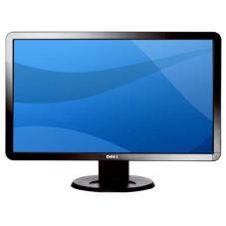
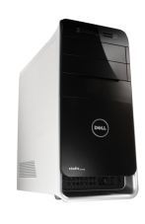




Better for Business
Greater Agility and Productivity
Quickly Deploy New Services,
Apps, Policies World-wide
Access all resources/data
from anywhere, any device
Mobile, Interactive
Productive Workforce
Lower hardware and operating costs
  More virtual desktops/server, reduced desktop cost, streamlined management, better resource management, environmental savings
Minimized Risk and IP Protection
Compliance control
corporate security policies
Notes:
Greater agility and productivity
Agility. Empowering users to become more productive and IT to become more response to changing demands gives the business greater ability to adapt to fluctuating business requirements and increased competition. Centralized control enables more automated change management, resulting in reduced downtime and faster time to deployment for new applications, features, and security policies. Rapid provisioning of IT services and underlying infrastructure increases business agility.
Productivity. Desktop virtualization enables all types of users across the enterprise to access corporate applications, collaborations tools, and compute resources from any device, anywhere, thus creating a more mobile, flexible, interactive, and productive workforce. Simplified management increase desktop administrator, IT, and help desk efficiency and productivity.
Lower hardware costs. Deploying and/or upgrading Cisco infrastructure to be HDX-aware allows enterprise IT to deliver against today’s traditional needs with assurance that as departments move to desktop virtualization the existing network infrastructure can support both environments. This provides investment protection and reduces operating costs.
Lower operating costs
More virtual desktops per server. The joint solution costs at least 20% less than competitors due in part to its radically simplified infrastructure architecture, which requires fewer components. The Cisco USC architecture in Cisco VXI supports 60% more virtual desktops without impacting user performance. Upfront infrastructure and licensing costs typically extend ROI to three or four years with other solutions. Because more desktops can be hosted per system, time to ROI can be dramatically reduced.
Reduce physical desktop costs. Centralizing compute services reduces the high CPU needs for desktops and laptops for all employees. Simple desktop monitors and keyboards, as well as other endpoint devices, reduce procurement costs. PC refresh can be avoided or significantly delayed by turning old PCs into thin clients, particularly for hardware that can’t support new applications. This enables IT to deliver performance and predictability on existing hardware platforms.
Streamlined desktop management. Centralized, single image management dramatically reduces desktop operations, helpdesk calls, and downtime.
Better resource utilization. Networking optimization enables better network utilization, and thus more users and higher-quality experience on existing network infrastructure. Single instance desktop images reduce storage and storage management requirements.
Environmental savings. Desktop virtualization enables teleworking, desk-sharing, and other alternative workplace strategies to reduce office-related expenses workplace space/power/cooling requirements. An added benefit is better environmental stewardship as a result of reduced commuter emissions. Fewer servers lead to reduced power and cooling requirements.
Protect intellectual property and minimize risk
Corporate security policies. Extend corporate security policies to virtual environments with comprehensive security access control and auditing capabilities.
Compliance control. Because all desktops are centrally managed, it is easier to ensure compliance of corporate, industry, and governmental regulations and policies. Desktops are provisioned consistently using pre-defined templates. Monitor, log, and report on user activity to ensure corporate and regulatory compliance requirements are met. Changes can be replicated to desktop templates and be immediately implemented

Slide 18






Better for People
Work and collaborate from anywhere, On any device
Mobile
Remote
Office
Guest
Task
Self-service Catalog of Desktops, Apps, Collaboration Tools, Services Tailored to Role
High-definition experience
  Always on, desktop-like performance
  Seamless use of local resources
Notes:
Work and collaborate from anywhere
Any device. Over a billion consumer devices across the globe, including Cisco endpoints, can access secure desktops and Windows, web, or SaaS apps through Citrix Receiver, enabling new levels of virtual work styles, business continuity, and user mobility.
Anywhere. Users of any type (employees, contractors, and partners) can access their corporate desktop services regardless of their location.
Follow-me services. Desktops, applications, data, and meetings follow the user, where ever they are, on any device.
Integrated communications and collaboration. Communications and collaboration are integrated with the virtual desktop to deliver a rich voice and video collaborative experience.
Connect to virtual desktop and cloud services
On-demand access. Instant and seamless access experience to desktop, applications, collaboration tools, and data, regardless of device or location.
For everyone. Desktop services and experience tailored to the user’s role and relationship to the company.
Self-service. Fast and intuitive self-service access to a full catalog of desktops, applications, and user support services from a personalized enterprise storefront. Users can easily view, subscribe, or request access, which automatically initiates the appropriate workflows to grant the right access, when and where they need it.
Connect with confidence. Desktop and cloud services over a Cisco HDX-aware network help ensure the highest performance by leveraging networks built by an industry leader.
High-definition user experience
Consistent performance. Consistent, corporate desktop-like performance on any device, anywhere, at any time, over a Cisco HDX-aware network.
Always on. Desktop services and data are always available, even after a dropped connection or device failure.
Offline support. Ability to work offline, with automatic synch back to the datacenter.
Seamless use of local resources. Seamless plug-n-play support for USB peripherals, multiple monitors, USB headsets, webcams, smartphones, smartcards, scanners, and printers with the virtual desktop.

Slide 19




Better for IT
End-to-end validated, tested solution
  Simplifies deployment and lowers risk
Scalable, modular, open infrastructure
  60% more desktops per server
Solution level support
  Improved SLAs and faster problem resolution
Simplified, centralized infrastructure, desktop, and application management
  Rapid provisioning, simplified help desk, better control
Secure by design
  Centralized, protected data, granular access policies,
  secure remote access
Notes:
Validated, tested, and supported solution
Integrated solution. Management and deployment are simplified with a single, integrated desktop virtualization and rich media solution that spans from the datacenter, to networking, to the end device, anywhere.
Tested and validated. Optimizations and integrations are fully validated and tested by both companies, reducing the integration burden and speeding deployments.
Support services. Cisco acts as a first point of contact for technical support across the entire VXI solution set, including Cisco and 3rd-party partner products. Customers can call either Citrix or Cisco and the companies will work to address interoperability issues.
Joint roadmap and on-going innovation. Over time, Cisco and Citrix will add product enhancements and increase product line capabilities, based on a joint roadmap designed to deliver a superior user experience and on-going value to the business.
Scalable infrastructure
Balanced for scalability. The Cisco UCS system balances and optimizes memory, I/O, and CPU, enabling customers to deploy more desktops per server and scale performance linearly, with a full system scaling to support 10s of thousands of virtual desktops. Extended memory and I/O help to provide additional performance and the network can be configured to provide bandwidth on demand.
Extensible. An extensible end-to-end architecture supports all user profiles and use cases and scales from 100s to 10,000s of users.
Modular. A modular approach enables customers to build the solution incrementally. Scalable starter and expansion packs are optimized and make it easier to get started or expand and help take the risk out of deployment.
Open. The solution is open and works with leading storage solutions, hypervisors, value-added solutions, and external cloud services. In addition, Cisco and Citrix are both leading development of emerging cloud technology as members of the OpenStack community.
Simplified management
Infrastructure management. Built from the ground up to support virtualization, Cisco UCS Manager provides unified, centralized, embedded management of all software and hardware components across multiple chassis and thousands of virtual machines. Industry-leading management tools as well as Microsoft App-V and Microsoft System Center can be integrated to automate and simplify infrastructure management.
Centralized desktop management. Desktops and applications are centrally and virtually managed, providing better control over licenses, application and OS updates and rollouts, and application usage. Devices, OS, applications and user personalization can be separated and maintained as single master images, and then managed from the datacenter, dramatically reducing on-going maintenance efforts and datacenter storage requirements. The infrastructure is automatically optimized to dynamically balance performance, security, endpoint flexibility, and network conditions based on the device, network, user, and security profile. Helpdesk staff can access a single console to monitor, troubleshoot, and fix issues for 1,000 users as easily as for one.
Rapid provisioning. Infrastructure resources can be quickly provisioned to support increases in demand, thus providing a better user experience and business flexibility. Rapidly provision server, storage, network, and desktop resources for simple and reliable deployment.
Secure by design
Centralized, protected data. User data can be more easily and cost-effectively protected from loss, corruption, and theft. All data is centrally located, making it possible to perform full data backups, periodic snapshots, etc. Data is no longer sitting on unprotected desktops or roaming on laptops in public spaces. Any data that does sit on endpoint can be automatically saved in an encrypted folder that is protected at all times from unauthorized users. By centralizing the server, applications, and storage, all data is kept safe within the datacenter, making it easier to detect and isolate threats or malware.
Granular access policies. Extensive role-based access control enables granular control and enforcement to ensure that intellectual property and privacy are protected. IT has a single point of control for access to any Windows, web, and SaaS application, desktop, or IT resource. End points are centrally controlled by IT. All data is encrypted and tunneled through a secure network and firewall, enabling IT to restrict access and use.
Single sign-on. SSL VPN appliances offer a single point of secure remote access with single sign-on capabilities to minimize the number of authentication prompts and enable easy navigation to key resources.

Slide 20




Addressing Requirements of the Virtual Workspace
Financial Services
Healthcare
Education
Government
Horizontal: Windows 7 upgrades, mobility, BYOD, hot-desking
Virtual
Classrooms
Productive
Teleworking
Immediate Access
to New Services
Seamless, Station-to
Station Roaming
All Workgroup Profiles: Task, Knowledge, Remote, and Mobile Workers
Notes:
Cisco VXI and Citrix XenDesktop address the requirements of the virtual workspace across industries. For example, in financial services, the solution provides immediate access to new services for faster time to market. For healthcare it provides seamless station-to-station roaming to increase productivity and care. For Education it enables virtual classrooms. And for government it enables productive teleworking. Across all industries, the solution helps ease the effort of Windows 7 upgrades, increases mobility, enables users to use their BYOD devices, and enables hot-desking. The solution also supports all workgroup profiles from task to knowledge and remote and mobile workers.

Slide 21

Geometric Limited (Software Developer)
CHALLENGE
Support telecommuting and use of consumer devices and 3D graphics in workforce
Reduce security threat and time spent on management
SOLUTION
  Cisco VXI and Citrix XenDesktop with NetApp
IMPACT
  Geometric employees can access their server-hosted virtual desktop from anywhere and from a broad range of devices, with the cloud infrastructure also helping to drive business productivity and reduced operating costs
  Centralized desktop management reduces security threat and
  time to manage
  Dramatically reduced cost
Notes:
21
Geometric Limited (BSE: 532312, NSE: GEOMETRIC) is a leader in Product Lifecycle Management (PLM), Engineering Services and Offshore Product Development (OPD) solutions and technologies.
Challenge: Adopt a cloud infrastructure to drive higher business productivity, support telecommuting and consumer devices with 3D graphics, and reduce security threat and time spent on management.
Solution: Based on NetApp unified storage, Cisco Unified Computing System, and Citrix XenDesktop theVXI architecture offers templates for easy deployment, a starter kit for the first 300 desktops, and plug-and-play expansion packs to scale to tens of thousands of additional users.
Impact: The deployment allows Geometric employees to access their server-hosted virtual desktop from anywhere and from a broad range of devices, with the cloud infrastructure also helping to drive business productivity and reduced operating costs.
By adopting the VXI solution the company has been able to centralize desktop management and as a result not only reduce the security threat but also reduce the time spent on management (for tasks like installation restoration of OS and other applications).
Cost efficiencies are expected to increase further by enabling longer desktop refresh cycles, resulting in greater opportunity to enable highly secure remote working, telecommuting and use of consumer computing devices. Geometric is looking to provide end users access to their Virtual Desktops from their own devices or from their homes in the future, and is working towards deploying a Virtual desktop solution for 3D Graphics applications.
A cost reduction of Rs. 1.2 million (approx. USD 27000) is anticipated with the deployment of 600 desktops. Geometric has already achieved significant benefits by an initial deployment of 250 desktops, which will further improve with scale.

Slide 22

Seattle Children’s Hospital
CHALLENGE
  Enable healthcare providers to focus on patients, not technology
  Thousands of instances of hundred of applications to manage
SOLUTION
  Cisco VXI and Citrix XenDesktop
IMPACT
  Increases prep time and time with patients
  Increases IT efficiency and effectives
  Reduces capital and operating expenses
Notes:
Founded in 1907, Seattle Children’s Hospital is one of the nation’s top children’s hospitals. In addition to providing outstanding patient care, the hospital conducts leading-edge pediatric research and serves as an educational resource for patients, families and healthcare professionals.
As a world-class healthcare organization, Seattle Children’s Hospital makes extensive technology resources available to its staff, from electronic medical records to databases of clinical information to real-time patient monitoring systems. In the past, however, healthcare professionals were constrained in their ability to put these resources to work for their patients. “Our doctors and nurses were spending too much of their time interacting with technology rather than patients,” says Jake Hughes, Chief Technical Architect for Infrastructure Systems at Seattle Children’s Hospital. As practitioners moved from offices to team rooms to patient bedsides to shared computers-on-wheels, differences in configuration among the 4,000 – 5,000 workstations in the organization made for an unfamiliar and unpredictable computing experience. With no mobile computing capability, doctors were unable to make effective use of mobile devices or respond remotely to patient needs. IT support was also a constant challenge, with thousands of instances of each of hundreds of applications to manage and troubleshoot; Hughes’ team spent an estimated 90 percent of its time dealing with repetitive issues and errors in the workstation environment.
With Citrix desktop virtualization, practitioners now use single sign-on to log into their desktop and applications on a zero client in a matter of seconds, then spend the rest of their preparation time discussing the patient they are about to see. Once in the clinic room, they can log into the exact same desktop state they’d just left, with the full information and patient context already displayed, in 10-15 seconds. They can begin interacting immediately, including showing the family diagnostic and informational images right on the screen—something they might previously have skipped due to time constraints.
Centralization and single-image management are bringing unprecedented simplicity and consistency to Children’s workstation environment. They can provision applications and complete desktops for new users in a matter of minutes, and log into the same familiar environment—including their own personalizations—no matter which machine they use. Updates are made to a single gold master, which becomes available to users on their next log-in.
Desktop virtualization has helped Seattle Children’s Hospital control IT costs by greatly reducing the number of trouble tickets to be responded to each day. This is complemented by the savings made possible by replacing a workstation environment with a three-year replacement cycle with a less expensive zero client with a 10-year replacement cycle. Taking into account the consolidation of resources from the workstation space into the datacenter, even after our investment in new storage, servers and infrastructure, we estimate roughly $1,000,000 in return on investment within a 4 – 5 year period.

Slide 23

University of Tennessee
CHALLENGE
  Transform computing environment into a flexible service to meets students’ work styles
  Easily support new applications every semester
  Support increasing data and information generated by UT and students
SOLUTION
  Cisco VXI and Citrix XenDesktop with NetApp Unified Storage Architecture
IMPACT
  Anytime access to virtual desktops, apps, personal files, network resources for over 27,000 students and staff on university-owned and personal devices
  Students’ educational experience is improved so they can make more efficient use of their time, giving UT a competitive edge when attracting students
  Reduced cost of software/hardware refreshes, security
  patches; increased energy savings
  Eventually phase out some computer labs
Notes:
Challenges: transform its computing environment into a flexible service that meets students’ personal work styles, providing access to their data and applications whenever and wherever they work. At the same time, easily support the new applications and desktop images required every semester. Give all university students the high degree of flexibility and availability they have come to expect from technology today. The explosion of new technologies that are being leveraged in the classroom is resulting in a significant increase in the amount of data and information that schools like the University of Tennessee at Knoxville need to store and manage.
Solution: Apps@UT is built on integrated solutions from Citrix, NetApp and Cisco, providing a flexible infrastructure that is validated and optimized to work together. the university is building its Citrix XenDesktop infrastructure on the Cisco Unified Computing System™ (Cisco UCS™) blade server platform. Cisco UCS offers a compelling mix of performance, scalability and decreased datacenter footprint, which reinforces the energy-saving aspect of Apps@UT. Technology partners Cisco and Citrix have jointly published validated design guidance that leverages the tight integration between their respective technologies and helps accelerate UT Knoxville’s time to deployment. Additionally with the Cisco UCS service profiles, UT Knoxville can quickly scale out additional virtual desktops for new students and faculty each year that are optimized to the type of usage and security they require. Additionally, the high-availability features inherent in the NetApp platform deliver 24x7 access to desktops and automatically backup student data.
Impact: By implementing Citrix® XenDesktop® that runs on a Cisco and NetApp® infrastructure to deliver full Windows® desktops and applications as an on-demand service, Apps@UT will give UT Knoxville’s more than 27,000 students and staff anytime access to virtual desktops, applications, personal files and network resources. By improving students’ educational experience and helping them make more efficient use of their time, the Apps@UT virtualized solutions will give the university a competitive advantage in attracting students to its campus,
By leveraging Citrix virtual solutions for on-demand access to data and applications, the University of Tennessee at Knoxville will enhance students’ learning environment and reduce their financial burden. UT Knoxville has transformed its computing environment into a flexible service that meets students’ personal work styles, providing access to their data and applications whenever and wherever they work. At the same time, the university can expect to save time and money as this virtual environment easily supports the new applications and desktop images required every semester.
The Citrix suite of virtual computing solutions is expected to save the university time and resources by enabling easy, centralized management of desktops and applications. This implementation will also reduce the cost of software refreshes, security patches, and other maintenance. In addition, as older PCs in the university labs are phased out and replaced by thin clients under the Apps@UT program, the university will generate energy savings and reduce both the frequency and cost of hardware refreshes.
By taking advantage of the 60 percent greater virtual desktop density provided by memory-extension technology in the Cisco Unified Computing platform, education organizations can scale to deliver high performance virtual desktops more easily to more students and faculty each year.” Ultimately, the Apps@UT program will enable the university to phase out some of its computer labs as more students and staff rely on remote access for their computing and storage needs.

Slide 24

The New Virtual Workspace
High Quality User Experience on
Any Device
Address Rising Expectations and Leverage Innovation
Scalable, Secure, Manageable Infrastructure
Keep Pace with Market
Velocity and Volatility
Greater Agility,
Lower TCO
and Risk
Reduce Financial Pressures
Notes:
In summary, Cisco VXI and Citrix XenDesktop offer a solution that eases adoption of desktop virtualization and the new virtual workspace while also delivering performance, reliability, and security. The solution makes yesterday’s exceptions today’s assumptions by providing a high-quality user experience on any device, making it better for users of any type in your organization. It provides the scalability, security, and manageable infrastructure to make it easier and better for IT to support the virtual workspace, as well as changes to the business as a result of market velocity and volatility. And by providing greater agility, the ability to attract, retain, and make employees more productive, and lowering TCO and risk, the solution is better for business as a whole. While both companies are leaders in their markets, when providing for the new virtualized workspace, they are truly, better together.

Slide 25

What do I do Next?
Let’s show you what the new virtual workspace looks like with a demo
Let’s sit together and consider the roadmap to get you there in a
two-hour assessment
Let's build something onsite that reflects your environment and begin the journey with a POC or pilot
Notes:
Other tools:
Learn more about how Citrix XenDesktop can help you support different types of workers at Flexcast.citrix.com
Learn how to accelerate your desktop transformation with the Citrix Desktop Transformation Accelerator.
Citrix Desktop Transformation Accelerator is a FREE, interactive XenDesktop assessment, design and deployment tool from the experts. Based on the industry-proven Desktop Transformation Model and real-world XenDesktop projects, it simplifies your desktop virtualization planning and installation with tools, decision checklists, best practices, peer benchmarks, documentation and how-to videos - all organized in a no-nonsense, step-by-step way. Perfect for IT managers, architects and administrators who are preparing to install XenDesktop, the Desktop Transformation Accelerator ensures you get value quickly from your XenDesktop purchase.
http://www.citrix.com/successaccelerator/?utm_source=citrixdotcom-xendesktop&utm_medium=web&utm_campaign=citrixdotcom-xendesktop-resources-link-20111013-sacc-xd
Calculate server TCO with the Cisco UCS TCO-ROI Advisor:
https://express.salire.com/Modules/Analyses/Edit/config.aspx
Download the Cisco Virtualization Experience Infrastructure CVD for Citrix :
Cisco Validated Design: http://www.cisco.com/en/US/docs/solutions/Enterprise/Data_Center/VXI/CVD/VXI_CVD_Citrix.html
This Cisco Validated Design Guide provides design considerations and guidelines for deploying an end-to-end Cisco® Virtualization Experience Infrastructure (Cisco VXI). This guide is intended for use by network engineers and architects considering the implementation of the Cisco Virtualization Experience Infrastructure system using Citrix XenDesktop system and XenApp.

Slide 26

We Can Help You Transition
Desktop/Datacenter Transformation Model Planner
2-hour presentation on solution and benefits
of joint solution
Desktop/Datacenter Transformation Discovery Session
Define Needs
Identify Strategies
Develop Roadmap
½ day technical workshop
What do you need your client services and datacenter environment
to deliver?
Best practice design, deployment, operating strategies
  Prioritized recommendations mapped to your key business objective to drive success within your organization
Notes:
We can help you transition with a 2-hour deep dive presentation followed by a ½ technical workshop to help define your needs, identify strategies, and develop a roadmap.

Slide 27





Take the Risk Out of Getting Started
Scalable Starter Pack and Expansion Packs
Starter pack supports more than 300 virtual desktops
A single Cisco Unified Computing System instance is designed to support 320 blade servers
Scale from PoC to support 1000’s of virtual desktops
Makes it easy to get started
Cisco UCS
Base Pack
for Desktop
Virtualization
Cisco UCS Expansion Pack for Hosted Shared Desktops
Cisco UCS Expansion Pack for Hosted VDI Desktops
Notes:
With scalable starter packs and expansion packs, you take the risk out of getting started. The starter pack supports more than 300 virtual desktops. A single UCS instance can support up to 320 blade servers, enabling you to start with a proof of concept and easily scale to thousands of virtual desktops.
Note for speaker: Citrix names are changing to Shared Desktops and Personal Desktops

Slide 28


Find Us on the Web
www.cisco.com/go/citrix
www.citrix.com/cisco

Slide 29
Additional Resources
Contact Us:
Cisco sales rep: [name, contact]
Citrix sales rep: [name, contact]
Find a Citrix partner: www.citrix.com/partners/locator
Find a Cisco partner: www.cisco.com/web/partners
Citrix and Cisco Alliance: www.citrix.com/cisco
Citrix XenDesktop: www.citrix.com/xendesktop
Cisco and Citrix Alliance: http://www.cisco.com/en/US/netsol/ns1099/index.html

Slide 30
Thank you

