Slide 1
How to Use This Deck…
Remove Prior to Presenting
Abstract: This deck provides a framework for discussing the VXI Smart Solution with customers and position Cisco as their vendor of choice
Audience: Senior IT decision makers (Data Center, Collaboration and Networking)
Sales Stage: Identify and Early Qualify
Note: In most cases customers have already decided to pilot or explore Desktop and/or Application Virtualization solutions; therefore, the objective would not be to reiterate in detail to the audience what Desktop and Application Virtualization are and how to leverage these technologies in their environment. The objective is to position Cisco VXI as a well differentiated solution that customers would want to explore further.
Please feel free to customize the deck, based on customer-specific interests, industry and deployment requirements.
Get the latest version of the presentation: www.cisco.com/go/partnervxi.

Slide 2
Cisco Virtualization Experience Infrastructure (VXI) Smart Solution
Virtual Desktops, Applications, and Collaboration
Presenter’s Name
Presenter’s Title
January 2013

Slide 3
Cisco VXI Smart Solution
Agenda
Next-Generation Workspaces and Cisco Unified Workspace Strategy
Desktop and Application Virtualization Overview
Cisco VXI Smart Solution
Desktop and Application Virtualization Top Challenges
Customer Success Stories
Summary and Next Steps
Notes:
The storyline is relatively simple. We first introduce the cisco unified workspace as the overarching strategy to meet the needs of current and future workspaces. We then outline how desktop virtualization and therefore VXI fit in that context, based on business drivers, benefits and outcomes.
We then discuss Next-Generation Workspaces and Cisco’s Unified Workspace Strategy
Desktop and Application Virtualization Overview
Market Adoption, Business Drivers and Expected Benefits
Customer Use Cases
Cisco VXI Smart Solution
Value Proposition and Tangible Business Outcomes
Core Elements of the Architecture
Desktop and Application Virtualization Top Challenges
Technical and Business Considerations
The Cisco VXI Advantage: Portfolio Elements in Context
Continuing to Evolve our Solution Strategy
Customer Success Stories
Summary and Next Steps

Slide 4
Next Generation Workspaces
Business Environment
Mobility
Workplace
Factors
Security
Access
Costs
Lines of Business
Users
I.T.
STRATEGIC FORCES
TACTICAL IMPERATIVES
MULTIPLE STAKEHOLDERS AND ROLES
The Modern Workspace Needs to Change to Support New Work-Styles,
Multiple Devices, Greater Mobility and Business Agility
Notes:
Key Message: The modern workspace is changing rapidly, bringing opportunities for end users, IT, and organizations that embrace and manage these changes. As a provider of IT services, the challenge is to provide the ‘right’ set of workspaces that suit your specific organization ..’ … that requires an ongoing ‘balancing act’. When it comes to workspaces, you may be thinking about strategic forces, shorter term priorities and a multitude of diverse organizational perspectives and needs based on your specific role within the organization.
The modern workspace is changing rapidly, bringing opportunities for end users, IT, and organizations that embrace and manage these changes. The workspace is arguably a (col)laboratory of innovation and one of the single most important and at times perhaps undervalued assets in your company.
The workspace used to rely on a single device per user model – fixed or mobile - Desktop, applications, and data stay with the device. More mobility, non-traditional work hours, and new access devices (smart phones, tablets, personal laptops) offer productivity benefits, but also security and control challenges for IT. And the workspace is more than just a PC and a phone – it is collaboration, video, and social. Users need and want any time, anywhere, from any device access. IT needs to improve control and security while enabling business agility.
A new approach to the workspace is required
As a provider of IT services, the challenge is to provide the ‘right’ set of workspaces that suit your specific organization ..’ … that requires an ongoing ‘balancing act’.
You may be thinking … about the (a) workspace strategy, (b) the shorter term priorities and a (c) multitude of diverse organizational perspectives and needs based on your role within the IT organization.
Multiple forces are shaping the workspace strategy
The type and location of work is changing (Virtual versus physical, deskbound versus mobility requirements, flexible, innovation centric, collaborative, visual, social, distributed and ‘always on’)
Industry requirements (the pace of regulation has yet to slow down, intrinsic industry challenges, market dynamics etc..)
LOB priorities (growth, risk, cost, productivity, specific requirements etc..)
IT trends (Consumerization of IT, Cloud, Social, Mobility, Data and Application deluge, Desktop Virtualization, BYOD, Mobility, Wireless, etc..)
And .. let’s not forget the status quo and current infrastructure …
Keep IT running without a glitch 24*7*365
Security, performance, availability, budget pressures etc
And the perspective re: workspace needs does change depending on the stakeholder (IT, LOB, Employees/Users) and their role (e.g., CIO versus IT Operations)

Slide 5
The Cisco Unified Workspace
A Balancing Act, Your Way
  Business Priorities…
  Growth
  Agility
  Risk Management
  IT Priorities…
  Business Enablement
  Security
  TCO Reduction
  User Priorities…
  Anywhere, Any Device
  Full Functionality
  Collaborative, Modern
  Workspaces
IT
Workspace That Is
Secure and Managed
Cisco
Unified
Workspace
Business
  Workspace as a Business Asset
Users
  Workspace Mobility and Personalization
The Cisco Unified Workspace Can Help Address Near-term
and Longer-term Workspace Priorities, Your Way…
Notes:
Key Message: Cisco has put in place a strategy - the Cisco Unified Workspace - that can help you balance your workspace related organizational priorities .. ‘Your way’ … enabling you to lead workspace transformation initiatives factoring in the needs of multiple stakeholders Employees, Business Leaders and IT
This is ultimately why Cisco has put in place a strategy called the ‘Unified Workspace’ which can help you balance these priorities … your way .. based on your organizational needs.
The promise of the CUW is multifaceted.. The Business, Employees and IT all have different priorities …
Employees – want access to any information, any application, any expertise from anywhere on any device. Companies need to be in a better position to accommodate various working arrangements (part-time, telecommuting, virtual work, retraining, job sharing etc..) It is a matter of necessity on one end and brand image on the other – the workspace you provide can be perceived as an extension of your brand / your image as a company.
LOB - The business wants to increase employee retention, engagement, talent optimization , business agility, productivity and more importantly views the workspace as a ‘business asset’
IT - Allows IT to retain control while enforcing policies and mitigating risk in alignment with industry regulations, business priorities, corporate policies etc...
Cisco in conjunction with its partner ecosystem is uniquely positioned to deliver on the promise of the Unified Workspace, by bridging the gap between traditional deskbound work styles and an increasingly mobile workforce.

Slide 6



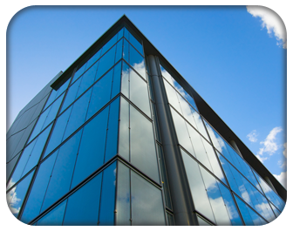

Desktop and Application Virtualization
Business Drivers Aligned with the Cisco Unified Workspace
Compliance
and Security
Evolving
Use Cases
IT Operational Efficiency
and Agility
Consumerization
of IT—BYOD
Desktop Refresh Cycles
Enterprise Mobility
Security from the end points, through the network, to the data center
Risk Management
Remote workers, tele-workers, contractors, consultants
Business
Process Outsourcing
Centralized control and management
of user desktops
Flexible
desktop and
application deployment
Desktop access regardless of network connection
Employee productivity
Desktop and data access from employee-owned assets
Policy-based access and control
Upgrade costs reduction (e.g., Windows 7/8)
Existing desktop software life extension
Notes:
Key Message: Traditional desktop virtualization can help you address a number (but not the entire set) of strategic imperatives that you would typically expect to be associated with Next generation Workspaces. We have observed based on direct customer engagements, primary and secondary market research studies that compliance/security, the need to address specific use cases, IT agility, operational efficiency, enterprise mobility all consistently represent key business triggers for desktop virtualization deployments.
Traditional desktop virtualization can help you address a number (but not the entire set) of strategic imperatives that you would typically expect to be associated with next generation Workspaces:
DV Business Drivers
Based on our experience and primary/secondary market research studies there are various business drivers that have prompted our customers to deploy desktop virtualization. In many cases it is about business agility and therefore the corresponding IT flexibility required to enable that. There is always tremendous focus on increasing IT operational efficiency specifically on the client side .. just think of the costs associated with the provisioning, support, asset management of traditional physical desktop infrastructures.
DV offers the ability to provision ‘any or all’ components tied in with the traditional desktop infrastructure in a cloud-like environment. This includes ability to provision services on the fly, elasticity, scalability, with elements of utility pricing. This can be dedicated to one customer (e.g., private environment) or deployed as a multi-tenant solution where components such as network resources and storage are shared among multiple customers.
Lately we have noticed an increase in a number of customers that deploy desktop virtualization also to better support enterprise mobility programs (e.g., BYOD). Market research data confirms the trend that we have observed anecdotally.
In regulated industries such as healthcare and financial services desktop virtualization has been around for a number of years to address security and business continuity requirements. At the same time, specific use cases have been developed to enable specific categories of workers (e.g., Remote workers, tele-commuters, contractors etc..) or industry specific use cases ...

Slide 7
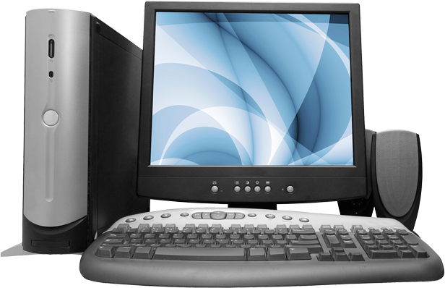
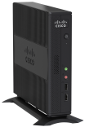

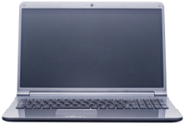
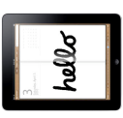

Desktop Virtualization: What Is It?
Traditional Desktop Delivered
and Managed One-by-One
Virtual Desktop Delivered
Across the Network
User
Settings
User
Settings
Applications
Applications
User Data
User Data
OS
Hardware
OS
ANY DEVICE, ANYWHERE,
ANY TIME
Decouple User Environment from Physical Hardware
Notes:
Key Message: Desktop virtualization addresses these challenges with a new way of organizing and deploying traditional desktop components. Desktop virtualization definition (for those who need it if any) is all about decoupling the user environment from the physical hardware.
Desktop virtualization addresses these challenges with a new way of organizing and deploying desktop components. Today, every desktop is unique because the operating system, all applications, and all user settings, such as screen background or web bookmarks, and the user’s data are tied to the hardware platform.
<CLICK> Desktop virtualization decouples the OS from the hardware, the user’s data from the hardware, applications from the OS, and user settings from both the OS and the Applications. The simple act of decoupling the components allows IT to deliver each users “desktop,” as collection of components, managed centrally, to any device, located anywhere in the world, at any time providing ultimate flexibility and productivity for the users. All while securing vital corporate user data in the data center for even better control than the traditional model, lowering risk. The fact that the data is centrally located increases availability while simplifying and standardizing management tasks greatly reducing total cost of ownership.
More detailed background …
Conceptually, ‘'Desktop virtualization” (sometimes called client virtualization) or Virtual Desktop Infrastructure (VDI), separates a personal computer desktop environment from a physical machine using client–server computing models. At its most basic level, "virtualization" is separating the "physical" from the "logical," so therefore "desktop virtualization" is separating the physical desktop device (laptop, desktop, etc.) from the logical desktop software (Windows).
Virtual desktop infrastructure often referred to as VDI is a server computing model enabling desktop virtualization, encompassing the hardware and software systems required to support the virtualized environment. Please note that there are multiple desktop virtualization technologies.
Many enterprise-level implementations of this technology store the resulting "virtualized" desktop on a remote central server, instead of on the local storage of a remote client; thus, when users work from their local machine, all of the programs, applications, processes, and data used are kept on the server and run centrally. This allows users to run an operating system and execute applications from a smartphone or thin client whose native hardware would otherwise be unable to run such software.

Slide 8
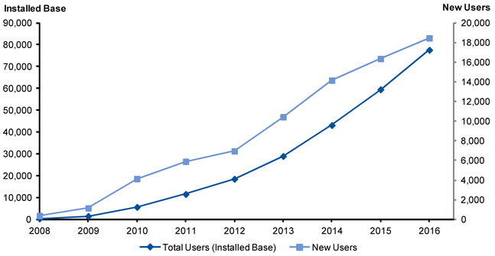
Market Adoption Continues to Grow
Gartner Hosted Virtual Desktop Forecast
“Gartner expects that by the end of 2016, 30% of large organizations (more than 1,000 users) will have deployed HVDs to 20% of their users or more.”
Figure 1. HVD Forecast, New Users and Installed Base, Worldwide, 2012-2016 (Thousands of Users)
Source: Gartner, Inc., Forecast: Hosted Virtual Desktops, Worldwide, 2012-2016 (2012 Update), 29 June 2012
Notes:
This slide cannot be changed and has been approved by Gartner ‘as is’
Key Message: Analysts continue to forecast strong adoption of desktop virtualization in the market.

Slide 9






Desktop and Application Virtualization:
Relevant to a Broad Set of Industries
Healthcare
Secure access to patient data
Regulatory compliance
Mobility for healthcare practitioners
Finance
Secure, flexible computing
Regulatory compliance
Disaster recovery
Education
Sharing computing resources
Collaborative classroom
Simple and fast provisioning
Government
Secure access to sensitive information
User based authentication/authorization
Cross-entity collaboration and
data sharing
Contact Center
Reduced agent seat cost
Quick on-boarding
Global coverage
Retail
Retail Kiosks and displays
Centralized management
Scalability and lower cost
Notes:
Key Message: Desktop virtualization has relevance across a broad number of industries and has been gaining robust market acceptance.
While desktop virtualization is not able to cover every single use case it has been gaining adoption across a broad set of industries some of which are highlighted on the slide. Desktop Virtualization is relevant to a broad set of industries based on market research data … and our actual customer base.
Healthcare
■ Meet compliance requirements, such as the Health Insurance Portability and Accountability Act (HIPAA), to protect the confidentiality of patient data.
■ Provide a consistent workspace that is constantly available, regardless of the medical practitioner's location within a healthcare setting, with minimal disruption to patient care
■ Replace nurses workstations, allowing flexible work rotation patterns.
■ Provide an access solution for remote data entry clerks and medical transcribers/billing/coders.
Finance
■ Centralize desktops, application and data to meet stringent compliance requirements — Sarbanes-Oxley Act, decision support system, PCI.
■ Improve management capability and avoid loss of financial data stored on traditional PCs.
■ Business continuity for traders, brokers and executive employees.
Education
■ Provide a consistent workspace for faculty members, enabling enhanced collaboration and secure remote working.
■ Accommodate flexible access policies, including technical enablement of BYOD programs for students. IT can deploy software to students between semesters in minutes. Also, students can be seated. in classrooms based on classroom size instead of the software physically installed in the room. This provides a considerable opex benefit due to the added flexibility.
■ Provision of library kiosk terminals, updated and maintained centrally.
■ Rapid provisioning of consistent desktops for departmental lab sessions.
■ Flexible persistent desktop solution for students on breaks or faculty on sabbatical.
Contact Centers can experience
■ Reduced average call-waiting time
■ Increased agent productivity
■ Cut customer relationship management workflow with faster service completion requests
Government
Unified Cisco environment leveraging Cisco VXI supports cross entity collaboration and streamlined data sharing
Improve network security and management
Cost-effective regionalization programs and services
• Increased online services for city residents and employees
• Improved security of virtual environment

Slide 10




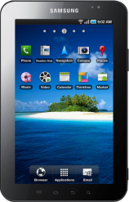
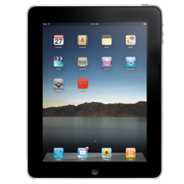
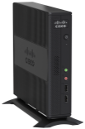
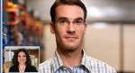



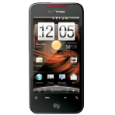
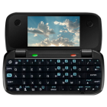

Smart Solutions Powering the Cisco Unified Workspace
Virtual Desktop +
Enterprise Collaborative
Applications
VXI Smart Solution
Unified Approach
VXI and BYOD Smart Solution
Native or Web-Based
Applications, Securely
BYOD Smart Solution
INTELLIGENT NETWORK
Notes:
Key Message: Cisco’s desktop virtualization offering is the Cisco VXI Smart Solution, a core component of the Cisco Unified Workspace Strategy and portfolio. Cisco has a bigger vision that goes beyond desktop virtualization. We see a workspace for users, that not only delivers a high-quality virtual desktop environment, but one that also efficiently integrates their collaboration technologies they need to be productive (think Unified Communications, WebEx, TelePresence, etc.) and mobility requirements with BYOD Smart Solutions while everything is delivered across a secure, efficient, scalable network (think Cisco Borderless Networks – The Intelligent Network). Cisco VXI (Virtualization Experience Infrastructure) makes this possible because only Cisco has expertise across all the components that need to come together.
The Unified Workspace is delivered by Smart Solutions from Cisco.
On one end of the spectrum is Cisco’s Bring Your Own Device or BYOD Smart Solution. This allows employees to use Native or Web-Based Applications, Securely to communicate and collaborate. But the solution goes beyond just device onboarding, providing native, platform-specific version of Cisco Enterprise Collaborative Applications to help achieve better workspace productivity.
On the other end is Cisco’s VXI Smart Solution, which delivers Virtual Desktop with full rich media (voice/video) capabilities – which is often the downfall of traditional VDI solutions. With traditional VDI solutions, voice and video suffer – often stuttering or dropping out. With the Virtual Experience Infrastructure or VXI Smart Solution from Cisco, you don’t need to make those tradeoffs. Layered on top of the VXI Smart solution is access to your enterprise applications as well as the full suite of Cisco Enterprise Collaborative Applications.
These new workspace access models are not an either/or decision, etiher. Both solutions can be deployed concurrently in what we call hybrid mode, so that you can use native or virtual access and applications depending on your requirements and work style. And they can co-exist with traditional corporate access models.

Slide 11
Cisco VXI Smart Solution

Slide 12


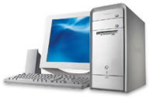

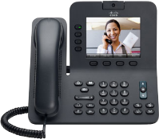


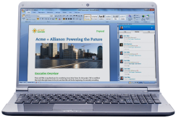


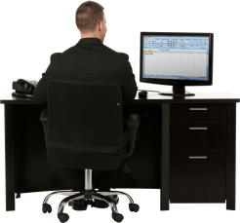
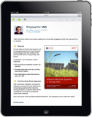
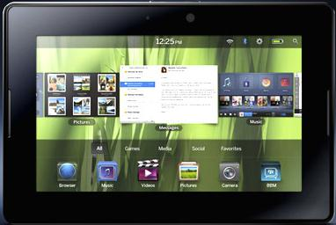
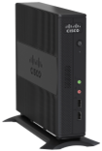
Cisco VXI Smart Solution
A Key Component of the Cisco Unified Workspace Strategy
VIRTUALIZED DESKTOP, APPLICATIONS, COMMUNICATIONS, CONTENT
Device-Centric
Private or Public Cloud
Media-Specific
User-centric
Device agnostic
Location-Bound
FREEDOM
OF DEVICE
FREEDOM
OF MEDIA
FREEDOM
OF LOCATION
Any App, Any Data, Any Device, Any Media…Securely, Anywhere!
Notes:
Key Message: The Cisco VXI Smart Solution delivers an uncompromised desktop and application virtualization experience that is collaborative, mobile and secure. VXI can increase business efficiency, productivity and agility by enabling an exceptionally flexible and secure workspace to any device in any location.
We have seen how Cisco’s answer to the Desktop and Application Virtualization customer initiative that you are about to undertake is .. VXI … a core component of Cisco’s Unified Workspace strategy.
The Cisco VXI Smart Solution delivers an uncompromised desktop and application virtualization experience that is collaborative, mobile and secure. VXI can increase business efficiency, productivity and agility by enabling an exceptionally flexible and secure workspace to any device in any location.
Cisco VXI delivers an end-to-end workspace solution that provides the security, scalability, and flexibility of desktop virtualization together with voice and video capabilities for an uncompromised and productive user experience. Virtual workspaces can be delivered to both company- and user-owned devices as part of a BYOD initiative.
Cisco VXI is:
Flexible: Cisco VXI supports user choice to accommodate different work styles and combinations of company- and user-owned endpoint devices while enhancing the user experience for improved productivity and satisfaction. It also provides a flexible, open workspace platform that offers agility for a variety of deployment scenarios and enables rapid responses to changing business needs. It allows IT to achieve faster, more efficient provisioning and management of workspace services through centralized control of virtual desktop, collaboration infrastructure and services.
Secure: Cisco VXI improves data confidentiality and integrity by centralizing, protecting, and controlling access to critical data and intellectual property at the data center rather than across diverse endpoints. Cisco VXI integrates policy-based identity services that enable device profiling and posture assessment, providing need-to-know access to centralized resources. This approach reduces exposure by protecting organizations from data loss, compliance litigation, loss of revenue, and brand damage. It also allows IT to respond quickly to security attacks and unplanned disruptions: technical, natural, or human made.
Uncompromised: Cisco VXI delivers an optimal desktop virtualization experience for campus, branch-office, and remote users. Cisco VXI also solves the traditional problems associated with integration of IP communications and business video into a virtual desktop environment, which typically results in a poor quality experience when real-time communications are employed. With Cisco VXI, Cisco VXC thin clients or Microsoft Windows endpoints running Cisco VXC software intelligently route multimedia communications traffic directly between virtual desktop endpoints. This bypasses the need for this latency-sensitive and bandwidth-intensive media to make the round-trip across the network to the data center and back. This innovative approach uses intelligent media-processing capabilities on the endpoint, improving video quality and voice communications while providing a user experience equivalent in quality to a traditional video-enabled desktop or phone.
Any device, anywhere with Receiver™. Today’s digital workforce demands the flexibility to work from anywhere at any time using any device they’d like. Leveraging Citrix Receiver as a lightweight universal client, XenDesktop users can access their desktop and corporate applications from the latest tablets, smartphones, PCs, Macs, Ultrabooks or thin client. This enables virtual workstyles, business continuity and user mobility.
XenDesktop 5 includes new Citrix Receivers for all the latest tablets, smartphones, Macs and thin clients.

Slide 13
VXI Evolution
EXPANDED DELIVERY MODELS
IMPROVED WORKSPACE SUPPORT
OPTIMIZED DESKTOP AND APPLICATION VIRTUALIZATION
Automated provisioning
Virtual/Native apps and content
On premise, cloud or hybrid
Multi-tenant
Collaboration
Voice, video optimization
BYOD
Workspace mobility
Enhanced performance
Simplified deployment
End to End security
Network optimization
Lower TCO
Cloud
Collaboration
Borderless Network
Data Center
Desktop Virtualization
Workspace Virtualization
Workspace as a Service
Increased Security, Flexibility, and Uncompromised User Experience
Increased User Freedom and IT Control
Notes:
Key Message: VXI can support a continuum of use cases. Cisco VXI is the ideal platform for desktop and application virtualization. It provides an optimized desktop virtualization environment with enhanced performance, simplified deployment, end to end security etc.. VXI is also able to address today the more sophisticated use cases of tomorrow inclusive of collaboration ,voice and video content thus delivering a complete desktop virtualization solution. And Cisco is continuing to invest in the business allowing consumption across multiple delivery frameworks (Cloud, Private, or Hybrid deployments)
Cisco VXI can address a multiplicity of use cases. From desktop and application virtualization, relying on the power of the Borderless Network and Data Center portfolio thus delivering lower TCO, enhanced performance, simplified deployment and end to end security. All critical attributes of leading desktop virtualization solutions.
But .. Cisco VXI goes beyond that .. And delivers today workspace virtualization solutions that go beyond desktop and application virtualization workloads to include voice and video, multimedia content and integration with mobility solutions. This is where Cisco’s well differentiated portfolio in the Collaboration space can expand market reach while increasing the number of addressable use cases.
Cisco will continue to augment its delivery models to include Workspace as a Service in conjunction with its broad partner ecosystem. With automated provisioning of the infrastructure, and a combination of on-premise, Cloud and Hybrid deployment frameworks, Cisco is uniquely positioned to guide customers through this journey while increasing security, flexibility along the way without compromising the overall user experience.
As customers progress from left to right through the journey at their own pace and consuming the elements they require customers will be able to increase their freedom of choice wrt how they access data and applications while IT will be able to retain if not enhance the level of control they have and security they can provide.
Desktop Virtualization: An integrated, validated infrastructure solution that provides a platform for hosting virtual desktops and applications with the required performance and scalability. The platform is open and flexible to meet different deployment scenarios and sizes. IT can deploy an infrastructure that is cost effective for initial work-group deployments, while scaling seamlessly to meet new work groups and use cases as the need arises. This also provides the foundation for the more extensive virtual workspace.
Workspace Virtualization: A virtualized approach to a complete unified workspace that supports a broad set of use cases by delivering integrated virtual desktop, voice, video, and collaboration services to any device in any location. This solution builds on the desktop virtualization infrastructure and delivers the hosted workspace across a network optimized for virtual desktop infrastructure (VDI) and multimedia traffic. This phase also includes end-to-end security policy and control that can be applied across both virtual and native environments for both fixed and mobile devices.

Slide 14
Cisco VXI Smart Solution in Action
What Some of Our Customers Have Achieved
Healthcare
Saved clinician 45+ MINUTES per day
50% REDUCTION in power consumption
Decreased OPEX $80,000/MONTH
Finance
Logon in 90 SECONDS from 8 minutes
Antivirus scans in 10 MINUTES—down from 1 hr
REDUCED TCO via Integrated desktop,
voice phone, video phone
Education
Saved 2M USD in licensing fees
App deployment reduced to MINUTES
Desktop deployment costs reduced by
300 USD per end-user
Government
11M USD in real estate savings
100% improvement in flexible working capability
SUPPORTED cross-municipality collaboration/sharing
Contact Center
Reduced call-waiting time by 40%
Increased agent productivity by 20%
Cut CRM workflow by 40%
Technology Solution Providers
Desktop deployment in 15 MINUTES from 1 hr
Desktop management costs DOWN 75%
Increased performance with
40% FEWER RESOURCES
Notes:
Key Message: The Cisco VXI Smarty Solution delivers tangible, measurable business results. What you see on the slide are actual benefits that customers across the globe and in a variety of industries have been able to derive when they deployed Cisco VXI.
Financial Services Firm
One of the largest banks in the United States by assets and market capitalization, with a workforce exceeding 200,000
Challenge
Be able to integrate voice and video with traditional virtual desktops
Establish a corporate strategy for desktop virtualization and overcome inefficiencies of each line of business rolling out its own desktop virtualization solution
Accommodate users so that they can work anywhere, securely
Solution
Bring together traditional virtual desktops and Unified Communications strategies with Cisco VXI
Create a data center and enterprise environment that includes: Cisco VXC 6215, Cisco UCS, Nexus product line, and Cisco UC
Results
Integrated voice phone, video phone, and PC capabilities reduced desktop operating costs
Increased VM density
Logon in 90 seconds vs. 8 minutes in the legacy environment
Antivirus scan time reduced from 1 hour to 10 minutes
Public Sector , Information Technology Services Department
• Implement VXI to deliver virtual workspaces that unify virtual desktops, voice, and video
• Update servers to leverage new virtualization infrastructure
RESULTS
• Support of over 400 virtual desktops across city’s public service departments
• Increased online services for city residents and employees
• Improved security of virtual environment
Government entity USA
Unified Cisco environment leveraging Cisco VXI supports cross-municipality collaboration and streamlined data sharing
Improve network security and management
Cost-effective regionalization programs and services
Streamline data center management and support future virtualization initiatives

Slide 15


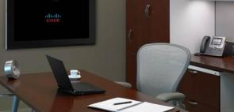






What Is a Cisco Smart Solution?
WORK, YOUR WAY
VXI
Smart Solution
BYOD
Smart Solution
Remote Expert
Smart Solution
SMART SOLUTION COMPONENTS
Tested, Validated, Documented Designs
Integrated Cisco + 3rd Party Roadmaps
Solution Lifecycle Management
Services Practices
Technical Training and Support
Cisco and Partner Enablement: Demos, ROI Assets, Tools, Financing
Notes:
Key Message: You may be wondering what our definition of a ‘Smart Solution’ is … on the slide we have captured the key ingredients associated with our characterization.
Cisco Smart Solutions include:
1. Cisco Validated Design -process and documentation
2. Integrated Cisco + 3rd Party Roadmaps
3. Solution lifecycle management to adapt itself to market requirements and dynamics
4. Service Practices
5. Sales and Technical Training and support
6. Solutions Enablement, Tools, Demos and Financing
Customer Benefits:
Sustainable solution for customers – reduce complexity today, provide continuity and investment protection as solution evolves (roadmap for solution)
Cisco absorbs complexity – Assuming responsibility for complex integration work for our customers, so they don’t have to integrate for themselves
Reducing risk – Customer is assured solution components will work together, can depend on Cisco for Smart Solution support

Slide 16
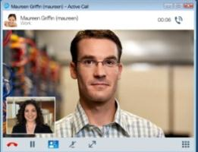




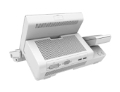
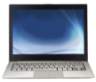



Cisco VXI Smart Solution Design
Cisco Products
Virtualized Data Center
Borderless Network
Collaborative Workspace
Cisco Collaboration Apps
AnyConnect
Cisco Jabber
Client Apps
SaaS
Web
Identity
Services
Engine
Desktop OS
DESKTOP
VIRTUALIZATION
Contact
Center
UC Mgr
Adaptive Security Appliance
HYPERVISOR
vWAAS
WAAS
Any Device
Virtual Desktop End-points
vASA
Nexus
1000v
Routing
(ISR)
Unified
Fabric
Unified
Computing
System
Network
Services
Wireless
Wired
STORAGE
Unified Access
Validated Designs, Services, Training and Support
Notes:
Key Message: Cisco VXI is supported by a cross-domain solution design that encompasses multiple elements of the Data Center, Borderless Network and Collaboration organizations.
Cisco VXI (Virtualization Experience Infrastructure) is supported by an architectural blueprint that crosses multiple IT buying centers. Cisco has expertise across all the components that need to come together: Data Center, Borderless Network, and Collaboration. Once you decide to disaggregate the desktop (that is basically what desktop virtualization does) the network that connects the various components becomes extremely important.
Cisco VXI combines Cisco’s industry-leading data center, networking, and collaboration technologies with services, validated designs, and a robust partner ecosystem to help IT simplify deployment, reduce costs, and mitigate risk. Only Cisco offers organizations a complete workspace solution that empowers people to adopt highly productive, mobile, unbounded work styles.
The core of Cisco VXI is the highly scalable Cisco Unified Data Center, which securely and efficiently hosts virtual desktops and applications and dramatically simplifies deployment and management. The data center module can be optimized for medium-sized deployments up to 2000 virtual desktops or highly scalable deployments exceeding tens of thousands of desktops.
The centrally hosted virtual desktops are delivered to user devices at any location across a secure wired or wireless network infrastructure, optimized to deliver virtual desktop, communications, and collaboration services and based on the Cisco Borderless Network Architecture and the Cisco Unified Access solution.
The virtualized collaborative workspace can be delivered on a diverse range of company-issued and employee-owned devices that support virtual desktop clients and Cisco Collaboration solutions, including Cisco Jabber™, to enable a consistent application, desktop, and communications experience anywhere and on any device. These devices include thin clients, zero clients, laptops, ultrabooks, smartphones, tablets, and the innovative Cisco Virtualization Experience Client (VXC) portfolio, which combines virtual desktops with voice and video capabilities.
More details …
From left to right – at the core we have Cisco Unified Data Center assets. Desktop Virtualization built on Cisco UCS – Unified Computing System (rack and blade servers) which in conjunction with our unique fabric architecture allows to reduce TCO associated with desktop virtualization deployments.
Unified Fabric, Nexus 1000v, vASA, vWAAS are integral components of the stack.
And, our solution is built leveraging desktop virtualization software technology from VMware (View) and Citrix (XenDesktop for Desktop Virtualization and XenApp – for Application Virtualization). We provide choice in terms of server hypervisor technologies from Microsoft, VMware or Citrix. We also have partnered with the storage leaders NetApp and EMC and we can deliver VXI leveraging multiple building blocks such as Vblock, FlexPod, EMC VSPEX etc..
On the Collaboration front, Cisco is ready to support multiple devices. From the VXC end points to 6215 (thin clients) and VXC 2100 and 2200 (zero clients) and Cisco Jabber that represents the unifying factor when communicating across a multitude of end points.

Slide 17
Desktop and Application Virtualization Top
Technical Challenges

Slide 18
Desktop Virtualization Technical Challenges
Cisco VXI Advantage
Virtualized Data Center
Borderless Network
Collaborative Workspace
Performance and Scalability
User Experience
Security and Risk
Deployment and Support
Notes:
Key Message: Cisco VXI is well positioned to address potentially any technical challenge that may arise as a result of the deployment of virtual desktops. You may be thinking of performance and scalability implications, how the user experience may be impacted, end to end security capabilities delivered, along with deployment and support across heterogeneous environments. Cisco can leverage its unique position in the industry and cross-architecture capabilities to deliver a tremendous value proposition and well differentiated capabilities.
You may be thinking … what technical challenges may arise during the deployment of DV solutions in your IT environment. Cisco has the experience and track record to guide you through the process.
Challenge #1 Will the architecture be able to Scale? - Performance and Scalability
Support for optimal user experience for all user types and delivery approaches (e.g., application and desktop virtualization; task/knowledge/power/graphic users etc.)
Performance at scale from 100’s to 1000’s of virtual desktops
Logon and boot storm I/O bottlenecks
Challenge #2 – How will the User experience be affected?
Performance impact of voice/video, graphic intensive applications and virus protection
VDI over WAN Performance
Challenge # 3 – How can you effectively Support and Deploy a solution that requires the cooperation of many vendors across HW and SW?
Managing and support of heterogeneous environments
No single point of accountability
Challenge #4 – Can you provide an end to end Secure DV solution?
Consistent secure access to virtual desktops from any device across any network
Scalable and manageable isolation between virtual desktop workgroups and production apps in data center
Protection from security leaks based on public content clouds
VXI can bring the power of the Cisco portfolio across Data Center, BN and Collaboration in context and help you address the toughest challenges associated with desktop and application virtualization deployments.

Slide 19
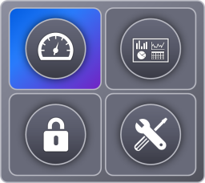
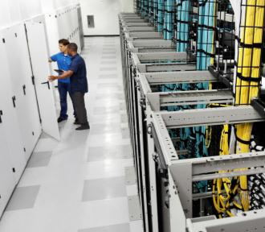


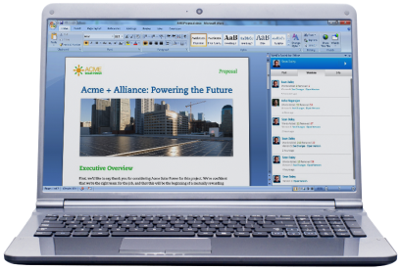

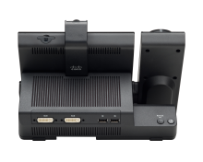



Cisco VXI Performance and Scalability
Branch
Telecommuter
Campus
Mobile
Data Center
Partner
Virtualized Data Center
Borderless Network
Collaborative Workspace
Cisco UCS’ Massive Scalability
  Manage up to 1.86M desktops with UCS Central across multiple geos
High Virtual Desktop Density
  Up to 186 VD on B200 M3
Strong Boot Process Performance
  Up to 5K desktops in 40 min
WAAS-based WAN Optimization
  Up to 70% faster
  Up to 3X More Users
Reduced Bandwidth per Connection
Scalable VPN Termination
Scale for Multiple Device Access Anywhere
Unified Access—Wired and Wireless
UPoE
Scaling, Hosting, Delivery and Management of Virtual Desktops and Applications
Notes:
Key Message: Cisco’s broad portfolio across data center, BN, and Collaboration can help you address scalability and performance requirements typically associated with desktop and application virtualization deployments.
Now let’s review how Cisco’s portfolio across data center, BN, and Collaboration can help you address scalability and performance requirements typically associated with desktop and application virtualization deployments.
Virtualized Data Center
---------------------------
Cisco UCS’ Massive Scalability
186 Desktops on B200 M3 Knowledge Worker Profile (Login VSI 3.x based) 384 GB memory Dual E5-2690 / 8 Core CPUSource Principled Technologies White Papers
Manage up to 1.86M desktops with UCS Central across multiple geos – with linear performance scalability
One UCS domain, Multiple VM management domains (scale attribute for management) – UCS domain up to 20 chassis (today) multiple VM domains carved out
On demand desktop provisioning (scale attribute)
High Virtual Desktop Density
Up to 186 VD on B200 M3
Strong Boot Process Performance
Up to 5K desktops in 40 min
Scale for bandwidth (with 1,2,4,8 uplinks to UCS Fabric Interconnect from UCS FEX Module) – Scale from 10 to 80Gbs in the same chassis without wiring / cabling
Borderless Network
-----------------------
Thanks to WAAS (Wide Area Application Services) Cisco can optimize network traffic in a distributed network infrastructure.
Our results have shown up to 70% faster application response time. This translates into better performance for the end users and our ability to deliver an experience that meets or exceeds your user expectations.
Additionally we have also seen up to 70% savings with three times as many users being supported using the same exact pipe without additional bandwidth costs (depending on the desktop virtualization software)
And on the collaboration front you can empower your business and employee stakeholders to access any information at any time from anywhere via wired and wireless connections.

Slide 20
Cisco VXI: Unified Data Center
Infrastructure Solutions Optimized for Desktop Virtualization
UNIFIED
FABRIC
UNIFIED COMPUTING
UNIFIED MANAGEMENT
  Highly Scalable,
  Secure Network Fabric
Modular Stateless
Computing Elements
Automated
Resource Management
Deliver architectural flexibility
for all Data Centers
Provide consistent networking across physical, virtual
and cloud
Unite computing, network, storage access, and virtualization
Deliver cohesive system that reduces TCO and increases business agility
Simplify and automate IT provisioning with policy-based management
Deploy physical and virtual resources on-demand for greater flexibility and agility
Notes:
Key Message: Cisco’s unique approach to the Unified Data center represents a key competitive advantage. Cisco’s data center infrastructure solutions are grouped into three main categories, each offers a selection of products to fit various data center needs. The Cisco Unified Data Center is composed of infrastructure solutions designed for ITaaS and Cloud including Desktop virtualization.
These are the components that you can take advantage of when deploying Cisco VXI:
Unified Management Solutions
Management solutions simplify and automate the deployment of IT infrastructure and operate across physical and virtual resources.
Unified computing management: Single management interface for hardware and software components and configurations
Cisco UCS™ Manager
Automation and orchestration: Allows policy-based, on-demand provisioning; quickly develop self-service portal and IT service catalog
Cisco Intelligent Automation for Cloud
Cisco Intelligent Automation for SAP
Data center network management: Optimize the overall uptime and reliability of your network to improve business continuity
Cisco Data Center Network Manager
Network services management: Policy-based solution for organizing, provisioning, and deploying network services and resources in cloud
Cisco Network Services Manager
Unified Fabric Solutions
Flexible network solutions deliver network services to servers, storage, and applications, providing transparent convergence, scalability, and sophisticated intelligence.
Solutions include:
Cisco multilayer data center switches
Cisco Nexus® switches
Cisco Catalyst® switches
Cisco Fabric Manager
Cisco NX-OS Software
Unified Computing Solutions
Cisco’s next-generation data center system unites computing, network, storage access, and virtualization into a cohesive system designed to reduce total cost of ownership (TCO) and increase business agility. The Cisco Unified Computing System™ (Cisco UCS) is built with:
Blade servers
Rack-mount servers
Fabric interconnects
Virtual interface cards

Slide 21
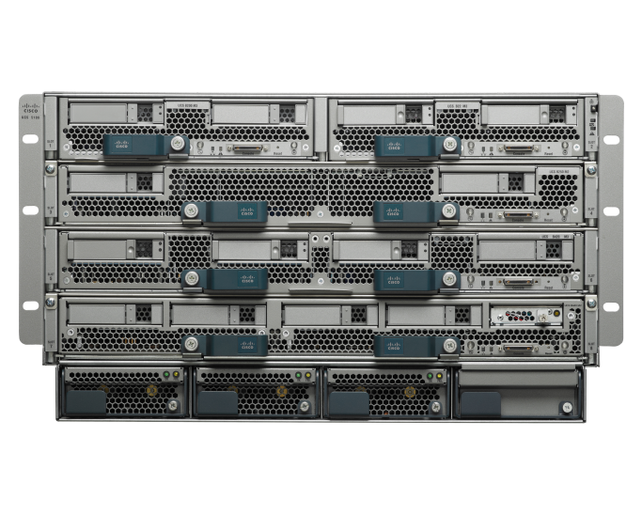
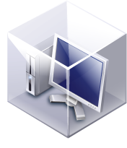
Cisco UDC:
Unified Computing System
Ideal Platform for Desktop Virtualization
Lower Cost for Compute + Network Infrastructure
Greater Virtual Desktop Density Without
Performance Impact
Simple Operation—Start in Minutes,
Scale in Seconds
Memory
Massive Scalability—Scales Easily to 1000’s
of Desktops per UCS System
CPU
I/O
Extended Memory and I/O to Avoid desktop
Virtualization Bottlenecks
Unified Fabric (FCoE)
Notes:
Key Message: Using the Cisco Unified Computing System as the foundation of your virtual desktop infrastructure you can unite computing, networking, virtualization, and storage access using technology innovation to bring you greater desktop density, operational simplicity, massive scalability and lower cost for your desktop virtualization workloads.
Using the Cisco Unified Computing System as the basis for your virtual desktop infrastructure unites computing, networking, virtualization, and storage access using technology innovation to bring ideal platform for desktop virtualization
Specifically, the Cisco UCS costs at least 20% less than competitors due to its radically simplified architecture requiring fewer components .
Supports 60% more virtual desktops without impacting user performance
Is easy to deploy and scale
Massive Scalability – Manage up to 1.86M desktops with UCS Central across multiple geos
Full system scales to 320 servers x 186 virtual desktops/server = up to 59,520 desktops depending on desktop virtualization software vendor and worker profile.
Largest and most cost-effective memory footprint for a 2-socket server combined with screaming fast, secured I/O avoiding bottlenecks

Slide 22
Cisco User Experience: WAAS
Superior WAN Performance
Response Time
Bandwidth Consumption
Video Quality
80ms 1.5Mbps WAN
60%
Savings
2x + Users
70%
Savings
3x + Users
70%
Faster
60%
Faster
Frames per second
HD
Quality
Seconds (s)
Kbps
Pixelated
Choppy Out
of Sync
Up to 70% Faster
Up to 3X More Users
HD Quality User Experience
Before Cisco WAAS
After Cisco WAAS
NOTE: To optimize VMware virtual desktop streams over the WAN, the RDP protocol must be applied.
Notes:
Key Message: Cisco’s capabilities in the networking space allow us to deliver an outstanding performance when it comes to WAN acceleration technologies. Basically with WAAS you get better bandwidth usage with compression and acceleration. Up to 70% performance improvement for apps and video, up to 2X increased scalability
Cisco WAAS can optimize Microsoft and VMware Virtual Desktops when using the RDP protocol. Like Citrix ICA, Microsoft RDP is encrypted and compressed by default. In this case, Cisco WAAS Transport Flow Optimization (TFO) can provide optimization. If an administrator disables native encryption and compression for the virtual desktops, then Cisco WAAS has been shown to provide excellent bandwidth and latency reduction for RDP <http://www.cisco.com/en/US/prod/collateral/contnetw/ps5680/ps6474/white_paper_c11-683601.pdf> .
For VMware PC over IP (PCoIP) based deployments, Cisco WAAS provides up to 90% optimization for the bandwidth intensive video streams deployed using Multi-media redirect (MMR) technology.
Here are some results from customer environments before and after using Cisco WAAS. In the grey – before, in the blue – after.
APPLICATION PERFORMANCE: Our results have shown up to 70% faster application response time. This means less frustration from your users, and your ability to deliver an experience that meets or exceeds your user expectations.
COST BENEFITS: Next, lets look at the cost benefits. With Cisco WAAS, we found our customer results show up to 60% savings with twice as many users being supported using the same exact pipe without additional bandwidth costs.
WAN CHALLENGES: And finally, we discussed the challenges of the WAN. Where video being a bandwidth demanding application, the experience over the WAN can be compromised. Here you can see that WAAS is able to take HD video over the WAN and deliver a LAN like experience. This is done using our ability to recognize Citrix traffic and also apply our sophisticated algorithms to effectively move the traffic over the wire … including DRE.
Cisco VXI Advantage ->
WAAS
Support for rich media and video through enhanced Cisco WAAS optimized for Citrix ICA that allows customers to apply QoS to multi-stream ICA (or HDX) with up to 5 levels of priority

Slide 23
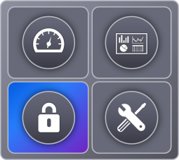
Cisco VXI End-to-End Security
Branch
Telecommuter
Campus
Mobile
Data Center
Partner
Virtualized Data Center
Borderless Network
Collaborative Workspace
Visibility and Zoning of Virtual
Desktops
Management of security policies
Virtual Security Gateway and Virtual Adaptive Security Appliance
Integrated Anti-virus Protection
Policy Enforcement
Secure Connectivity
Intrusion Detection and Prevention
AnyConnect VPN Clients
Single Sign On (SSO)
Encryption
Location Aware
Device Aware
Context Aware
Comprehensive Security Across Client, Access, Network, and Data Center
Notes:
Key Message: Both physical and virtual desktops require a secure environment. Cisco has solutions for both providing a comprehensive approach to the entire desktop environment – virtual or not.
Data Center Security
Visibility and Zoning of Virtual Desktops – Nexus 1KV has built in capabilities for visibility into network traffic, for example with Netflow you can analyze network traffic parameters.
Virtual Security Gateway provides an inter-VM firewalling – VMware provides somewhat similar capabilities and can isolate VMs in multi-tenant installations. This is critical for security purposes in a VD environment. For example, with Nexus 1010 (bundled offering that includes 1 WAAS, 1 network analysis, 1VSG etc..) you can provide outstanding security for virtual machines.
Integrated Anti-virus Protection
N1K (security policy alignment) – vmotion VMs are moved from one server to another, security policies alignment which move with the VM.
UCS Role-based access control and authentication - Desktop aware policies and administration – attach users to VM domain and assign policies to VM domains
Comprehensive end-end security from Datacenter to Network all the way to Client – AnyConnect – VPN server N1K On demand trust-zones and security templates (translates to dynamic provisioning) – Integrated with VM VCenter – VM aware networking –
Cisco VXI Advantage
Improved device, application and data security with validated smartcard solutions, Single Sign On (SSO) for Citrix Virtual Desktops and common security policy enforcement across traditional, BYOD and virtual desktops.
Secure remote access -> PCs, thin clients, zero clients, smartphones, tablets -> Cisco AnyConnect Secure Mobility (Cisco AnyConnect 3.0 for email and web security); EasyVPN, DMVPN, and GET VPN for site-to-site VPN technologies; VXC with VPN, VXC with Cisco Virtual Office
Virtualization security -> Hypervisor, virtual machines, and virtual switches -> Cisco Virtual Security Gateway (VSG), Cisco Nexus 1000V Series, virtual machine LAN security, PVLAN, IP source guard, Domain Host Configuration Protocol (DHCP), snooping, Address Resolution Protocol (ARP) Inspection, and Cisco NetFlow
Threat defense -> Data center defense -> Cisco Adaptive Security Appliance (ASA), firewall, and Intrusion Prevention System (IPS)
Application and content security -> HTTP and XML attacks -> Email and web security with Cisco IronPort™ and Cisco ScanSafe appliances
Secure user virtual experience -> Display protocol and interactive media -> Secure integrated desktop virtualization and secure interactive media experience
Device identity and network data loss prevention (DLP) -> Endpoints and network access -> Cisco Identity Services Engine (ISE), Cisco AnyConnect, VXC
Enhanced authentication and seamless sign-on -> Endpoints and user authentication -> USB-based smartcards validated with certificates on VXC backpack and tower, Gemalto .NET card, Gemalto PC USB-TR reader, VXC 2000 Series
Rapid desktop provisioning leaves room for admin error and security loopholes -> Access to and from virtual desktops -> Cisco UCS Service Profiles and Cisco UCS Virtual Network Interface Card 1280 offering dedicated logical interfaces to facilitate full separation of virtual machines (VMs),
Malware and viruses in virtual desktops -> Desktop users and data center -> Virtual antivirus solutions from McAfee and Trend Micro

Slide 24


SecureX: An Integrated and Holistic
Network-Based Security Architecture
BYOD
VXI
Collaboration
1011010
Secure Access For The Distributed Workforce
Virtual Desktops, Applications
and Collaboration
Securing Applications,
Content and Traffic
Global and Local Threat Intelligence
Common Policy and Management
Mobility
Network Enforced Policy Integrated Threat Protection
Cloud
AnyConnect
VSG
ASA
IPS
ISE
Appliances
Switches
Routers
Wireless
Firewall
VPN
The Cisco Intelligent Network
Professional and Technical Services, Compliance, CVDs, etc.
Notes:
Key Message: The Cisco SecureX security framework allows you to establish and enforce security policies across the entire distributed network, not just at a single point in the data stream. By leveraging global and local security intelligence for dynamic, real-time threat protection, Cisco SecureX responds to the evolving security needs of today's borderless network environments. Secure-X is relevant to VXI and other workloads.
Security – what VXI customers care about and challenges
Consistent secure access to virtual desktops from any device across any network
Scalable and manageable isolation between virtual desktop workgroups and production apps in data center
Protection from security leaks based on public content clouds
Cisco VXI Advantage (what Cisco can offer)
Improved device, application and data security with validated smartcard solutions, Single Sign On (SSO) for Citrix Virtual Desktops and common security policy enforcement across traditional, BYOD and virtual desktops.
Secure remote access -> PCs, thin clients, zero clients, smartphones, tablets -> Cisco AnyConnect Secure Mobility (Cisco AnyConnect 3.0 for email and web security); EasyVPN, DMVPN, and GET VPN for site-to-site VPN technologies; VXC with VPN, VXC with Cisco Virtual Office
Virtualization security -> Hypervisor, virtual machines, and virtual switches -> Cisco Virtual Security Gateway (VSG), Cisco Nexus 1000V Series, virtual machine LAN security, PVLAN, IP source guard, Domain Host Configuration Protocol (DHCP), snooping, Address Resolution Protocol (ARP) Inspection, and Cisco NetFlow
Threat defense -> Data center defense -> Cisco Adaptive Security Appliance (ASA), firewall, and Intrusion Prevention System (IPS)
Application and content security -> HTTP and XML attacks -> Email and web security with Cisco IronPort™ and Cisco ScanSafe appliances
Secure user virtual experience -> Display protocol and interactive media -> Secure integrated desktop virtualization and secure interactive media experience
Device identity and network data loss prevention (DLP) -> Endpoints and network access -> Cisco Identity Services Engine (ISE), Cisco AnyConnect, VXC
Enhanced authentication and seamless sign-on -> Endpoints and user authentication -> USB-based smartcards validated with certificates on VXC backpack and tower, Gemalto .NET card, Gemalto PC USB-TR reader, VXC 2000 Series
Rapid desktop provisioning leaves room for admin error and security loopholes -> Access to and from virtual desktops -> Cisco UCS Service Profiles and Cisco UCS Virtual Network Interface Card 1280 offering dedicated logical interfaces to facilitate full separation of virtual machines (VMs),
Malware and viruses in virtual desktops -> Desktop users and data center -> Virtual antivirus solutions from McAfee and Trend Micro

Slide 25
Cisco Identity Service
Engine (ISE) for VXI
Consistent Security Policy Enforcement Network-wide
Identifies both physical and
virtual devices
Enables IT to better support BYOD
Supports Data Security, Access Control, and Compliance
Protects intellectual property
Ensures right level of access for
device type
Context-Aware Identity and Authentication Services
WHO
WHAT
WHERE
WHEN
HOW
Notes:
Key Message: Cisco ISE provides a policy driven approach to security. It includes device profiling and associates different policies for corporate vs. non-corporate devices or on a per device basis. It recognizes tablets such as iPad and Ultrabook and other non-corporate devices and mandates that the user in corporate network on personal device or tablets accesses any and every corporate data through virtual desktop alone. The corporate device will have better flexibility of accessing data directly on the desktop or through a VDI session. This model of flexibility and control allows the IT admin to be assured of data containment in virtual desktops or corporate devices and minimizes the threat of leaking data via employee’s personal desktop after employee leaves the company.
Policy based Access for VXI with Cisco Identity Services Engine (ISE)
Cisco Identity Services Engine (ISE) – designed to deliver policy-based services that easily scale across multiple applications and network services – has been validated for the Cisco Virtualization Experience Infrastructure (VXI) to provide secure role-based and device-based access to corporate data via virtual desktops. By combining network and VDI capabilities, businesses now have the flexibility to allow users to bring personal devices onto the corporate network without compromising data integrity. .
Scales to Meet Organizational Need: Allows IT to efficiently and easily extend support from physical desktops to virtual desktop environments with multiple devices per user. ISE centralizes all policy creation, and seamlessly propagates the information to all Cisco switches, wireless controllers, and network access devices (NAD).
Data Security and Compliance for Bring Your Own Desktop (BYOD) and Mobile Tablets - ISE helps IT simplify how to manage the bring-your-own-device (BYOD) phenomena, where users expect to access their virtual desktops through multiple devices. Cisco ISE centralized policy platform enables coordinated policy creation and consistent policy enforcement across the entire corporate infrastructure, with any user, using any device from anywhere -- both virtual and non-virtual sessions.
ISE provides device profiling and associates different policies for corporate vs. non-corporate devices or on a per device basis. It recognizes tablets such as iPad and Ultrabook and other non-corporate devices and mandates that the user in corporate network on personal device or tablets accesses any and every corporate data through virtual desktop alone. The corporate device will have better flexibility of accessing data directly on the desktop or through a VDI session. This model of flexibility and control allows the IT admin to be assured of data containment in virtual desktops or corporate devices and minimizes the threat of leaking data via employee’s personal desktop after employee leaves the company.

Slide 26

VXI Solution ‘Roadmap’ – Investment Protection
Alignment with Market Dynamics
Combine BYoD
and workspace virtualization
Fully Integrated Solution
Combined virtual desktops/apps,
voice, video
On-premise,
Cloud and Hybrid deployments
Increased Scalability Performance
Automated virtual workspace
provisioning
Lower
TCO
Cloud, HTML5 web, virtual or native application and content delivery
Optimized Desktop
and Application Virtualization
Consistent
security policy
for “native” and
“virtual” workspaces
Unified access for fixed/mobile clients
Simplified
deployment
Workspace as a Service
Desktop Virtualization
Workspace Virtualization
Integrated Solutions, Validated Designs, Ecosystem, Services, Support
Increased Security, Flexibility, and Uncompromised User Experience
Increased User Freedom and IT Control
Notes:
Key Message: Cisco is investing in the VXI portfolio to ensure that our solution ‘roadmap’ is able to keep the pace with changing market dynamics. That in turn allows us to provide customers with the investment protection they need. This slide is about deployment risk
The Cisco VXI solution roadmap is aligned to a typical adoption journey, although different organizations apply the roadmap to their own unique needs as appropriate. The three key phases of the Cisco VXI solution roadmap are:
1. Desktop Virtualization: An integrated, validated infrastructure solution that provides a platform for hosting virtual desktops and applications with the required performance and scalability. The platform is open and flexible to meet different deployment scenarios and sizes. IT can deploy an infrastructure that is cost effective for initial work-group deployments, while scaling seamlessly to meet new work groups and use cases as the need arises. This also provides the foundation for the more extensive virtual workspace.
2. Workspace Virtualization: A virtualized approach to a complete unified workspace that supports a broad set of use cases by delivering integrated virtual desktop, voice, video, and collaboration services to any device in any location. This solution builds on the desktop virtualization infrastructure and delivers the hosted workspace across a network optimized for virtual desktop infrastructure (VDI) and multimedia traffic. This phase also includes end-to-end security policy and control that can be applied across both virtual and native environments for both fixed and mobile devices.
3. Workspace-as-a Service: Brings the innovations in cloud and desktop virtualization technologies together to deliver workspaces on demand from a private, public, or hybrid workspace cloud. Building on the previous two phases, customers can build toward the workspace-as-a-service solution incrementally or implement a cloud solution form the outset.
Each phase includes technology roadmaps, a broad partner ecosystem, validated system-level designs, and cross-domain professional services.

Slide 27
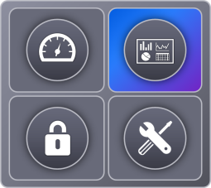
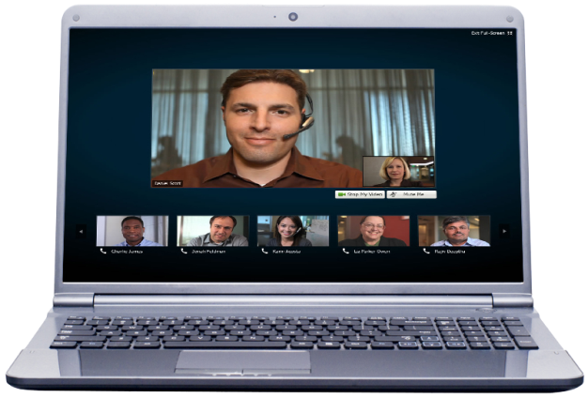

Cisco VXI Uncompromised User Experience
Branch
Telecommuter
Campus
Mobile
Data Center
Partner
Virtualized Data Center
Borderless Network
Collaborative Workspace
Data Center QoS
  Per virtual desktop SLA ‘guarantees’
I/O Optimization – VM-FEX
  Lower latency
Storage Caching
Nvidia vGPU based Graphics
WAAS-optimized Virtual Desktop Delivery (HDX/RTP)
Superior WAN Performance
HD Quality User Experience
Cisco Jabber on any device
Enterprise-grade communications capability
Powered by Cisco Unified Communications
Uncompromised User Experience for Voice, Video, and Data
Notes:
Key Message: User experience is everything. Adoption and success can take place if and only if the user experience resulting from the deployment of desktop virtualization technologies remains uncompromised. Cisco has the capabilities to make sure the deployment of virtual desktops does not impact the overall user experience irrespectively of media type.
Data Center
Data Center QoS. Bandwidth provisioning for SLA guarantees. QoS can be split into Bandwidth and priority. SLAs can be specified on a per VM basis and therefore for each desktop you can assign bandwidth partitioning. IP packet prioritization (Within the UCS dashboard you obtain visibility per VM basis regarding VM traffic, I/O flow latency etc..)
I/O Optimization – VM-FEX – Cisco UCS differentiator – In a virtualized environment you often have VM to VM communication within the same server. This is why we have a software switch such as the Nexus 1000V .. But this additional workload slows down the overall server performance (15-20%). VM-FEX offloads the VM switching to the external switch (which is HW based) therefore traffic goes to Fabric Interconnect -> regaining performance (15-20% improvement )
Storage Caching (Fusion IO based – translates into improved user experience) – Fusion I/O brings the storage into the server mezzanine card, fusion IO offers almost 1 TB of storage cache. As a result now desktop images are stored/cashed locally improves performance, boot times etc..
Low Latency Infrastructure, for rapid desktop/apps deployment and improved response times – (Fusion I/O) – boot process as well
Nvidia vGPU based Graphics offload – Enhanced user experience for Media-rich, Graphics use cases – running on a rack server C class at this time only. This extends the use cases and improves overall performance.
The Cisco VXI Advantage ->
Lower cost VDI support for workstations and graphical applications through new virtual GPUs on Cisco UCS servers (C-Series).
UDC High scalability and high performance virtual desktops deployments
Borderless Network
Cisco has worked with vendors such as Citrix to ensure that CISCO is able to see inside the VD protocol from the data center to the end points – by doing that WAAS is able to optimize traffic flows for example when audio/video are present – WAAS therefore is an asset wrt WAN traffic optimization. This is a differentiator for Cisco.
Another aspect tied to traditional VDI is the inability to reroute traffic when a end point to end point audio/video call is taking place. When it comes to rich media – the internet video is streamed from the DC to the internet back to the virtual desktop. Rich media is CPU intensive. With traditional DV the video is processed on the server. This impacts the user experience – hairpin effect.
The next few slides will articulate in more detail how the Collaboration portion of the Cisco portfolio can really address and enhance the overall VXI user experience

Slide 28
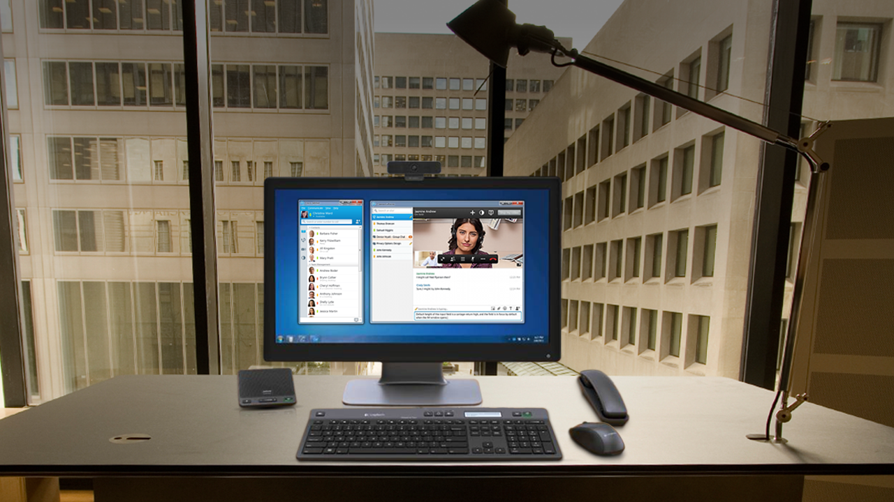




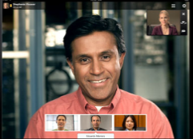

Enabling a Collaborative Workspace with Cisco Jabber
Desktop
Mobile
Thin Client
Collaboration + Virtual Desktop
Presence and IM
Voice
Video
Conferencing
Messaging
Notes:
Key Message: Our Desktop virtualization solutions are collaboration ready. With Cisco Jabber you can easily collaborate from anywhere on any device. This represents a great differentiator allowing you to support uses cases of today and tomorrow.
Let’s quickly review Cisco Jabber. Jabber gives your teams the freedom to be productive from anywhere, on any device from desktops to mobile devices to thin clients. Cisco Jabber lets you:
Quickly and easily find the right people
See if and how they are available
Collaborate using your preferred method
Users simply click to communicate via IM, presence, voice, high-definition (HD) video, voice messaging, desktop sharing, and conferencing.

Slide 29
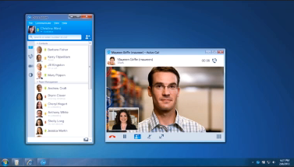

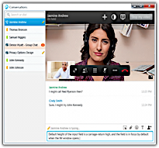
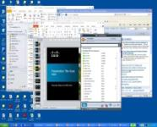

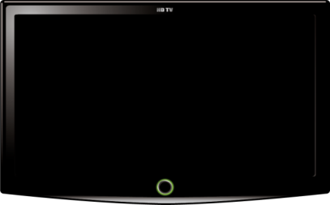


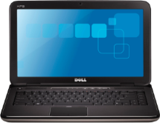
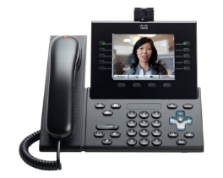


A Network Based Approach
Data Center
Uncompromised User Experience
User Desktop
Routes voice and video
point-to-point
Cisco Virtualization Experience Media Engine (VXME)
Optimized Resources
Media Flow
Bandwidth reduction from megabytes to kilobytes
Reduced processing in data center
Enterprise-Grade Voice
and Video Based on
Cisco Unified Communications
Cisco UC Manager
Across All Devices
Signaling
Desktop Virtualization Protocol
Notes:
Key Message: Users interact with Jabber on their hosted virtual desktops to see presence status, instant message others, check voice messages, or collaborate over a video call.
Voice and video traffic is processed locally by Cisco VXME and routed point to point between endpoints, bypassing the data center and eliminating the “hairpin” of media.
For transparent voice and video in a virtual desktop environment, Cisco offers Virtualization Experience Media Engine that enables intelligent processing of real-time voice and video traffic in virtualized environments
Delivers seamless collaboration experience that supports the full capabilities of Cisco Jabber on the virtual desktop
Secure high definition audio and video via local media processing
Intelligent Quality of Service via MediaNet service for Voice/Video and Data traffic
Integrated Unified Communications accessories
Supported with Citrix XenDesktop, Citrix XenApp for Published Desktops, VMware View
Cisco VXME will work on Cisco thin clients, 3rd party windows-based thin clients and Windows PCs.
In virtual environments, Jabber for Windows is deployed in the data center while VXME is running locally
Users interact with Jabber on their hosted virtual desktops to see presence status, instant message others, check voice messages, or collaborate over a video call.
Voice and video traffic is processed locally by Cisco VXME and routed point to point between endpoints, bypassing the data center and eliminating the “hairpin” of media.
With this optimized architecture, users in virtualized settings can benefit from the same uncompromised user experience of Cisco Jabber.

Slide 30
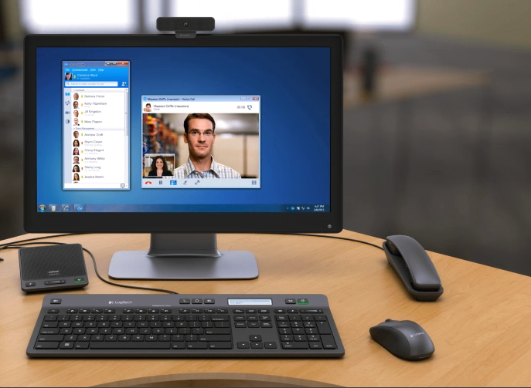

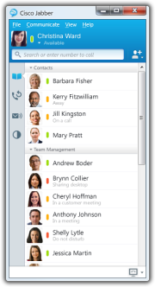
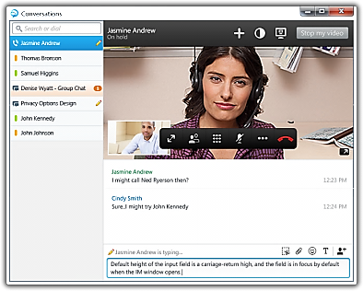
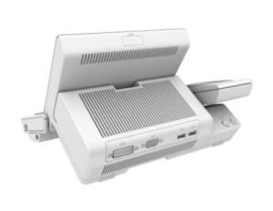
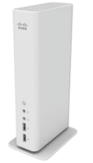


Cisco Jabber and Virtualization Experience Client (VXC)
Cisco Jabber with Cisco VXME
Cisco VXC 6215 Thin Client
Cisco VXC 2000 Series
Zero Clients
Integrated UC Accessories
Notes:
Key Message: Cisco offers a complete range of end points for your desktop virtualization and workspace virtualization solution.
In addition to Cisco Jabber with Cisco VXME, Cisco offers Cisco zero clients and thin clients. Cisco VXC 6215 is a Linux-based thin client that can unify voice, video and virtual desktop all in once device when deployed with VXME.
Cisco VXC 2000 Series are zero clients that come in two form factors; an integrated form factor that integrates into select Cisco IP phones and a standalone model.
We are also introducing Unified Communications accessories that are tightly integrated with Jabber and VXME’s call control to deliver a superior user experience for collaboration.
These accessories from Logitech and Jabra, co-designed with Cisco, deliver the optimal unified workspace experience by extending the time-proven communications features to the virtual, flexible and mobile workspace environment.
Jabra Handset 450 for Cisco
USB based, Plug & play DECT cordless handset
Jabra Speak 450 for Cisco
Plug & play USB & Bluetooth speakerphone ideal for handsfree operation
Logitech UC Keyboard K725-C and Logitech Mouse M525-C
Revolutionary keyboard design integrates phone
and video call controls
Logitech Webcam C920-C
Superior 720p / 30 fps HD performance with local video processing within the camera

Slide 31
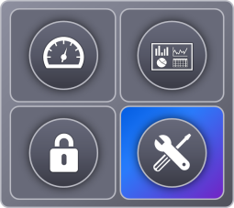
Cisco VXI Deployment and Support
Campus
Data Center
Branch
Virtualized Data Center
Borderless Network
Collaborative Workspace
Cisco Validated Designs for Citrix and VMware
End-to-end Advanced Services
End-to-end Multi-Vendor Solutions Support
Integrated Solution Roadmap
VXI-Enabled Partners—Worldwide
Faster and Lower Risk Deployments With End-to-end Designs and Support
Notes:
Key Message: When it comes to deployment and support you may have concerns about your IT organization’s ability to effectively support and manage an heterogeneous environment that spans the data center, the network and the end points wherever they may be located at any given time. Cisco can assist you with a strong value chain inclusive of CVDs, end to end advanced services, multi vendor solution support and a broad geo presence with VXI partners ready to deploy desktop virtualization solutions based on Cisco VXI.
Cisco VXI provides you with:
Cisco Validated Designs - IT organizations tasked with making sure of the availability and high performance of solutions such as the Cisco Virtualization Experience Infrastructure (VXI) need validated designs and support capabilities that include firsthand knowledge of the solution and the ability to manage issue resolution among the Cisco solution technology partners involved in the solution. Cisco has developed and tested Cisco VXI and Virtual Desktop Infrastructure (VDI) solutions with industry-leading solution technology partners including Citrix, EMC, NetApp, VMware, and others. These solution designs, called Cisco Validated Designs (CVDs), document and demonstrate interoperability between solution elements and provide solution validation to enable safer, more predictable implementations.
A broad portfolio of Cisco Advanced Services - Cisco Desktop Virtualization Services help you strategize, plan, design, migrate, and operate a cost-effective, secure, end-to-end desktop virtualization solution for any user in any environment with minimal business risk.
Cisco Solution Support Services provide customers with a single point of contact to manage issues that might arise within their solution. For example, with Solution Support Service for VXI, you get access to Cisco cross-domain experts, who are trained in third-party products that are part of the VDI/VXI infrastructure and are qualified to troubleshoot and drive resolution of issues. As a result, the customer’s IT department can rely on Cisco for solution expertise and issue resolution, making sure of maximum solution uptime and employee productivity. Solution Support Services provide a Cisco umbrella of support over the entire solution to complement Cisco and Cisco solution technology partner product support through a higher level “solution support service.” Cisco Solution Support Services supplement product-level support for all elements in the Cisco Validated Design solution. This service is available where all products in the customer’s CVD solution are supported through a minimum of core product-level support services, such as Cisco SMARTnet® Service, Essential Operate Services, Software Application Support, and Unified Computing Support Services as applicable. Cisco Solution Support Services offload the task of coordinating complex issue isolation and resolution by providing a single point of contact to any support request within the CVD-covered solution. The customer may call Cisco for any issue within the solution, and, as long as the customer maintains product support on all covered elements, Cisco will work to resolve the issue regardless of which Cisco or solution technology partner products are involved.
Cisco continues to invest in a cohesive set of integrated solutions as we have previously articulated to match an evolving set of technological trends and customer requirements
Last but not least we want to provide our customers with choice, Cisco VXI is available through a number of channel partners on a worldwide basis.

Slide 32
Cisco VXI Services
Architectural
Services Approach
Architectural
Deployment
Incremental Architectural Change and Maintenance
Implementation
Desktop Virtualization Validation Service
Optimization and
Solution Support
Identify Business Value + Business Outcomes
Pre-Production Pilot
Planning and
Design
Strategy and Assessment
Customer Outcomes and IT Priorities
Discovery Session
  Enhanced security and compliance
  Lower operating costs
  Business agility
  Superior work style experience
Plan/Build
Manage
Notes:
Key Message: Cisco and its Partners can provide services to support customers through each stage of the solution lifecycle, from architecture planning and design to implementation and optimization. Depending on geo and partner these services can be delivered via Cisco Collaborative Professional Services for partners or via Cisco Brand Resale Program for partners
Complementing the Cisco VDI and VXI solutions, Cisco Desktop Virtualization Services deliver rich, expert-based services end to end that can help you rapidly realize a desktop virtualization solution of your choice anywhere, with any device, over any medium. These services also help provide the right fit with your existing investments and align your IT and business strategies. Our services can help you plan, build, and manage a secure desktop virtualization solution. These include:
Plan
▪ Desktop Virtualization Strategy Service: Develop a comprehensive business case and solution strategy for desktop virtualization. Assess operational and mobility services readiness. Create an architecture that may include desktop virtualization, collaboration, and innovation.
▪ Desktop Virtualization Assessment Service: Conduct a comprehensive feasibility study and total cost of ownership (TCO) analysis for desktop virtualization.
▪ Desktop Virtualization Planning and Design Service: Design a reliable desktop virtualization infrastructure that fits your IT strategy and user requirements.
Build
▪ Desktop Virtualization Pre-Production Pilot Service: Validate specific technical requirements for your proposed desktop virtualization design prior to full production.
▪ Desktop Virtualization Implementation Service: Smoothly implement your desktop virtualization solution, including creating an implementation plan and migrating users.
Manage
▪ Desktop Virtualization Optimization Service: Understand the performance and utilization of your desktop environment and evolve your VDI or VXI solution to assure operational excellence as you expand.
▪ Cisco Solution Support Service for VXI: Rapidly resolve operational issues with solution support that provides a single point of contact.
32

Slide 33
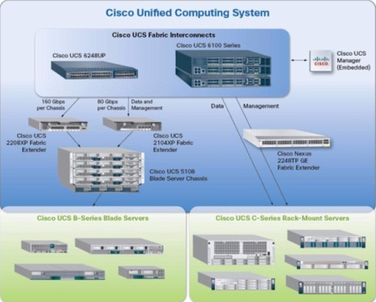

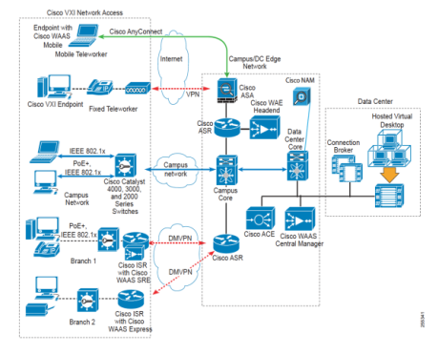
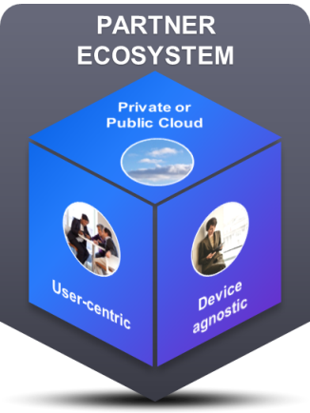
Deploy with Confidence
VXI Cisco Validated
Designs (CVDs)
Partner Ecosystem
Channel Partners
Citrix XenDesktop
VMware View
EMC, Intel, NetApp
AppSense, McAfee, Microsoft
LiquidwareLabs, Trend Micro, Atlantis Computing, Unidesk
Nimble Storage, Nexenta, Whiptail
From traditional desktop virtualization to Unified Workspace practice
ACCELERATE TIME TO VALUE
LOWER
DEPLOYMENT RISK
REDUCE
COSTS
Notes:
Key Message: Simply stated with Cisco you can deploy your desktop virtualization infrastructure with confidence. Cisco is uniquely positioned to provide you with all the key ingredients to lower your deployment risks (e.g., via CVDs,) while offering a broad partner ecosystem and a large scale channel reach.
Accelerate time to value, lower deployment risk and reduce TCO when you leverage Cisco VXI for your desktop virtualization deployments.

Slide 34
Desktop and Application Virtualization Top
Business Challenges

Slide 35
Desktop Virtualization—Business Challenges
Cisco VXI Advantage
Evolving Work Styles and Use Cases
Cisco Unified Workspace Strategy
Cisco Smart Solutions (e.g., BYOD)
Strategic Solution Provider
CapEx for Desktop Virtualization
Cisco’s holistic approach
Cisco VXI as a Proven Solution
Partner ecosystem
Continued technology investments
TCO Calculators
Cisco Capital
Notes:
Key Message: Cisco can also help you address the business challenges that we have found to be typically associated with Desktop virtualization deployments. Simply put you will need a strategic partner, able to deliver workspace solutions for your rapidly evolving user needs, use cases and work styles and all of this while making sure that you achieve your business goals and limiting capital investment outlays. Cisco along with its partner community can also enable you to address the toughest challenges across all three dimensions. This is part of the Cisco VXI advantage.
With any technologies though there are both technical and business challenges that need to be properly sorted out, understood and tackled in context based on your individual priorities and IT environment.
We have seen how Cisco VXI enables you to tackle the toughest technical challenges you may encounter when deploying DV solutions . We can now review some of the most common business challenges that we have encountered and that we have helped our customers solve.
CAPEX
CapEx for traditional VDI is still high, up to 60% more expensive than physical desktop infrastructure, admittedly storage costs are a major component.
Cisco can help … Self funding model put in place with Cisco Capital, advanced services to help you develop the business case, TCO calculators and white papers that articulate the overall economic impact of VXI
There are also technological traits that help us deliver more value thus reducing your TCO for example:
We continue to increase UCS density by supporting more virtual desktops per server leveraging the latest Cisco UCS innovations, including M200 M3 blades (up to 186 desktops per blade) and more scalable I/O network architecture
Lower storage costs with storage optimization solutions for Cisco UCS. Solutions include SSD modules and hypervisor caching with Fusion I/O
Broadening your choice of storage vendors with best in class providers such as EMC and NetApp
EVOLVING WORKSTYLES
Support for evolving workstyles (Need to support all required business, desktop apps and services, need to support fixed, mobile employees/partners on-premise and off-premise, need to support a broad set of corporate-issued and BYOD devices)
Cisco can help .. we have developed a BYOD Smart Solution that includes wireless and security components, supported by the broader CUW strategy;
Cisco is able to support various end points and we can show case the solution end-to-end
Collaboration capabilities provide support across many device types, including virtual and native desktops, and mobile and campus-based desktops by extending the Cisco Jabber experience to Windows in HVD and Jabber support for XenApp
With VXI we continue to expand the number of use cases suitable for DV deployments. For example integration with optimized call contact centers, video streaming, branch offices etc..
Last but not least AS can help you be better prepared to deploy your solution and analyze the use cases ..
CISCO AS A STRATEGIC PARTNER
Complexity of provisioning, deployment, operations of DV services. Deploying DV requires alignment within your IT organization. There is a fair degree of organizational complexity due to desktop virtualization crossing multiple IT domains (desktop, data center infrastructure, network, communications, apps)
Cisco has core expertise across all the elements of the DV portfolio and therefore understands the dynamics.
Cisco can provide an impartial perspective since we do not have to protect a slow growth thin margin desktop PC business
Advanced Services can help you navigate that alignment as needed / required
Procurement , coordination and maintenance of multi-vendor stacks can add risk to the overall DV project and impact business outcomes
Cisco Solution Services allows you to select Cisco as the single ‘throat to choke’ wrt support services
Cisco Validated Designs to reduce deployment and support risks
Risk of Vendor Lock-in – often customers prefer to leverage already established relationships with resellers, VARs, GSIs of choice
Cisco ecosystem includes trained channel partners to implement and support VXI deployments

Slide 36
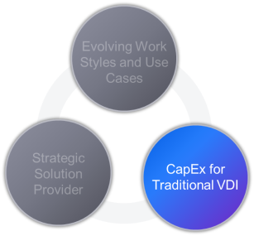

CapEx Considerations
Cisco VXI Economic Impact
Sustained Technology Investments
Plan
Finance
TCO Calculators
Advanced Services Business
Value Analysis (Strategy)
UCS virtual desktops server density and technology advancements
Storage optimization solutions
Operational streamlining (UCS Profiles)
QoS for virtual desktops/applications (e.g., XenApp with VM-FEX)
Cisco Capital
Notes:
Key Message: Cisco can also help you tailor the financial aspects associated with desktop virtualization deployments to your specific environment. That in turn helps you rationalize the initial capital investment required in a broader context, in terms of ROI and TCO reduction. Cisco Advanced services can assist in the process. We can make available TCO calculators to help you get started or provide help with Cisco Capital to qualified customers. But we are not stopping here, we will continue to invest to drive infrastructure costs further down.
Increase virtual desktop server density
XenApp 6.5 published shared desktop, including Jabber for Windows
Reduce TCO through server technology advancements
UCS B200M3 (1600MHz memory), VIC 1240 (80 Gbps I/O), UCS 2.0.2, Fabric Interconnect 6296UP
Decrease storage costs for View and XenDesktop
Solid State Drives (SSD) for desktop image
Whiptail
Decrease storage costs with hypervisor caching technology
ESXi CBRC
Leverage Cisco Capital for Cisco financing – self funding business model.

Slide 37
Cisco VXI: Key Value Drivers
Client
Hardware
and Software
Lower cost client devices
Extend life of desktops
Data Center Infrastructure
(Investment)
UCS virtual desktop density
UCS Unified fabric
End-to-end validated design
IT Operational Costs
Lower deployment, administration and Help Desk costs
Utilities and Facilities
Lower power consumption
Energy Management
Power over Ethernet benefits
CISCO VXI TCO BENEFITS WITHOUT VOICE+VIDEO
Notes:
And our innovations and investments will focus on capabilities that deliver the highest value to our customers.

Slide 38
Cost Savings with VXI
Drive up to 25% Savings In Overall Desktop and Video TCO
Annual TCO Per User ($)
Desktop: -17%
Voice: - 30%+
Total: -24%
Notes:
Reducing the overall TCO is one of the main value propositions of Cisco VXI. Comparing a traditional PC desktop which constitutes for every $1 in software / hardware there is $3 spend over the life of the asset on life cycle management and support. In addition, separate voice and video systems that don’t work in conjunction with the solution add to the costs. However, with Cisco VXI we can essentially collapse the support costs and life cycle costs of Unified Communications, Desktop and Application Management which essentially lowers the total costs by 25% in many cases.

Slide 39


Cisco as Your Strategic Partner
A Broader Value Proposition
Competence Across
the Value Chain
Broad Ecosystem
Of Partners
Proven Solution
Over 1000 Desktop Virtualization Customers
in Production
Key Sectors are Financial Services, Healthcare, Public Sector and Education
Select customers running well over 20,000 VXI/VDI seats on Cisco UCS
Industry awards: 2011 Citrix Ready Solution of the Year, Best of VMworld 2010 Hardware for Virtualization, new VMmark 2.1 benchmark World record with Cisco UCS (2012)
Experience integrating desktop virtualization with network and collaboration
Data center, network, collaboration, security
and services
Solution level support with Cisco Solution Support Service for VXI
Over 20 technology and integration partners
for delivery
Best of breed approach—
no proprietary storage
lock-in
Notes:
Key Message: When you chose an IT vendor you chose a partner for your desktop virtualization journey. We can demonstrate very clearly how VXI offers a proven solution, strong competence across the entire value chain and a tremendous ecosystem of partnerships.

Slide 40
Cisco VXI with Citrix
Joint VXI Solution Roadmap and Momentum
Cisco and Citrix Strategic Relationship
Multi-year Strategic Agreement
That Includes Technology and
GTM Investments
Expanded Partnership in
Networking, Cloud
and Workspace Mobility
Outstanding Go-to-market,
Partner Alignment and
Shared Culture
Ongoing Joint Investment in
VXI Cisco Validated Designs
“Citrix and Cisco share a common vision of computing in the mobile and cloud era, and have a strong shared culture focused on openness, user experience and a relentless commitment to customer success. Extending our successful partnership to new areas like cloud, mobility and networking will allow us to bring some amazing new innovations to our joint customers in both the enterprise and service provider markets.”
Wes Wasson, Senior Vice President of Strategy, Citrix
100s of 1000s of XenDesktop
Seats Deployed Worldwide*
100s of Enterprise and Service
Provider Customers of All Sizes
Rich HD Experience For Citrix Virtual Apps
and Desktops on Cisco Infrastructure
Learn more www.cisco.com/go/citrix
Notes:
Partnership Momentum: Since announcing a partnership last year at Citrix Synergy, Cisco and Citrix have more than doubled business together by deploying tens of thousands of new virtual desktops to small and large customers across the globe through the successful implementation of Cisco's Virtualization Experience Infrastructure (VXI) smart solution with Citrix XenDesktop. Recognizing the transformation taking place in enterprise networks as companies support more mobile, anytime, anywhere access to enterprise applications, Cisco and Citrix are capitalizing on the opportunity to align and deliver a unique solution. By combining Cisco's industry leading compute, networking and collaboration capabilities with Citrix's desktop virtualization software, the companies are delivering the industry's first true rich-media virtual desktop solution.
Cisco and Citrix have deployed tens of thousands of new virtual desktops to small and large customers across the globe through the successful implementation of Cisco’s Virtualization Experience Infrastructure (VXI) Smart Solution with Citrix XenDesktop.
Cisco and Citrix recognize the transformation taking place in enterprise networks as companies support more mobile, anytime, anywhere access to enterprise applications. As a result, we’re capitalizing on the opportunity to align and deliver unique solutions for mobile workstyles and cloud services. By combining Cisco’s industry leading compute, networking and collaboration capabilities with Citrix’s desktop virtualization software, the companies are delivering the industry’s first true rich-media virtual desktop solution.

Slide 41
Differentiated Solutions from Cisco
Summary
END-TO-END CAPABILITIES
Data Center, Borderless Network, Collaboration
and Services
UNIFIED WORKSPACE STRATEGY
A Holistic Approach to Address a Broad Set of
Use Cases…Your Way
IMPROVED RISK PROFILE
Purpose-Built Into Every Stage of the Journey
PARTNER ECOSYSTEM
A Broader Set of Choices That Prevents Vendor Lock-in
FLEXIBLE DEPLOYMENT MODELS
Native, Virtual and Cloud-Based

Slide 42
Customer Success Stories

Slide 43
Presentation Details (Hidden Slide)
Presentation: VXI on UCS Case Studies (approved for external use)
Target Audience: BDM or TDM
What This Presentation Is: A collection of our externally available case studies that you can use in customer presentations
Resources:
  External to Cisco: http://www.cisco.com/en/US/solutions/ns340/ns517/ns224/dc_case_studies.html

Slide 44

Banco Azteca
CISCO DATA CENTER ENVIRONMENT
CHALLENGE
  Improve information security by moving proprietary data stored on
  desktops and laptops to a secure, central, location
  Reduce capital and support expenditures
  Deliver IT agility to meet needs of increasingly mobile workforce
  Cisco Virtualization
  Experience Infrastructure
  (VXI) Smart Solution
  Cisco Unified Computing
  System (UCS)
  Virtual Desktops: 500 in pilot;
  scale to 5,000
  Cisco MDS networking
  Deployed in Vblock
  Storage: EMC Celerra unified storage; EMC Ionix Unified Infrastructure Manager
  Desktop Virtualization Software: VMware View; VMware vSphere virtualization
CUSTOMER STATS
  Financial Services
  1,500 branches and
  15 million customers
  17,000 employees
  Heaquartered in Mexico City, Mexico
  Operations in Mexico, Panama, Guatemala, Honduras, Peru and Brazil; specializes in micro-loans and depository services
  Theater: Americas
WHY CISCO DATA CENTER SOLUTIONS
  Cisco VXI Smart Solution delivers flexible, secure, and unified end-to-end infrastructure to support a diverse desktop environment
  Cisco UCS platform improves performance of virtualized applications
  Ability to scale to 5,000 virtual desktops delivers business agility
BENEFITS
  Deployment of 500-seat VDI pilot in 3 weeks
  Delivers agility needed to expand into new markets or offer new lines
  of business
  Increased data security through centralization of proprietary data
“The possibilities for our Vblock solution are endless. It will give us much more agility as we expand into new markets and offer new lines of business, since less physical infrastructure will be required.”
—Raul Hidalgo, Infrastructure Manager, Banco Azteca

Slide 45

Barwon Health
CISCO DATA CENTER ENVIRONMENT
CHALLENGE
  Simplify management of decentralized, heterogeneous environment
  Provide reliable anytime, access to patient information systems
  Enable easier collaboration among healthcare providers across the region
  Better secure sensitive patient information
  Cisco Virtualization
  Experience Infrastructure (VXI), including Cisco Virtualization Experience Client
  Cisco UCS B200 Blade Servers
  Cisco UCS 6140 Fabric Interconnects
  10-Gbps Cisco Nexus switch architecture
  Cisco Nexus 2104XP
  Fabric Extenders
  Cisco Unified IP phones
  Applications: Electronic Health Records (HER); Cisco Jabber
CUSTOMER STATS
  Healthcare
  Regional health network with 22 sites spanning 60,000 square kilometers
  6,000 employees
  Headquartered in Australia
  Theater: APJC
WHY CISCO DATA CENTER SOLUTIONS
  Cisco VXI increases reliability and reduces management overhead by
  unifying virtual desktops, voice, and video to enable next wave of electronic healthcare delivery
  Cisco UCS architecture and 10-Gbps switching delivers high-performance environment for supporting data-intensive information exchange and
  video collaboration
BENEFITS
  Reliable, flexible, secure access to patient information offers improved patient experience and addresses regulatory requirements
  Consolidation from 100 physical servers to four or five server blades reduces data center space requirements and management costs
  Reducing points of failure and security leaks minimizes risk
“Converging previously disparate systems will allow a more reliable experience for clinicians and patients and enable the next wave of electronic healthcare delivery.”
— Paul Cohen, Deputy CEO, Barwon Health

Slide 46
Geometric
CISCO DATA CENTER ENVIRONMENT
CHALLENGE
  Traditional PC environment was costly, time consuming to manage and did not deliver needed data security or flexibility
  Regular PC maintenance resulted in significant downtime
  IT team concerned about security, performance, and cost of implementing virtual desktop environment
Geometric Ltd.
  Cisco Virtualization Experience Infrastructure (VXI)
  Cisco UCS with 6120 XP Fabric Interconnects
  Cisco Nexus 5000 switches
  Cisco 6509 switch
  Virtual Desktops: 600
  OCS, Cisco Softphones
  Network technologies: VSS, FCOE, NFS, iSCSI, 802.1x VLAN Security
  Storage: NetApp FAS3140
  Desktop Virtualization Software: Citrix XenDesktop
CUSTOMER STATS
WHY CISCO DATA CENTER SOLUTIONS
  Cisco VXI delivers superior collaboration and rich media user experience with proven ROI
  Cisco VXI enables all categories of Geometric workers to use the Internet and become more productive from anywhere, anytime
  Cisco Data Center solutions integrate easily with Geometric’s existing VLAN structure, greatly simplify IT management, and reduce cabling and power demands
  Engineering Services
  10 global delivery locations in the US, Romania, India, and China
  3,900+ employees, globally
  Headquartered in Mumbai, India
  Revenues exceeding
  $136 million USD
  600 seats
  Theater: APJC
BENEFITS
  Greatly reduces network components and complexity, reducing Ethernet cabling
  by 60% and eliminating FC cabling and switching
  Accelerates by 76% IT fulfillment for new desktop allocations, reinstallations,
  and restorations
  More secure remote working options and reliable connectivity to variety of
  consumer devices
“This solution allows our employees to use the internet and be productive from anywhere, at any time, using any device of their choice, without affecting security or performance. It also cuts the time that the business is waiting on IT for computing resources by 76%.”
—Prashanta Ghoshal, Director ITES

Slide 47

Indianapolis Public Schools (IPS)
CISCO DATA CENTER ENVIRONMENT
CHALLENGE
  Improve student access to computing labs and resources
  Reduce number of physical servers to save on hardware and maintenance costs
  Enable large school district to provide online state testing for 33,000
  students by 2014
Geometric Ltd.
  Cisco UCS B230 and B250
  Blade Servers
  Cisco Nexus 5000 Series Switches
  Cisco Nexus 2000 Series
  Fabric Extenders
  Cisco Content Switching Module
  Applications: Tyler Technologies Munis ERP, Microsoft SQL Server, and MySQL
  VMware View
  VMware ThinApp
  Number of VDI clients: 5300
CUSTOMER STATS
WHY CISCO DATA CENTER SOLUTIONS
  Cisco Desktop Virtualization built on UCS offers cost-effective, scalable data
  center solution
  Cisco UCS B230 and B250 Blade Servers support administrative and
  educational applications
  Cisco Nexus 5000 Series Switches enable FCoE transport
  Industry: Education
  Employees: 6400
  Student population: 33,000
  K-12 students
  Largest school district in Indiana
  Principal goal of IPS IT is to provide students and staff with access to computing resources and applications to achieve educational excellence
  Cisco data center customer
  since 2011
  Theater: Americas
BENEFITS
  Saved up to US$2 million in licensing fees by delivering 5300 virtual desktops to 33,000 students, faculty, and administrators
  Simplified desktop IT support model, reducing application deployment time from hours to minutes and helping enable greater agility
  Cut approximately $1.1 million in hardware costs and services by reducing number of physical servers from 300 to 17
“Desktop virtualization built on Cisco UCS gave us the opportunity to extend the life of our hardware, while still offering a newer Windows 7 operating system. We saw it as a more cost-effective way to operate.”
—Wayne Hawkins, Technology Systems Officer
Notes:
Customer Overview
Based in the state’s capital, Indianapolis Public Schools (IPS) is the largest school district in Indiana. Its 33,000 students are enrolled in 64 schools, from elementary to high schools. In addition to student computer labs, the IPS data center supports more than 2400 teachers and 4000 staff members.
Challenge
The principle goal of the IT staff at IPS is to provide students and staff with access to the computing resources and applications that they need to achieve educational objectives. Yet with 300 physical servers supporting up to 35,000 active users, IPS was running low on the resources and space required to accommodate its rapidly evolving needs. Another challenge was the ongoing application needs required to support district curriculum or specific class requirements. Furthermore, IPS needed to prepare for a statewide paperless initiative that required all students to take state tests online by 2014.
Solution
After testing a number of competitive solutions, IPS decided to implement Cisco Desktop Virtualization, part of the Cisco Virtualization Experience Infrastructure (VXI). As part of the UCS deployment, IPS deployed Cisco UCS B230 and B250 Blade Servers. Using this infrastructure, the district deployed over 5300 virtual desktops across many different form factors, including desktop hardware, thin clients, tablets, and smartphones.
IPS’s data center also included many Cisco components, which made for a straightforward UCS implementation. For its access layer, the district utilized Cisco Nexus 5000 Series Switches, which supports Fibre Channel over Ethernet (FCoE) transport between its UCS systems and storage arrays. It also implemented Cisco Nexus 2000 Series Fabric Extenders to create a top-of-rack solution that sidestepped the usual two-switch-per-rack configuration.
Benefits
Saved up to US$2 million in licensing fees by delivering 5300 virtual desktops to 33,000 students, faculty, and administrators
Simplified desktop IT support model, reducing application deployment time from hours to minutes and helping enable greater agility
Cut approximately $1.1 million in hardware costs and services by reducing number of physical servers from 300 to 17
Cisco and the Cisco logo are trademarks or registered trademarks of Cisco and/or its affiliates in the U.S. and other countries. To view a list of Cisco trademarks, go to this URL: www.cisco.com/go/trademarks. Third party trademarks mentioned are the property of their respective owners. The use of the word partner does not imply a partnership relationship between Cisco and any other company. ©2012 Cisco and/or its affiliates. All rights reserved. This document is Cisco Public Information.

Slide 48

KPIT Cummins
CISCO DATA CENTER ENVIRONMENT
CHALLENGE
  Performance issues impacting employee productivity
  Costly underutilization of key IT assets
  Rapidly growing employee base taxing IT resources and increasing complexity
  Efficiently replace existing systems reaching end of life
Geometric Ltd.
  Cisco Virtualization Experience Infrastructure (VXI)
  Cisco Virtualization Experience Client 2212 (VXC)
  Cisco UCS B-Series Servers
  Cisco Nexus 2000 Switches
  Cisco Nexus 3000 Switches
  Cisco Catalyst 4500 Switches
  Cisco Catalyst 6500 Switches
  Virtualized Desktops: 800
  Deployed in Vblock
  Desktop Virtualization Software: VMware vSphere, VMware View
  Applications: Microsoft Active Directory, Microsoft Exchange Server, SAP, CA Service
  Desk Manager
CUSTOMER STATS
  Technology
  Works with manufacturing corporations in: automotive, energy and utilities, industrial equipment,
  and semiconductor
  7,000 employees worldwide
  Headquartered in Pune, India
  Theater: APJC
WHY CISCO DATA CENTER SOLUTIONS
  Reliability and performance of Cisco VXI enable VDI delivery of critical applications
  VCE provides an end-to-end solution based on the best practices Cisco, VMware, and EMC
  Cisco UCS infrastructure delivers increase in performance in virtualized environment, with fewer resources
BENEFITS
  Reduces desktop deployment times from 1 hour to <15 minutes
  Reduces desktop management costs by approximately 75 percent
  Delivers increased performance, using 40 percent fewer resources
  Decreases energy consumption by 60%, reducing costs and supporting
  KPIT’s green initiatives
“With the Vblock, we can manage the entire infrastructure from a central location. As a result, the time taken for allocation and the recovery of assets have been dramatically reduced, which has helped us to reduce our desktop management costs by approximately 75 percent.”
—Mandar Marulkar Head of IT and Chief Information Security Officer KPIT Cummins

Slide 49

Metro Health
CISCO DATA CENTER ENVIRONMENT
CHALLENGE
  Virtualizing desktop environment to ensure secure voice and video experience
  Support thousands of point-of-care desktops in simple, most efficient way
  Deliver safe, reliable access to patient data and virtual desktops for
  clinicians and staff
  Cisco Virtualization Experience Client s (VXCs) with VMware, deployed on FlexPod
  Cisco UCS B-Series Blade Servers
  VMware View 5, ThinApp, and vSphere
  NetApp FAS3240 Storage
  Applications: Epic EpiCare EMR, Windows 7
CUSTOMER STATS
WHY CISCO DATA CENTER SOLUTIONS
  Cisco VXCs with VMware View provides capacity to deliver healthcare applications to a multitude of devices at any location
  Cisco VXI Data Center built on Cisco UCS optimizes virtualized clinician workspaces to deliver uncompromised voice and video experience in a virtualized desktop environment
  FlexPod, based on Cisco, VMware, and NetApp solutions, offers pre-validated, scalable infrastructure for private cloud
  Healthcare
  2400 employees
  Based in Grand Rapids, Michigan
  Integrated healthcare system with 13 locations throughout West Michigan
  Founded in 1942
  Cisco data center customer
  since 2011
  Theater: Americas
BENEFITS
  Decreased capital expenses by 30% through unique, voice and video processing proficiencies that efficiently use network and DC resources
  Improved graphics acceleration rate by +300% with PC over IP protocol (PCoIP)
  Streamlined clinical workflows enhancing patient care
“We’re looking to take advantage of the next generation of virtualization. And [our Cisco] partnership will enable that with a private cloud solution that we can extend across our health system…”
—Bill Lewkowski, CIO and Executive Vice President, Metro Health

Slide 50

Muskegon County
CISCO DATA CENTER ENVIRONMENT
CHALLENGE
  Deliver exceptional services despite aging IT infrastructure
  Outdated software decreased employee productivity
  Reduce security risks of existing network infrastructure
  Enable enhanced collaboration across county agencies
  Cisco Virtualization Experience Infrastructure (VXI)
  Cisco Virtualization Experience Client (VXC) 6000 Series
  Cisco 4500 Catalyst Core Switches
  Cisco 2960S Power over Ethernet Access Switches
  Cisco 9951 Video Phones
  Cisco Unity Connection 8.5
  Cisco Unified Communications Manager 8.5
CUSTOMER STATS
WHY CISCO DATA CENTER SOLUTIONS
  Cisco 4500 Catalyst Core Switches and Cisco 2960S Power over Ethernet Access Switches enabled leveraging of existing fiber optic network, delivering greater coverage and retaining high availability
  Cisco VXI, including VXC 6000 Series, reduces cost, complexity by unifying
  voice, video, and virtual desktops
  Replace 35 disparate, unsecure servers with two virtualized data centers built
  on Cisco UCS
  State and Local Government
  Delivers of wide range of diverse programs to citizens
  1,300 employees
  Headquartered in Muskegon
  County, Western Michigan
  Theater: Americas
BENEFITS
  Unified Cisco environment leveraging Cisco VXI supports cross-municipality collaboration and streamlined data sharing
  Improve network security and management
  Cost-effective regionalization programs and services
  Streamline data center management and support future virtualization initiatives
“ …we’ve become a model for years to come when it comes to information technology in local governments.”
—Heath Kaplan, Finance and Management Services Director, Muskegon County

Slide 51

Oak Hills Local School District
CISCO DATA CENTER ENVIRONMENT
CHALLENGE
  Goal to expand accessibility to online teaching and learning systems
  Scheduled retirement of 850 aging, high-maintenance desktops and laptops
  District-wide budget reductions of 10%
  Cisco UCS B250 M2 Extended Memory Blades
  Virtualized Desktops: 1,200
  OS: Microsoft Windows
  Storage: NetApp FAS3140
  Desktop Virtualization Software: VMware View, vSphere 4.0 Virtualization Platform
CUSTOMER STATS
WHY CISCO DATA CENTER SOLUTIONS
  Cisco UCS delivers the efficient form factor, high-performance processors, extended memory, and scalability needed to support virtual desktop
  hosting workloads
  Cisco Services design validation and knowledge would help meet an aggressive deployment schedule and ensure staff could effectively manage the solution
  K–12 Education
  Third-largest district in the Hamilton County, Ohio
  8,100+ students
  Headquartered in Hamilton County, Ohio
  Theater: Americas
BENEFITS
  Give students and teachers 24x7 access to learning systems
  Virtualize 1,200 desktops in 2 months
  Enhance extensibility for growth and eLearning leadership
  Update desktops 98% faster
  Support access from student-owned devices
  Achieve 13-month payback, 3-year savings of $1.27M
  Slash desktop TCO by 67%
“In the past, a desktop update would have taken five or six people 4 days. Using Cisco UCS preconfigured service profiles in conjunction with VMware and NetApp rapid cloning capabilities enabled us to complete the same process in 6 hours…”
—Mike Cooper, Technology Coordinator, Oak Hills Local School District

Slide 52

Seattle University
CISCO DATA CENTER ENVIRONMENT
CHALLENGE
  Deliver state-of-the-art computing services across 20 campus labs
  Short desktop computer lifecycles, difficult-to-manage desktop application environment, high-operating expenses
  Inability to meet specific, real-time software application requests from professors, students, and college deans
  Cisco Virtualization Experience Infrastructure (VXI)
  Cisco UCS 5100 Series Blade Server Chassis
  Desktop Virtualization
  Software: VMware View,
  VMware server virtualization
CUSTOMER STATS
  Higher Education
  Largest, independent, multidisciplinary university in the Northwestern U.S.
  7,751 undergraduate and graduate students; 1381 faculty and staff
  Headquartered in Seattle, WA
  Theater: Americas
WHY CISCO DATA CENTER SOLUTIONS
  Planning, design, and implementation expertise of Cisco Services
  Implement state-of-the-art Cisco UCS solutions optimized for Cisco VXI and VMware to accelerate rollout of virtual desktops
  Enable server management from single screen using UCS to streamline implementing more modern, flexible computing environment
BENEFITS
  Ability to deploy on-demand software applications and business requirements for any educational or administrative department
  Support individual student needs and deliver more effective teaching and
  learning environment
  Conversion of lab machines to virtual desktops, decrease in operating expenses, and prolonged desktop lifecycle
“We cut down on the amount of people deploying software in multiple areas for specific classroom needs and requests. The Cisco Unified Computing System provides centralized management across campus to modernize our learning environment.”
—Dan Duffy, Chief Technology Officer, Seattle University

Slide 53

Sinopec Beijing Yanshan Company
CISCO DATA CENTER ENVIRONMENT
CHALLENGE
  Support more than 6,000 computer terminals with limited IT staff
  High energy costs due to large number of computer terminals
  Insufficient data security
  Insufficient data center capabilities to support expansion of VDI environment
  Cisco Virtual Experience Infrastructure (VXI)
  Cisco UCS B250 blade servers
  Cisco Nexus 7000 Switches
  Cisco ASA Series Adaptive
  Security Appliance
  Cisco Nexus 1000V Switches and Virtual Security Gateway
  Virtual Desktops: 6,000
  Deployed in Vblock
  Storage: EMC
  Desktop Virtualization
  Software: VMware
CUSTOMER STATS
WHY CISCO DATA CENTER SOLUTIONS
  Cisco UCS delivers improved manageability and application performance
  With unique memory extension, Cisco UCS servers can support company’s 6,000-seat VDI deployment with fewer servers
  Integration with EMC and VMware delivers high operability and availability of Cisco virtual desktop solution
  Manufacturing
  China’s largest producer of
  synthetic rubber, synthetic resins, phenol-acetone, and other high-quality oil products
  10,000 employees
  Headquartered in Beijing, China
  Theater: APJC
BENEFITS
  72 Cisco UCS blade servers to support the workload of more than 6,000
  concurrent users
  Reduce number of servers by 64%
  Reduces capital expenditure on servers, data center footprint, and energy consumption, freeing up capital for innovation and business development
  Enabled efficient management of end-to-end network
“We were deeply impressed by Cisco VXI…it has created extraordinary results for us in terms of reducing IT investment, simplifying equipment management workflow, increasing IT deployment flexibility, and improving the overall security…”
—Liu Yanbo, IT Project Leader, Sinopec Beijing Yanshan Company

Slide 54

Temasek Polytechnic
CISCO DATA CENTER ENVIRONMENT
CHALLENGE
  Creating a 24/7 learning environment and supporting a comprehensive eCampus
  Migrating to a private cloud for internal applications along with cutting-edge education software delivered across disciplines and devices
  Fostering a student-centric learning environment that also maps to sustainable environmental practices
  Cisco Nexus 1000V Series Switches
  Cisco UCS Manager
  Cisco VDI/VXI
  Storage: EMC
  Virtualization: VMware
  Partner: VCE
  Applications: Shared applications and internal applications designed for virtual desktops and BYOD
CUSTOMER STATS
  Industry: Higher education
  Approximately 15,000 students
  Location: Singapore
  Ranked as one of Singapore’s leading providers of paraprofessional education; offering 52 degree programs for full-time students,
  along with more than 40 part-time courses that have an Advanced Diploma designation
  Theater: Global
WHY CISCO DATA CENTER SOLUTIONS
  Cisco Data Center Solutions integrated easily with key VDI solutions and storage
  as part of a Vblock platform
  Cisco Data Center Solutions offer a proven platform for VDI, enabling Temasek
  to rollout more streamlined, cost-effective desktop administration and access
  across campus
BENEFITS
  Increase efficiency and cost effectiveness using a proven data center environment to support VDI
  Reduce energy consumption for cost savings, while accelerating application rollout and streamlining IT systems management
  Minimize environmental impact through award-winning green data center
  Expand student and faculty access to education services
“Cisco and its partners brought to the table industry-leading desktop virtualization technologies, services, and best practices combined with strong partnerships.”
—Ms. Mandy Mak Yoke Lai, Deputy Director/Technology & Academic Computing, School of Informatics & IT, Temasek Polytechnic
Notes:
Customer Overview
Temasek Polytechnic (TP) is one of Singapore’s leading providers of paraprofessional education. TP is receiving recognition worldwide for its 24x7 eCampus enabled using technology from Cisco, VMware, EMC, and other partners. TP delivers a private cloud model to students that is enriched by seamless application delivery virtual desktops across campus. That virtual desktop environment is enabled through an award-winning green data center built on Cisco, VMware, and EMC solutions. TP is also using Fujitsu solutions as part of its environment.
Challenge
TP wants to position itself in the education world as an innovator. Some obstacles for TP in rolling out a virtual, more integrated learning environment included balancing IT budgets and accomplishing all deployments and ongoing support with zero-to-no downtime. At the same time, TP wanted to meet its “green/sustainability” initiatives and adopt proven data center and VDI technology. The goal was to minimize costs, reduce energy use, and accelerate rollout of new applications and services to students and faculty everywhere.
Solution
The eCampus platform enabled through Cisco solutions supporting VDI is providing students and faculty with easy access to learning resources and course materials anytime, anywhere. The increasing number of applications being rolled out can now be updated remotely on virtual machines; they are also available to end users across devices and platforms. By virtualizing desktops using solutions from Cisco and its partners, TP is playing an important role in making learning resources more readily available.
Benefits
Increase efficiency and cost effectiveness using a proven data center environment to support VDI
Reduce energy consumption for cost savings, while accelerating application rollout and streamlining IT systems management
Minimize environmental impact through award-winning green data center
Expand student and faculty access to education applications and services
Cisco and the Cisco logo are trademarks or registered trademarks of Cisco and/or its affiliates in the U.S. and other countries. To view a list of Cisco trademarks, go to this URL: www.cisco.com/go/trademarks. Third party trademarks mentioned are the property of their respective owners. The use of the word partner does not imply a partnership relationship between Cisco and any other company. ©2012 Cisco and/or its affiliates. All rights reserved. This document is Cisco Public Information.

Slide 55

Utica City School District
CISCO DATA CENTER ENVIRONMENT
CHALLENGE
  Deliver 24/7, 21st-century learning resource center to diverse student population
  Enable multifaceted, collaborative, education opportunities for students, within constraints of small budget
  Reduce cost and complexity of desktop and server environments
  Cisco Virtualization Experience Infrastructure (VXI)
  Cisco UCS B200 M2 Blade Servers
  Cisco Nexus 7000 Series Switches
  Cisco IPS 4200 Series Sensors
  Cisco C20 Quickset Video Conferencing Units
  Cisco TelePresence C20 Quickset Video Conferencing Units
  Cisco LAN Controller 5508
  Cisco 1142 Wireless Access Points
  Virtual Desktops: 1,000
CUSTOMER STATS
  K–12 Education
  2,000 faculty, staff and administrators; approximately 10,000 students
  district wide
  Diverse and culturally rich
  student population
  Headquartered in Utica City, NY
  Theater: Americas
WHY CISCO DATA CENTER SOLUTIONS
  Cisco VXI delivers multifaceted, collaborative, education environment
  Cisco UCS delivers simplicity, security, and scalability required in cash-strapped educational environment
  Cisco Nexus switches enable cost-effective collaboration across entire district
BENEFITS
  Consolidation of 44 disparate servers down to 2
  Conversion of 1,000 desktops to virtual desktop infrastructure; serving
  10,000 students
  Support larger number of end-users with existing IT resources
  More engaging, effective and inclusive learning environment
“Our new virtualized, collaborative workspace has been very positively received by students, faculty and administration. The students are more motivated using technology in their lessons.”
—Steve Davis, Director of Technology, Utica City School District

Slide 56

Volunteer State Community College
CISCO DATA CENTER ENVIRONMENT
CHALLENGE
  Support growing student population while reducing operational costs to accommodate 15% funding cut
  Deliver state-mandated switch from instructor-led teaching to computer-based teaching with instructor support
  Completed large lab modernization project with no increase in staff
  Cisco Virtualization Experience Infrastructure (VXI)
  Cisco Virtualization Experience Client 2212 (VXC)
  Cisco UCS B-Series Servers
  Cisco Nexus 2000 Switches
  Cisco Nexus 3000 Switches
  Cisco Catalyst 4500 Switches
  Cisco Catalyst 6500 Switches
  Virtualized Desktops: 160
  Desktop Virtualization Software: Citrix XenDesktop
  Applications: Microsoft HyperV; Microsoft Office
CUSTOMER STATS
  Higher Education
  8,500 students and 600 full-time faculty and staff
  Headquartered in Gallatin, Tennessee
  Theater: Americas
WHY CISCO DATA CENTER SOLUTIONS
  Cisco UCS met virtual computing requirements with less central processing units and more virtual desktops per server than the legacy vendor
  Ability to reduce server count by 50% over legacy vendor solution
  Future proof IT environment: deploy virtual desktops today, unify virtual desktops, voice, and video in the future
BENEFITS
  Reduces desktop deployment costs by $300/end-user
  Extends delivery of education services within budget constraints
  Reduces routine software upgrade times from 30 hours to less than one hour
  Realized additional savings with efficient data center management
“Cisco Virtualization Experience Infrastructure, built on Cisco UCS, became the foundation we relied on to meet Volunteer State’s virtual vision and enable education programs at our community college.”
—Brian Kraus, Director of Information Technology, Volunteer State Community College

Slide 57

West Texas A&M University
CISCO DATA CENTER ENVIRONMENT
CHALLENGE
  Support growing student enrollment, while helping university reduce operating budget by USD$3.6M
  Support growing distance learning requirements
  Reduce cost and complexity of rapidly growing data center environment, while improving access to services
  Cisco Virtualization Experience Infrastructure (VXI)
  Cisco Virtualization Experience Client 2212 (VXC)
  Cisco UCS 5108 B-Series Chassis
  Cisco UCS 6120XP 20-Port
  Fabric Interconnect
  Cisco UCS B200 M1 and M2
  Blade Servers
  Cisco UCS B250 M1 and M2
  Blade Servers
  Cisco Catalyst 6500 Series 10 Gigabit Ethernet Modules
  Desktop Virtualization Software: VMware View
CUSTOMER STATS
WHY CISCO DATA CENTER SOLUTIONS
  Cisco UCS provides consolidated, cost-effective, approach to data center design and ease of expanding into virtual desktops
  Launched Cisco VXI with VMware View across campus to reduce costs
  Superior 24x7 support ensures smooth deployment and operations
  Consolidated Cisco environment integrates student and faculty service functions with consolidated communications
  Higher Education
  8,000 students, 1,200 faculty and staff
  Leader in distance education
  Headquartered in Canyon, TX
  Theater: Americas
BENEFITS
  Leverage virtual desktops on campus to reduce cost of replacing
  personal computers annually by 65 percent
  Deliver improved data center service to school and community;
  despite $200K budget cut
  Reliable, cost-effective, infrastructure enables growth in university’s leading distance education services
“We truly are partners in integration. With Cisco, we’ve set the standard in the A&M system for our work in the data center.”
—James Webb, CIO, West Texas A&M University

Slide 58

Xerox
CISCO DATA CENTER ENVIRONMENT
CHALLENGE
  Enhance scalability of worldwide Global Delivery Center network to meet
  fast-growing demand for cloud-based Managed Print Services
  Improve performance of big data analytics supporting service delivery and
  product development
  Deliver cloud services, including Infrastructure as a Service and Cisco Hosted Collaboration services, on reliable platform
  Vblock 700 Series
  Cisco UCS B200 M2, B230 M2,
  and B440 M1 Blade Servers
  Cisco UCS C460 M2
  Rack-Mount Servers
  Cisco Intelligent Automation software, including Cisco
  Process Orchestrator
  Cisco Nexus 5000, 2000, and 1000v Series Switches
  Cisco MDS 9000 Series
  Multilayer Switches
  Cisco Application Control Engine (ACE) Modules
  Cisco UCS 6248UP
  Fabric Interconnects
  Cisco Unified Computing
  System Manager
  Storage: EMC
CUSTOMER STATS
  Industry: Business Process, Document, and IT Services
  Employees: 140,000
  Location: Norwalk, Connecticut
  Business process services include HR, accounting and finance, healthcare provider solutions, and programs for federal, state, and
  local governments
  IT services offered include designing, developing, delivery, and support of various business-critical systems
  Theater: Americas, AP/J/GC,
  and EMEAR
WHY CISCO DATA CENTER SOLUTIONS
  Vblock, including Cisco UCS, EMC storage, and VMware virtualization, and
  Cisco Nexus switches update the Xerox global delivery center network to create and support a flexible, powerful virtual environment using an integrated, prevalidated architecture
BENEFITS
  Accelerated performance of applications for Managed Print Services, improving response times
  Streamlined environment for faster and easier deployment, reducing number of server profiles by as much as 80 percent
  Improved staff productivity by 20 percent, freeing staff to focus on higher-value support and development activities
“With rapidly increasing demand for services, we had to be able to apply service profiles quickly and get new servers and applications running, without rebuilding environments every time. Cisco UCS delivers a more integrated, easier-to-manage platform that has reduced the number of server profiles we manage by as much as 80 percent.”
—Scott Biesaart, Manager, MPS Technology Group, Xerox
Notes:
Customer Overview
Originally known worldwide as a print and copier innovator, Xerox today has established itself as a leading business process and document services company, delivering popular solutions that include Xerox Managed Print Services (MPS) and Xerox Cloud Services.
Challenge
The Xerox MPS global delivery centers consisted of static rack servers that were difficult to scale due to multiple hardware configurations. The centers were also reaching capacity, causing concerns about poor response speed that could slow transactions and worsen system reliability resulting in outages.
Xerox also expanded into the cloud with services beyond printing and print management. Xerox Cloud Services started with Infrastructure as a Service (IaaS) before adding backup, disaster recovery, and mobile device management that now also runs mission-critical applications for customers that require 24/7 reliability. From support for big analytics, to management of a large volume of transactions and devices, Xerox needed solutions that match the company’s growth and focus on delivering outstanding customer service.
Solution
Cisco UCS B200 Blade Servers handle administrative and infrastructure functions that help the entire data center run smoothly. Cisco UCS B230 Blade Servers support basic application and virtualization functions. For higher-performance applications, including SQL databases, Xerox uses Cisco UCS B440 Blade Servers and Cisco UCS C460 Rack-Mount Servers.
Nexus 5000, Nexus 2000, and Nexus 1000v, as well as Cisco MDS 9000 Series Switches, provide fast 10-gigabit Ethernet connections as part of the Cisco Unified Fabric. The Cisco Nexus 5000 switches also support unified ports with fibre channel over Ethernet (FCoE), which enables Xerox to connect to EMC storage over a single network.
Benefits
Accelerated performance of applications for managed print services, improving response times
Streamlined environment for faster and easier deployment, reducing number of server profiles by as much as 80 percent
Improved staff productivity by 20 percent, freeing staff to focus on higher-value support and development activities
Cisco and the Cisco logo are trademarks or registered trademarks of Cisco and/or its affiliates in the U.S. and other countries. To view a list of Cisco trademarks, go to this URL: www.cisco.com/go/trademarks. Third party trademarks mentioned are the property of their respective owners. The use of the word partner does not imply a partnership relationship between Cisco and any other company. ©2012 Cisco and/or its affiliates. All rights reserved. This document is Cisco Public Information.

Slide 59

Yakima Public Schools
CISCO DATA CENTER ENVIRONMENT
CHALLENGE
  Deploy 14 computer labs that meet schools’ needs today while preparing to support a 1:1 computing environment
  Leverage existing technology investments while increasing application responsiveness
  Lean IT staff that is almost one-third the industry average
  Cisco UCS 5100 Series Blade Server Chassis
  VMware View deployed on Cisco UCS B250 Extended Memory
  Blade Servers
  Cisco UCS Manager Routing and Switching
  Cisco Nexus 7000 Series Switches and Cisco Catalyst 4500 Series Switches
  Virtual Desktops: 450
  Storage: NetApp
  Desktop Virtualization Software: VMware View 4.5, VMware
  vSphere 4
  Applications: Wyse Zero Client
CUSTOMER STATS
WHY CISCO DATA CENTER SOLUTIONS
  End-to-end Cisco architecture
  Cisco’s vast IP experience would enable IT to save money and reduce implementation times by using existing IP infrastructure
  Cisco UCS delivers scalability and predictable application responsiveness as new virtual desktop clients are added
  Built VDI solution leveraging solutions from Cisco, VMware, and Ednetics, a Cisco Premier Certified Partner
  K—12 Education
  14 elementary schools, 5middle schools, 4 high schools
  1,700 employees, 15,300 students
  Headquartered in Yakima, WA
  Theater: Americas
BENEFITS
  Simplifies lab management and reduces technical support costs
  Reduces software licensing costs by up to 60 percent
  Reduce power requirements from 150 watts per station to 30 watts
  Provides granular control over access and learning environment to support 1:1 computing environment
“We felt that Cisco’s IP experience would enable us to take full advantage of our IP environment. Cisco’s responsiveness and end-to-end architecture were so much better that we were convinced that it was the direction we wanted to go.”
—Sev Byerrum, Executive Director of Technology, Yakima School District

Slide 60

Tower Hamlets London Borough Council
CISCO DATA CENTER ENVIRONMENT
CHALLENGE
  Improve worker flexibility to cope with London 2012 Olympic and
  Paralympic Games
  Deliver planned real estate rationalization and optimize disaster recovery planning
  Cisco UCS B200 M2 and B250 M2 Blade Servers with Intel® Xeon® 5600 Series multi-core processors
  Cisco Nexus 5500 Series Switches
  Cisco Catalyst 6500 Switches
  Cisco UCS 6140XP 40-Port Fabric Interconnects
  Applications:
  VMware vSphere
  Citrix XenDesktop 5.5
  Citrix XenApp
  Oracle
  SQL
  Progress Software
  Microsoft Lync
  Microsoft Exchange Server 2010
CUSTOMER STATS
CISCO SOLUTION
  Cisco Virtualization Experience Infrastructure solution based on Cisco Unified Computing System, implemented by ANS Group
  Industry: Public Sector
  Employees: 4500
  Location: United Kingdom
  Important borough towards the east of London, serving a diverse population of 254,000 citizens as well as the global financial services district based in the London Docklands.
  Incorporating the newly-constructed Olympic Park, the borough had the world’s attention during the London 2012 Olympic and Paralympic Games
  Theater: EMEA
BENEFITS
  USD$11 million in real estate savings
  100 percent improvement in flexible working capability
  100 percent improvement in data center redundancy and disaster
  recovery capability
“Previously, if one of our employees in the field needed to file a report at the end of the day, they would have to come into the office, involving up to an hour in travel time. Now they can go straight home and file it from there. The bandwidth is phenomenal. The Cisco VXI solution integrates really well with NetApp and VMware. To be honest, it would be hard to get it to work any better.”
— Mark Ferreday, Technical Architect, Tower Hamlets London Borough Council
Notes:
Customer Overview
Since its creation in 1987 as part of preparations for the Barcelona Olympic Games, the high-performance sports center, Centre d’Alt Rendiment (CAR), has been helping some of the world’s best athletes fulfill their potential while pioneering new sports coaching techniques.
Challenge
The challenge was to build the world’s first facility to be designed at the outset to support state-of-the-art performance equipment and collaborative training regimes. CAR needed to create a wireless IP-enabled environment able to support unified communications, entry access, climate control, and lighting and ventilation systems. It would need the networking, computing, and storage power to support day-to-day operations and pioneering real-time high-definition (HD) video capture and streaming in line with the EXPERIMEDIA EU project, a major EU research project into Future Media Internet (FMI) technologies.
Solution
CAR decided that a solution based on Cisco Unified Data Center Architecture offered a number of advantages. Cisco Nexus 7000 Series Switches meet the new building’s high bandwidth demands, along with the lowest possible latency and jitter. The ability to collapse the aggregation layer on to Nexus platform avoided the cost of intermediate switches, Cisco Catalysts Switches connect to the Nexus at 10Gbps to form the access layer for eighty Cisco Aironet Wireless Access Points that provide 802.11n coverage at speeds of more than 150Mbps to every part of the building. The Cisco Nexus platform also delivers 10Gbps access to an eight-blade Cisco UCS platform for stateless, VMware-based virtualized computing. CAR has taken advantage of the scalability and modularity that UCS offers by running its backoffice applications, including Cisco Unified Communications Manager and Oracle, on four B-Series 200 Blade Servers.
Benefits
Transformation in training and coaching of high-performance athletes
30 percent saving in power consumption, resulting in reduced cost and carbon footprint
Tenfold increase in bandwidth, computing power, and storage
Cisco and the Cisco logo are trademarks or registered trademarks of Cisco and/or its affiliates in the U.S. and other countries. To view a list of Cisco trademarks, go to this URL: www.cisco.com/go/trademarks. Third party trademarks mentioned are the property of their respective owners. The use of the word partner does not imply a partnership relationship between Cisco and any other company. ©2012 Cisco and/or its affiliates. All rights reserved. This document is Cisco Public Information.

Slide 61
Links to Case Studies Highlighting VXI on UCS on cisco.com
Customer | Link
Banco Azteca | http://www.cisco.com/en/US/solutions/collateral/ns340/ns517/ns224/vce-cs-banco-azteca.pdf
Barwon Health | http://www.cisco.com/en/US/solutions/collateral/ns340/ns517/ns224/cs_c36_690289.pdf
Geometric | http://www.cisco.com/en/US/solutions/collateral/ns340/ns517/ns224/geometric.pdf
Indianapolis Public Schools (IPS) | http://www.cisco.com/en/US/solutions/ns340/ns517/ns224/indianapolis_public_schools_cs.pdf
KPIT Cummins | http://www.cisco.com/en/US/solutions/collateral/ns340/ns517/ns224/vce-case-study-kpit.pdf
Metro Health | http://www.cisco.com/en/US/solutions/collateral/ns340/ns517/ns224/hospital_lowers_it_costs_cs.pdf
Muskegon County | http://www.cisco.com/en/US/solutions/collateral/ns340/ns517/ns224/muskegon_cs.pdf
Oak Hills School District | http://www.cisco.com/en/US/solutions/collateral/ns340/ns517/ns224/oak-hills.pdf
Seattle University | http://www.cisco.com/en/US/services/ps2961/ps10312/case_study_seattle_university.pdf
Sinopec Beijing Yanshan Company | http://www.cisco.com/en/US/solutions/ns340/ns517/ns224/sinopec.html
Temasek Polytechnic | http://www.cisco.com/en/US/solutions/collateral/ns340/ns517/ns224/cisco_case_study_temasek_polytechnic.pdf
Utica School District | http://www.cisco.com/en/US/solutions/collateral/ns340/ns517/ns224/utica_cs.pdf

Slide 62
Links to Case Studies Highlighting VXI on UCS on cisco.com
Customer | Link
Volunteer State Community College | http://www.cisco.com/en/US/solutions/collateral/ns340/ns517/ns224/volunteer_community_cs.pdf
West Texas A&M University | http://www.cisco.com/en/US/solutions/collateral/ns340/ns517/ns224/west_texas_am_university.pdf
Xerox | http://www.cisco.com/en/US/solutions/collateral/ns340/ns517/ns224/Xerox_external_case_study_ final_11_02_12.pdf
Yakima Public Schools | http://www.cisco.com/en/US/solutions/collateral/ns340/ns517/ns224/casestudy_c36_677443.pdf
Tower Hamlets | http://www.cisco.com/en/US/solutions/collateral/ns340/ns517/ns224/lb_tower_hamlets.pdf

