Slide 1
Cisco BYOD Smart Solutions:
Freedom, Flexibility & Choice to Work Your Way
Notes:
(Slide deck with builds)

Slide 2





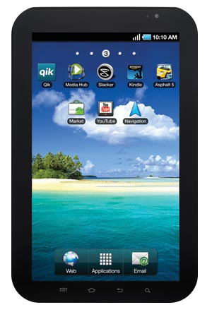
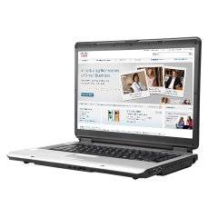

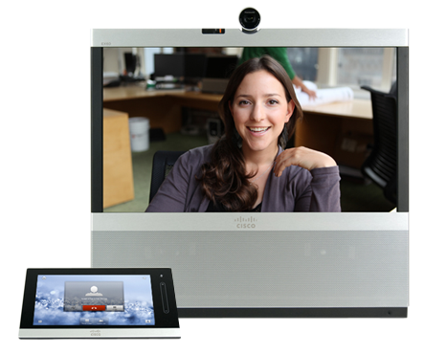




The Future Enables Freedom
Location/Device/Application
Independence
Notes:
Connection centric
Different experience depending on app. /device
Policy / security defined per devices
Identity-based access
Connection agnostic
Seamless experience across apps. / device
Consistent policy across devices

Slide 3

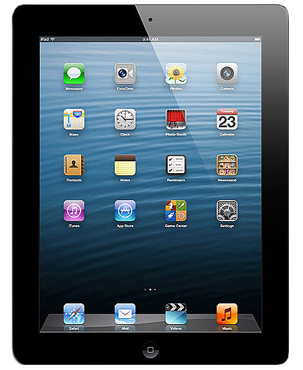


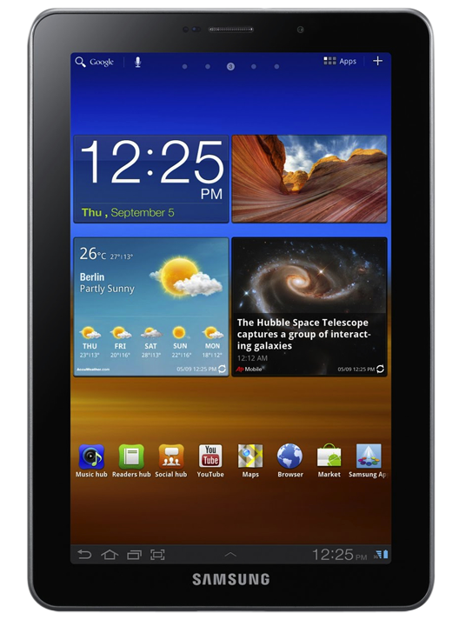
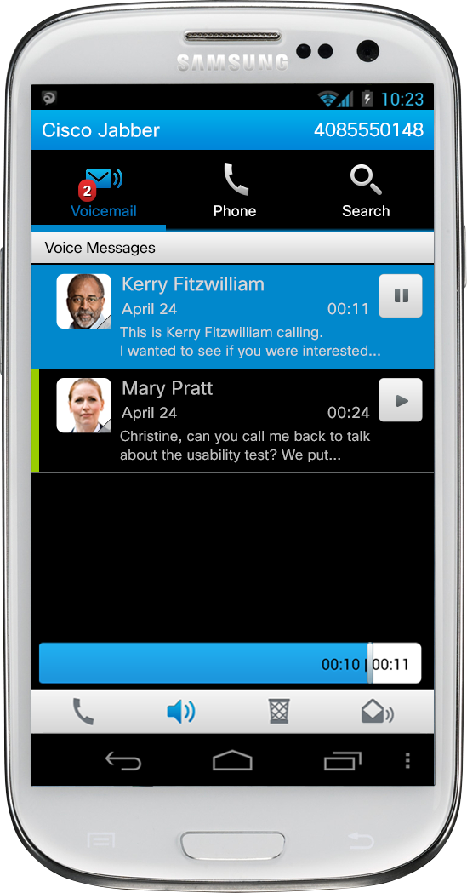
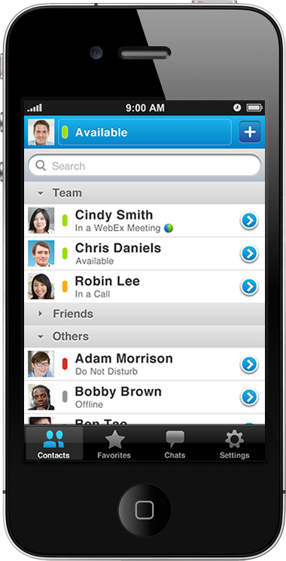
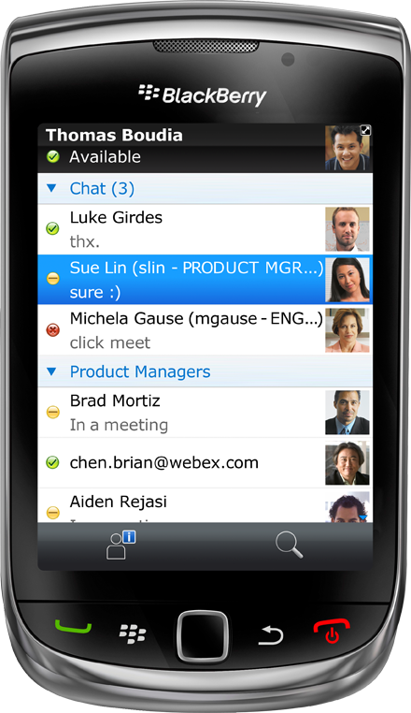
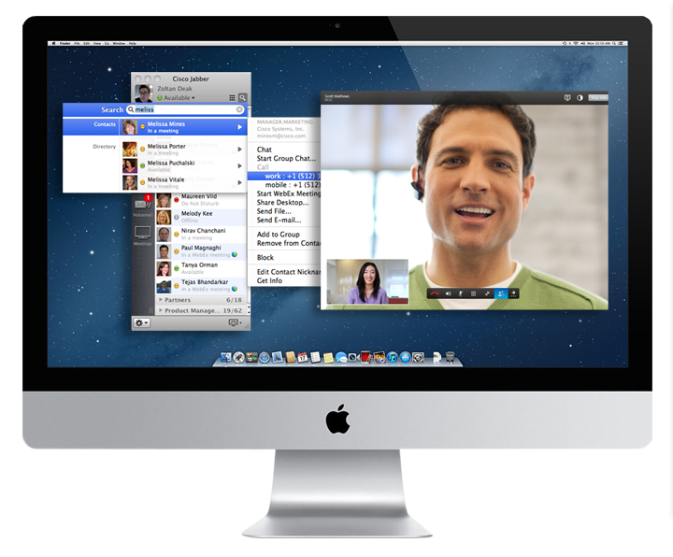
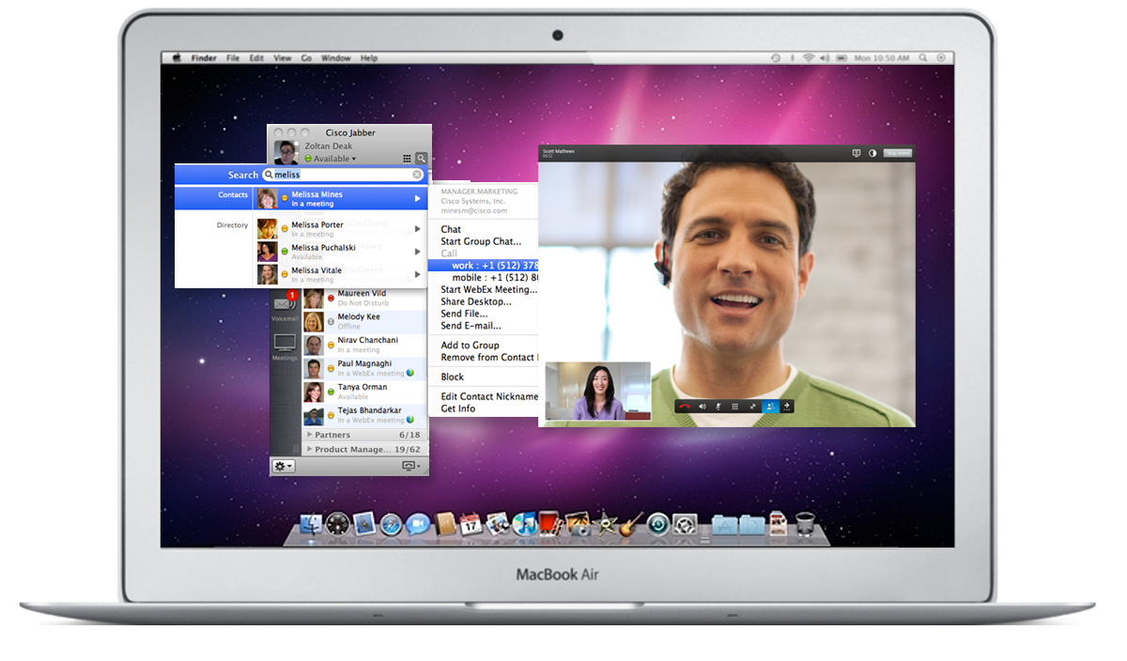
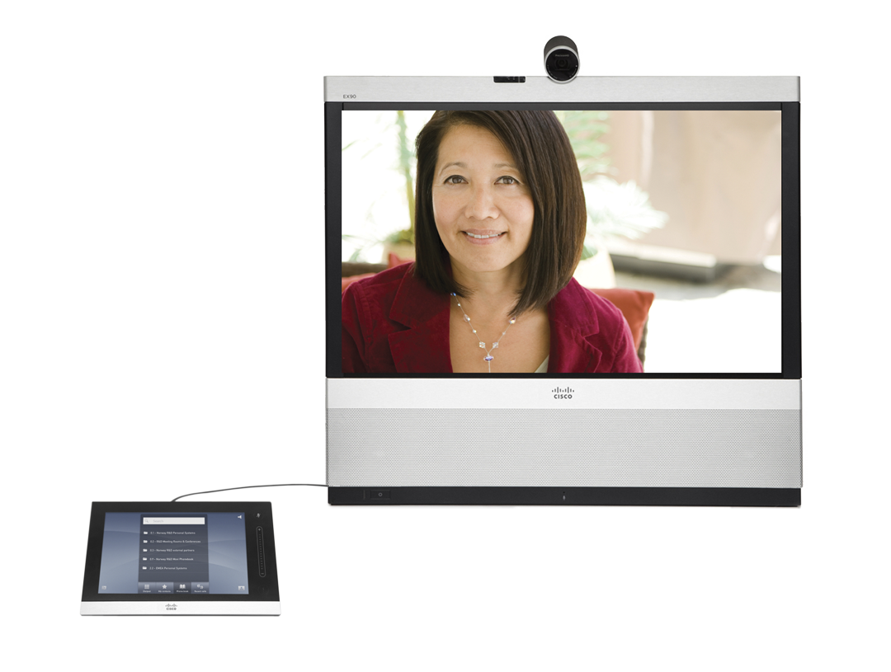

Smart Solutions Powering Mobility
Virtual Desktop plus
Enterprise Collaborative Applications
Virtual
Hybrid Approach
Native or Web-Based
Applications, Securely
Native
INTELLIGENT
NETWORK

Slide 4
BYOD Smart Solution
A Single Cross-Architectural Technology Framework
Virtual
Native
Corporate or Personal
Device/Endpoint
Workspace Productivity Applications
Workspace Management
Secure Mobility
Policy Management
Core Infrastructure
Notes:
Cisco’s BYOD integrated whole offer is designed to be a flexible set of building blocks that can be used or removed, depending on the customer need and use cases.
Through the addition of services, SBAs, and Cisco Validated Designs (CVDs), the BYOD Integrated Solution (Whole Offer):
• Simplifies operations and reduces risk: By providing pre-validated designs, system roadmaps, end-to-end support and services that enable faster deployment of workspace and business services
• Fosters Innovation: Allows IT orgs and enterprises to focus on innovation, not mitigation. Rather than solving the technology issues, you can focus on new business models

Slide 5

Introducing the BYOD Smart Solution
Unified Access Foundation with Collaboration for Productivity
  Unified Access—the foundation
    One Policy
    One Management
    One Network
  3rd Party MDM—industry’s only integrated approach
  Collaboration—unsurpassed productivity experience
Workspace Productivity Apps
Collaboration
Webex
Jabber
3rd Party
Workspace Management
MDM
Unified Access
Security Mobility
Policy Management
AnyConnect
ISE
NCS Prime
Core Infrastructure
Firewall
Wireless
Switching

Slide 6
Making the Technology a Smart Solution
A Comprehensive Workspace Approach
Workspace Productivity Apps
  Each layer delivers best-of-breed technology
    Gartner Magic Quadrant leadership across each layer
  Comprehensive workspace vision
    Only Cisco can span all layers of the solution
    Across virtual and native
    With investment protection through common components
Workspace Management
Security Mobility
Policy Management
Core Infrastructure

Slide 7
BYOD Smart Solution
A Single, Integrated, Cross-Architectural Technology Framework
Virtual
Native
R
Roadmap
E to E
End-to-End
Support
Corporate or Personal
Device/Endpoint
Workspace Productivity Applications
Workspace Management
V
Validated
Secure Mobility
M
Modular
Policy Management
Core Infrastructure
S
Services

Slide 8

























A Single Cross-Architectural Technology Framework
Virtual
Native
Remote Expert
R
Roadmap
E to E
End-to-End
Support
Corporate or Personal
Device/Endpoint
Workspace Productivity Applications
Workspace Management
V
Validated
Secure Mobility
M
Modular
Policy Management
Core Infrastructure
S
Services

Slide 9
Investment protection and end-to-end support
Modular and Validated
Building Blocks
Added at any time
Are guaranteed to work together
Mitigate risk
Protect investment
Support Example:
1) Call with wireless issue
2) Appears to be really a policy issue
3) Finally determine it is a MDM issue
Virtual
Native
Remote Expert
R
Roadmap
E to E
End-to-End
Support
Corporate or Personal
Device/Endpoint
✓
Workspace Productivity Applications
Workspace Productivity Applications
✓
3
Workspace Management
V
Validated
✓
M
Modular
Secure Mobility
Secure Mobility
✓
Policy Management
2
Policy Management
1
Core Infrastructure
S
Services

Slide 10




BYOD made easy
Modular and Validated
Integrated & Work-ready
Workspace Productivity Applications
Workspace Management
Secure Mobility
Policy Management
Core Infrastructure

Slide 11


Pulling it All Together
Collaborating on any device
Secure Mobility with seamless anywhere access
Delivering the Workspace in a pervasive and predictable manner
Manage and Secure
the Devices
Network Access – right person with right device having access to the right information
Onboarding – automatic onboarding using profiling and provisioning
Notes:
Different experience depending on app. /device
Policy / security defined per devices
Identity-based access
Connection agnostic
Seamless experience across apps. / device
Consistent policy across devices

Slide 12
BYOD Use Cases & Solutions
USE CASE
LIMIT
BASIC
ENHANCED
ADVANCED
IT Requirements
Visibility to who/what is on network
Restrict access to only corporate issued devices.
Restrict personal devices to public internet.
Restricted access to internal sites
Allow granular on-site and off-site access to network/applications
Enable a full mobile and collaboration experience
User Scenario
(Example)
Hospital extends wired access to medical staff only
Hospital provides guest access to patients
Doctor uses personal device in hospital and in an offsite coffee-shop
Hospital administrator is granted full network access and uses native application
Technology
Workspace Productivity Apps
Workspace Productivity
Workspace Productivity
Workspace Productivity
Webex, Jabber
Workspace Management
Workspace Management
Workspace Management
Workspace Management
MDM
Secure Mobility
Secure Mobility
Secure Mobility
AnyConnect, ASA
AnyConnect, ASA
Policy Management
Identity Services Engine
Identity Services Engine
Identity Services Engine
Identity Services Engine
Core Infrastructure
Wired, Wireless
Cisco Prime Infra
Wired, Wireless
Cisco Prime Infra
Wired, Wireless
Cisco Prime Infra
Wired, Wireless
Cisco Prime Infra

Slide 13



Advantages of a Comprehensive Workspace Approach
I Can Use an iPad
on the Network
Simple Approach
End User
Comprehensive
Approach
Drive New
Business Models
Increase Productivity
Business
Increase Agility
Attract And Retain Talent
Simplify Operations
Speed Time To Market
Mitigate Risk
IT
I Need a Workspace Optimized for Business Success

