Slide 1
Is Your Network Ready for BYOD? Introducing the Cisco BYOD Smart Solution for Commercial Customers
June 2012
Notes:
This presentation is designed to help you communicate the value of the commercial BYOD Smart Solution to your customers.
[Last updated June 2012]

Slide 2
Agenda
Market Trends
Key Challenges
Cisco Smart Solution
Getting Started
Notes:
The presentation is organized around this agenda.

Slide 3
What’s Happening
15 billion
networked mobile devices by 2015
56%
of information workers spend time working OUTSIDE THE OFFICE
3/4 of employees uses MULTIPLE DEVICES for work
100%
of IT staff STRUGGLE to keep up with mobile needs
Notes:
It is estimated that there will be 15 billion networked mobile devices in the next three years.
Work is no longer a place that you go, but a thing that you do: from any location, on any device.
The result of these transformative trends is that IT teams are universally struggling to keep up with the new demands.
But there is no escaping that people love their devices, so IT needs to find a way to manage them.

Slide 4
The Good News…
15 billion
new networked mobile devices by 2015
56%
of information workers spend time working OUTSIDE THE OFFICE
3/4 of employees uses MULTIPLE DEVICES for work
100%
of IT staff STRUGGLE to keep up with mobile needs
Increase Productivity
Attract Employees
Drive Innovation
Notes:
The good news of the BYOD and mobile workforce policies is that organizations who empower these capabilities report significant increases in productivity and are able to attract high-quality employees who are increasingly expecting this level of flexibility.

Slide 5
The Good News…
15 billion
new networked mobile devices by 2015
56%
of information workers spend time working OUTSIDE THE OFFICE
3/4 of employees uses MULTIPLE DEVICES for work
100%
of IT staff STRUGGLE to keep up with mobile needs
Increase Productivity
Attract Employees
Drive Innovation
Notes:
[This is a transition slide.]

Slide 6
The Key Challenges
Straining the Network
Overwhelming IT
Creating Security Risks
Increasing Complexity
Notes:
This employee empowerment does create additional challenges for the IT team.

Slide 7
Cisco BYOD Smart Solution
Connect
wherever employees are
Automate
adding new devices
Enforce policy across all devices
Manage
wired, wireless, VPN, and identity
Wired, Wireless,VPN, and Identity
“Single Pane of Glass” Management
Industry Leading Network Access Control
Notes:
The Cisco® BYOD Smart Solution is designed to address today’s trends and the resulting challenges. The solution includes the required networking, security, and management technologies to create a reliable and highly secure solution.
Customers can:
Connect to the network wherever they are
Automate the addition of new devices to the network
Enforce policy across all the devices on the network
Manage wired, wireless, VPN, and security with a “single pane of glass”

Slide 8
Cisco BYOD Smart Solution: In Detail
Connect
Wireless LAN, Switching, VPN
Automate
Identity Services Engine*
Number of Users
< 250
250–1,000
1,000–2,500
Enforce
Identity Services Engine
Manage
Cisco Prime Infrastructure
Unique Configurations for Different Sizes
Validated with Smart Business Architecture
* NOTE: Automated device on-boarding requires ISE 1.1MR
Notes:
The Cisco® BYOD Smart Solution has been validated with Cisco’s Smart Business Architecture (SBA) and includes recommended configurations for three different-sized organizations:
Up to 250 users
250 to 1000 users
1000 to 2500 users
Supporting technologies for the Cisco BYOD Smart Solution include:
Wireless networking for connecting devices in the office
LAN switching for wired connections and to support the wireless access points
VPN connectivity for connecting devices while away from the office
Identity services for detecting devices and users, automating the process of adding new devices, and enforcing access policies
Network management for managing wired, wireless, VPN, and identity with a “single pane of glass”

Slide 9
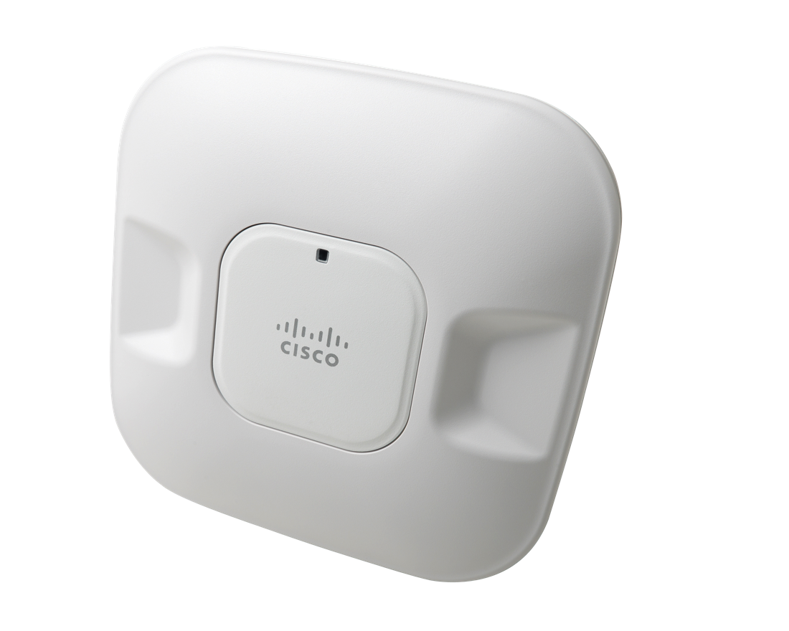
Cisco BYOD Smart Solution: Wireless Access
Most employee owned devices will connect with Wi-Fi
AP 1040
ClientLink 2.0
VideoStream
CleanAir
AP 3600
Business Ready 802.11n
2x2 MIMO Performance, 802.3af PoE, LLW
Improved Performance
Proactive and automatic beam forming for 802.11n and legacy clients
Improved Performance
Wired multicast over a wireless network
Improved Performance
Proactive and automatic interference mitigation
Access Point Innovation
The Tablet AP, 4x4 MIMO throughput and coverage for advanced applications
Cisco 2500 Series WLC: Up to 250 Users
Cisco 5500 Series WLC: Up to 2,500 Users
Notes:
The vast majority of personal devices connect to the network via Wi-Fi. Cisco delivers the best in business mobility with one network that can span wired, Wi-Fi, and cellular access. Cisco provides one source of policy and one unified management platform to help you deliver "bring your own device (BYOD)" support. With Cisco solutions you can deliver highly secure access for any device, simplify operations end to end, and build an intelligent network to facilitate productive business.
The BYOD Commercial Smart Solution recommends the Cisco 2500 Series Wireless LAN Controller for up to 250 users and the Cisco 5500 Series Wireless LAN Controller for up to 250 users for up to 2,500 user.s

Slide 10
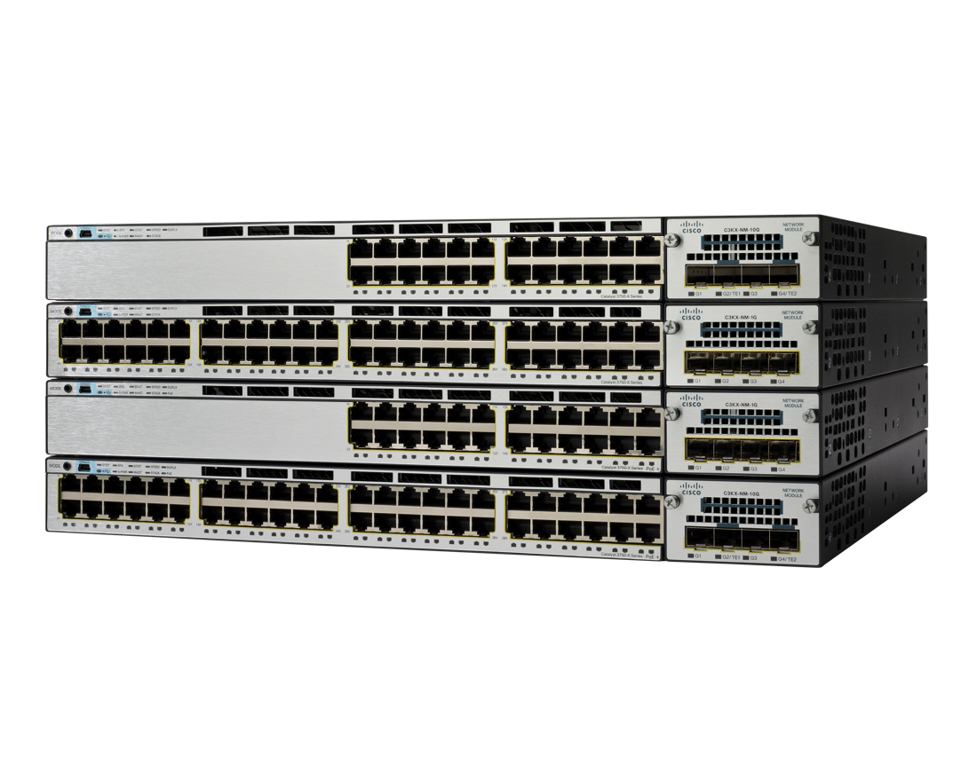
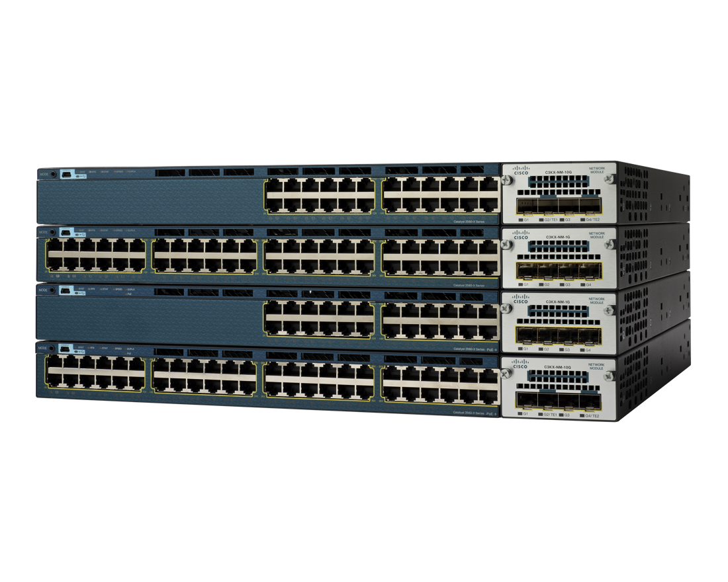
Cisco BYOD Smart Solution: Switching
Access points and wired devices connect with Ethernet
Unique Differentiators for BYOD
Catalyst 3750-X
Discover and Profile: End devices with IOS Sensor
Access Control: No impact using Monitor Mode
Link Layer Encryption: Embedded MACsec
Network Visibility: Flexible NetFlow
Attack Forensics: Smart Logging and Telemetry
Catalyst 3560-X
Catalyst 3750-X: Network & Power Stacking
Catalyst 3560-X: Stand Alone Fixed Switch
Notes:
The client LAN access switches address the primary responsibility of connecting end-users’ devices to the network. The client LAN access design provides Layer 2 switching functionality for all connected endpoints, either directly through wired-Ethernet connections, or indirectly via connected wireless access points (APs). Switches must supply adequate bandwidth to every endpoint device, both on the access port and in the connection to the core.
Another important function of the LAN access switch role is supplying Power over Ethernet (PoE). PoE/PoE+ delivers power to IP telephones, wireless access points (APs), security cameras, and other low-power devices. cost of re-engineering the network in the future as PoE devices are deployed.
The BYOD Smart Solution recommends either the Catalyst 3750-X or the Catalyst 3560-X:
The Cisco Catalyst 3750-X Series is a fixed-port stackable switch with modular uplinks that is capable of expansion.
The Cisco Catalyst 3560-X Series is a fixed-configuration, non-stackable switch with modular uplinks that provides flexibility and features for many access-level switching environments with low port-density requirements.

Slide 11
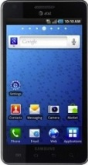
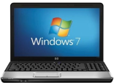
Cisco BYOD Smart Solution: AnyConnect
Using devices away from the office builds on productivity gains
Easily Manage Remote Security
Policy Enforcement: Context-aware and preemptive
Always-On: Simplified user experience
Easy to Deploy: Managed and unmanaged devices
iOS
Android
OS X
Windows
Cisco ASA 5515-X: Up to 250 Users
Cisco ASA 5545-X: Up to 2,500 Users
Notes:
The VPN experience is simpler and more secure with the enhanced remote access technology of Cisco AnyConnect Secure Mobility Client. As mobile workers roam to different locations, with always-on and intelligent VPN, the Cisco AnyConnect client can:
Automatically select the optimal network access point
Adapt its tunneling protocol to the most efficient method
The BYOD Commercial Smart Solution recommends the Cisco Adaptive Security Appliance (ASA) 5515-X for up to 250 users and the ASA 5545-X for up to 2,500 users

Slide 12
Cisco BYOD Smart Solution: ISE
Automate Adding New Employee Owned Devices
New Capabilities in ISE 1.1MR
Zero-Touch On-Boarding: Minimizes impact on IT
Self-Service: User-based registration
Registration: In-band or out-of-band
802.1x: Flexible profiles
Devices: Black-listing and reinstating
iOS
Android
OS X
Windows
Cisco ISE 3315: Up to 250 Users
Or…
a Virtual
Machine
Cisco ISE 3355: Up to 1,000 Users
Cisco ISE 3395: Up to 2,500 Users
Notes:
The Cisco Identity Services Engine is a next-generation identity and access control policy platform that enables enterprises to enforce compliance, enhance infrastructure security, and streamline service operations – it is a core component of the Cisco BYOD Smart Solution and Cisco continues to invest in its capabilities. Here are some of the recent innovations, including the automatic provisioning of new devices.
There is also an ISE virtual machine.

Slide 13
Cisco BYOD Smart Solution: ISE
Enforce Policy Consistently Across Devices
Regardless of device ownership
Increased Visibility: Who/what is on the network
Integrated AAA, Profile, Posture: Simplifies installs
Accurate Device Profiling: Increases security
Context-Aware Policies: Adapt to business needs
Gartner: Leader in Magic Quadrant for NAC
iOS
Android
OS X
Windows
Cisco ISE 3315: Up to 250 Users
Or…
a Virtual
Machine
Cisco ISE 3355: Up to 1,000 Users
Cisco ISE 3395: Up to 2,500 Users
Notes:
ISE provides visibility and control for every device accessing the network and can block unwanted devices.
It automates policy enforcement for devices on the network, including adding an employee’s personally owned smartphone or tablet.
It customizes each user’s access to resources based on their role, the device they are using, and how they are accessing the network.
It provides a way for employees to update their devices and helps ensure that they have the latest software installed to minimize security risks before they access the network.
Cisco ISE has been positioned as a leader in the Gartner Magic Quadrant for Network Access Control.
[Note: see http://www.gartner.com/technology/reprints.do?id=1-18VNF2C&ct=120119&st=sb]

Slide 14
Cisco BYOD Smart Solution: ISE
Integrate Mobile Device Management (MDM)
2nd Half 2012: Added Capabilities
ISE 1.2 Partners
On-Premises: Directed to registration site
Restricted Access: For non-compliant devices
End-Point Data: In addition to profiling data
Initiate Action: Device wipe or application upgrades
Cisco ISE 3315: Up to 250 Users
Or…
a Virtual
Machine
Cisco ISE 3355: Up to 1,000 Users
Cisco ISE 3395: Up to 2,500 Users
Notes:
ISE protects information by deleting it remotely when devices are lost. This will be accomplished through partnerships with third parties by end of 2012 calendar year. Initial partnerships include Airwatch, Good Technology, MobileIron, and Zenprise.
(Note: See the Cisco Helps Companies Move Beyond Basic ‘Bring Your Own Device’ Connectivity to Create a Better Workplace Experience press release at http://newsroom.cisco.com/press-release-content?articleId=736376&type=webcontent for more information.)

Slide 15
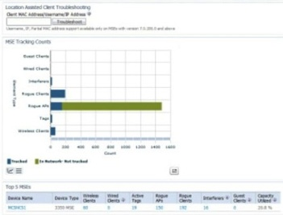
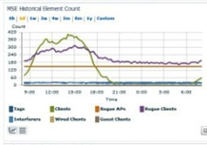
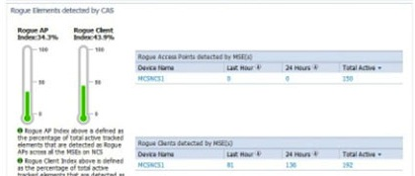
Cisco BYOD Smart Solution: Cisco Prime
Manage Wired, Wireless, VPN and Policy with One Interface
Prime Infrastructure: LMS + NCS
Integrated Interface: All locations, devices, users
Complete Management: Across products’ lifecycles
Simplified Deployment: Automate network services
Accelerated Troubleshooting: Single user interface
Application Requires a Server (e.g.—UCS)
Dedicated Appliance (NCS) Available
Can be Deployed on Virtual Machine(s)
Notes:
Cisco Prime for Enterprise is an innovative strategy and portfolio of management products that empower IT departments to more effectively manage their networks and the services they deliver. Cisco Prime simplifies network management, improves operations efficiency, reduces errors, and makes the delivery of network services more predictable.
Cisco Prime Infrastructure is a bundled solution for complete wired and wireless lifecycle management. It offers:
Converged management for ease of monitoring, troubleshooting, and reporting
Improved configuration, change, and compliance management for lower TCO
Similar look and feel for an improved user experience and workflow management

Slide 16
Cisco BYOD Smart Solution: Summary
Connect
wherever employees are
Automate
adding new devices
Enforce policy across all devices
Manage
wired, wireless, VPN, and identity
Wired, Wireless,VPN, and Identity
“Single Pane of Glass” Management
Industry Leading Network Access Control
Notes:
Cisco is the only vendor that brings these capabilities together, bringing you a competitive advantage.
You can:
Connect employees to the network wherever they are
Automate the addition of new devices to the network
Enforce policy across all the devices on the network
Manage wired, wireless, VPN, and security with a “single pane of glass”

Slide 17
Cisco BYOD Smart Solution: Getting Started
Pre-Tested, Validate Solutions: Smart Business Architecture
Foundation
Identity Services Engine
Advanced ISE
Advanced Remote Access
Advanced Wireless
Wireless
Guest Network
Switching
VPN
Authentication, Authorization, Accounting
Device Profiling
Posture Assessment
Phased Implementation
Recommended Migration Path
Full TrustSec Deployment
Integrated ScanSafe
Always-On Protection
Simplifies Remote Tablets
Automated Guest Access
Zero-Touch Provisioning
Full Compliance
Based on Live Network Configurations
Fully Documented Down to the CLI
Updated Every 6 Months
Notes:
Cisco has invested in pretested, validated solutions for us to build on for your requirements. [We – meaning the partner – can adapt these designs for your specific needs at greatly reduced risk.]
[For more information about the Smart Business Architecture (SBA) see, www.cisco.com/go/sba ]

Slide 18
Cisco Smart Services
Accelerating Your Profitability and Differentiation Differentiation
Smart Services drive business results
Improve risk management
Simplify operations to create efficiencies
Resolve problems faster
Reduce costs
Improve user and customer satisfaction
Notes:
Cisco Smart Services from Cisco and its partners enable you to realize the full business value of your technology investments by harnessing the network as a powerful business platform.
Cisco SMARTnet® Service facilitates rapid resolution of critical network issues and improves operational efficiency through a combination of expert technical support, flexible hardware coverage, OS updates, and smart, personalized capabilities.

Slide 19
Cisco BYOD Smart Solution: Cisco Capital
Defer payment for 6-months
Don’t wait for budget to become available
Alternate Credit: Delay payment without affecting existing credit lines
Flexible Terms: Convert capital expenses to operating expenses
Align Technology Costs: With user benefits
Reduce Total Cost of Ownership
Notes:
Cisco Capital offers financing options that makes Cisco technology affordable and quickly accessible, giving you customers more flexibility without having to wait for budget to become available.

Slide 20
Cisco BYOD Smart Solution
Next Steps
Agree on Your Goals
Assess Your Situation
Customize a Solution
Plan Timing and Deployment
Notes:
[Partner, we recommend that you customize this slide for your customer and the next steps you anticipate with the account.]
The Cisco BYOD Smart Solution is designed to streamline and simplify the process for you.

