Slide 1
Maximise Your Purchasing Power with Unified FlexPod Financing
<insert name>
<insert date>

Slide 2
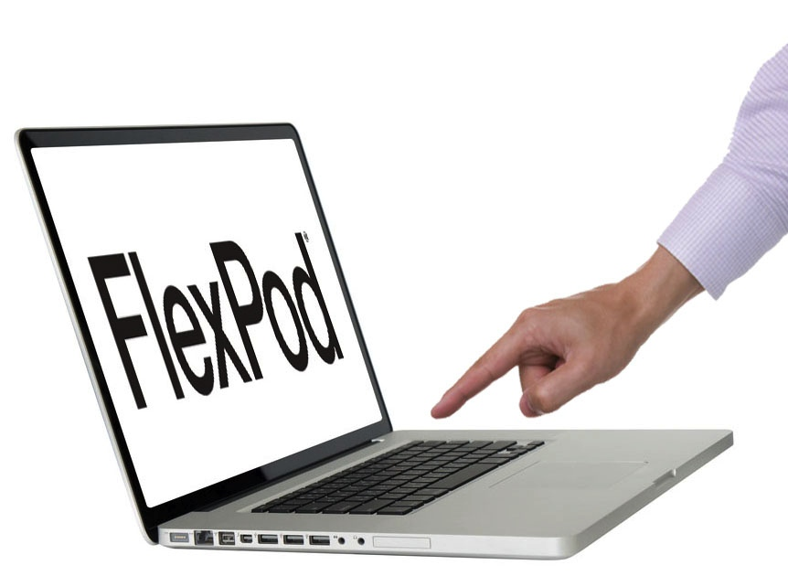
Agenda
Advance your business requirements
Accelerate to a converged infrastructure
Simplify technology refresh
Maximise your purchasing power
Unified FlexPod® financing

Slide 3

Advance Your Business Requirements
The Power of a Unified Approach to Financing
New joint financing offered
through NetApp® and Cisco®
Select from a united portfolio
of extensive financing options
for FlexPod solutions

Slide 4

Accelerate Your Move to a
Converged Infrastructure
Maximise Your
Purchasing Power
Overcome Budget
Constraints
Unified Approach
to Financing
Keep it simple by consolidating your investment into a single transaction:
NetApp and Cisco technology
Services, support,
and education
Third-party products
Partner-provided products and services
Options to meet budget requirements:
Pay low fixed monthly payments
Time payments to meet cash flow
Meet growth by adding schedules
Refresh technology by extending agreement
Roll-over investments
Access to the best financing solutions:
Broader array of financing options
Innovation to help
you achieve a business advantage
Financial strength for optimised terms and rates
Flexibility to help you qualify faster

Slide 5

Simplify Technology Refresh
Say YES to Growing
Business Demands
Improve efficiency and decrease
expense by aligning your technology
investments with business value
Financing helps you realise a faster return by deferring a large upfront investment into payments over time
Accelerate the
Return on Your
FlexPod Investment
Protect Against
Obsolescence
It’s easy to keep pace with the newest
hardware and software releases in an uninterrupted manner by adding a
schedule to your current agreement

Slide 6
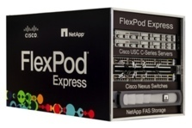


Maximise Your Purchasing Power
Start right with a cost-effective, easy-to-deploy solution that consolidates your application and data requirements
FlexPod Express provides a single, convenient, converged platform to manage your entire infrastructure
Start Right
Keep It Simple
Keep it simple by consolidating your entire purchase into a single transaction
Finance software, support, services, third-party hardware and partner provided products
Grow smart with the ability to migrate toward a newer solution in an uninterrupted manner
Stay in step with advances in technology by financing future upgrades in a predictable manner
Grow Smart

Slide 7

Unified FlexPod Financing
Unified FlexPod Financing from NetApp and Cisco*
Select a financial solution that matches your cash flow
Total solution financing that includes services, support, education, and other third-party and partner-provided products
Must include FlexPod Datacenter or FlexPod Express
Terms and conditions
No minimum or maximum dollar amount
Minimum term of 24 months, with terms up to 60 months
Subject to credit approval
Cannot be combined with existing finance promotions
Available in the UK now, ending 31 July 2016
Email FlexPodFinance@leasedirect.com
*Financing availability varies by country

Slide 8

Learn More about Unified FlexPod Financing
See how Unified FlexPod Financing makes it possible to:
  Realise immediate return on new investments
  Manage cash flow
  Improve competitiveness with advances in technology
  Experience a faster payback period
Contact your certified FlexPod partner:
  www.netapp.com/us/partners/flexpod
Learn more about a FlexPod solution:
  www.cisco.com/go/flexpod
  www.netapp.com/flexpod

Slide 9
© 2014 NetApp, Inc. and Cisco Systems, Inc. All rights reserved. No portions of this document may be reproduced without prior written consent of NetApp, Inc. and Cisco Systems, Inc. Specifications are subject to change without notice. NetApp, the NetApp logo, and FlexPod are trademarks or registered trademarks of NetApp, Inc. in the United States and/or other countries. Cisco is a registered trademark of Cisco Systems, Inc. All other brands or products are trademarks or registered trademarks of their respective holders and should be treated as such.

