Slide 1
Cisco Employee Resource Organizations (EROs) March 2014
Cisco ERO Strategist, Rosie Cofre (rcofre@cisco.com)

Slide 2
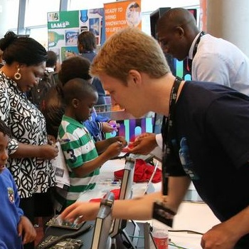
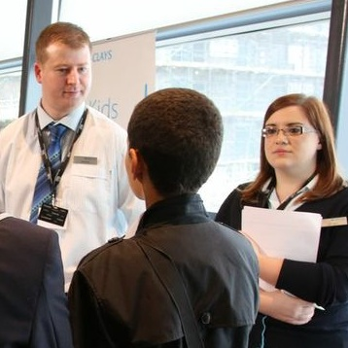
Employee Resource Organizations (ERO)
Global, Virtual Organizations
Diverse Communities
Business Integration
Stretch Assignments
Changing the Conversation…
Notes:
*

Slide 3
Community Alignment

Slide 4
Cisco Employee Resource Organizations
Engage, Empower, Transform
Networking Academy Outreach
Career Days
Mentoring
STEM Global Outreach
Campus Visits and Internships
© 2013 Cisco and/or its affiliates. All rights reserved.

Slide 5
Business Alignment

Slide 6
Business Led Engagements
Talent Management
Orientation & Onboarding
Career Development
Bring Career to Life
Corporate Affairs
Networking Academy - Girls in ICT (Q3 – FY12)
Inclusion & Diversity
Women of Impact
Executive Shadow
GLBT Ally Strategy
Stretch Assignment Marketplace (SAM)
ERO Executive Round Table
University
Engagement Board – Platinum schools
ERO
Public Relations
External Engagements
Diversity Staffing/ Engineering
ERO Employee Referral Program (HIRE)
Community Relations
US2020 STEM Initiative

Slide 7
Business Alignment Example

Slide 8
Cisco Networking Academy
1M
Students
10,000
Academies
165
Countries
Notes:
CISCO NETWORKING ACADEMY
The Cisco Networking Academy develops ICT curriculum used by educational organizations to equip learners with skills needed to design, build, maintain, and secure computer networks.
Each year, Networking Academy’s innovative, blended learning model prepares over one million students across the globe for successful careers in ICT.
*

Slide 9
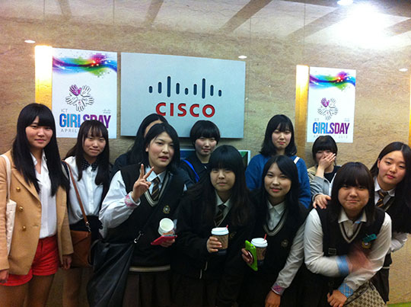
Innovative, Blended Learning Model
Cisco Networking Academy
Girls in ICT Events
Cisco EROs
Notes:
INNOVATIVE, BLENDED LEARNING MODEL
In partnership with the United Nations ICT subcommittee, the Cisco Networking Academy participates in the yearly “Girls in ICT” event by hosting young girls in Cisco offices around the Globe.
Networking Academy approached the Cisco EROs as an ideal partner because of their deep-rooted relationships in the community.
EROs became the vehicle for reaching a diverse group of girls and helping to meet the Networking Academy objective of getting more girls interested in STEM-related (Science, Technology, Engineering, and Math) careers.
Their initial goal was to double the number of “Girls in ICT” attendees, from 500 to 1000 globally.
*

Slide 10
Cisco Networking Academy
Girls in ICT Event
1st Year
500 Girls
44 Locations
2nd Year Goals
1,000 Girls
80 Locations
2nd Year Actuals with EROs
2,000 Girls
80 Locations
Notes:
CISCO NETWORKING ACADEMY
Partnership with all the Cisco EROs resulted in Networking Academy successfully doubling its target, hosting 2,000 girls.
In alignment with the ERO operating model, Networking Academy assumed the role of “Business Sponsor” for the ICT Event for Girls by:
Assigning people from their team to the roles of Global Program manager and Project Managers (x3)
Hiring a contractor to develop resource materials, design the website, and run reports
Funding the girls’ visit, lunch, and a ‘give away item’.
Establishing, tracking and reporting success metrics for the event and ERO impact.
*

Slide 11
Thank you.

