Slide 2
Notes:
Licensing Strategy Overview
There are no changes to the structure of Cisco’s licensing, but significant value has been added. Cisco still offers three main licenses – UCL Enhanced, CUWL Standard, and CUWL Pro. Cisco continues to add value to existing offers by adding products and features into the offers at no additional charge.
The following are key elements of Cisco’s Collaboration Pricing and Licensing strategy for FY14.
Add Value to Current UC Licensing Solutions
Maintain market price with increased value
Provide features and products customers value
Encourage Strategic Collaboration Trends
Offer flexibility in voice and video offers including cloud and mobile
Deliver Simple and Consistent Pricing Methodology
Continue with a consistent user-based bundling strategy
Enable Migration between On Premise and Cloud
Improve Ease of Doing Business with Cisco
Including ordering, UCSS renewal, License Mgmt.

Slide 3
Notes:
Cisco’s licensing structure hasn’t changed since last year, with three main licenses – UCL Enhanced/Enhanced Plus, CUWL Standard, and CUWL Pro.
As depicted here, each license builds upon the previous.
Note that the elements highlighted in green are updates and additions for Systems Release 10. More details on each of these new features will follow in this deck.
Note that the UCL Basic and UCL Essential licenses still exist for more basic needs but aren’t shown here. The main three offers are Cisco’s focus for collaboration workers.

Slide 4
Notes:
UCL Enhanced is the first level licensing for Collaboration users
This hasn’t changed from last year’s release. Key features include …
UCL Enhanced supports UC applications for one device and UCL Enhanced Plus supports for 2 devices per user
Both licenses support Cisco’s entire portfolio of personal endpoints (including all Jabber softclients, IP and video-enabled devices, personal telepresence devices)
New for System Release 10 is the inclusion of Expressway for remote and mobile workers, which provides a VPN-less option for IM&P, voice and video firewall traversal within an organization. This enhancement makes users truly mobile. Note that B2B and third-party interop firewall traversal are not included here, but that capacity can be purchased separately.
Another addition in System Release 10 is the inclusion of Prime Collaboration Standard licensing management. This is included in CUCM.

Slide 5
Notes:
CUWL Standard has become Cisco’s most popular licensing for Collaboration users
This license includes all features of UCL Enhanced / Enhanced Plus, including the new additions of Expressway and Cisco Prime Collaboration
The key differentiators as compared with UCL Enhanced continue to be …
UC application support for more than two devices
Cisco’s unified messaging, or Cisco Unity Connection

Slide 6
Notes:
The third and final main software bundle is CUWL Pro, which is the most comprehensive license option
As you can see here, this includes all features of CUWL Standard and UCL Enhanced / Enhanced Plus. Again, this structure has not changed since last year.
There are two key differentiators we’ll discuss as compared with CUWL Standard…
The first, is the enhancements made to the WebEx Conferencing component of CUWL Pro licensing. Although WebEx is included in CUWL Pro today, the offer has changed in two significant ways.
First, the named user license replaces the existing ratio of ports per user. So instead of one WebEx port for every 10 CUWL Pro licenses, as it is today, the offer includes one named user for each CUWL Pro license.
Secondly, the offer is updated to include both the perpetual, on-premises license of WebEx Meeting Server (or CWMS) AND the one-year cloud subscription for WebEx Meetings Center.
The second significant enhancement in CUWL Pro is the addition of the named user license for Personal Multiparty. For each CUWL Pro user license, one named host is entitled to host ad-hoc multiparty meetings with up to three additional parties, using a personalized contact address. This is included with CUWL Pro and can also be purchased a la carte to complement lower levels of licensing.

Slide 7
Notes:
This license overview should look familiar. Last year, a similar graphic was used to depict Cisco licensing, and that structure hasn’t changed. We use this graphic to show more of the details in each license offer.
Note that the check marks represent what’s included in the user license, while the plus signs are a la carte options that have additional costs.
Again, perpetual pricing has not changed. The list prices shown here have remained constant while Cisco has added products and functionality to the licenses.
More details of each enhancement can be found in following slides.
While the focus for collaboration users is on the three main licensing levels, Cisco realizes that our customers still need to provision simple phones to put in public spaces or shared use environments. Essential and Basic provide licensing for those scenarios where customers still need to enable endpoints for places, not people. Examples include: conference rooms, lobbies, quiet rooms and fax machines.

Slide 8
Notes:
Personal Multiparty alignment with FY14 strategy

Slide 9
Notes:
WebEx Conferencing alignment with FY14 strategy

Slide 10
Notes:
Expressway for remote and mobile workers alignment with FY14 strategy

Slide 11
Notes:
Cisco Prime Collaboration alignment with FY14 strategy

Slide 13
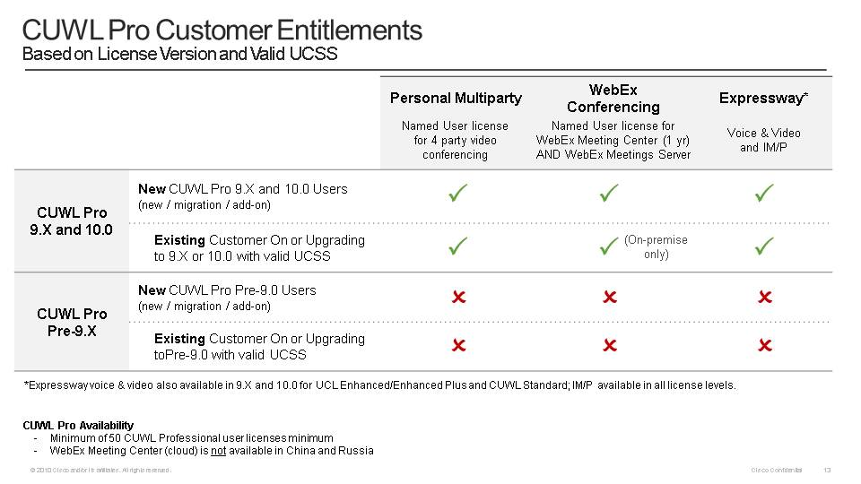
Notes:
New CUWL Professional customers and existing CUWL Pro customers on valid UCSS have the opportunity to take advantage of the updates in Systems Release 10, in both versions 9.X and 10.0.

Slide 14
Notes:
UCSS remains the preferred method for license upgrades. As is always the case, customers on valid UCSS are provided rights to major upgrades at no additional cost.
For customers not on UCSS…
The Cisco Collaboration Breakaway Plus Drive to 9 promotion is designed to encourage current customers to upgrade their Cisco UCM to the latest releases. Customers upgrading to version 9.1 and later will be rewarded with exceptional discounts. A similar offer will be available with the v10 release, and details will follow at the time of launch.
Get Current, Stay Current provides a price incentive for customers without UCSS to upgrade to the latest release. This is a new component of the product offer – not a promotion – where customers can purchase the latest version of licensing at 20% of list price when they buy 3 years of UCSS. Further, this offer can be combined with the CB Plus Drive to 9 promotion in order to receive even more favorable pricing.
Lastly, the A La Carte Upgrade remains an option, although it’s the least cost efficient.

Slide 17
Notes:
Tiered pricing continues to exist for Cisco’s UCL license offers.

Slide 23
Notes:
The Cisco Enterprise Agreement for Collaboration, or Collab EA, provides software deployment and services consumption rights for the entire organization in a single co-terminated, multi-year agreement.
Under the Collab EA, each suite includes enterprise-wide access to software, upgrade subscriptions, or UCSS, and technical support, or ESW. Note that hardware is excluded from the Collab EA and must be purchased separately.
At least 2,000 knowledge workers are required to qualify for the Collab EA. Please leverage your EA BDM [voice: letters B,D,M] or Licensing Executive if you have potential opportunities you’d like reviewed.
[click]
Along with the number of knowledge workers, the Collab EA takes customers’ previous investments in Cisco collaboration products into account.
Previously procured on-premise licenses and the residual value of the UCSS and ESW are factored into pricing, so customers do not pay twice, depicted here by the reduction in the knowledge workers by the existing installed base.
[click]
The cost of the Enterprise Agreement is fixed over the length of the contract agreement, based on the number of knowledge workers at the time of purchase.
The customer then has unlimited applications and services consumption over the term of the agreement without any financial true-ups due to growth.
License rights include unlimited organic growth, as well as inorganic growth, such as mergers and acquisitions, up to 20%.
Customer term lengths can be 3 or 5 years. Note that periodic payment options are available through Cisco capital to meet customers’ budget needs and align with their deployment requirements.

Slide 24
Notes:
There are five Collab EA suites available. As noted here, many are new to the market in FY14. Please contact your EA BDM or Licensing Executives if you have potential opportunities you’d like reviewed.

Slide 25
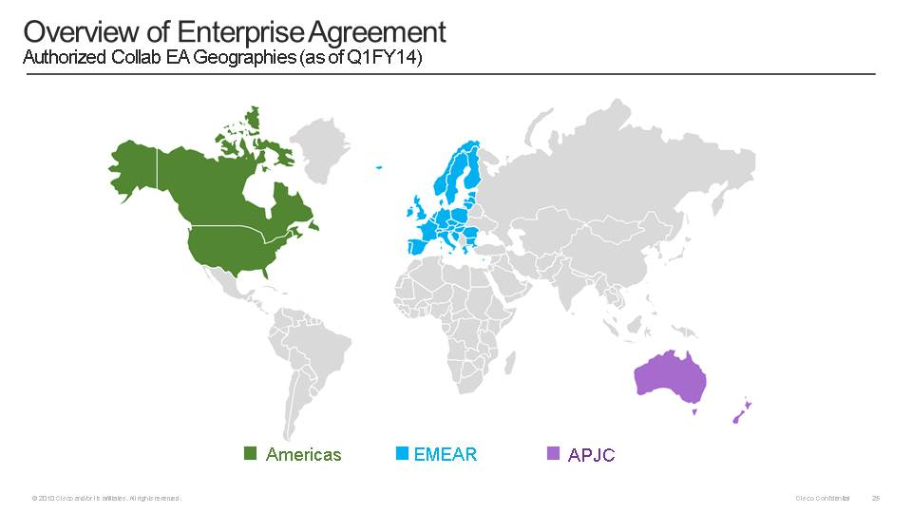
Notes:
To qualify for a Collab EA, the transaction must take place in one of these authorized Collab EA countries and transacted through a Collab EA-authorized partner. Companies with global workforces can deploy on a worldwide basis, as long as their Collab EA transaction occurs in one of these authorized geographies.
Cisco is constantly expanding authorized geographies, so please contact your Collab EA BDM or Licensing Executive for the most current listing of authorized Collab EA countries.

