Slide 1


Cisco 300 Series Switches
Product Presentation
“Cisco has raised the bar for this product category”
– Kevin Tolly, Founder, The Tolly Group

Slide 2
Cisco SMB Switching
The leader in Switching solutions for small to medium businesses
Over 20 million Switching ports shipped per year
  Solid market share = right features, price, & reliability for your business
Purpose-built for SMB:
  Pricing, functionality, and ease that customers are asking for
  Easy to install and maintain
Part of a complete data, voice and video networking solution
  Simplified integration for data, voice and video communications needs
Backed by Cisco
  Comprehensive quality and integration testing → works as you expect it to work
  Superior support → better tools, documentation and technical support for Cisco class support

Slide 3

Cisco Small Business 300 Series
Value Proposition
Market-leading price/performance family
Ease of Use
Peace of Mind with Enhanced Support and Warranty
  Lowest Energy consumption including EEE Support and others
  Advanced Threat Protection and Security
  Optimal price/port and price/PoE Watt
  Rich support for QoS, IPv6, L3, Multicast, others
  Wirespeed, non-blocking performance with Low latency
  Consistent interface across all Cisco® Small Business products
  Ease deployments with CDP/LLDP-MED discovery, Auto Smartports, Cisco VSDP
  Interface and documentation available in seven languages
  Multiple management options – CLI, embedded HTTP Device Manager GUI, SNMP, Onplus Cloud, CCA System Mgmt, Cisco Prime LMS
  Cisco Small Business Support Service
  Limited lifetime warranty with next business day advanced replacement
  Free firmware updates

Slide 4
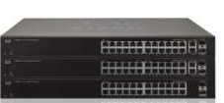
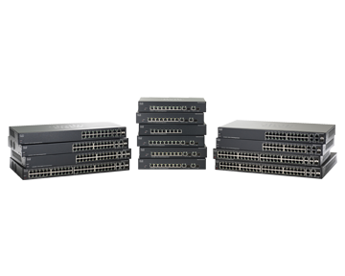

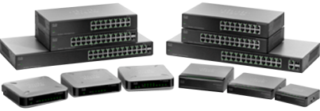
Cisco SMB Switch Portfolio
ADVANCED LAYER 2 / Basic L3
(Managed/Stackable) PORTFOLIO
BASIC LAYER 2
(Unmanaged/Smart) PORTFOLIO
500 Series Stackable
10G Uplinks/Stack
PoE/PoE+
Higher resilience
Dynamic Routing (L3)
E-LLW
300 Series Managed
1G Uplinks
PoE/PoE+
Advanced Mgmt, QoS,
Security, Availability,
Static Routing (L3)
E-LLW
200 Series Smart
1G Uplinks
Partial PoE
Basic Mgmt, QoS,
Security, Availability
LLW
100 Series Unmanaged
1G Uplinks
Partial PoE
Plug & Play simplicity
LLW
Fast Ethernet
Gigabit Ethernet
Fast Ethernet
Gigabit Ethernet
Fast Ethernet
Gigabit Ethernet
Fast Ethernet
Gigabit Ethernet

Slide 5
Cisco 300 Switches
KEY FEATURES
OPERATIONAL SIMPLICITY
Designed for deployment/management of SMB environments
Portfolio feature set consistency
Optimally integrates with other
Cisco SMB products
Limited Lifetime Warranty w/NBD
Auto Smart Ports
Network-Wide Auto Voice
Discovery and Cloud
Management with OnPlus
Web GUI and CLI
>15M PORTS SHIPPED
>$200M REVENUE
USGv6 / IPv6 GOLD LOGO
ENERGY EFFICIENCY
PURPOSE-BUILT FOR SMB
Addressing new opportunities and markets for SMB

Slide 6
Cisco 300 Series Switches
Product Overview
Next-generation Cisco Managed Switches for SMB
8–52-port models up to Gigabit Ethernet – PoE/PoE+ and non-PoE
Easy configuration, deployment, and management
Green energy-efficient technology including EEE, Cable Length detection, Energy Detect, and others
Enhanced features including Threat Protection, QoS, Layer 3, and IPv6
Network-wide Auto Voice deployment with Auto Smartports, CDP/LLDP, and VSDP (patent pending)
Three-Year Extended Service (available option) through Cisco SBSC Support Center
Limited lifetime warranty w/NBD

Slide 7
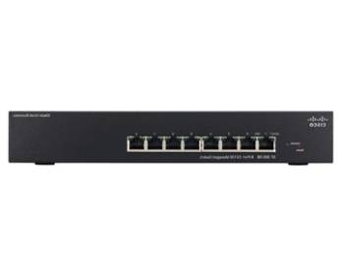
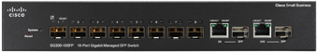
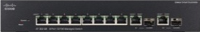
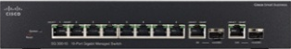
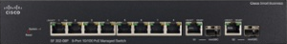
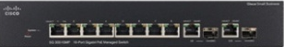
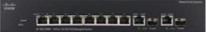
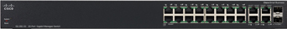
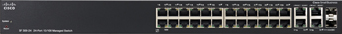
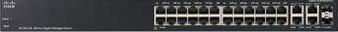
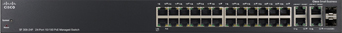
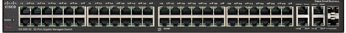
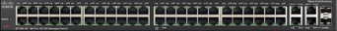
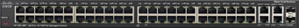
Cisco 300 Series Switches
Model Overview
Fast Ethernet
Gigabit Ethernet
SF300-08
8 10/100 ports
SG300-10SFP
8 10/100/1000 SFP ports
2 combo mini-GBIC ports
SF302-08
8 10/100 ports
2 combo mini-GBIC ports
SG300-10
8 10/100/1000 ports
2 combo mini-GBIC ports
SF302-08P|SF302-08PP
8 10/100 PoE ports
2 combo mini-GBIC ports
SG300-10P|SG300-10PP
8 10/100/1000 PoE ports
2 combo mini-GBIC ports
SG300-10MP|SG300-10MPP
8 10/100/1000 Maximum PoE ports
2 combo mini-GBIC ports
SF302-08MP|SF302-08MPP
8 10/100 Maximum PoE ports
2 combo mini-GBIC ports
SG300-20
18 10/100/1000 ports
2 combo mini-GBIC ports
SF300-24
24 10/100 ports
4 10/100/1000 (2 combo)
SG300-28
26 10/100/1000 ports
2 combo mini-GBIC ports
SF300-24P|SF300-24PP
24 10/100 PoE ports
4 10/100/1000 (2 combo)
SG300-28P|SG300-28PP
26 10/100/1000 PoE ports
2 combo mini-GBIC ports
SF300-24MP
24 10/100 Max PoE ports
4 10/100/1000 (2 combo)
SG300-28MP
26 10/100/1000 Max PoE ports
2 combo mini-GBIC ports
SG300-52
50 10/100/1000 ports
2 combo mini-GBIC ports
SF300-48
48 10/100 PoE ports
4 10/100/1000 (2 combo)
SG300-52P
50 10/100/1000 POE ports
2 combo mini-GBIC ports
SF300-48P|SF300-48PP
48 10/100 PoE ports
4 10/100/1000 (2 combo)
SG300-52MP
50 10/100/1000 Max POE ports
2 combo mini-GBIC ports

Slide 8
300 Series Features and Benefits
Features | Partner & Customer Benefits
Advanced Threat Protection (DAI, IPSG, DHCPS, etc) | Protect the network from DOS attacks and other threats maximizing uptime
Localized GUI and Docs | Clarity of product installation and operation for select markets
Flexible Management options – GUI, CLI, Prime LMS, SNMP | Ease of Management options matching the needs to customers
Lifetime Warranty with NBD Advanced Replacement | Delivers peace-of-mind
L3 Routing - Static | Simplifies networks & increases performance Increases network availability
Basic OnPlus Services | Managed Services ready platform enabling partners to build a practice and derive on-going revenue stream
Gold IPv6 & USGv6 | Future proofs network with next generation IP infrastructure
Energy Efficient with EEE support | Lowers operational costs via lower power consumption & cooling requirements
Network-wide Auto Voice + Auto Smartports + CDP | Ease of use – plug and play out of the box installation for voice Lowers partner learning curve and provides up-sell opportunities

Slide 9
Cisco 300 Series
Model Pricing
Model Name | Product ID | Description | List Price
SF300-08 | SRW208-K9 | 8 10/100 ports | $217
SF302-08 | SRW208G-K9 | 8 10/100; 2 Combo mini-GBIC ports | $267
SF302-08P | SRW208P-K9 | 8 10/100 PoE ; 2 Combo mini-GBIC ports | $387
SF302-08PP | SF302-08PP-K9 | 8 10/100 PoE+ ; 2 Combo mini-GBIC ports | $414
SF302-08MP | SRW208MP-K9 | 8 10/100 Maximum PoE; 2 Combo mini-GBIC ports | $521
SF302-08MPP | SF302-08MPP-K9 | 8 10/100 Maximum PoE+; 2 Combo mini-GBIC ports | $562
SF300-24 | SRW224G4-K9 | 24 10/100; 2 10/100/1000 ports; 2 Combo mini-GBIC ports | $333
SF300-24P | SRW224G4P-K9 | 24 10/100 PoE ; 2 10/100/1000 ports; 2 Combo mini-GBIC ports | $725
SF300-24PP | SF300-24PP-K9 | 24 10/100 PoE+ ; 2 10/100/1000 ports; 2 Combo mini-GBIC ports | $784
SF300-24MP | SF300-24MP-K9 | 24 10/100 Maximum PoE ; 2 10/100/1000 ports; 2 Combo mini-GBIC ports | $1,190
SF300-48 | SRW248G4-K9 | 48 10/100; 2 10/100/1000 ports; 2 Combo mini-GBIC ports | $762
SF300-48P | SRW248G4P-K9 | 48 10/100 PoE; 2 10/100/1000 ports; 2 Combo mini-GBIC ports | $1,356
SF300-48PP | SF300-48PP-K9 | 48 10/100 PoE+; 2 10/100/1000 ports; 2 Combo mini-GBIC ports | $1,463
SG300-10SFP | SG300-10SFP-K9 | 10 10/100/1000 SFP ports (2 combo) | $598
SG300-10 | SRW2008-K9 | 8 10/100/1000; 2 Combo mini-GBIC ports | $319
SG300-10P | SRW2008P-K9 | 8 10/100/1000 PoE; 2 Combo mini-GBIC ports | $516
SG300-10PP | SG300-10PP-K9 | 8 10/100/1000 PoE+; 2 Combo mini-GBIC ports | $557
SG300-10MP | SRW2008MP-K9 | 8 10/100/1000 Max PoE; 2 Combo mini-GBIC ports | $616
SG300-10MPP | SG300-10MPP-K9 | 8 10/100/1000 Max PoE+; 2 Combo mini-GBIC ports | $665
SG300-20 | SRW2016-K9 | 18 10/100/1000 ports; 2 Combo mini-GBIC ports | $546
SG300-28 | SRW2024-K9 | 26 10/100/1000 ports; 2 Combo mini-GBIC ports | $783
SG300-28P | SRW2024P-K9 | 26 10/100/1000 PoE; 2 Combo mini-GBIC ports | $1,076
SG300-28PP | SG300-28PP-K9 | 26 10/100/1000 PoE+; 2 Combo mini-GBIC ports | $1,162
SG300-28MP | SG300-28MP-K9 | 26 10/100/1000 Max PoE; 2 Combo mini-GBIC ports | $1,508
SG300-52 | SRW2048-K9 | 50 10/100/1000 ports; 2 Combo mini-GBIC ports | $1,357
SG300-52P | SG300-52P-K9 | 50 10/100/1000 PoE; 2 Combo mini-GBIC ports | $2,143
SG300-52MP | SG300-52MP-K9 | 50 10/100/1000 Max POE; 2 Combo mini-GBIC ports | $2,679

Slide 10
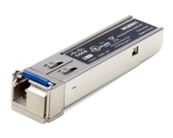
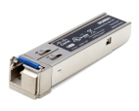




Small Business Switch Accessories
Mini-GBIC/SFP Transceivers
Fast Ethernet Transceivers
Gigabit Ethernet Transceivers
MFEBX1
100 BASE-BX-20U SFP transceiver
1310-nm wavelength for single-mode fiber
For distances up to 20 kilometers
MFEFX1
100 BASE-FX SFP transceiver
1310-nm wavelength for multimode fiber
Support for 100-Mbps speed up to 2 km
MFELX1
100 BASE-LX SFP transceiver
1310-nm wavelength for single-mode fiber
For distances up to 10 km
MGBBX1
1000BASE-BX-20U SFP transceiver
1310-nm wavelength for single-mode fiber
For distances up to 40 km
MGBLH1
1000BASE-LH SFP transceiver
1310-nm wavelength for single-mode fiber
For distances up to 40 km
MGBLX1
1000BASE-LX SFP transceiver
1310-nm wavelength for single-mode fiber
For distances up to 10 km
MGBSX1
1000BASE-SX SFP transceiver
850-nm wavelength for multimode fiber
For distances up to 550 meters

Slide 11




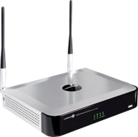


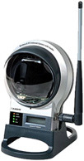
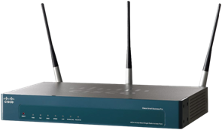
Reliable Small Business
Network Foundation
SG300-10P
SG300-28
Internet
SG300-10P
AP541
Creates a reliable, small business local-area network
Easily integrates with data, voice, video, wireless, video surveillance, and storage products
Easy to use with consistent interface across all Cisco® Small Business products

Slide 12

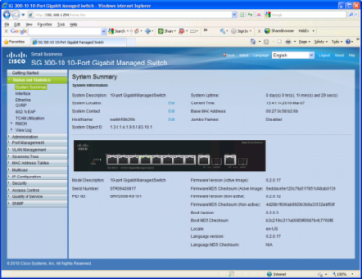
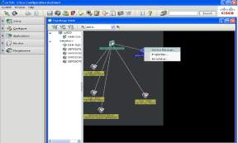

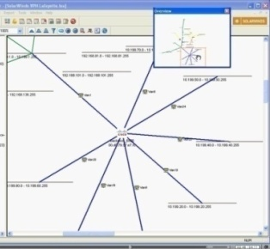
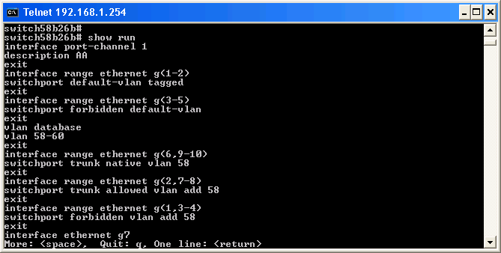
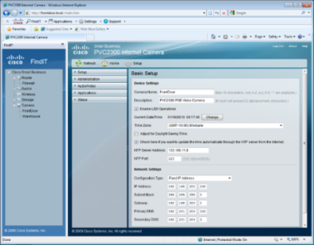
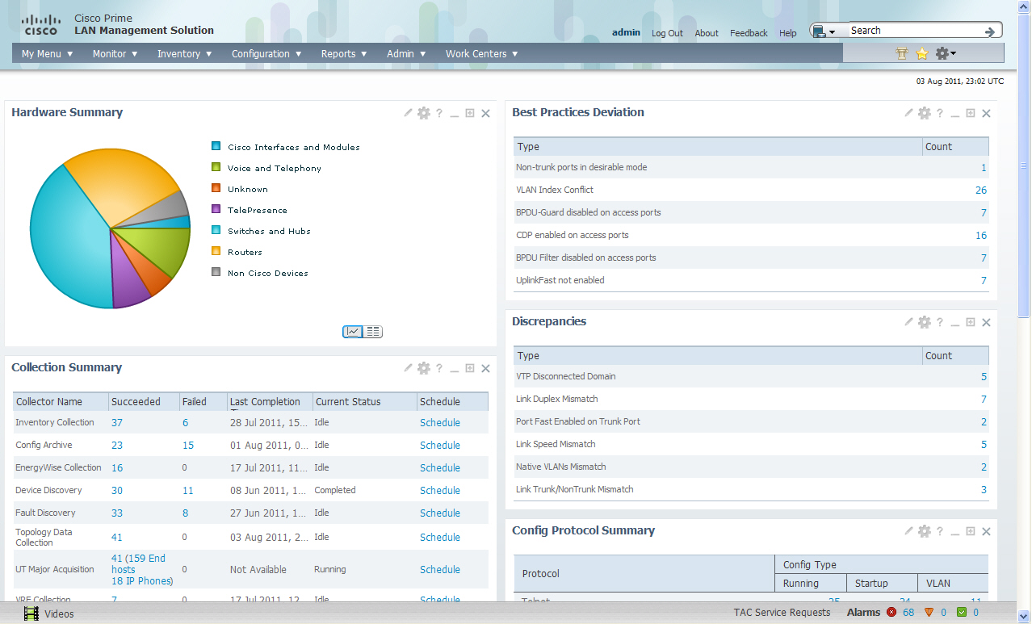
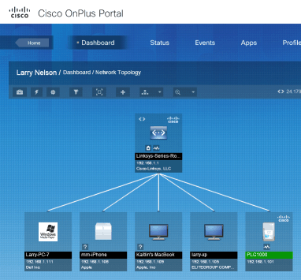
Simplified Configuration and Common Management
Web
GUI
  Cisco Configuration Assistant (CCA) for
  system-wide deployments
  Cisco Discovery Protocol and Cisco SmartPorts for easy management
  CLI for text-based configuration for mass deployment
  Cisco FindIT/Small Business Toolbar Application
  Full integration with OnPlus Cloud Manager
  Cisco Prime LMS support
  True stacking to manage multiple switches as
  a single unit
  Standalone configuration using the embedded Web GUI
  Remote monitoring support using SNMP
  Menu-based access through console for
  disaster recovery
CCA
SNMP Mgmt
Platform
CLI
FindIT
Prime LMS
OnPlus
© 2010 Cisco and/or its affiliates. All rights reserved.
Cisco Confidential

Slide 13
Prime LMS Support
3rd Party Generic | Non-Enterprise Cisco (ESW2/300/500) | Cisco Core (IOS devices – Catalyst, WNBU)
Discovery/Inventory
Fault Management
MIB Compiler (read-only)
 | Health (uptime, historical report, etc)
 | Configuration push/archive
 | Image Management
 | Lifecycle Management (EOX) and PSIRT reporting (Future)
 | L2 Topology (Future)
 | CiscoView (Future)
 |  | BN Services (Trustsec, Medianet, Energywise, etc)
 |  | IOS Features – VLAN, stacking, Routing, etc
 |  | Full Compliance – PCI, SOX, HIPAA, etc
 |  | Assurance – Netflow, IPSLA, NBAR
 |  | Best Practice Config Templates
 |  | User / Endpoint tracking and Troubleshooting

Slide 14

Cisco 300 Series New Features Offer
Ease of Use
Consistent user interface and product feature set across the entire family
Products localized into seven languages: English, German, French, Spanish, Italian, simplified Chinese, and Japanese
  Localized user interface, support documentation, help system, and website and product discovery*
Standards-based features for easy integration with existing and Cisco® Small Business solutions
Smart Designs and Smart Tips guides solution integration
TextView: management and mass deployment
Text-based configuration: mass deployment
and troubleshooting
*Industry first among managed switching competition
Notes:
Consistent UI & product feature set across the entire family (new)
Localized UI, Docs, Help System, & product discovery* (new)
Standards based features for easy integration with existing & Cisco Small Business solutions

Slide 15

Cisco 300 Series
Warranty
Covers
Switch, fans and power supplies
Length
Limited lifetime warranty (new)
Hardware Replacement
Next business day advance replacement (where available, otherwise return to factory)
Complimentary Phone Support
One year
Online Chat Support
One year
Software Updates for bug fixes
Term of warranty

Slide 16
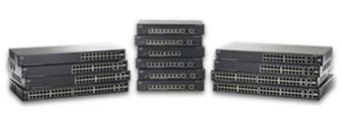

Service Extends to All
Cisco Small Business Products
Small Business Support Service
Pricing and SKU
3 Years of ‘peace-of-mind’ support for Small Business Products
Simple, easy-to-sell and support
Access to Small Business Support Community
Online Chat Support 24x7
Telephone Support during Local Business Hours
Delivered by Cisco, optional Partner value-add
CON-SBS-SVC2
Small Business Support Center
Quick access to CCNA certified engineers for small business support issues
Notes:
16
16
Cisco expands small business support, making the Cisco Small Business Support Service—delivered by the partner, backed by Cisco—available across the entire small business portfolio. Cisco warranties for small business products have also been enhanced and simplified.

Slide 17

Technical Overview

Slide 18






Feature-Rich Switches Offer Best Value
Performance
Layer 2 Switching and Layer 3
Security
Quality of
Service
Management
and General
Cisco® Discovery
Protocol and Smartports
Wire-speed performance on Fast Ethernet and Gigabit Ethernet switches
Nonblocking switch fabric
PoE+ (802.3at) with up to 30W per port
VLANs
Spanning tree
Link aggregation
802.1Q trunking
Port and VLAN mirroring (SPAN)
Multicast
Static L3
MAC-based port security
IEEE 802.1x
Web Based Authentication
Storm control
Secure Core Technology (SCT)
Private VLAN Edge (PVE)
DAI, IPSG, STPRG, DHCP Snooping
Web Auth
Classification
802.1P
DSCP/CoS
WRR/SP
Rate limiting
Policing and Shaping
Intuitive interface
IPv6 Host
Port and VLAN mirroring
Localization
LLDP-MED / CDP
Auto voice VLAN
Cloud
Desktop
Cisco phone
plus desktop
Router
Switch
Access point
Other
Designed for SMB

Slide 19

Energy-Efficient Technology
Automatically turns off power on Gigabit Ethernet RJ-45 port when detecting link down
  If there is no link on a port (i.e. no connection or device connected is turned off), the port(s) enter a “sleep mode”
Resumes active mode when the switch detects the link up or device connected
  Switch sends out electrical pulses at frequent intervals
Adjusts power based on cable length (on Gigabit Ethernet models)
Detects the length of connected Ethernet cable and adjusts power usage accordingly—without affecting performance
EEE (802.3az) support delivers optimal power consumption in the presence of data traffic
Disabling of LEDs to save power supported
Low power 65nm silicon
Numerous fanless models deliver low power and quiet operation

Slide 20
300 Switches Improve Deployments
DHCP Auto Configuration
A way to deploy switches en-masse
Switch automatically loads its config from a TFTP Server
LLDP-MED + CDP
LLDP - Stds-based discovery mechanism similar to CDP
Switch learns devices attached to specific ports
Uses DHCP Options 66 and 67
Switch notifies endpoint which Voice VLAN to use, QoS parameters to set, etc
Auto Smartports
Smartports - pre-created macros to speed up deployments
Auto Smartports - Apply appropriate Smartports role to port based on discovered device
Auto Voice VLAN
Dynamic creation and propagation of Voice VLAN and QoS across the network
TextView CLI
Text-based Command Line Interface to ease mass deployment
Additional Management options: Full SNMP support, FindIT, CCA, OnPlus Cloud

Slide 21
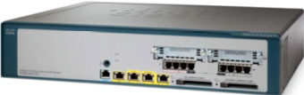
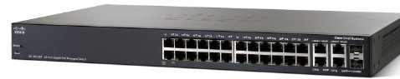


Auto Voice VLAN Competitor support
Call Control
UC or HSB
Additional Manual Config:
When Voice VLAN changes
When QoS rules in network changes
If Voice VLAN on switch 2 not set same as switch 1
If QoS on Switch 2 not set same as switch 1
If OUI table not correctly populated
LLDP approach
A
Create Voice VLAN
`
B
Setup QoS parameters
2
C
Config LLDP-MED Network Policy
Instruct phone which Voice VLAN and QoS to use – LLDP-MED
D
Add Voice VLAN to port
Switch 1
1
Recognize phone –
LLDP-MED
A
Activate OUI Auto Voice VLAN
B
Create Voice VLAN on switch
OUI approach
C
Populate OUI table
Auto
Apply appropriate QoS and assign to Voice VLAN
Switch 2
D
Add Voice VLAN to port
2
1
Recognize phone –
OUI
Legend
Manual Config
Auto
Automatic setup

Slide 22
Auto Voice deployment across network
Supported only with Cisco 300 and 200 switches
True zero touch deployment
Call Control
UC or HSB
NO MANUAL CONFIG
Network adapts automatically to:
- Voice VLAN changes
QoS rule changes in network
If Voice VLAN on switch 2 not set same as switch 1
If QoS on Switch 2 not set same as switch 1
Even when different call control devices advertizing different Voice VLANs connected to the network
5
CDP Advertises
Voice VLAN 100
Switch Configures port Fa1
with optimal parameters for
IP Phone
1
4
Gi4
2
VLAN 100 created
on switch – assigned to port Gi4 and Gi5
Instruct phone which Voice VLAN and QoS to use – LLDP-MED or CDP
Fa1
Switch 1
Gi5
3
6
Advertizes Voice VLAN 100 and QoS parameters
via VSDP to switch 2
Recognize phone –
CDP / LLDP-MED
7
VLAN 100 created on switch – assigned to port Gi1 and Fa1
Gi1
Fa1
Switch 2
Patent Pending
10
Instruct phone which Voice VLAN and QoS to use – LLDP-MED or CDP
Switch Configures port Fa1
with optimal parameters for
IP Phone
9
8
Recognize phone –
CDP / LLDP-MED
Legend
Manual Config
Auto
Automatic setup

Slide 23
Sx300/200 in UC & HSB deployments
Power the phones using PoE
Zero-touch deployments
  Learns the Voice VLAN from UC3xx/5xx or IAD via CDP/LLDP
  Instruct phones via CDP/LLDP on Voice VLAN and QoS parameters to use
Automatically assign Voice VLAN on all relevant ports in the network
  Links between Switches
  Links to UC and IAD
  Links to Phones
  Links to APs
Automatically set Security levels for different types of devices with Auto Smartports
  Number of devices, Storm Control, Port mode, VLAN, Spanning Tree

Slide 24
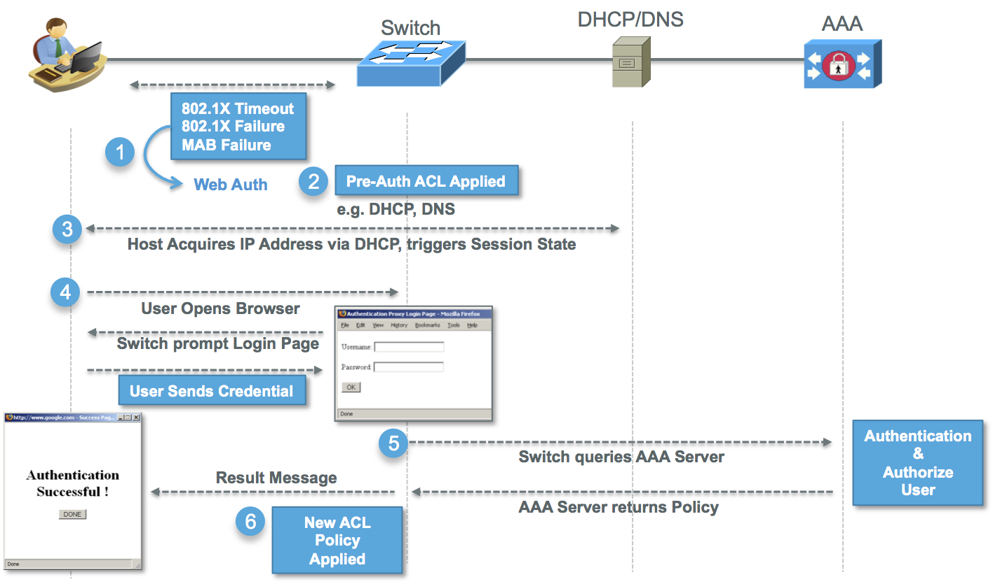
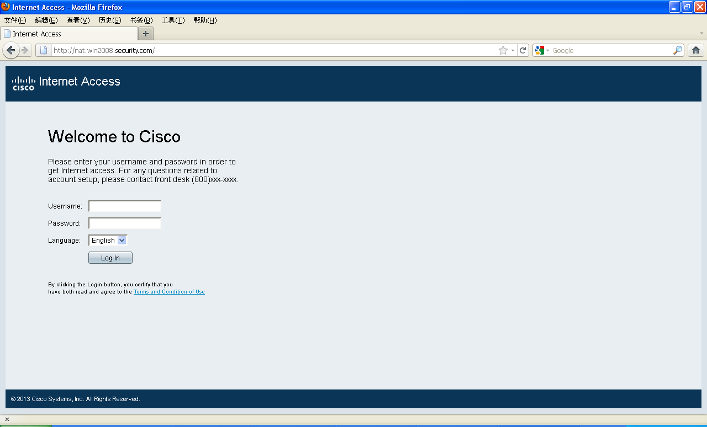
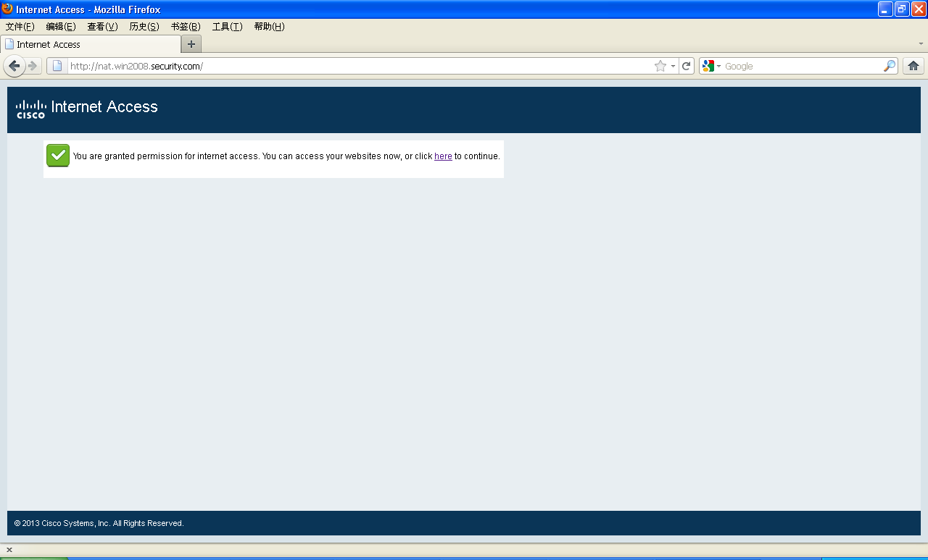
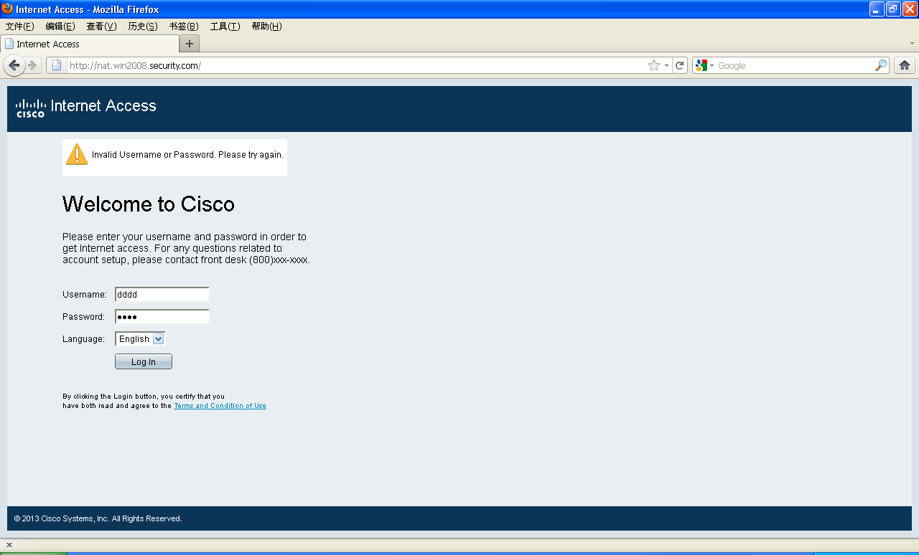
Web based authentication
Easily authenticate the mobile users
  New user information provisioned on authentication server
  Mobile user connects to the network and access any website
  Session is redirected to network login page for user credentials
  Only after successful login, the user is able to access the network
  Simple & intuitive
  No hassle of 802.1x client
  Friendly to guest users for offices, hospitality and education
Web based authentication

Slide 25


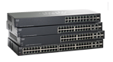
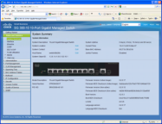
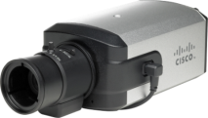
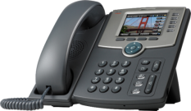
Next-Generation Internet
IPv6
Enables next generation of applications and operating systems
Provides customers with support for Next-Generation Internet
Delivers consistent functions across breadth of portfolio
Supports IPv4
Products will include IPv6 support:
Routers
Switches
Applications
Cameras
Phones
Telephone Gateways
Notes:
Purpose and Benefit
Provide customers with transition path to Next-gen Internet
Deliver consistent functionality across breadth of portfolio
Enables next generation of applications and services
Driving forces
Multiple OS’s and Applications (Windows 7, Linux)
IP address space exhaustion
Market forces – Countries, Governments, MSOs mandating support for IPv6
Affected products and functionality
Most new products built by Cisco Small Business will have IPv6 support
Routers , Switches, APs, Cameras, Phones and Telephony Gateways
Dual IPv4/IPv6 Host Mode - Facilitates management of devices from a native IPv6 or IPv4 endpoint
IPv6 QoS and ACLs – prioritize, secure or Rate Limit by IPv6 address
MLD Snooping – IPv6 Multicast
ISATAP transition mechanism – customers can transition to IPv6 seamlessly
Significance:
Our solution:
Delivers the infrastructure to support IPv6-enabled applications. Apps in Vista (peer-to-peer like Meetingspace and Remote Assistance). In Vista, IPv4 is used as last resort. V6 first, ISATAP second, v4 third. Lowest performance v4
Consistent functionality across all products in our portfolio – sw, rtr, wireless, NAS, etc
Deliver transition capabilities to move at your own pace – Dual stack, isatap

Slide 26
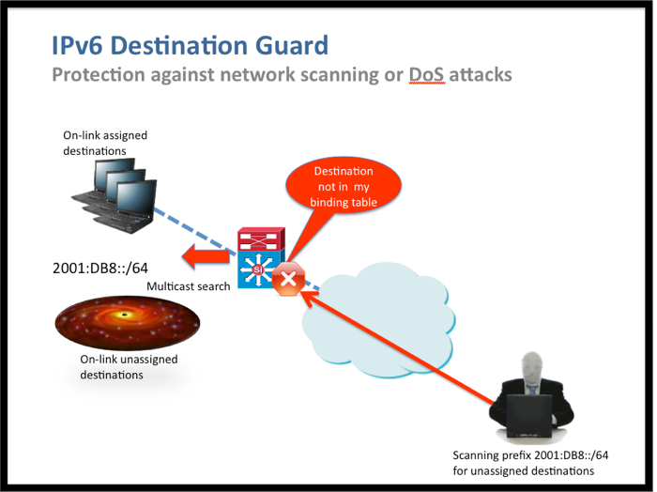
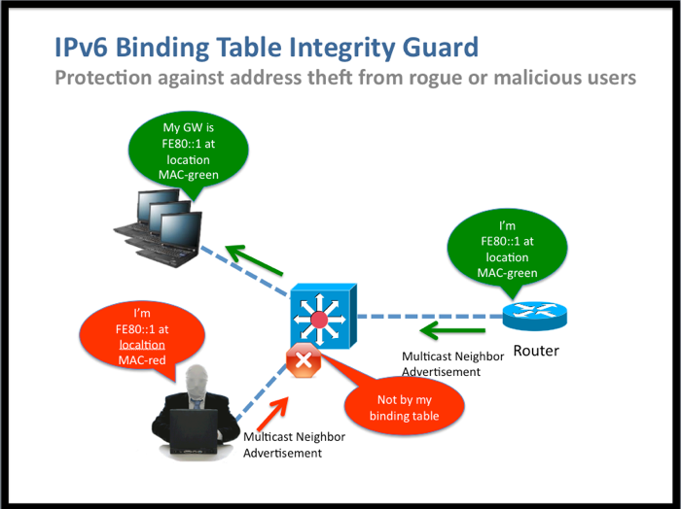
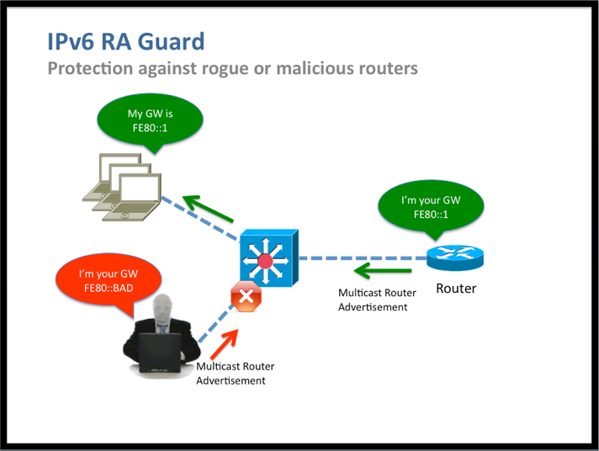
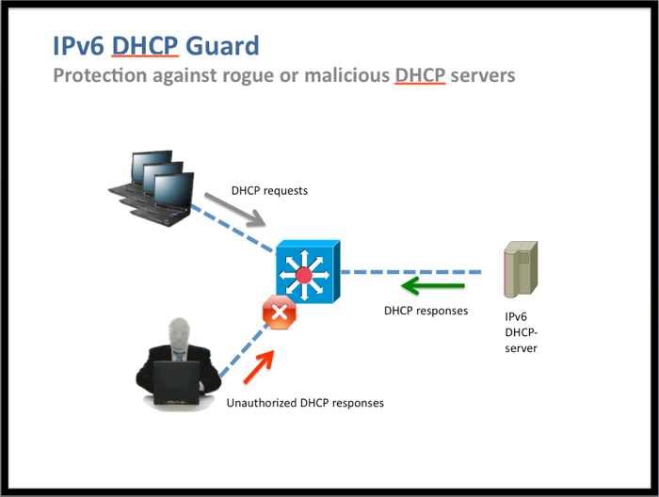
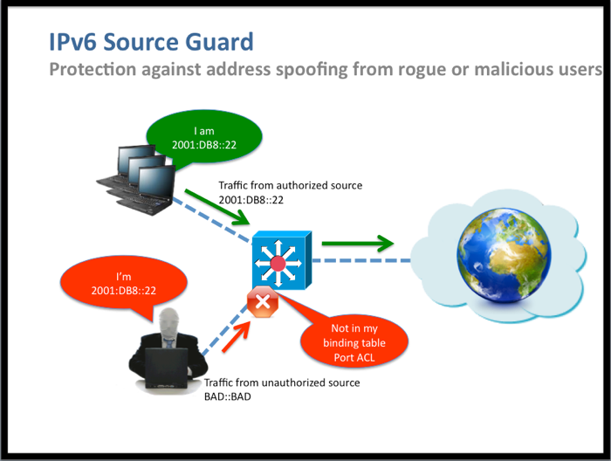
IPv6 First Hop Security (FHS)
Securing IPv6 Networks
IPv6 FHS
IPv6
Integrity Guard
IPv6
RA Guard
IPv6
DHCP Guard
IPv6
Source Guard
IPv6
Destination Guard
*
*
Integrity protection for FHS binding table
Protection against IPv6 address theft
Protection against MiM Attacks
Protection against rouge or malicious Router Advertisement
Protection against MiM & DoS attacks
Rejects invalid DHCP Offers
Validate source address or prefix
Protects against source address spoofing
Validates destination address of IPv6 traffic reaching the link
Protects against scanning or DoS attacks
*
Future release

Slide 27

Positioning

Slide 28

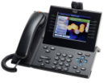
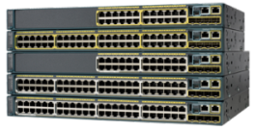
Catalyst 2K and SB Positioning
APJC, Emerging and LATAM
SMB
SMB / Mid Market / Enterprise
Data
Voice
Data
Voice/Vide
Cisco 100, 200, 300, 500 Series
Purpose built for Small Business
Optimized for deployment in small networks
Lower CapEx
A fundamental building block of Cisco Small Business solutions
Catalyst 2960-S
Foundation for Borderless Access solutions
World-class switching portfolio for any size business
Reduced OpEx with Smart Operations & EnergyWise
Foundation for open, flexible and feature-rich communications solutions
Optimized OpEx / Scalability / Supportability
Notes:
28
This is the Catalyst product positioning slide.
2K-S positioning in the traditional workspace
On the one hand, if you want a highly competitive product with standards based speeds and feeds, great competitive feature set that will help reduce TCO, and that can deliver capabilities for the traditional workspace, around integrating voice and video- then the 2K-S is appropriate.
3K-X and 4K positioning for the next generation workspace
But, if it’s important to prepare and address the next generation workspace challenges presented earlier with capabilities like greater security, supporting exploding video, PoE leadership and high availability, and at the same time achieving a lower total cost of ownership (with capabilities that extend the refresh cycle, enterprise-wide energy management and features that reduce operational costs), than the 3K and 4K platforms are the right solution.
With the Catalyst 3K and 4K, intelligence at the edge helps solve and drive video, security, HA and PoE

Slide 29

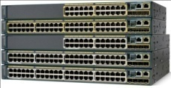
Catalyst and SB Portfolio Positioning
 | SMB | Catalyst
Target Market | SMB | SMB, Mid-market and Enterprise
TCO | Lower CapEx | Lower OpEx (overall network life)
Integration | Seamlessly integrates with other SBTG solutions | Foundation for Borderless Networks solutions
Support | Cisco SBSC | Cisco TAC
Features | Small Business Architecture, ease-of-use | Advanced Architectures – TrustSec, Medianet, EnergyWise, Smart Operations
Software | Non Cisco IOS Software | Cisco IOS Software
Orderability / Refresh Cycles | 3-5 years orderability 1-2 years product refresh Support: 5 yrs after EOS | 5-7 years orderability 3-5 years product refresh Support: 5 yrs after EOS
Services | Cisco SMB Services | Cisco SMARTnet® / SmartCare Services
Scalability | Scale to a few sites | Scale up to world’s largest networks
Management | Optimized for deployment and management of small networks | Multiple enterprise-level management options: CNA, Prime LMS for large/multi-site networks with TCO emphasis
Notes:
SMB and SME (?) – for APJC and SBTG
Integration
SBTG - Designed to be integrated with products from Cisco’s Small Business portfolio as part of the Small Business Architecture
Catalyst - The foundation for Cisco’s Borderless Network end-to-end solution, integrating with Cisco’s broad Enterprise portfolio as part of Cisco’s Smart Business Architecture
Management
SBTG - Management tools optimized for easily deploying and managing smaller networks; Web-based UI and text-based CLI; Cisco Configuration Assistant
Catalyst - Management tools optimized for management of large and multi-site networks with emphasis on service deployment and reducing Total Cost of Ownership; Cisco IOS, Cisco Prime, as well as 3rd-party network-wide management solutions
Product Life Cycle
SBTG - Rapid product revisions; Limited software updates to support new features
Catalyst - Longer product lifecycle to support multi-year enterprise deployments;
Frequent software updates to support enhanced features

Slide 30
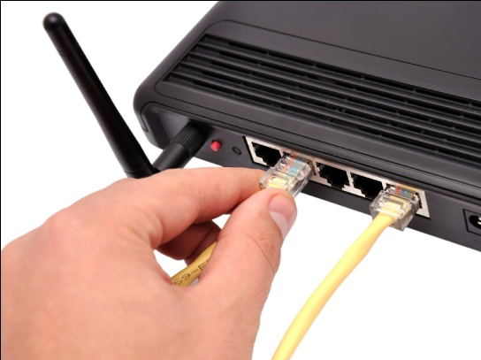



A Spectrum of Buying Personas
SMB (5 to 250 Employees)
 | Basic | Open to Guidance | Elite
IT Resources | On My Own | Rely on Partner | Collaborate w/Partner
View of Technology | Stick to Basics | Willing to Invest | Strategic Weapon
Temperament | Reactive | Proactive | Strategic
Purchase Mindset | Product | Solution | Architecture
Decision Driver | Simplicity and Value | Trusted Partner | Platform for Growth
Satisfied When It… | …Just Works | …Boosts Productivity | …Transforms Business
Preferred RTMs | Retail, eComm, NDI, SP | Unregistered, Registered, Select, SP | NDI, Select, Premier, SP

Slide 31
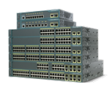

Managed Switching for SMB
One Portfolio—A Spectrum of Choices
Fixed Standalone
Fixed Stackable
Catalyst
3560
Catalyst
3750
Functionality
Catalyst
2960
Switches
Catalyst
2960-S
LAN Base
300 Series
Managed
500 Series
Switches
Cost
© 2010 Cisco and/or its affiliates. All rights reserved.
Cisco Confidential
31

Slide 32

Competitive

Slide 33


Report: DR120119 – 24 Feb 2012
www.miercom.com
Report: #211103 – Feb 2011
www.tolly.com
Cisco 200/300 switches versus:
HP E2620, E2810, E2520, E2510, E1810 D-Link – DES-3052 / DES-3052P
Cisco 300 switches versus:
HP E2610, E2810, E2510
D-Link – DES-3528 / DES-3528P
Netgear – FSM726, GSM7224
“They were the most energy efficient…”
“Cisco had the most extensive feature set for IPv6 transitions”
“easiest to configure and implement”
“forwarded line rate full mesh traffic at all frame sizes with zero loss”
“Cisco switches more economical”
“Highest capacity and scalability”
“Best resiliency when subjected to a DOS attack”
“We were impressed with the comprehensive set of features, performance, overall power efficiency, and ease-of-use of the Cisco switches” – Rob Smithers, CEO, Miercom
“Lowest power consumption and best-in-class efficiency overall”
“Most extensive set of IPv6 protocol and application support”
“Best usability with simplified UI”
“Wirespeed, non-blocking, L2 performance at all frame sizes”
“Best price/performance”
“Most extensive feature set”
“most extensive capabilities, best performance, lowest latency, lowest overall Energy consumption, and best user experience”
“Cisco has raised the bar for this product category” – Kevin Tolly, founder, The Tolly Group

Slide 34
Cisco 300 Series Switching Competitive Comparison
 | Cisco 300 SB Managed | Netgear Managed FSM/GSM | D-Link Managed DES/DGS | HP Managed E2810, E2620, E2510, E2520 | Adtran Netvanta 1200 ,1500
Advanced Features – IPv6, L3, EEE, etc
Cisco Unique Value + Price competitiveness | CDP, OnPlus, Smartports
Programs: Fasttrack, PDF, etc
Warranty + Support
Multiple Mgmt: LLDP/CDP/Bonjour CLI/Menu CLI SNMP Management CCA – System Mgmt FindIT

Slide 35
Market validations for 300 Series switches
"The Cisco Small Business SG300-28P switch is declared the leader in the Computer Shopper independent test on a range of network switches from multiple vendors.“ – Computer Shopper
"For the small office or department, the CRN Test Center recommends Cisco every time.“ CRN
“It is an ideal combination in terms of price, performance and capabilities for our Small Business segment customers.”– Belgacom
“…offers a good mix of features that few switch vendors can match at this price”– PCPro
“Cisco Series 300 Switches don’t cut networking corners”– eWeek
"I highly recommend this switch series“ - NetScanTools
“Our opinion is that these switch fits perfectly into the small customer market because of pricing, easy administration and the design” – Comstor (Germany)
“Cisco has raised the bar for this product category” – Tolly Group
“We were impressed with the comprehensive set of features, performance, overall power efficiency, and ease-of-use of the Cisco switches” – Miercom

Slide 36
Competitive Selling Messages
Competitive Advantage
Silver Bullet
  Broadest range of switches:
  8 to 24 ports Fast Ethernet;
  10 to 52 ports Gigabit Ethernet
  Additional ports on Gigabit Ethernet
  Enhanced features: IPv6, Layer 3,
  and security
  Cisco quality and reliability
  Energy-efficient technology on all models
  Cisco® Small Business support community; staffed by CCNA® certified professionals
  Cisco small business online support community for self-help
  Cisco 300 Series offers the best value/feature mix, it is priced lower than the competition, and it offers more features
  Cisco 300 Series Switches are part of a comprehensive network portfolio that includes Voice, wireless, and routing—all designed to work together
  Cisco 300 Series offers the most Energy Efficient portfolio in the market
  Cisco 300 Series offers the most extensive IPv6 capabilities for this part of the market

Slide 37
Resources and URLs
Cisco® 300 Series Switches
www.cisco.com/go/300switches
Partner Central Small Business Switching
www.cisco.com/go/smbpartner/switching
Cisco Small Business Support Community
https://www.myciscocommunity.com/community/smallbizsupport
Cisco 300 Series Switches Warranty
http://www.Cisco.com/go/warranty
Cisco Small Business Service
www.cisco.com/go/smbservices

Slide 39
100 Series | 200 Series | 300 Series | Stackable 10 Gig - 500X Series
Non-Blocking | Non-Blocking | Non-Blocking | Non-Blocking
Green Ethernet | Green Ethernet | Green Ethernet | Green Ethernet
24 ports GE | 26 ports GE | 28 ports GE | 28 ports GE
8K MAC | 8K MAC | 16K MAC | 16K MAC
Transparent to VLAN tags | 802.1q VLANs (128/256) | VLAN - 802.1q (4K) | VLAN - 802.1q (4K)
 | 4 Queues | 4 Queues (8 future) | 4 Queues (8 future)
 | Link Aggregation | Link Aggregation | Link Aggregation
 | Spanning Tree | Spanning Tree | Spanning Tree
 | Port Mirroring | Port Mirroring | Port Mirroring
 | IGMP Snooping | IGMP Snooping | IGMP Snooping
 | L2 priority - 802.1p | L2 priority - 802.1p | L2 priority - 802.1p
 | MAC-based Filters | MAC-based Filters | MAC-based Filters
 | Multicast/Broadcast/Unknown Unicast Storm control | Multicast/Broadcast/Unknown Unicast Storm control | Multicast/Broadcast/Unknown Unicast Storm control
 | 802.1 x w/RADIUS | 802.1 x w/RADIUS | 802.1 x w/RADIUS
 | Rapid Spanning Tree | Rapid Spanning Tree | Rapid Spanning Tree
 | Rate Limiting | Rate Limiting | Rate Limiting
 | Bonjour | Bonjour | Bonjour
 | Voice VLAN | Voice VLAN | Voice VLAN
 | VSDP | VSDP | VSDP
 | LLDP-MED | LLDP-MED | LLDP-MED
 | IPv6 (USGv6 and Gold Certified) | IPv6 (USGv6 and Gold Certified) | IPv6 (USGv6 and Gold Certified)
 | DHCP Option 67 | DHCP Option 67 | DHCP Option 67
 | Text Editable Configs | Text Editable Configs | Text Editable Configs
 | CDP | CDP | CDP
 | Auto Smartports | Auto Smartports | Auto Smartports
 | Nework-wide Auto Voice | Nework-wide Auto Voice | Nework-wide Auto Voice
 | Onplus Cloud | Onplus Cloud | Onplus Cloud
 | No | Secure Copy | Secure Copy
 | .3af POE (1/2 enabled); Budget 1/4 ports at 15W | .3at POE and .3af (all enabled) | .3at POE and .3af (all enabled)
 | SNTP | SNTP | SNTP
 | Cable Diagnostics | Cable Diagnostics | Cable Diagnostics
 | SNMP | SNMP | SNMP
 | RMON | RMON | RMON
 |  | Multiple Spanning Tree | Multiple Spanning Tree
 |  | Telnet/SSH | Telnet/SSH
 |  | TextView (CLI) | TextView (CLI)
 |  | Flow-based Security with ACL | Flow-based Security with ACL
 |  | Flow-based QoS with ACL | Flow-based QoS with ACL
 |  | Dual Image | Dual Image
 |  | L3 priority - DSCP/TOS | L3 priority - DSCP/TOS
 |  | Shaping | Shaping
 |  | GVRP | GVRP
 |  | DOS Attack Prevention | DOS Attack Prevention
 |  | Q-in-Q | Q-in-Q
 |  | Guest VLAN | Guest VLAN
 |  | IGMP Querier | IGMP Querier
 |  | Private VLAN Edge | Private VLAN Edge
 |  | MAC-based VLAN | MAC-based VLAN
 |  | Dynamic VLAN Assignment | Dynamic VLAN Assignment
 |  | IP Source Guard | IP Source Guard
 |  | DHCP Snooping | DHCP Snooping
 |  | Dynamic ARP Inspection | Dynamic ARP Inspection
 |  | MVR | MVR
 |  | Spanning Tree Root Guard | Spanning Tree Root Guard
 |  | SSD | SSD
 |  | SCT | SCT
 |  | Unauthenticated VLAN | Unauthenticated VLAN
 |  | Static Routing - 32 routes | Static Routing - 128 routes
 |  | MLD Snooping | MLD Snooping
 |  | DHCP Relay | DHCP Relay
 |  | Radius/TACACS Accounting | Radius/TACACS Accounting
 |  | ELLW | ELLW
 |  | Weighted Congestion Avoidance | Weighted Congestion Avoidance
 |  | Per-VLAN mirroring | Per-VLAN Mirroring
 |  | Time-based 802.1x | Time-based 802.1x
 |  | No | 5G Stack (500); 10G stacking capable (500X)
 |  | No | Protocol-based VLANs
 |  | Time-based ACLs, ports, POE | Time-based ACLs, ports, POE
 |  |  | 500X - RIP v2
 |  |  | 500X - VRRP
 |  |  | 10 Gig interfaces - 500X

Slide 40
Terms and Acronyms
Cisco Term | Alternative (Standard) Term/Protocol Mapping
SPAN | Port Mirroring
TDR | Cable Diagnostics
VTP | GVRP
PAgP | LACP
HSRP | VRRP
PVST / PVST+ | MSTP
ISL (Cisco Inter-Switch Link) | 802.1Q
DTP (Dynamic Trunking Protocol) | 802.1Q
CDP | LLDP
Port Channel | LAG (Link Aggregation Group)
PVID | Native VLAN
Acronyms
DAI – Dynamic ARP Inspection
IPSG – IP Source Guard
DHCPS – DCHP Snooping
STPRG – Spanning Tree Root Guard
CDP – Cisco Discovery Protocol
VTP – VLAN Trunking Protocol
GVRP – GARP VLAN Registration Protocol
MSTP – Multiple Spanning Tree Protocol
TDR – Time Domain Reflectometer
LACP – Link Aggregation Control Protocol
SPAN – Catalyst Switch Port Analyzer
HSRP – Hot Standby Router Protocol
VRRP – Virtual Router Redundancy Protocol
PVST – Per-VLAN Spanning Tree
LLDP – Link Layer Discovery Protocol
PVID – Port VLAN ID

Slide 41

IPV6 First Hop Security
Guard against proliferation of IPv6 devices –Mobiles, Tablets
Secure
BINDING INTEGRITY GUARD:
Defend Source Imitation with IPv6 Source Identity
HOST
ROUTER+
DHCP server
PEER
DHCP GUARD:
Defend against Fake Server DHCP Replies
SWITCH
vlan 100
L2/link
Infrastructure
Internet
INTRUDER
Certificate
Server
RA GUARD:
Defend against Fake Router Advertisements
Time
Server
ROUTER
DHCP
Server
FAKE
ROUTER
I am Router
Configuration
Server
FAKE SERVER
SWITCH
Provisioning
Infrastructure
Hosts
PC (IPv6)
Notes:
IPv6 has more addresses (2⁶⁴). More hosts are allowed in the link resulting in bigger links. More states (Neighbor Cache etc.) on hosts, routers and switches create new opportunities for DOS attacks. IPv6 link operations protocol is Neighbor Discovery. It results in more distributed and autonomous operations. Nodes discover default routers automatically. Nodes auto-configure their addresses and defend themselves (seND)!
Router Discovery Protocol leads to possibility of Router Thefts – Attacker tricks victim into accepting itself as default router based on rogue router advertisements. This leads to victim hosts unable to connect to internet or reach wrong destinations!
Duplicate Address Resolution leads to possibility of Address Thefts – Switch logs binding integrity (address, port, MAC, VLAN) to verify address uniqueness before using it. It prevents victims being unable to configure IP addresses and communicate.
DHCP Guard mitigates threats from rogue DHCP servers. The switch learns and secures bindings for stateful DHCP assigned addresses. It then intercepts, validates and removes invalid DHCP messages.
DHCP Guard ensures switch learns the host interface ID to the Server.

