Slide 1
CCA Architecture – Overview
Last Updated : May 6th 2013

Slide 2
CCA Overview
Fully geographically redundant, highly available and scalable audio conferencing solution
Uses call signaling between enterprise's IP PBX and WebEx’s audio bridge through a Session Border Controller (SBC)
Enabled through redundant IP connections between customer’s and Cisco’s data centers
Customer leverages its existing carrier terminations for off-
net calling - calls generated from phone numbers that do not reside on the customer’s network
Notes:
2

Slide 3










CCA Call Flow
Call routing by customer CUCM
Gigabit Ethernet IP connection
On-net
Callers
Customer Network
Cisco WebEx® iPOP
Media Gateway
Cisco WebEx®
Cloud
Off-net
Callers
CUBE and firewall provide highly secure border
PSTN
On-net calls: Call originating from or terminating to a phone on customer’s network would bypass PSTN toll and will traverse between customer’s Cisco Unified Communication Manager and WebEx.
Off-net calls: Calls originating from or terminating to a phone outside of customer’s network will be routed by customer’s Cisco Unified Communication Manager over existing PSTN terminations.
Notes:
Key benefits of routing all the previously dedicated PSTN traffic?

Slide 4







CCA – Active/Active Architecture
Highlights
Audio mixing occurs on the active audio bridge at all times except in case of failure when conferencing fails over to standby audio bridge.
All call routing will be managed within customer’s network
SIP Signaling and Audio traffic to flow between WebEx CUBE and Customer CUBE.
Multiple active peering connections. At least 2 full or fractional GigE BGP/BFD peering links in different locations.
Traffic stays on WebEx’s network as long as possible – Customer’s traffic hop on to WebEx’s network from closest interconnection point
Callbacks are routed to a single entry point into customer’s IP telephony infrastructure, a SIP proxy or redirect server – Signaling goes through SIP proxy but media takes the shortest path.
The demarcation is the cross-connect in WebEx’s cage
Active
Bridge
Standby
Bridge
WebEx
CUBE
WebEx
CUBE
WebEx Layer 3 Network
Router
Router
Router
BGP/BFD
BGP/BFD
BGP/BFD
Router
SIP
Proxy
Router
SIP
Proxy
Router
SIP/G711
SIP/G711
SIP/G711
CUCM1
V 8.5
CUCM1
V 8.5
CUCM1
V 8.5
Customer
CUBE1
Customer
CUBE2
Customer
CUBE3
Customer DC 1
Customer DC 2
Customer DC 3
CCA Phase II Architecture © 2012 Cisco and/or its affiliates. All rights reserved. Cisco Confidential

Slide 5
Normal Call Flow
Highlights
Each CUCM prefers the topologically closest customer CUBE (pre-configured)
Each customer CUBE prefers the primary WebEx CUBE (pre-configured)
Packets from and to a customer CUBE go on and off WebEx’s backbone at the closest peering connection (ideally, a co-located connection).
Ingress (to WebEx) packets traverse the peering point that is topologically closest to the source subnet
Egress packets traverse the peering point that is topologically closest to the destination subnet
Desktop based VOIP traffic, data and video traffic will go over internet
Active
Bridge
Standby
Bridge
WebEx
CUBE
WebEx
CUBE
WebEx Layer 3 Network
Router
Router
Router
BGP/BFD
BGP/BFD
BGP/BFD
Router
SIP
Proxy
Router
SIP
Proxy
Router
SIP/G711
SIP/G711
SIP/G711
CUCM1
V 8.5
CUCM1
V 8.5
CUCM1
V 8.5
Customer
CUBE1
Customer
CUBE2
Customer
CUBE3
Customer DC 1
Customer DC 2
Customer DC 3
Bidirectional packet flow
CCA Phase II Architecture © 2012 Cisco and/or its affiliates. All rights reserved. Cisco Confidential

Slide 6
CCA Call-In Requirements
Customer must provide WebEx with at least one domestic toll E.164 number that Customer’s employees and guests will dial in order to reach WebEx’s service
  Customer can also choose to provide a toll free number
  The preferred toll and toll free numbers are displayed on Meeting Info page, Audio dialog box in WebEx UI and in the email invites.
  Customer needs to provide one toll and/or one toll-free number for each country where customer expects the users to dial from.
  CCA service requires that customer sends a single DNIS for all the dialed numbers, including preferred toll and toll free and all in-country phone numbers. This number will be sent to Cisco/WebEx CUBE from customer's CCA CUBE.
Calls originating from within Customer’s network will be routed directly across the peering link and will never traverse PSTN.
  Employees located in one country may dial a dedicated conferencing number in another country without incurring any toll charges, since the call will be routed internally. This rule applies even in cases where there is no CUBE or peering link in either country.
Calls dialed on PSTN will enter Customer’s network and should be routed to the peering connection with WebEx.
Notes:
6

Slide 7
CCA Callback Requirements
Customer must provide a single signaling entry point into its IP telephony infrastructure, a SIP proxy or redirect server.
  There should be at least two identically configured such servers in geographically diverse locations for failover.
  WebEx can send all calls to the primary SIP proxy/redirect server, or balance equally among the two, as required by the customer.
  Signaling goes through SIP proxy/redirect server and media will take the shortest path.
If Customer has CUBEs in different countries, it is important that the entry point SIP server routes the pattern of the E.164 numbers of that country to a CUBE located in that country.
Notes:
7

Slide 8
Normal Callback Flow
Highlights
Cisco WebEx calls primary SIP proxy/redirect server (if active/standby SIP proxy)
SIP Proxy redirects the call to appropriate CUBE based on customer’s dial plan.
Customer CUBE sends the call to its local CUCM
WebEx sends the media to the customer CUBE.
Active
Bridge
Standby
Bridge
WebEx
CUBE
WebEx
CUBE
WebEx Layer 3 Network
Router
Router
Router
BGP/BFD
BGP/BFD
BGP/BFD
Router
SIP
Proxy
Router
SIP
Proxy
Router
SIP/G711
SIP/G711
SIP/G711
CUCM1
V 8.5
CUCM1
V 8.5
CUCM1
V 8.5
Customer
CUBE1
Customer
CUBE2
Customer
CUBE3
SIP Signaling
Customer DC 1
Customer DC 2
Customer DC 3
Media Flow
CCA Phase II Architecture © 2012 Cisco and/or its affiliates. All rights reserved. Cisco Confidential

Slide 9
CCA Interoperability Requirements
Highlights
Designed to work with audio compression codec G.711
Customer needs to transcode any non-G.711audio media stream to G.711
Cloud Connected Audio supports SIP (Session Initiation Protocol) signaling
Customer needs to convert any non-SIP
signaling into a SIP before sending it to WebEx
Supports RFC2833 for dual-tone multifrequency (DTMF)
CUBE (WebEx)
SIP
G711µ,G.711A
RFC 2833
E.164
SIP
G711µ,G.711A
RFC 2833
E.164
Service
Demarc
CUBE (Customer)
SIP
G.711µ, G.729, G.711A
On-net numbering plan
SIP
G.711µ, G.729, G.711A
On-net numbering plan
CUCM
G.729, SCCP
G.711A, SCCP
G.711µ, SCCP
Location 1
Location 2
Location n

Slide 10
CCA Architecture - Failover Scenarios

Slide 11
CCA Failover Scenarios
Scenario 1: Peering connection failure
  The network converges on one of the other peering connections
    Which one exactly is determined by network configuration: the connection with the lowest customer network traversal.
  Existing calls are preserved with a brief media flow interruption (depending on convergence speed)
  There is no change in behavior of layer 7 devices on both sides of the failed connection.
  Scenario 2: CUBE failure
  Existing calls are
    dropped if no redundancy scheme is used
    Preserved if box-to-box redundancy has been configured
  CUCM on the side of the failed box tries to send new calls to the failed CUBE. When it fails, it sends them to the other active CUBE.
Notes:
11

Slide 12
Peering Connection Failure And Recovery
Failure
One of the customer router looses its connections and BGP convergence commences.
Signaling and media packets are lost during convergence Callers hear silence for the duration of the event.
Active
Bridge
Standby
Bridge
WebEx
CUBE
WebEx
CUBE
WebEx Layer 3 Network
Original call flow
Router
Router
Router
BGP/BFD
BGP/BFD
BGP/BFD
Recovery
BGP Convergence completes.
The flow of media and signaling resumes with no dropped calls. Router 1 is now the default router for all the subnets previously served by router 2
Router 1
SIP
Proxy
SIP
Proxy
Router 2
Router 3
SIP/G711
SIP/G711
SIP/G711
CUCM1
V 8.5
CUCM1
V 8.5
CUCM1
V 8.5
Customer
CUBE1
Customer
CUBE2
Customer
CUBE3
Recovered packet flow
Customer DC 1
Customer DC 2
Customer DC 3
CCA Phase II Architecture © 2012 Cisco and/or its affiliates. All rights reserved. Cisco Confidential

Slide 13
Customer CUBE Failure And Recovery
Failure
CUBE 2 is lost.
All calls connected through it are dropped.
OPTIONS pings from WebEx CUBE and customer’s CUCM stop being answered.
Until CUBE 2 is removed from CUCM’s and WebEx CUBE’s dial peer groups, each new call suffers delay.
After failing to receive a response to its INVITE, CUCM sends the call to CUBE 1and it connects
Active
Bridge
Standby
Bridge
WebEx
CUBE
WebEx
CUBE
WebEx Layer 3 Network
Router
Router
Router
BGP/BFD
BGP/BFD
BGP/BFD
Original call flow
Router 1
SIP
Proxy
SIP
Proxy
Router 2
Router 3
Recovery
CUBE 2 has been removed from all dial peer tables due to failure to answer OPTIONS ping request.
All calls are now going through CUBE 1.
SIP/G711
SIP/G711
SIP/G711
CUCM1
V 8.5
CUCM1
V 8.5
CUCM1
V 8.5
Customer
CUBE1
Customer
CUBE2
Customer
CUBE3
Recovered packet flow
Customer DC 1
Customer DC 2
Customer DC 3
CCA Phase II Architecture © 2012 Cisco and/or its affiliates. All rights reserved. Cisco Confidential

Slide 14
CCA Customer Premise Design Options

Slide 15



Design Option 1a: Single CUBE in each Data Center Separate CUBE and Edge Router (CE)
WebEx
Telephony Platform
Highlights
Separate CUBE and Edge Router (CE)
One CUBE in Each Data Center.
Two Independent CUBEs Running Active/Active
CUBE to CUBE Load Sharing
DC to DC failover
No Stateful Failover between CUBEs within each DC
No Stateful Failover across CUBEs in each DC
No DC to DC HA Replication
Redundancy through hardware.
Two WAN circuits to two WebEx datacenters.
Public AS required for eBGP and public IP required for iPOP between CUBE and ASR
WebEx Cloud
CUBE
CUBE
Service Provider
Active Peering Connections
(eBGP/BFD)
Customer
Customer WAN
Data Center 1
Edge Router
Edge Router
Data Center 2
CUBE
(ASR Or ISR)
CUBE
(ASR Or ISR)
CUBE
CUBE
Customer WAN
Customer SME Cluster
Customer End Point Cluster

Slide 16
Design Option 1b: Single CUBE in each Data Center Combined CUBE and Edge Router (CE)
WebEx
Telephony Platform
Highlights
Combined CUBE and Edge Router (CE)
One CUBE in Each Data Center.
Two Independent CUBEs Running Active/Active
CUBE to CUBE Load Sharing
DC to DC failover
No State Replications between CUBEs
No CUBE-to-CUBE HA Replication
No DC to DC HA Replication
Redundancy through hardware.
Two WAN circuits to two WebEx datacenters.
Public AS required for eBGP and public IP required for iPOP between CUBE and ASR
WebEx Cloud
CUBE
CUBE
Service Provider
Active Peering Connections
(eBGP/BFD)
Customer
Customer WAN
Data Center 1
CUBE
(ASR Or ISR)
CUBE
(ASR Or ISR)
Data Center 2
CUBE
CUBE
Customer WAN
Customer SME Cluster
Customer End Point Cluster

Slide 17
Design Option 2: Redundant CUBEs in each Data Center - Localized Box-to-Box HA
WebEx
Telephony Platform
Highlights
Local box to box HA
Stateful Replication within each data center
No HA In Case of data center failure
Independent Edge Router Required
No Call Loss During Local HA Event
WAN circuits to two WebEx datacenters.
Public AS required for eBGP and public IP required for iPOP between CUBE and ASR
Stateful Failover between CUBEs within each DC
No Stateful Failover across CUBEs in case of DC failure
WebEx Cloud
CUBE
CUBE
Service Provider
Active Peering Connections
(eBGP/BFD)
Customer
Customer WAN
Data Center 1
Edge Router
Edge Router
Data Center 2
CUBE
CUBE
CUBE
CUBE
Customer WAN
Customer SME Cluster
Customer End Point Cluster

Slide 18
CCA Customer Design Option Comparison
 | Option 1a | Option 1b | Option 2
# Data Centers | Two or more | Two or more | Two or more
HW Redundancy within DC | No | No | Yes
HW Redundancy between DC | Yes | Yes | Yes
High Availability within DC | No | No | Yes
# WAN Circuits | Two or more | Two or more | Two or more
# Devices in | Few | Fewest | Most
Cost | Moderate Expensive | Least expensive | Most expensive

Slide 19
Hybrid CCA with WebEx PSTN

Slide 20


Hybrid CCA and WebEx PSTN audio
Customer can choose to have both CCA and WebEx PSTN audio on single WebEx site.
Hybrid solution provides flexibility to customer to use WebEx PSTN numbers in countries where it does not have IP network.
CCA will be billed based on ports and usage on WebEx PSTN numbers will be billed by minutes.
There are separate SKUs for CCA Ports and WebEx PSTN Audio minutes
Customer will provide the list of countries where customer will provide the conferencing numbers and will use the CCA architecture and where it needs numbers from WebEx
Telephony Platform
PSTN
WebEx Cloud
CUBE
CUBE
CCA Peering Connections
(eBGP/BFD)
US Location
UK
Location
French
Location
Belgium
Location
Customer WAN
On-net user in US
On-net user in UK
On-net user
On-net user
PSTN
PSTN
Off-net user
Off-net user in US
Off-net user in UK
CCA Call Flow
WebEx PSTN Call Flow
If customer is using CCA for on-net users and WebEx PSTN for off-net users for dial-in within in the same country then customer will use WebEx provided numbers in that country. Both off-net users and on-net users will dial into WebEx provided number. Customer will route the call from on-net user to WebEx via customer’s CUCM/CUBE and SIP trunks. Customer must replace the WebEx dial-in number with customer’s uniquely routable E.164 number at CCA CUBE.
In any given country, unlike dial-in, regular callbacks can either use CCA call flow or WebEx PSTN call flow but cannot do both. However, Customer can use “Internal Callback” to route callbacks to on-net users over CCA and regular callbacks for off-net users over WebEx PSTN.
Notes:
Key benefits of routing all the previously dedicated PSTN traffic?

Slide 21
CCA Internal Callback

Slide 22
CCA Callback Scenarios
Regular Callback (Only)
Internal Callback
Same as current WebEx audio behavior
To callback PSTN number
WebEx UI displays drop down of country codes
User selects the country code and enters the callback number
Callback number is formatted in E.164 format
For any given country all regular callbacks can either be routed over CCA SIP connections or WebEx PSTN but not both
Customer can select the list of countries that customer wants the callback to be enabled for
Available in Meeting Center, Training Center and Event Center
Available only with CCA
To callback corporate internal extension
If “Internal Only callback” is enabled for a given site then regular callback to PSTN is not available
There is no dropdown for country codes
User enters the callback number
Callback number is not formatted
All internal callbacks will always be made over CCA SIP connections.
Internal callback, if enabled for a site, is applicable to the entire site i.e. cannot be enabled by region or country
Only available in Meeting Center. Training Center and Event Center have regular callback option only
Notes:
22

Slide 23
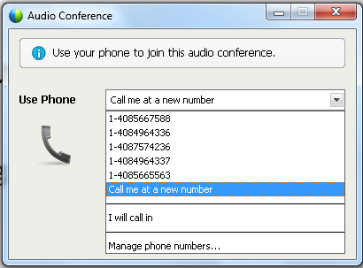
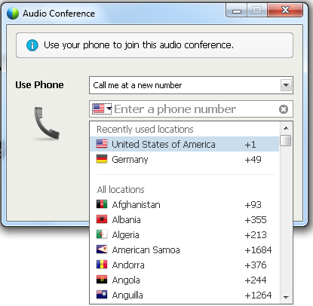
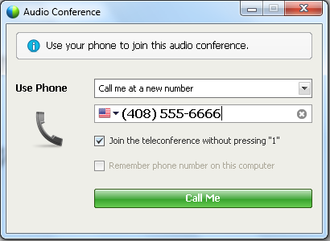
Regular Callback Flow
User selects the callback option
Country Code Drop down
Callback number is formatted in E.164 format
Notes:
23

Slide 24
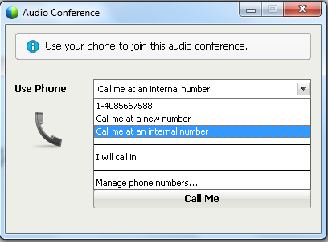
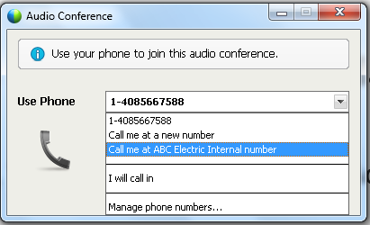
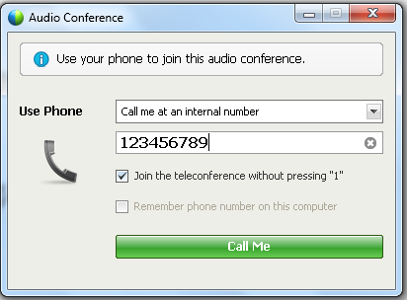
Internal Callback Flow
1. User sees two callback options.
2. User selects “call me at an internal number” for internal callback
Customer can customize the callback string
Customized callback string cannot be localized
1. No country drop down.
2. No formatting of callback number
Notes:
24

Slide 25
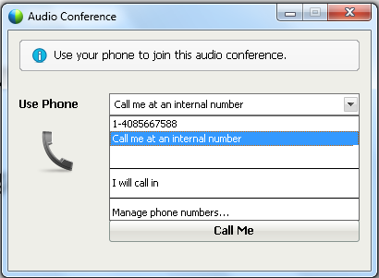
Internal “Only” Callback Flow
Customer can choose to enable “Internal Only Callback”
This configuration is turned on by WebEx provisioning in SuperAdmin and is not available in site admin
Regular callback to PSTN number is no longer available, if Internal Only callback option is enabled
1. Only internal callback option is available
2. User can no longer callback to PSTN number
Notes:
25

